Slide 2

Recursion
The idea of breaking the problem into similar sub-problems of the same form
When the process cannot be simplified further, we call it the base case

Slide 3
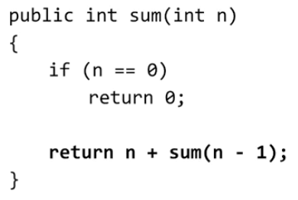
Task: Summing the number from 0 to 10
Solution 1: Using a for loop
for (int i=0;i<=10;i++){count+=i;}
Solution 2: Using Recursion
//Sum(10)=10+sum(9)=10+9+sum(8)=…
//General formula: Sum(n) = n+Sum(n-1)
//When should we stop, what is our base case?
//Sum(0)
Now the full code

Slide 4
Recursive Searching
Linear Search
Binary Search

Slide 5
Case study - linear search
[2,3,5,7,8,15,24,158,350,351,1000]
What is the index of 350 in the list?
How many numbers did you look through to get the correct answer?
Best case scenario: 1 operation
Average case scenario: 6 operations
Worst case scenario: 11 operations

Slide 6
Case Study – Binary Search
1. Sort the Data [2,3,5,7,8,15,24,158,350,351,1000]
2. Find the Middle Index
3. Compare and Eliminate: Look at that middle item and compare it to your target to determine which side of the list to eliminate
4. Repeat: Take the remaining, un-eliminated half of the list. Find its new middle, make the comparison, and cut the list in half again.
5.Terminate: Continue this loop until you either land exactly on your target, or you run out of items to check (meaning the target does not exist in the list).

Slide 7
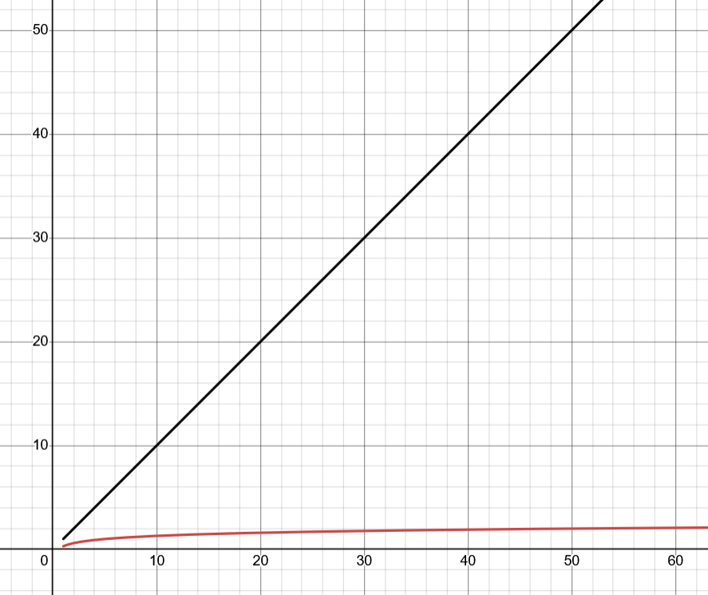
Binary Search Time complexity & Demo
Maximize Iteration needed to find a given number using Binary Search: log2​(N)

Slide 8
Binary Search with loops
10.2.3

Slide 9
Binary Search with Recursion
10.2.4

Slide 10
Recursive Sorting
Mergesort
Notes:
https://www.youtube.com/watch?v=es2T6KY45cA

Slide 11
Review – Previous Sorting Techniques
Insertion Sort
Selection Sort
Selection Sort
Insertion Sort

Slide 12
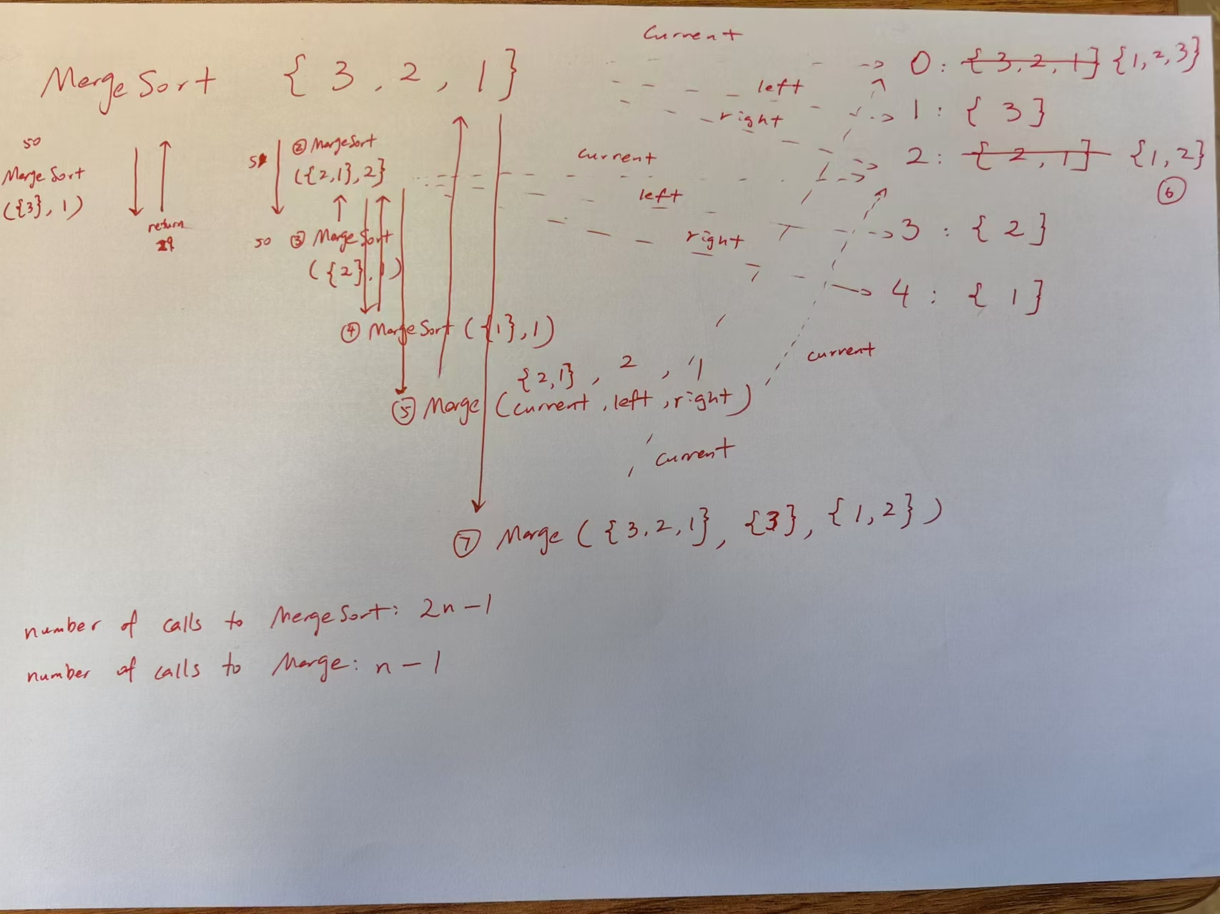
MergeSort

Slide 13
Important Summary
Number of calls to MergeSort: 2n-1
Number of calls to Merge: n-1
n is the number of elements in the array

Slide 14
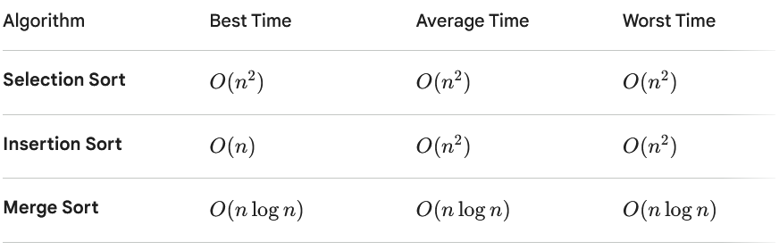
Comparison Between Sorting Techniques

Slide 15
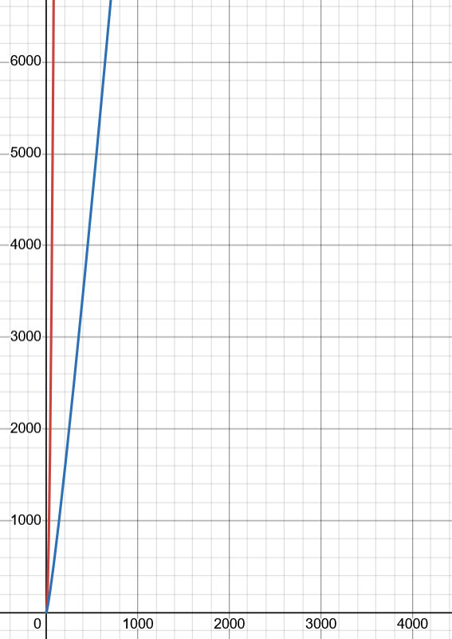

Slide 16
Inheritance
Object Class (contains .equals() and .toString())
Superclass
All other Classes
SubClass
(Inheritance: it has access to the instance variable and
methods of its superclass)

