Slide 2

What is Java
Java is a programming language. Programming language is a special language we use to give instructions to a computer.

Slide 3



Is Java the only programming language?
Absolutely Not! We have over 8000 programming languages in the world! (Gemini)

Slide 4
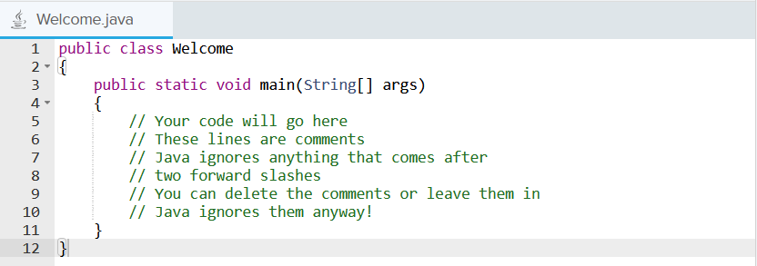
How to write Java: Lesson 0
Main skeleton

Slide 5
Printing in Java
System.out.println(“ “);
System.out.print(“ “);

Slide 6
1.2 Data Types
Common data types:
int (2)
double (2.5)
char (‘a’)
boolean (true/false)
String (“xyz”)

Slide 7
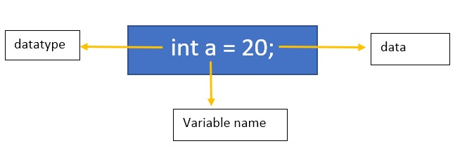
Variables
A variable is a placeholder for a value that can change. Think of it as a labeled box where you can store information
Variable Naming:
Descriptive
Use lower camelCase
Cannot start with number (e.g. int 5a = 10;)
Variable type must match

Slide 8
Changing variable value
int a=10;
How do I change the value of a to 20?

Slide 9
The final key word
To prevent from accidental changes made to the variable
final int a=10;
a=20; What will happen?

Slide 10
1.3 Arithmetic Expressions
We can do basic mathematical operation in Java, and the order of operation is the same as what you learned in your math class
+
-
*
/
%

Slide 11
Integer Division
5/2 = ?
5.0/2 = ?
5/2.0 = ?
int a = 5.0/2 ?
double a=5/2?
int a=2.0*2?
int a=2*2.5?
Any time you see a double datatype in the operation, the result type must also be a double

Slide 12
1.4 Compound Assignment Operator
A short cut to rewrite long pieces of code:
X = X + Y; X+=Y
X = X* Y; X *= Y
…

Slide 13
A special shortcut for adding and subtracting 1
X= X+1; X++;
X=X-1; X--;

Slide 14
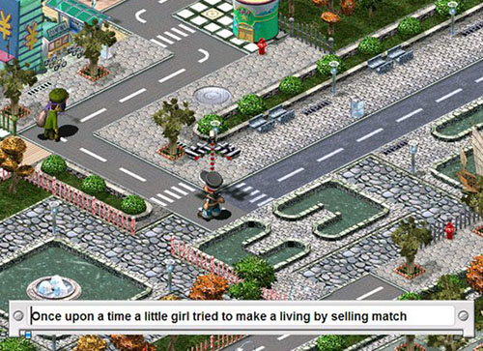
1.5 User Input
Up until this point, we only learned how to output stuff
Here, we will learn how to interact with the users (i.e. input)

Slide 15
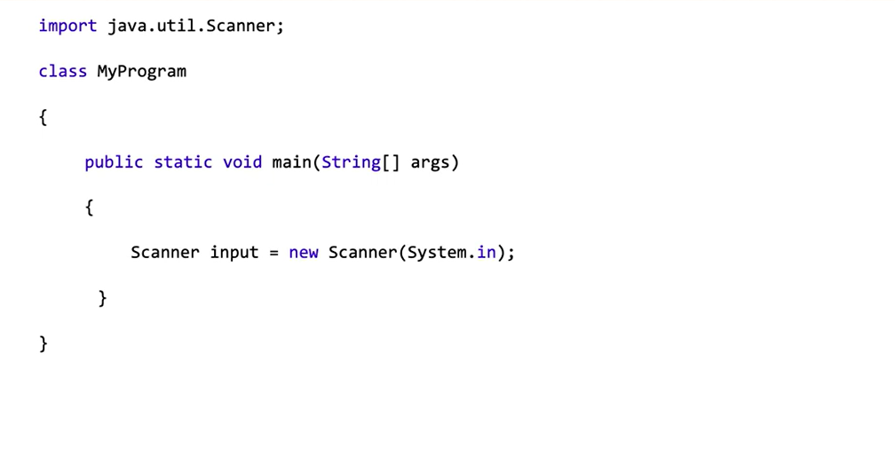
The template

Slide 16
Getting User Input
The datatype must match!
String name = input.nextLine();
int number = input.nextInt();
double decimal = input.nextDouble();
boolean bool = input.nextBoolean();

Slide 17
Warning: Be careful with using nextLine() after nextInt()
nextInt() only absorbs the int which the user typed, but when user hit “enter”, a newline character(\n) is created.
You must use an empty input.nextLine() to absorb this \n character before moving to the actual String input you ask the user to type

Slide 18
1.6 Casting
Casting means convert between different data types, you only need to know double and int casting

Slide 19
One example of using it
int total = 100;
int numPeople = 40;
double average = total / numPeople;

Slide 20
Java Maximum and Minimum Integer
Integer.MIN_VALUE
Integer.MAX_VALUE

Slide 21
Other Things You need to know
Compiler: Translated human readable Java code into machine code. It checks for error before the running the program
Programming errors:
Syntax error: A mistake in the program where the rules of the programming language are not followed. These errors are detected by the compiler
Logic error: mistake in the algorithm or program that causes it to behave incorrectly or unexpectedly
Run-time errors: a mistake in the program that occurs during the execution of a program
Exception: Atypeofrun-timeerrorthat occurs as a result of an unexpected error that
was not detected by the compiler.

