Slide 2
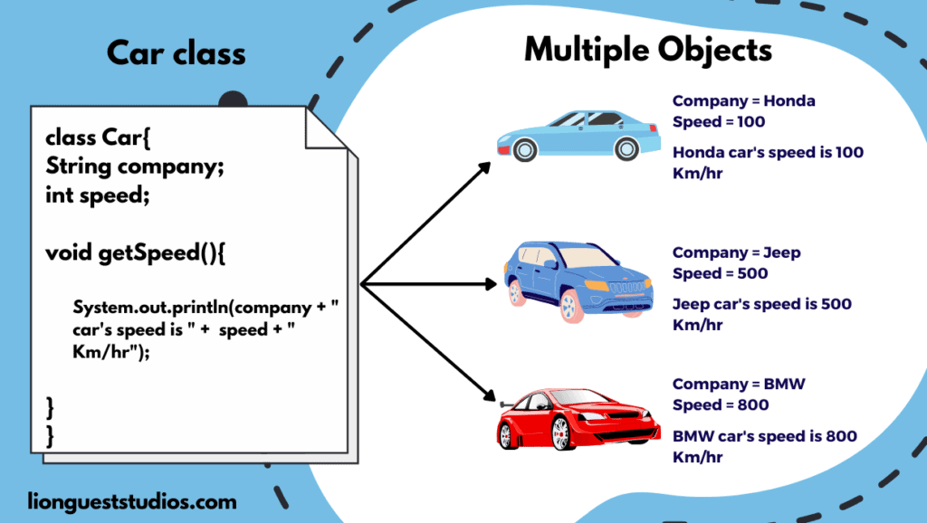
Unit 2 Overview
Object-Oriented Programming (OOP): A core feature of Java, which you can created digital blueprint called classes for various things, such as cars, bank account etc. An object is an instance of a class.
Classes: A template or blueprint
Objects: Instances of a class

Slide 3
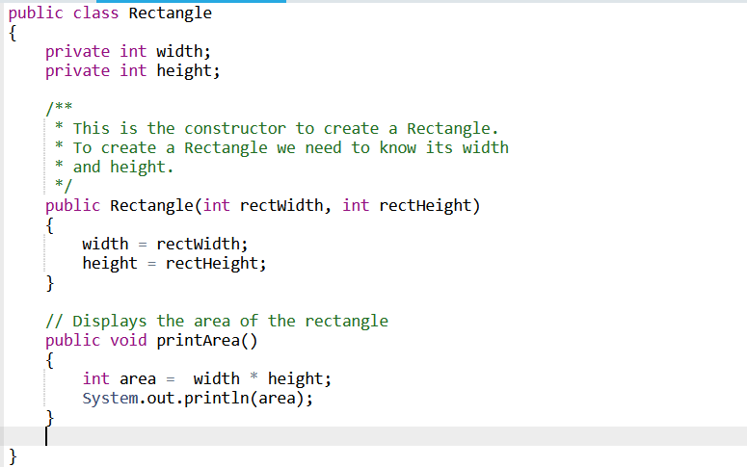
Class Structure
A class consists of:
State (Instance Variables)
Constructor (Initialize state value)
Behavior (methods)

Slide 4
2.2 Creating and Storing Objects
Class: A template or blueprint
Objects: Instance of a class

Slide 5
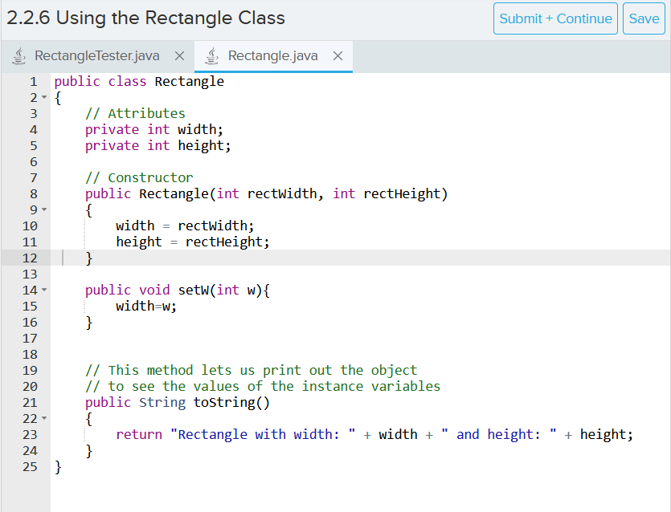
Class Structure
A class consists of:
State (Instance Variables)
Constructor (Initialize state value)
Behavior (methods)

Slide 6
Key things to remember:
Class name must match file name
Constructor name must match class name, all instance variables should be initialized with a value
toString method is used to print out the desired information about the current object

Slide 7

How to instantiate Object

Slide 8
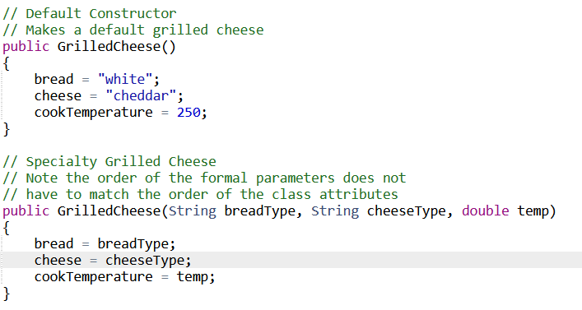
2.3 Method Overloading
Overload means having multiple constructors with the same name but different parameters
Gives more freedom to object declaration, makes code writing more convenient

Slide 9
Memory Storage
Primitive Types (int, double, char, Boolean) stores the exact value
Reference Types (classes) stores the address
null means the absence of an object
Example:
int a=5;
rectangle r1=new rectangle(5,10);
rectangle r2= null;
Address
Data
x01
a | 5
r1 | x05
R2 | null
x02
x03

