Slide 1
Arduino Circuit Design
Noise Detector Alarm Device in Self-study Room
Student name : Jiang Yuhan，
Guo Hangkai
Research Advisor：Mr. Wang

Slide 2
00
Contents
01
06
Background
Circuit design
02
07
Demonstration
Research Question
03
08
Literature Review
Program Flowchart
04
09
What Is Arduino
Research Significance
05
10
Conclusion & Reference
Research Design

Slide 3
01
Background
Hazards of noise in a self-study room
Lack of concentration
Irritability
Standards and Regulations
Environmental Quality Standards for Noise (GB 3096-2008)
Code for Design of Library Buildings (JGJ38-2015)
Allowable noise limit for self-study room: 45 dB

Slide 4
02
Research Question
How to locate the noise source in the study room
How to remind people who make noise

Slide 5
03
Literature Review
Previous research & Limitations
Most related studies only focus on the hazards of noise
Most noise Detector Alarm Device do not pay attention to the mutual influence between noise areas

Slide 6
04
What Is Arduino
Open-source electronics platform based on easy-to-use hardware and software
Be paired with many accessories.
Inputs---Such as：voice sensor
Output---Such as：activating motor, LED
We can tell the board what to do by sending a set of instructions to the microcontroller on the board.

Slide 7
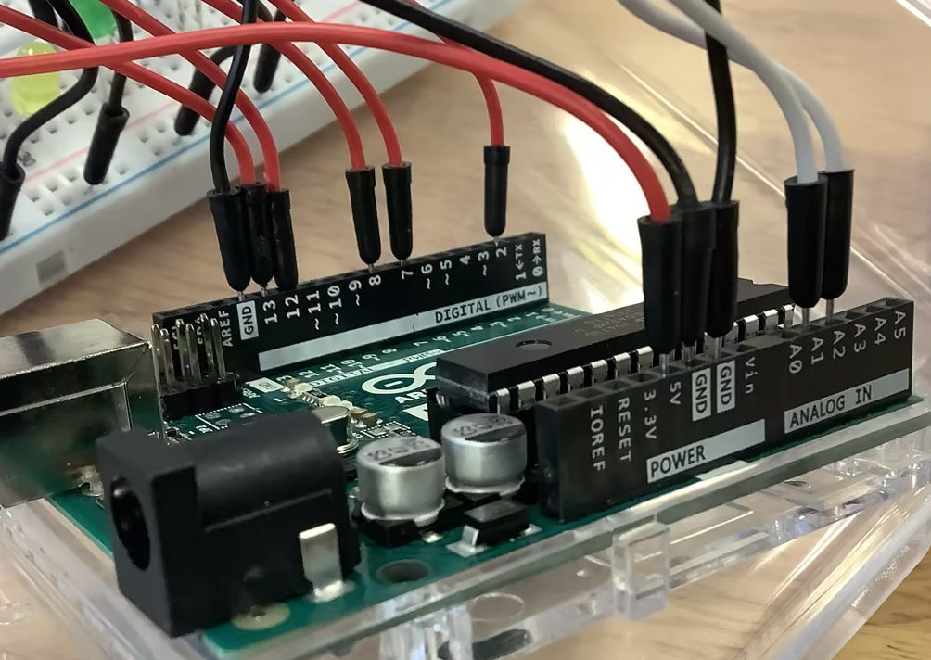
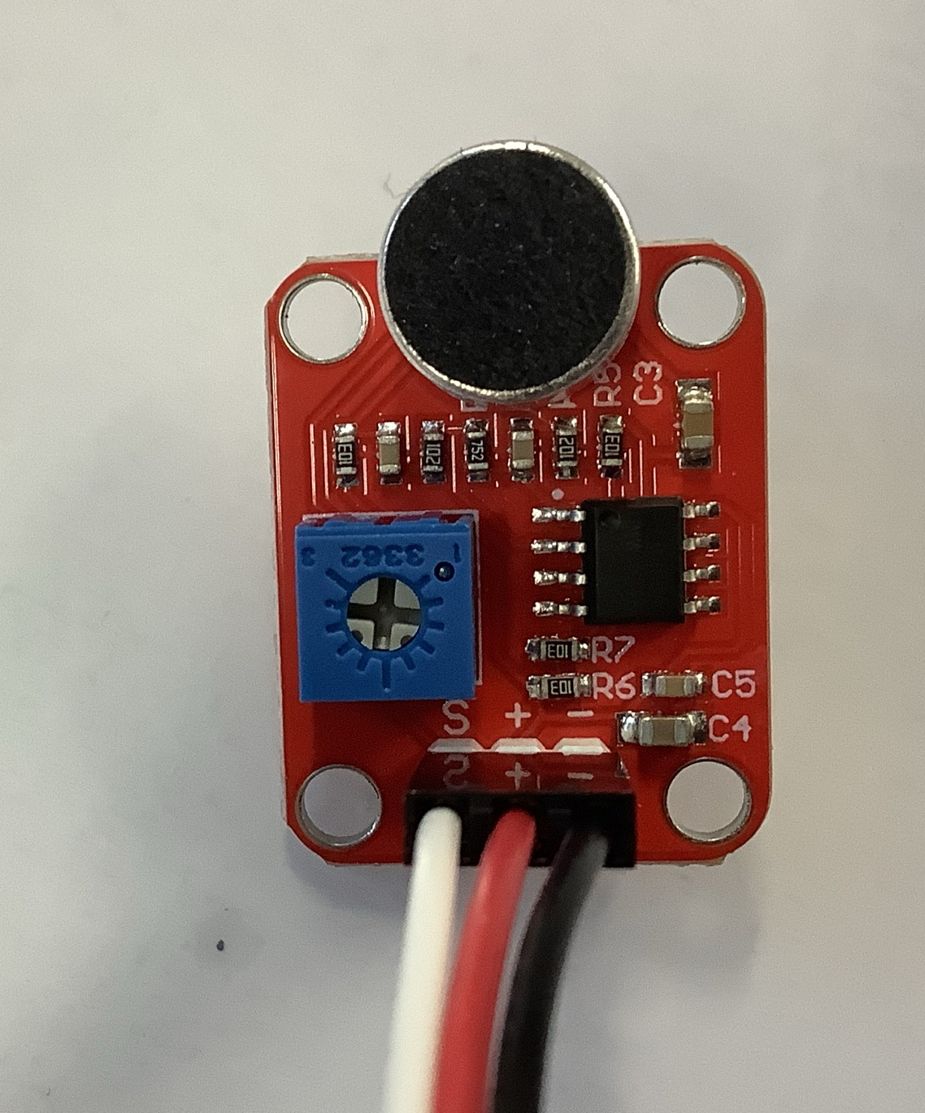
04
What Is Arduino

Slide 8
05
Research Design
Divide the classroom into areas and store them in a matrix
Circuit with Arduino UNO R3 development board
Sound sensors：Collect sound data from each area
LED lights：Providing reminders

Slide 9
05
Research Design
 | 0 | 1 | 2 | 3
0 | Sensor/ LED 1 | Sensor/ LED 2 | Sensor/ LED 3 | Sensor/ LED 4
1 | Sensor/ LED 5 | Sensor/ LED 6 | Sensor/ LED 7 | Sensor/ LED 8
2 | Sensor/ LED 9 | Sensor/ LED 10 | Sensor/ LED 11 | Sensor/ LED 12
3 | Sensor/ LED 13 | Sensor/ LED 14 | Sensor/ LED 15 | Sensor/ LED 16

Slide 10
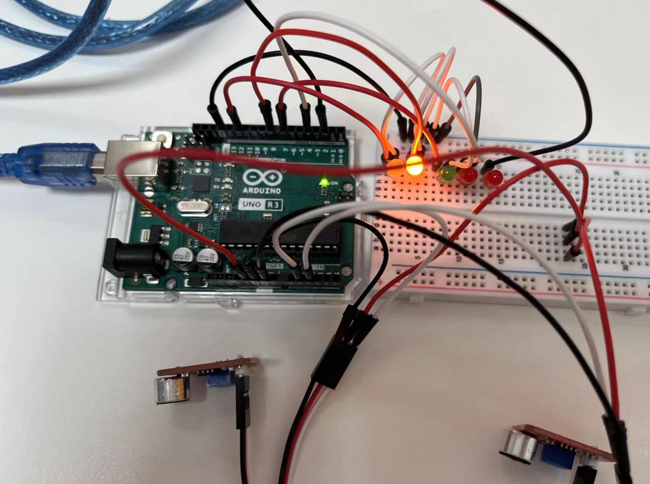
06
Circuit design

Slide 11
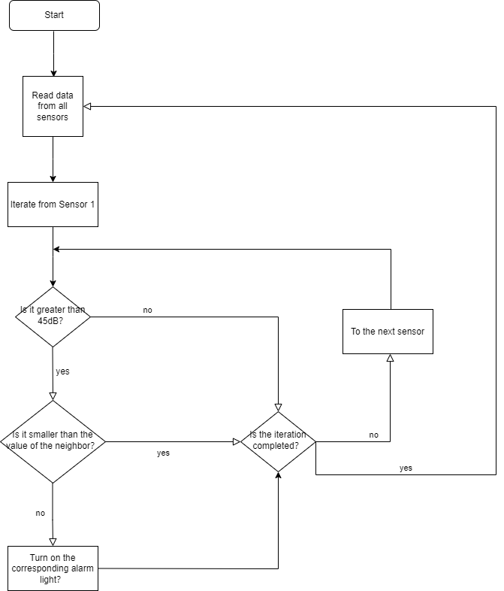
07
Program Flowchart
 | 0 | 1 | 2 | 3
0 | 30 | sensor | 40 | 53
1 | 29 | 40 | 50 | 65
2 | 30 | 30 | 58 | 51
3 | sensor | 40 | 40 | 55

Slide 12
08
Demonstration

Slide 13
09
The originality of our study
Digitizing areas of the study room
The mutual influence between noise areas
Circuit design
Programming
Easy to deploy

Slide 14
10
Conclusion & Reference
Edgar, A., Aakansha, et al. (n.d.). Noise Detector Alarm Device.
Technical Specification for Classification of Sound Environment Functional Zones. (2014). GB/T 15190-2014.
Environmental Quality Standards for Noise. (2008). GB 3096-2008.
Code for Design of Library Buildings. (2015). JGJ38-2015

Slide 15
Thank you for your constructive feedback!
Student name : Jiang Yuhan，Guo Hangkai Research Advisor：Mr. Wang

