Slide 1
AP Computer Science Principles

Slide 2
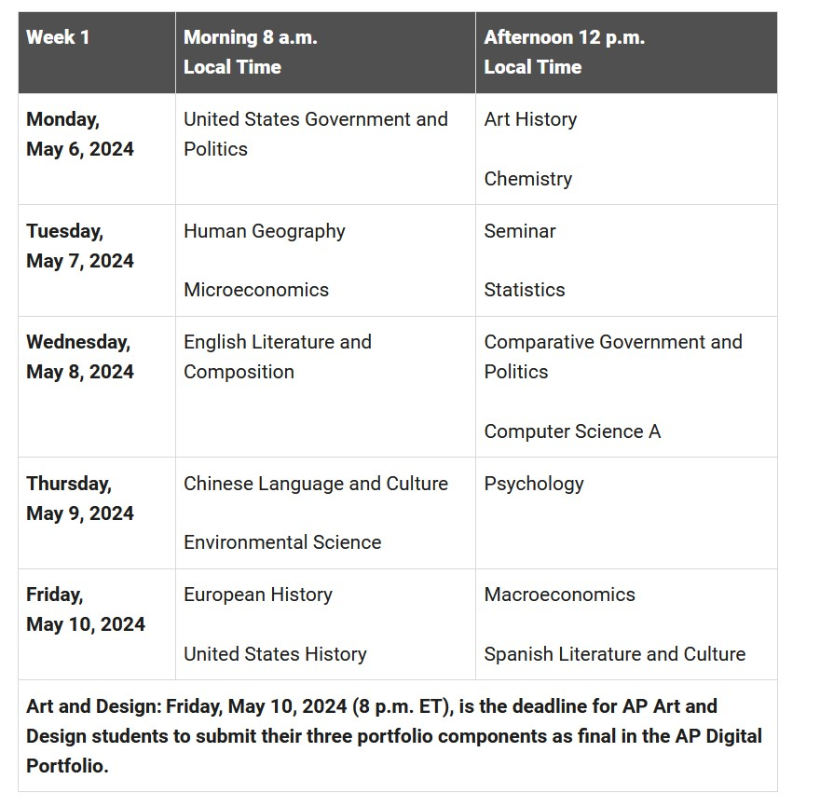
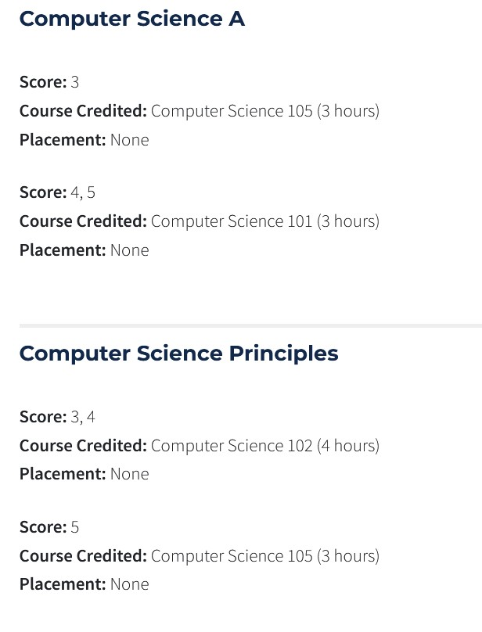
About the course
AP Computer Science Principles is a 1-year introductory college-level computing course that introduces students to the breadth of the field of computer science.
It can be used to fulfill college credit (≈$)
Exam date: May 8, 2024

Slide 3
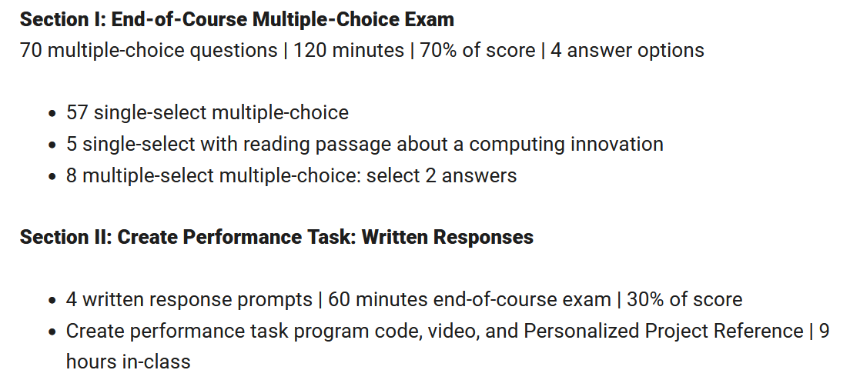
About the AP Exam

Slide 4
Course Syllabus
Unit 1: Digital Information
Unit 2: The Internet
Unit 3: Programming
Unit 4: Algorithms
Unit 5: Data analysis
Unit 6: Simulations
Unit 7: Online data security
Unit 8: Computing innovations

Slide 5
Course Grading
20% In-class worksheet
20% Quiz/unit test
20% Homework
10% Project
30% Midterm & Final

Slide 6
Unit 1: Digital Information
Bits and Bytes
Binary Numbers
Limitations of storing numbers
Storing text in binary
Converting analog data to binary
Lossless data compression
Lossy data compression
Digital Copyrights and licenses

Slide 7
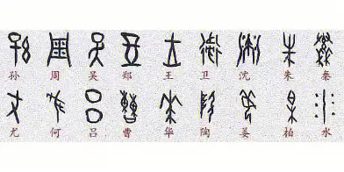
How do we represent data?
Audio, image, text…
Notes:
https://image.baidu.com/search/detail?ct=503316480&z=0&ipn=d&word=%E7%94%B2%E9%AA%A8%E6%96%87&step_word=&hs=0&pn=7&spn=0&di=7249025186345779201&pi=0&rn=1&tn=baiduimagedetail&is=3976304936%2C1120545613&istype=0&ie=utf-8&oe=utf-8&in=&cl=2&lm=-1&st=undefined&cs=1939822475%2C2801510703&os=3976304936%2C1120545613&simid=1939822475%2C2801510703&adpicid=0&lpn=0&ln=1794&fr=&fmq=1691836106413_R&fm=&ic=undefined&s=undefined&hd=undefined&latest=undefined&copyright=undefined&se=&sme=&tab=0&width=undefined&height=undefined&face=undefined&ist=&jit=&cg=&bdtype=0&oriquery=&objurl=https%3A%2F%2Fgimg2.baidu.com%2Fimage_search%2Fsrc%3Dhttp%3A%2F%2Fsafe-img.xhscdn.com%2Fbw1%2F3be1b607-ebb6-4cc8-9d31-e60e2ef7f9fd%3FimageView2%2F2%2Fw%2F1080%2Fformat%2Fjpg%26refer%3Dhttp%3A%2F%2Fsafe-img.xhscdn.com%26app%3D2002%26size%3Df9999%2C10000%26q%3Da80%26n%3D0%26g%3D0n%26fmt%3Dauto%3Fsec%3D1694428407%26t%3De17ed4d95a7a70d63e8eefb7d5460206&fromurl=ippr_z2C%24qAzdH3FAzdH3Fooo_z%26e3Bxtw5i5g2fi7_z%26e3Bv54AzdH3F1tfv5ej6yAzdH3Ftpj4AzdH3Fmdmk01mlaaaaaaaaa8ad1mwm&gsm=1e&rpstart=0&rpnum=0&islist=&querylist=&nojc=undefined&dyTabStr=MCwzLDYsMSw0LDUsMiw4LDcsOQ%3D%3D

Slide 8
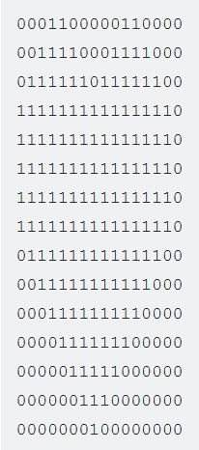
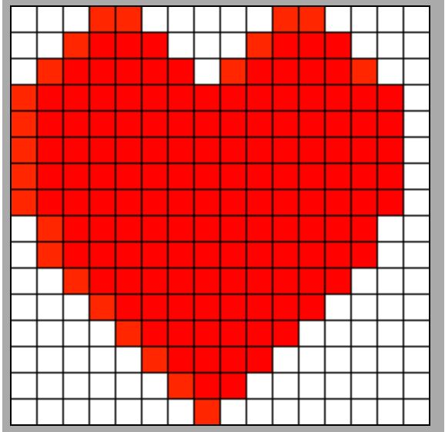
How do computers represent data?
0s and 1s
Notes:
https://www.khanacademy.org/computing/ap-computer-science-principles/x2d2f703b37b450a3:digital-information/x2d2f703b37b450a3:lossless-data-compression/a/simple-image-compression

Slide 9
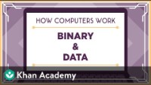

Slide 10
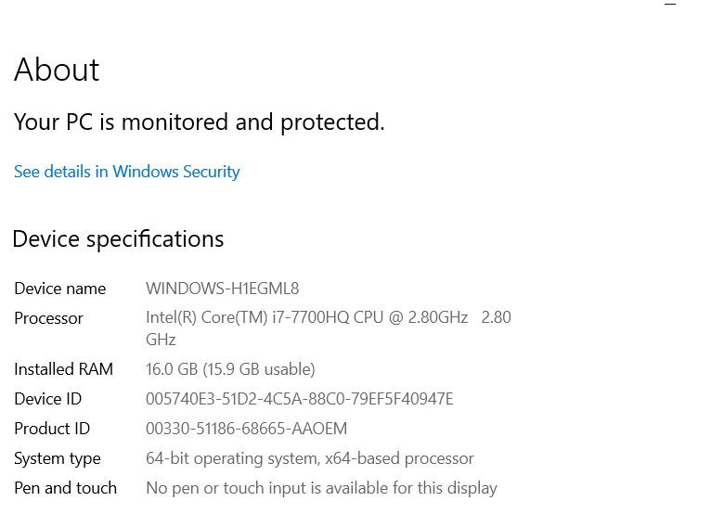
Bits (binary digits) & Bytes
Computers store information using bits. A bit (short for "binary digit") stores either the value 0 or 1
1 byte = 8 bits

Slide 11
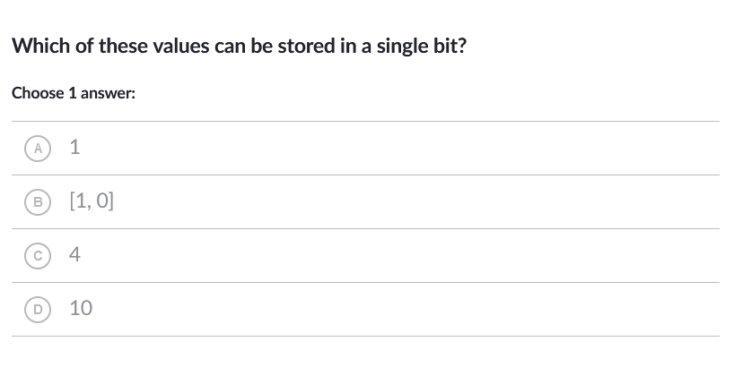
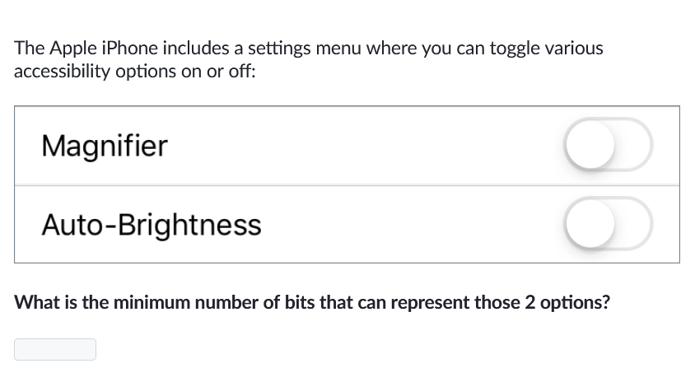
Homework Recap

Slide 12
Any questions before the quiz?

Slide 13
Unit 1: Digital Information
Bits and Bytes
Binary Numbers

Slide 14
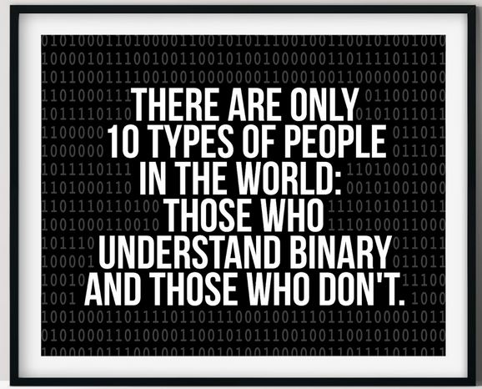
Binary v.s. Decimal v.s. Hexadecimal numbering system
Binary: Base 2 (0,1)
Decimal: Base 10 (0,1,2,3,4,5,6,7,8,9)
Hexadecimal: Base 16 (0,1,2,3,4,5,6,7,8,9,A,B,C,D,E,F)
Notes:
https://www.etsy.com/listing/866567178/binary-code-joke-print-there-are-only-10

Slide 15
Binary to decimal conversion
Important

Slide 16
Binary to Decimal conversion Exercise
01011100
10110011
11111111
00110011
11000011
10101010
01001101

Slide 17
Decimal to binary conversion
Important

Slide 18
Decimal to binary conversion exercise
255
78
25
14
1
0
66
129

Slide 19
Warm-up exercise
Convert the following numbers from decimal to binary:
55
30
88
66
212
Convert the following numbers from binary to decimal:
10001111
00111100
01010011
10110100
00011111

Slide 20
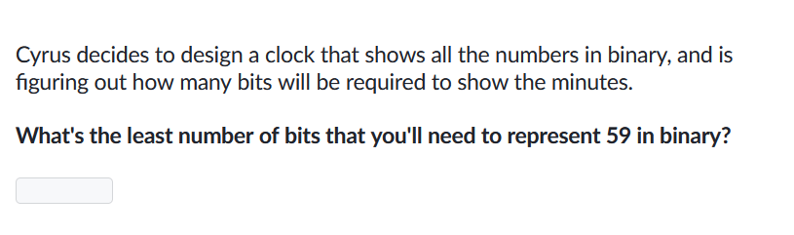
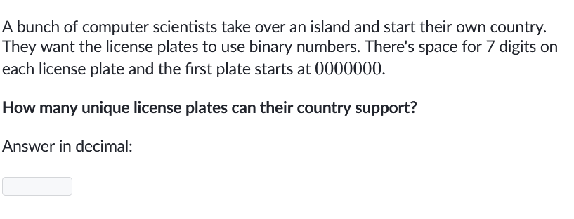
Homework Problems

Slide 21
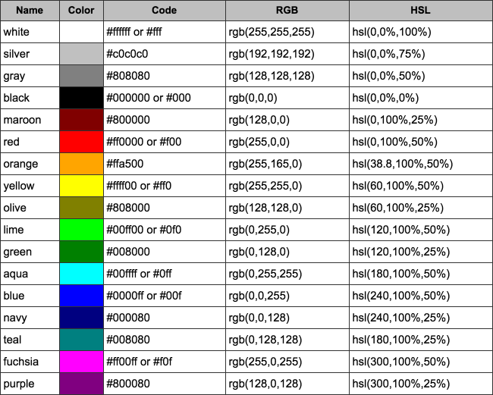
Binary to Hexadecimal conversion
Important
Hexadecimal: Base 16 (0,1,2,3,4,5,6,7,8,9,A,B,C,D,E,F)

Slide 22
Binary to Hexadecimal conversion exercise
01011100
10110011
11111111
00110011
11000011
101010
01101

Slide 23
Important Announcement
Register for a Khan Academy account, and get added to the class
Finish Khan Academy Quiz 1
Homework worksheet due

Slide 24
Unit 1: Digital Information
Bits and Bytes
Binary Numbers
Limitations of storing numbers

Slide 25
Limitations of storing numbers
Negative numbers?
Overflow?
Fractions and irrational numbers?
Rounding errors?

Slide 26
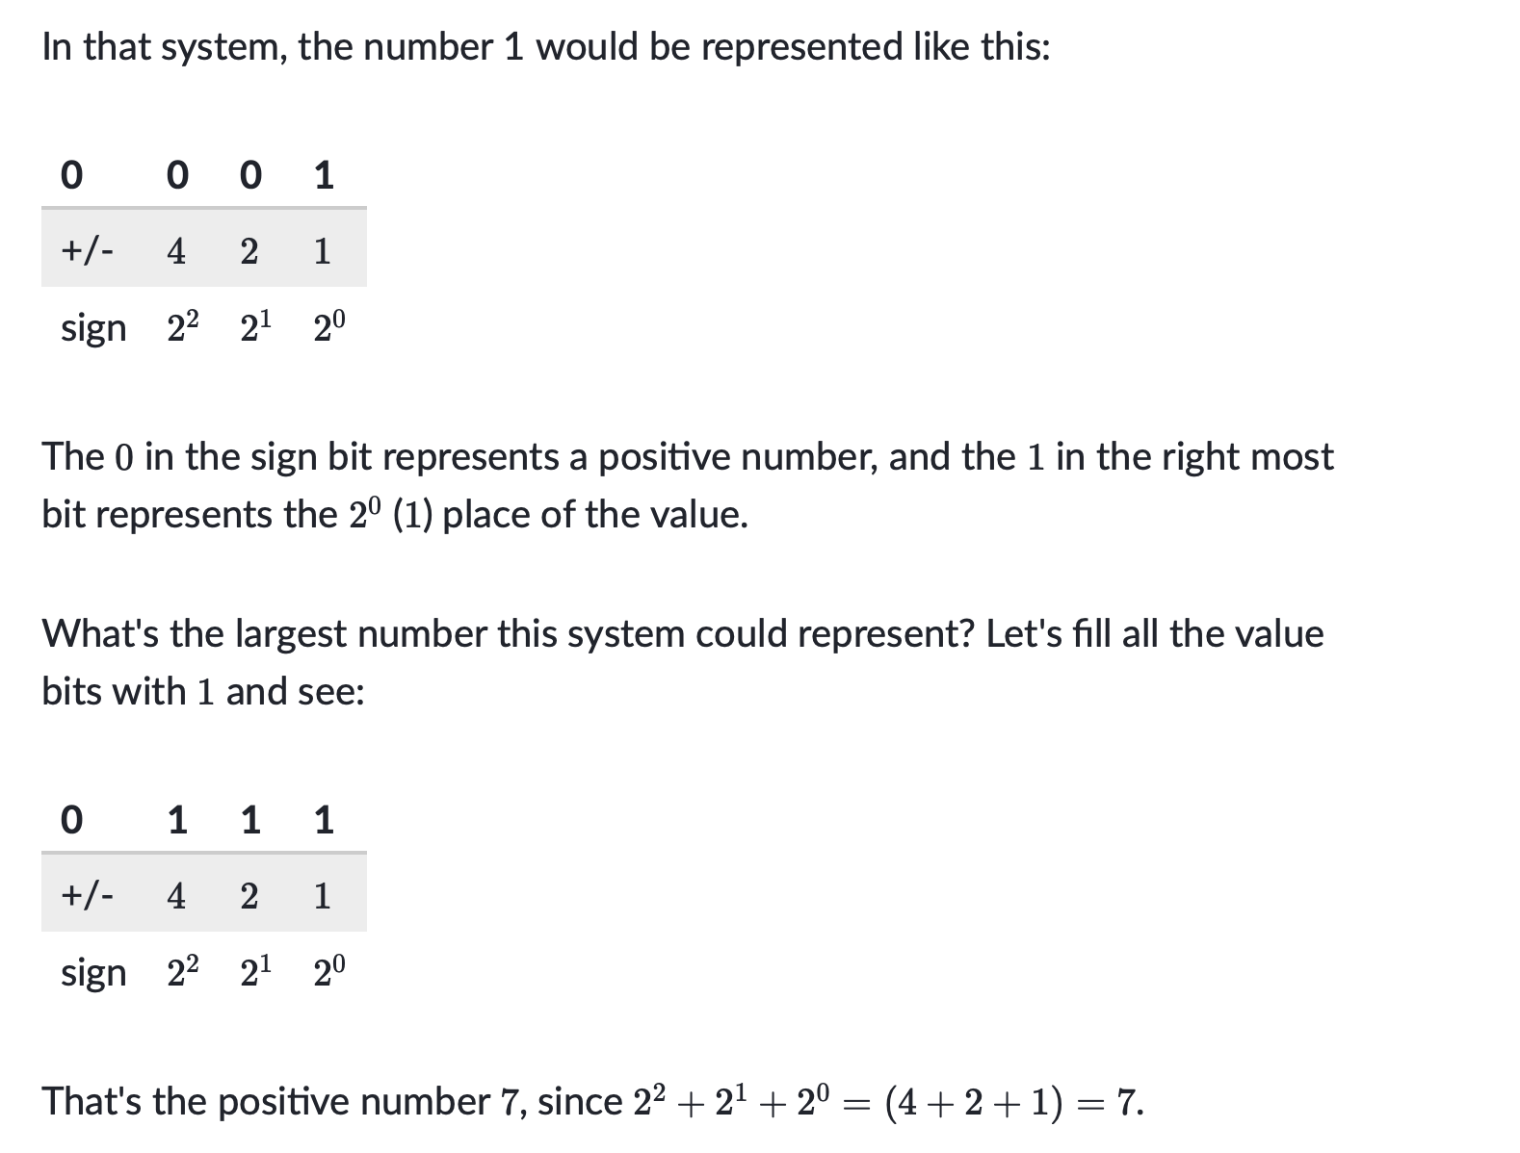
Negative numbers question about reading

Slide 27
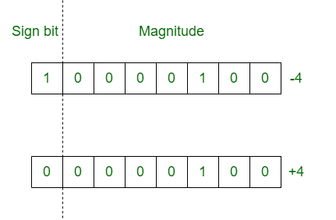
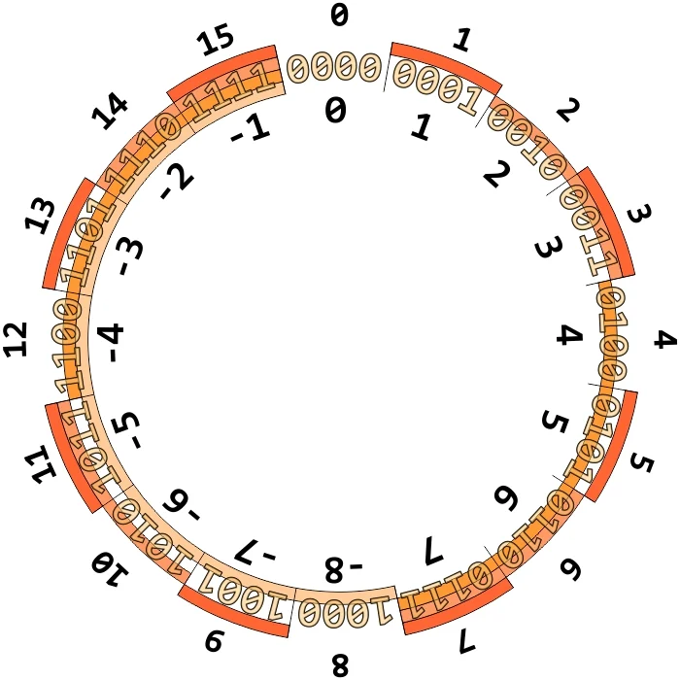
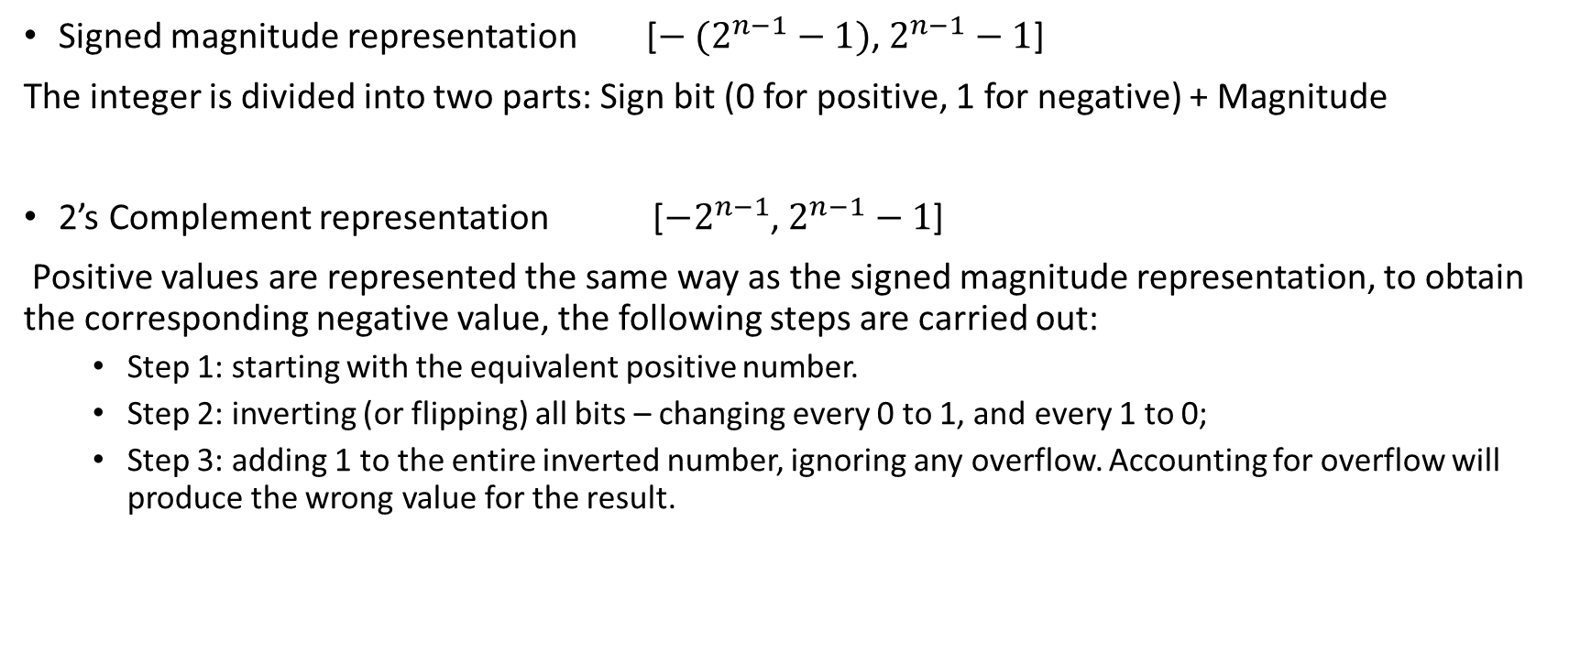
How to represent negative integers?
Signed magnitude representation [${− (2}^{n−1}−1)$, $2^{n−1}−1$]
The integer is divided into two parts: Sign bit (0 for positive, 1 for negative) + Magnitude
2’s Complement representation [${−2}^{n−1}$, $2^{n−1}−1$]
Positive values are represented the same way as the signed magnitude representation, to obtain the corresponding negative value, the following steps are carried out:
Step 1: starting with the equivalent positive number.
Step 2: inverting (or flipping) all bits – changing every 0 to 1, and every 1 to 0;
Step 3: adding 1 to the entire inverted number, ignoring any overflow. Accounting for overflow will produce the wrong value for the result.
Fig.1. Signed magnitude graphical representation
Fig.2. 2’s complement graphical representation
Notes:
https://www.geeksforgeeks.org/difference-between-signed-magnitude-and-2s-complement/
https://www.allaboutcircuits.com/technical-articles/twos-complement-representation-theory-and-examples/

Slide 28
Advantages and disadvantages of using signed-magnitude representation v.s. 2’s complement
Easy to understand, very intuitive
Easy to implement on hardware
Makes addition and subtraction simple

Slide 29
2’s Complement representation exercise
+44
+89
+106
-18
11100111
00001001
11001110
Positive->negative in 2’s complement: Invert(flip) every bit, then add one
Negative->positive in 2’s complement
Subtract one, then flip every bit
Notes:
1. + 44 = 00101100
2. + 89 = 01011001
3. + 106 = 01101010
4. - 18 = 11101110
5. 11100111=-25
6. 00001001=9
7. 11001110=-50

Slide 30
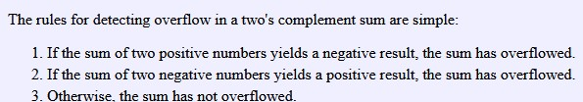
2’s Complement Addition and Subtraction exercise
You must carry out the computation in binary form, and please show all your work
69+12 (8-bit register)
69-12 (8-bit register)
12-69 (8-bit register)
1+7 (4-bit register)
Notes:
0101 0001
0011 1001
1100 0111

Slide 31
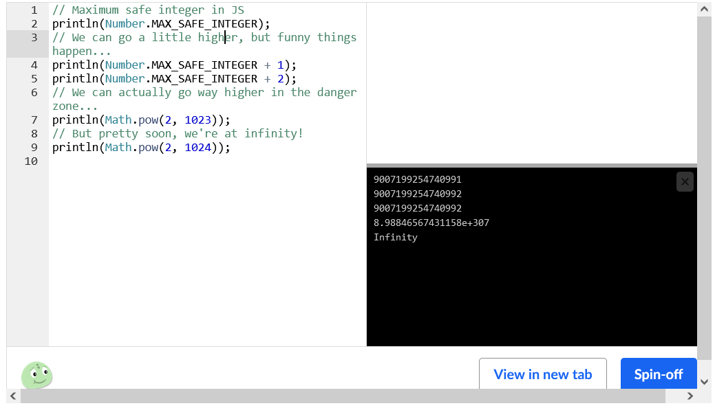
Overflow question about reading

Slide 32
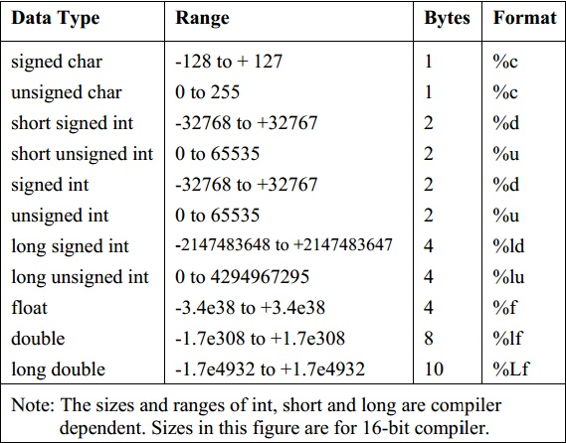
What happens if our numbers overflow?
Overflow: Overflow occurs when the magnitude of a number exceeds the range allowed by the size of the bit field (All about circuits)
Ex: Unsigned number addition
1000
+1000

Slide 33
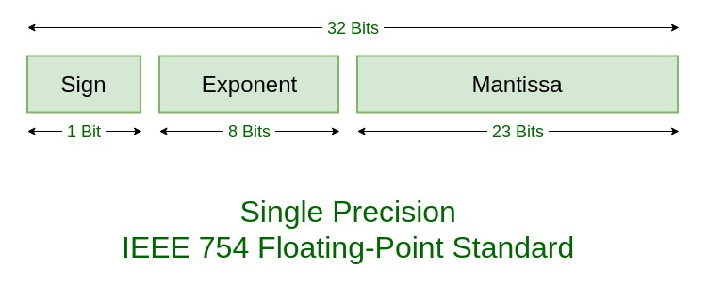
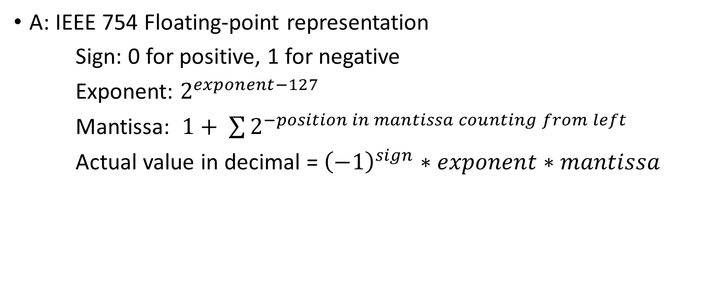
How do we represent fractions and irrational numbers, like 3.14159?
A: IEEE 754 Floating-point representation
Sign: 0 for positive, 1 for negative
Exponent: $2^{exponent−127}$
Mantissa: $1+ \sum{2^{−position in mantissa counting from left}}$
Actual value in decimal = ${\left(−1\right)}^{sign}∗exponent∗mantissa$

Slide 34
Floating-point representation exercise
Decimal value: 1
Decimal value: 6
Floating-point value: 01000001110100000000000000000000
Notes:
https://www.geeksforgeeks.org/ieee-standard-754-floating-point-numbers/
00111111100000000000000000000000
01000000110000000000000000000000

Slide 35
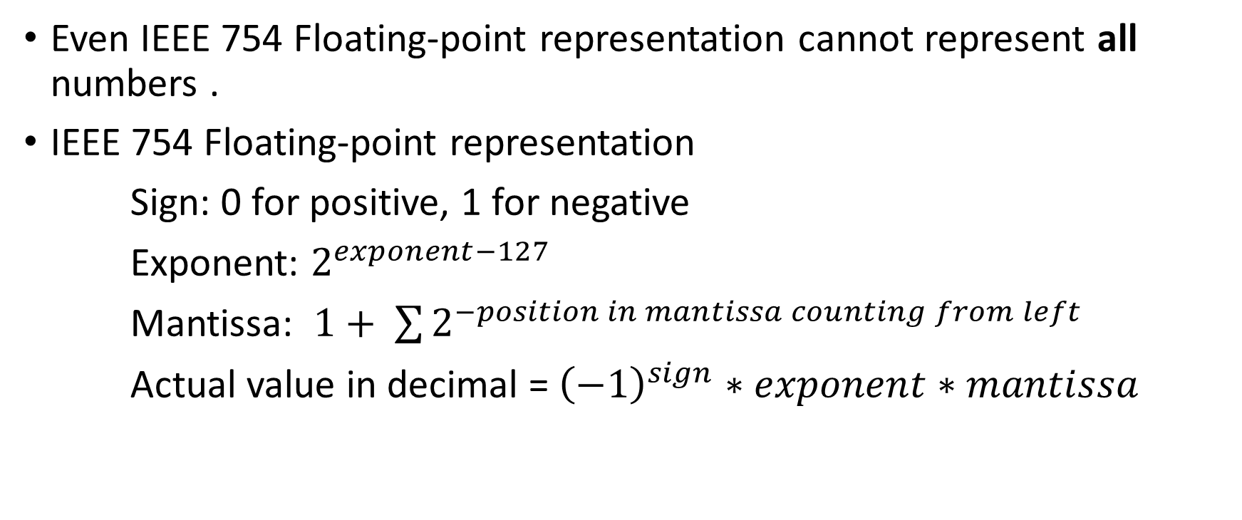
Roundoff errors
Even IEEE 754 Floating-point representation cannot represent all numbers .
IEEE 754 Floating-point representation
Sign: 0 for positive, 1 for negative
Exponent: $2^{exponent−127}$
Mantissa: $1+ \sum{2^{−position in mantissa counting from left}}$
Actual value in decimal = ${\left(−1\right)}^{sign}∗exponent∗mantissa$

Slide 36
Example of roundoff errors
https://www.h-schmidt.net/FloatConverter/IEEE754.html

Slide 37
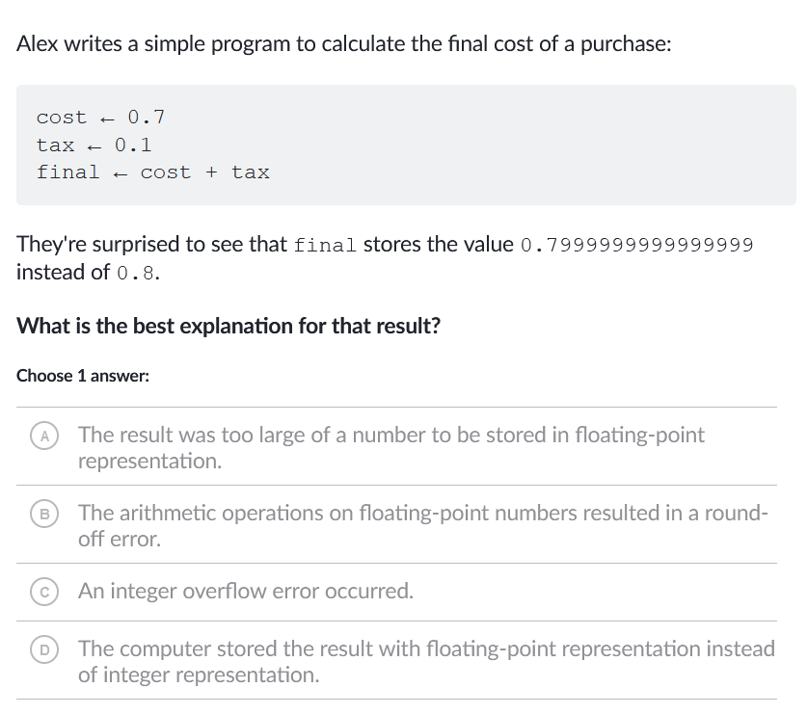
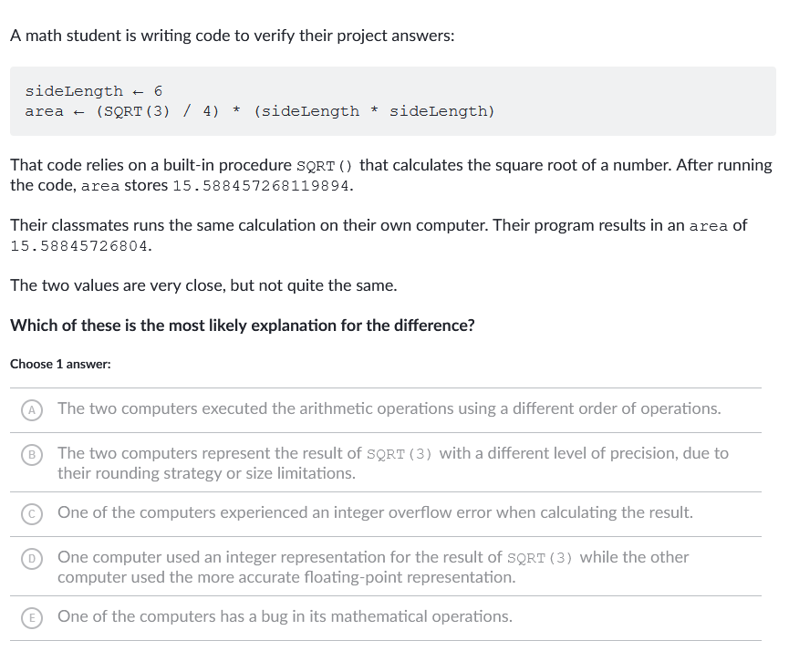
Homework Exercise

Slide 38
Unit 1: Digital Information
Bits and Bytes
Binary Numbers
Limitations of storing numbers
Storing text in binary

Slide 39
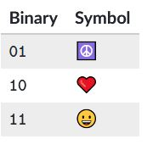
Storing text in Binary
Encoding: Mapping from a character to a binary number
Q: What symbols would the following binary sequence display?
011011011111

Slide 40
In-class activity
Create your own encoding table and write a sequence of binary numbers that uses the character or symbol from your encoding table. Note that the sentence you wrote must having some meaning.
Now, give the binary sequence and encoding table to your neighbor, have him or her translate the sequence into characters.

Slide 41
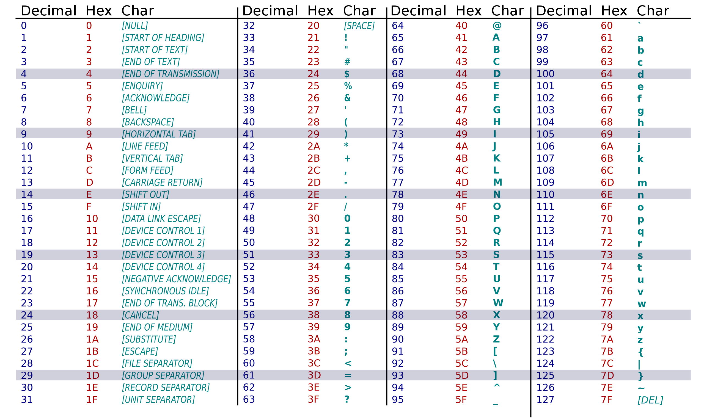
An encoding table for common English characters – ASCII Table

Slide 42
In-class activity - ASCII Encoding conversion exercise
Convert the following texts into its corresponding binary or hex representation, the first one has been done for you. Remember an empty space also counts as a character!
AP CSP = 0x415020435350
I Love You!
Your first name
Biology
Convert the following binary numbers into its corresponding text using the ASCII table. Note the empty space between bytes are just for easier reading
1000001 1000010 1000011 = ABC
01001001 00100000 01001100 01101111 01110110 01100101 00100000 01010001 01000001 00001010
Notes:
https://www.rapidtables.com/convert/number/ascii-to-binary.html

Slide 43
What are some problems with ASCII encoding?
ASCII only includes letters from the English alphabet and a limited set of symbols. What if we have Chinese characters?

Slide 44
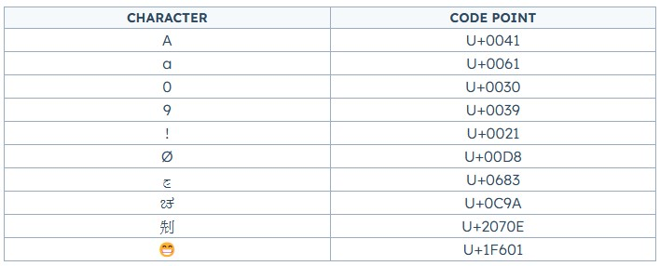
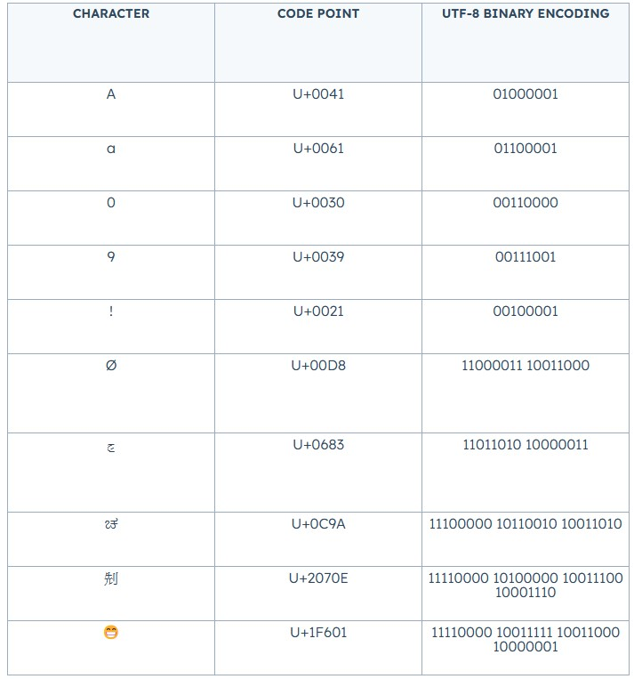
Unicode & UTF-8
Unicode: A character set that assigns a character to a unique code point
UTF-8: A encoding table for Unicode
Notes:
https://blog.hubspot.com/website/what-is-utf-8

Slide 45
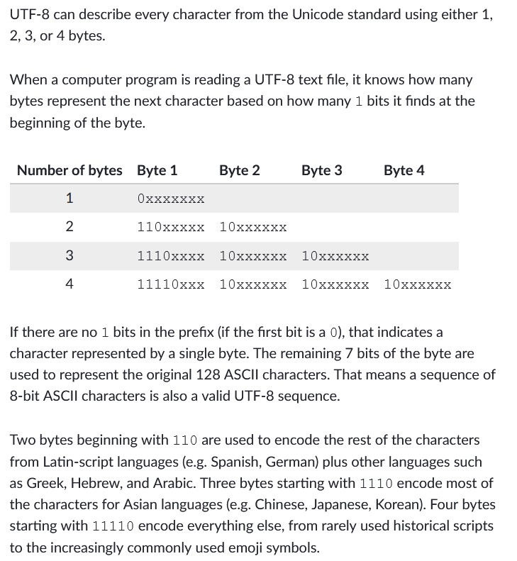
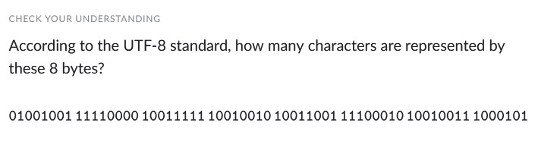
UTF-8 encoding rules
3

Slide 46
Unit 1: Digital Information
Bits and Bytes
Binary Numbers
Limitations of storing numbers
Storing text in binary
Lossless & Lossy compression

Slide 47
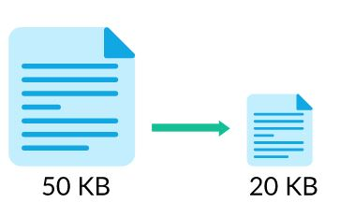
Why is compression useful?
To save space

Slide 48
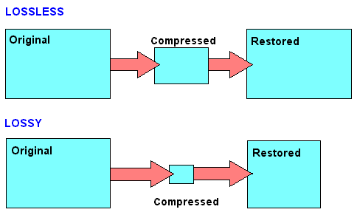
Lossless v.s. Lossy compression
Lossless compression: Lossless compression algorithms reduce the size of files without losing any information in the file, which means that we can reconstruct the original data from the compressed file.
Lossy compression: Lossy compression algorithms reduce the size of files by discarding the less important information in a file, which can significantly reduce file size but also affect file quality

Slide 49
Lossless compression for text
LOL
ty
Btw
Afk

Slide 50
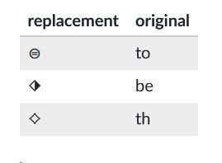
Lossless compression for text
The idea of lossless compression for text is to replace the repeating words/sentences/phrases with a shorter representation
Ex: to be or not to be, that is the question
What words or sequence can we replace?
To, be, th
What is the new representation with the replacement?

Slide 51
In-class exercise lossless text compression
You are in pretty good shape for the shape you are in.
Dr. Seuss
What sequences can be replaced to compress the text?

Slide 52
Recap – Idea of lossless text compression
Replace the repeating words/sentences/phrases with a shorter representation

Slide 53
Lossless compression for image
Computer uses bitmaps to represent image

Slide 54
RLE image compression algorithm
In run-length encoding, the computer replaces each row with numbers that say how many consecutive pixels are the same color, always starting with the number of white pixels
Take the first row for example, the first row contains 3 white pixels, 2 red pixels, 5 white pixels, 2 red pixels, then 4 white pixels:
0001100000110000
This would be represented as follows:
3,2,5,2,4

Slide 55

RLE compression algorithm in-class exercise
First identify what animal the pixel art below shows, then construct the bitmap for the first three lines. Finally, compress line 1, line 3 and line 6 of the image using RLE algorithm.

Slide 56

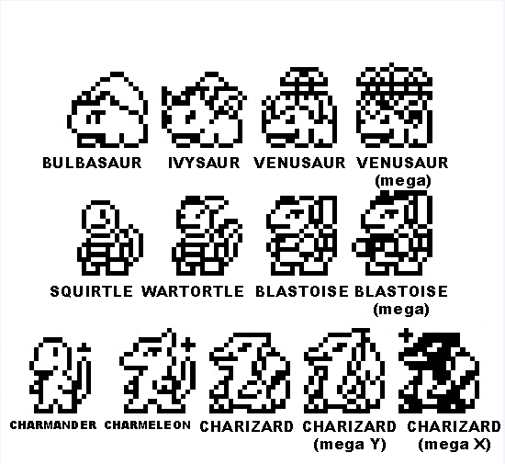
RLE compression Homework exercise
Reconstruct the pixel art using the RLE representation below:
0,2, 25, 2
0,4, 20, 4
0, 3,1,1,18,1,1,3
0,3,2,2,14,2,2,3
1,2,4,1,12,1,4,2,1
1,2,5,2,2,4,2,2,5,2,1
2,1,7,2,4,2,7,1,2
2,1,7,2,4,2,7,1,2
3,1,20,1,3
4,1,1,1,14,1,1,1,4
5,1,16,1,5
5,1,16,1,5
4,1,3,2,8,2,3,1,4
4,1,2,2,1,1,6,2,1,1,2,1,4
One extra point if you can guess the correct character represented by the pixel art

Slide 57

RLE compression Homework exercise
Reconstruct the pixel art using the RLE representation below:
0,2, 24, 2
0,4, 20, 4
0, 3,1,1,18,1,1,3
0,3,2,2,14,2,2,3
1,2,4,1,12,1,4,2,1
1,2,5,2,2,4,2,2,5,2,1
2,1,7,2,4,2,7,1,2
2,1,7,2,4,2,7,1,2
3,1,20,1,3
4,1,1,1,14,1,1,1,4
5,1,16,1,5
5,1,16,1,5
4,1,3,2,8,2,3,1,4
4,1,2,2,1,1,6,2,1,1,2,1,4
One extra point if you can guess the correct character represented by the pixel art

Slide 58

Limitation for RLE
Only work for images with limited color patterns

Slide 59
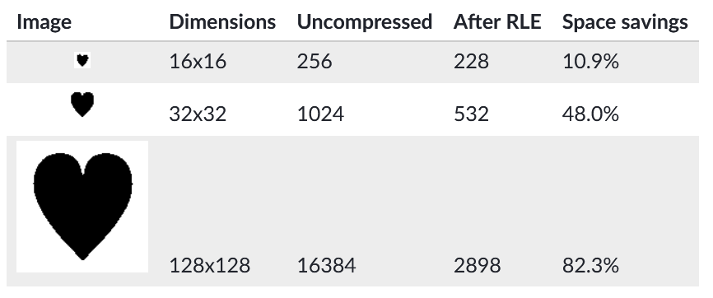
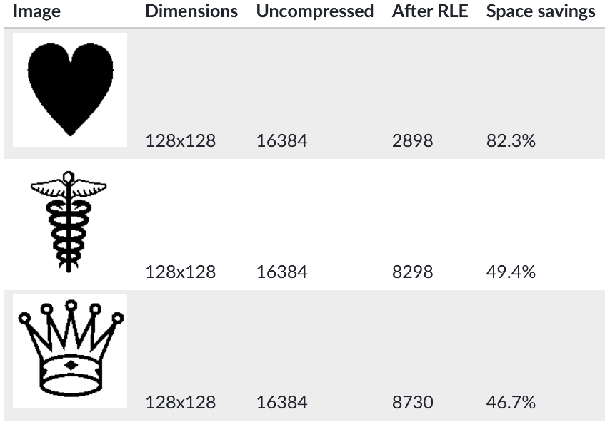
Compression Ratio – A way to quantify how much space has been saved

Slide 60
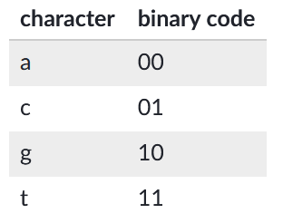
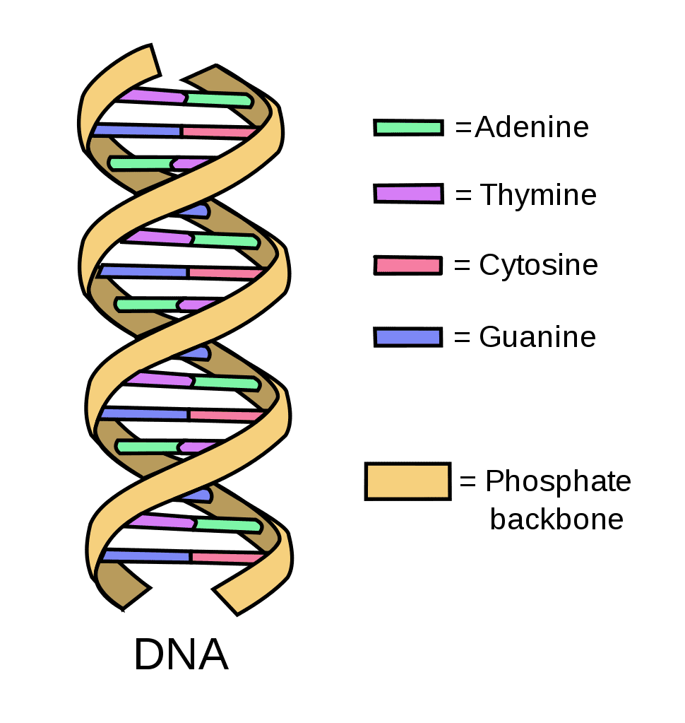
Lossless bit compression
Suppose we want to come up with an encoding table for the four DNA bases: A, C, G, T. How would we do it?
The most naïve way to do it would be the following:
Are there better (in terms of less space used) ways to do it? Hint: Think about what we did for lossless text compression

Slide 61
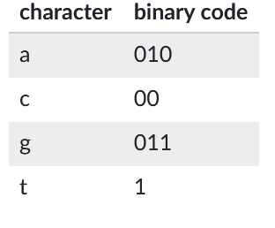
Hoffman coding algorithm
The idea of Huffman encoding algorithm is to use fewer bits for characters that occur more frequently.
Here is the starting DNA sequence of E.coli:
agcttttcattct, which would be translated to 00100111111111010011110111 that is 26 bits long
Note that the base “t” and “c” occurs significantly more that the number of times base “g” and “a” occur. Thus, we propose the following encoding table, which assigns a fewer bits to represent bases “t” and “c”
What is the new binary sequence?
How much space did we save?

Slide 62
Summary
Lossless compression
Text compression
Replace the repeating words/sentences/phrases with a shorter representation
Image compression
RLE: In run-length encoding, the computer replaces each row with numbers that say how many consecutive pixels are the same color, always starting with the number of white pixels
Bit compression
Hoffman coding algorithm: Use fewer bits for characters that occur more frequently.

Slide 63
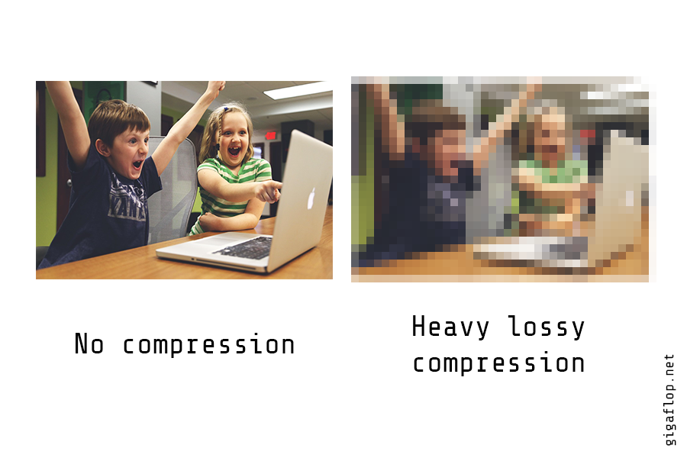
Lossy compression
Lossy compression algorithms are techniques that reduce file size by discarding the less important information.

Slide 64
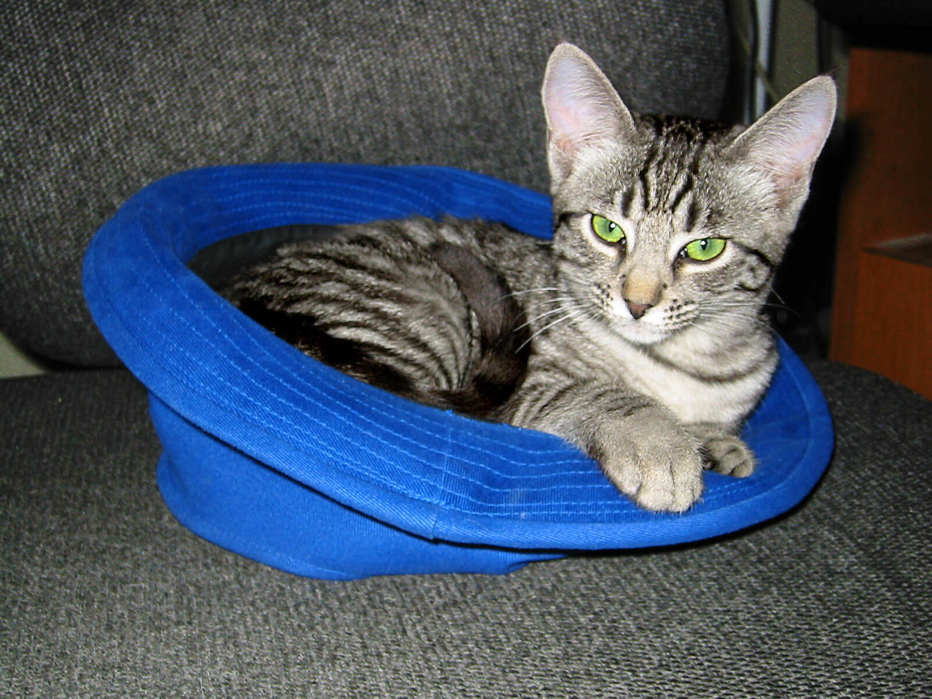

Lossy compression for Image
Isn’t lossless compression always better than lossy compression because we do not lose any information? So why do we use lossy compression?

Slide 65
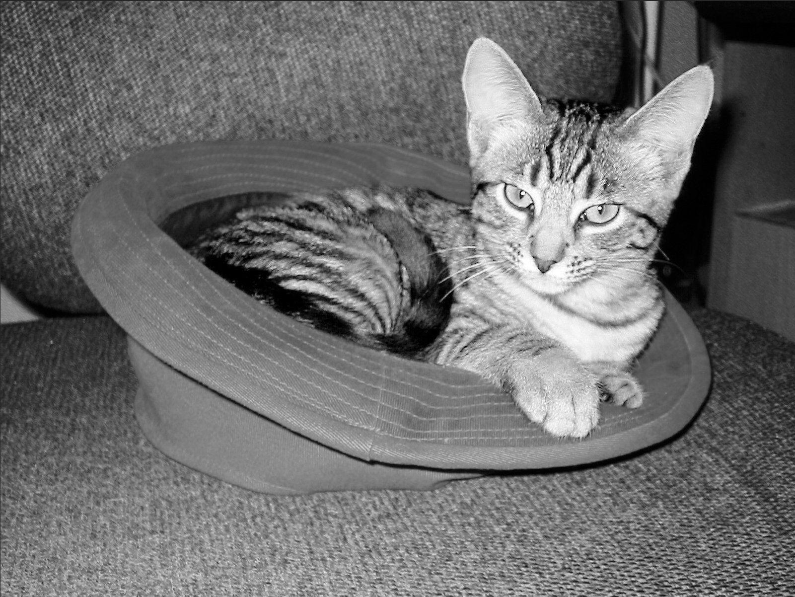



Lossy image compression algorithm – keep the brightness, average the color

Slide 66
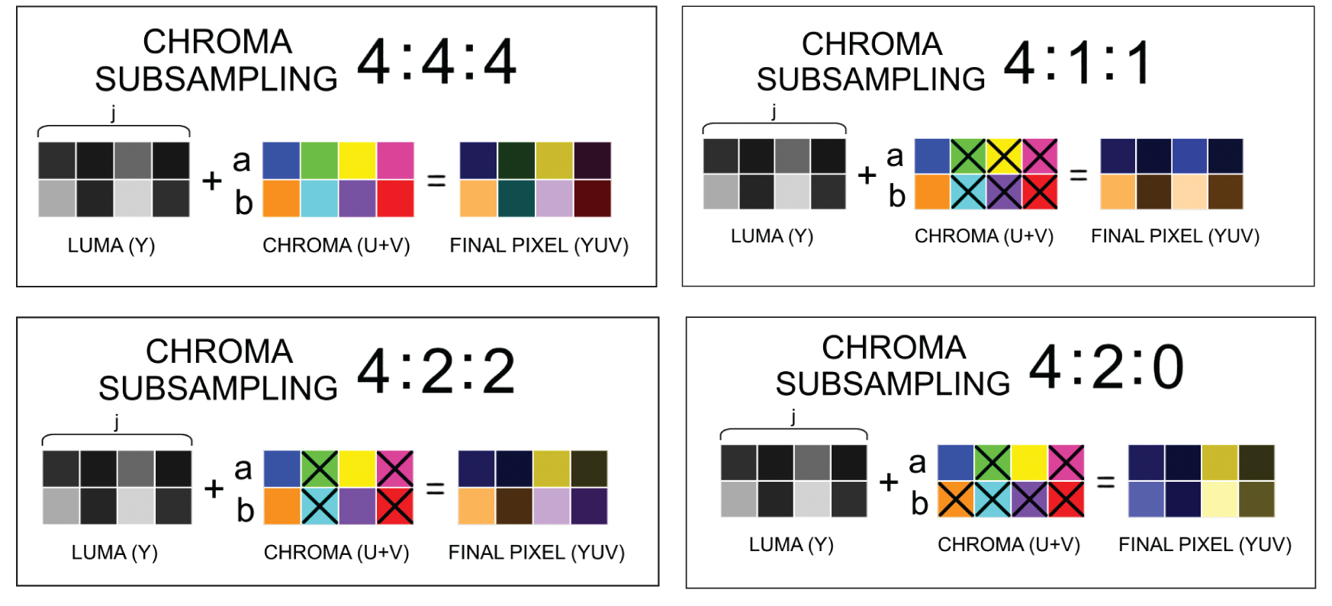

Lossy image compression – Chroma Sampling

Slide 67
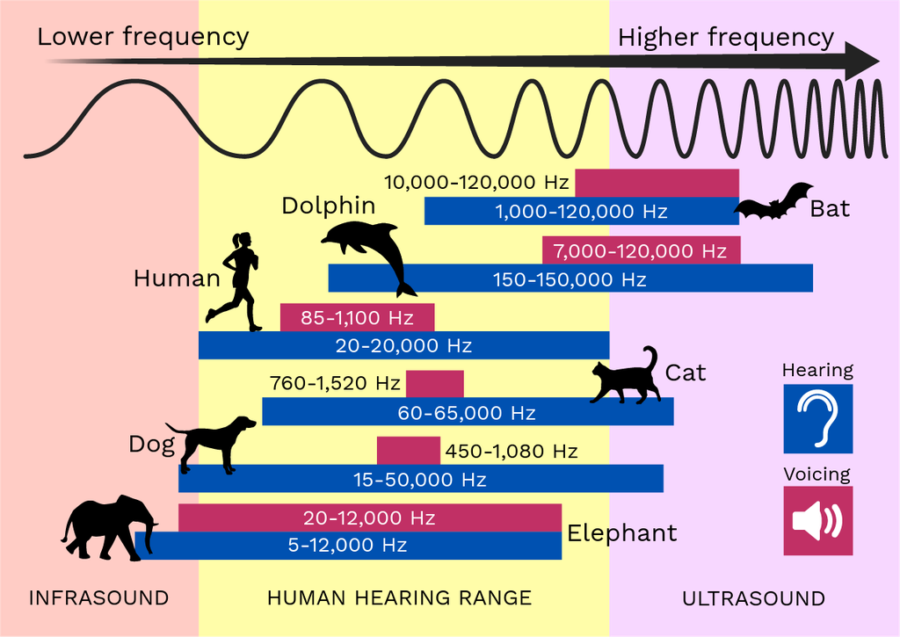
Lossy compression for audio
The idea of audio compression is to drop the sound our ears cannot hear
The human ear has limitations to what it can hear. Audio compression algorithms can analyze an audio file and discard the sounds that are outside our hearing capacity, a process known as perceptual audio coding.

Slide 68
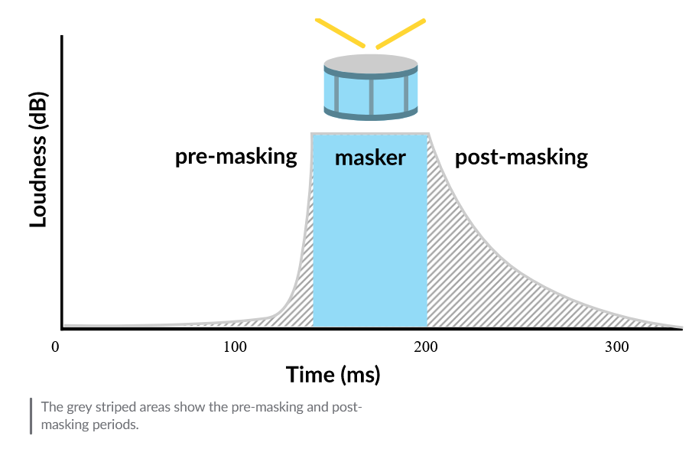
Temporal masking

Slide 69
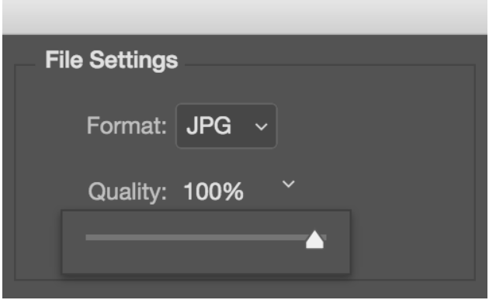
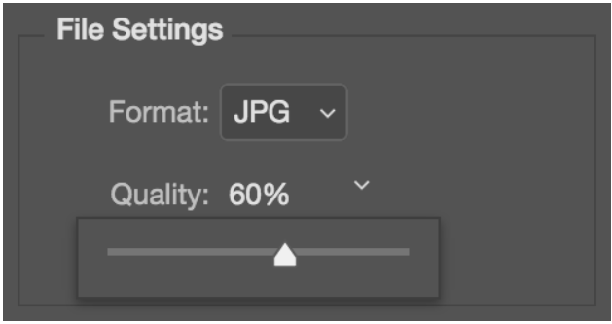
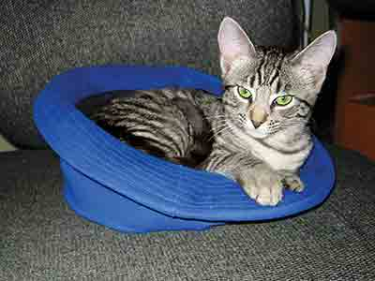


Compression quality
169 KB
48 KB
12 KB

Slide 70
Unit 1: Digital Information
Bits and Bytes
Binary Numbers
Limitations of storing numbers
Storing text in binary
Lossless & Lossy compression
Converting analog data into binary

Slide 71


Steps to convert from analog data to digital data
Analog data: a continuous stream of data
Digital data: discrete data represented by 0s and 1s
Step 1: Sampling
Step 2: Quantization
Step 3: Binary Encoding
Step 4: Reconstruction

Slide 72


Step 1 - Sampling
Taking samples from the analog signal at regular time intervals, and this will reduce the analog signal into a series of discrete signal
Sampling rate: the number of samples per second

Slide 73


Step 2: Quantization
After sampling, our y-values still consist of a wide range of numbers. In the quantization step, we reduce them to discrete values.
Quantization interval of 25 volts

Slide 74
Step 3: Binary Encoding
Instead of storing the actual y-value, we can store a much smaller value that represents the quantized y value.
This encoding uses 4 bits per sample. The number of bits per sample is also know as the bit depth
[-100, -75, -50, - 25, 0, 25, 50, 75, 100]
[0000, 0001, 0010, 0011, 0100, 0101, 0110, 0111, 1000, 1001]

Slide 75


Step 4: Reconstruction
We can convert the digital signal back to analog by reconstruction
Interpolation
difference

Slide 76
End of Unit 1

