Slide 1
Lecture 1 Introduction to Computers and Programming Languages

Slide 2
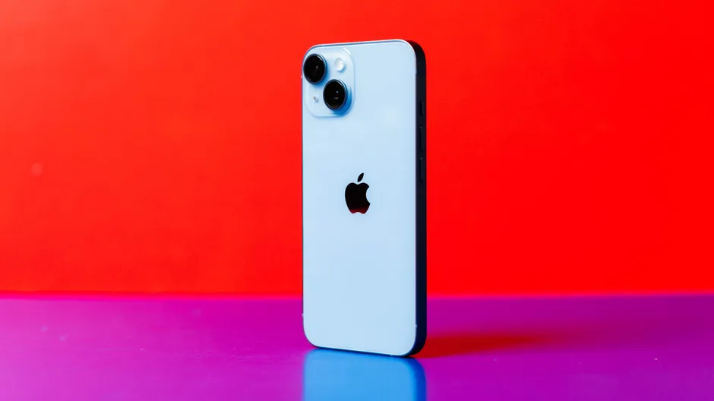

Computers
An electronic device that manipulates data based on a given set of instructions.
https://www.cnet.com/tech/mobile/best-phone-to-buy/
https://www.notebookcheck.net/Microsoft-Surface-Laptop-4-13-Ryzen-5.541951.0.html

Slide 3
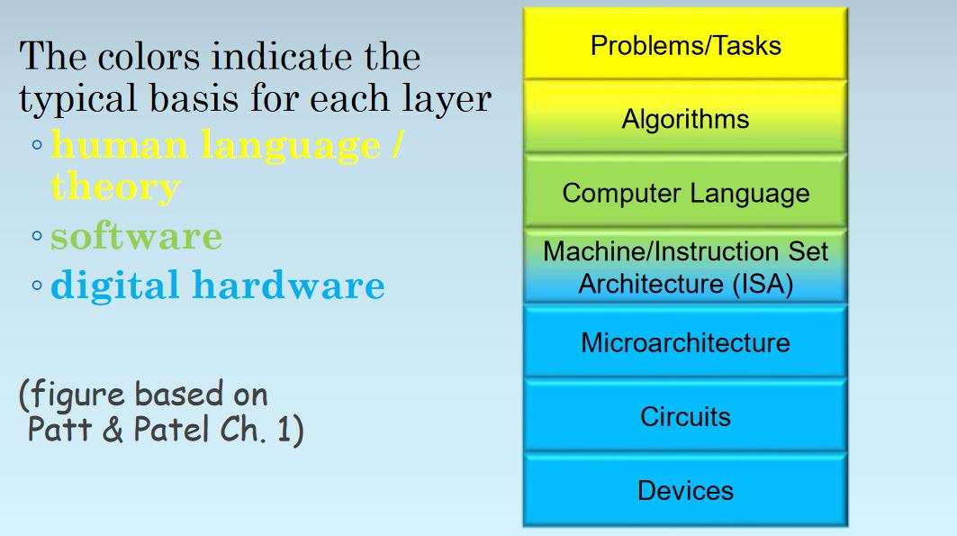
Computers - Abstraction

Slide 4
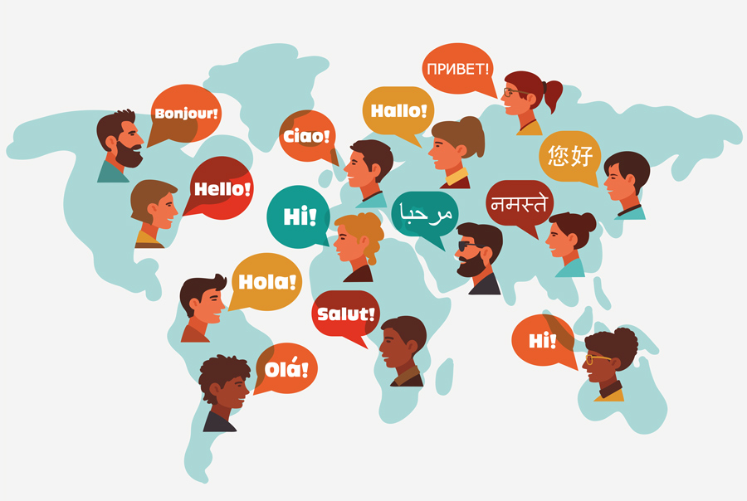
Problem/Tasks
Stated in Human Language
What does 25+30 equal to?
Please buy a few apples when you go to the market this afternoon. If you saw a watermelon, buy one.
Q: How many apples would you buy? How many watermelons?
Problem with human language: Ambiguity

Slide 5
Algorithms
A step-by-step process to solve a problem
Requires three things:
Definiteness (no ambiguity)
Effective computability
(each step simple enough for a computer)
Finiteness (finishes)
Example: Recipes
ECE 120, Steven S. Lumetta

Slide 6

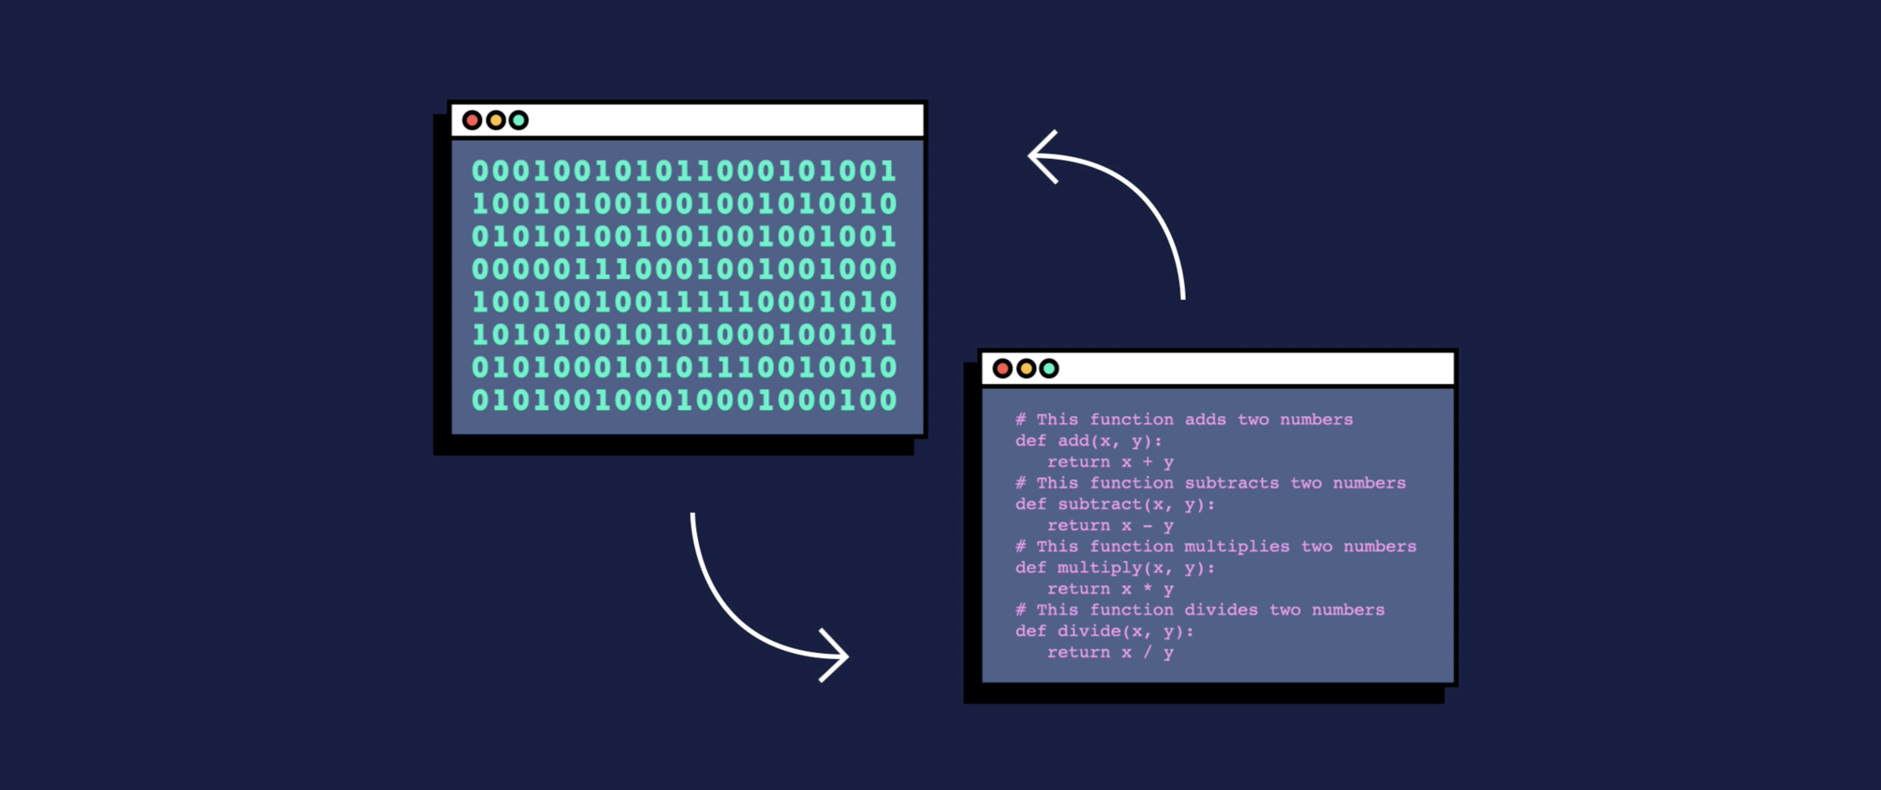
What is computer language?
In simple terms, it’s the language we use to give computer instructions
Compiler
+
Assembler
C++, C , Python etc.
https://www.codecademy.com/resources/blog/programming-languages/
https://researchoutreach.org/articles/trans-actional-autopoiesis-relational-view-human-language/
https://www.freepik.com/premium-vector/laptop-hands-typing-keyboard-human-working-laptop_19876781.htm

Slide 7
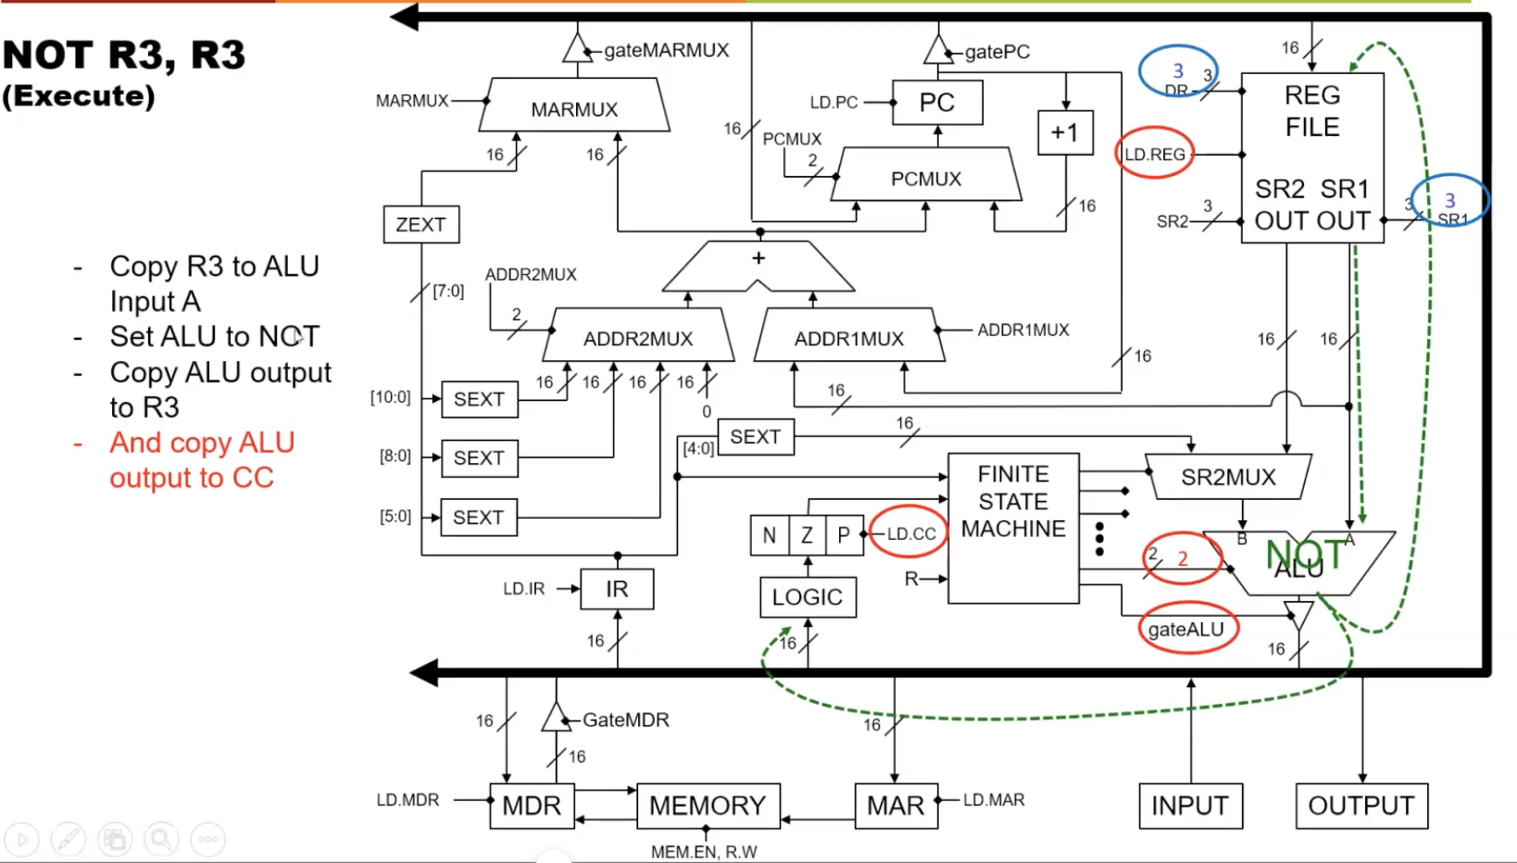
Instruction Set Architecture (ISA)
Interface between software and hardware
ECE 120, Steven S. Lumetta

Slide 8
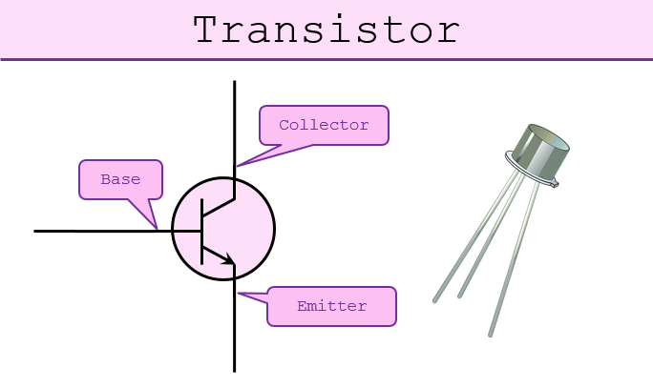
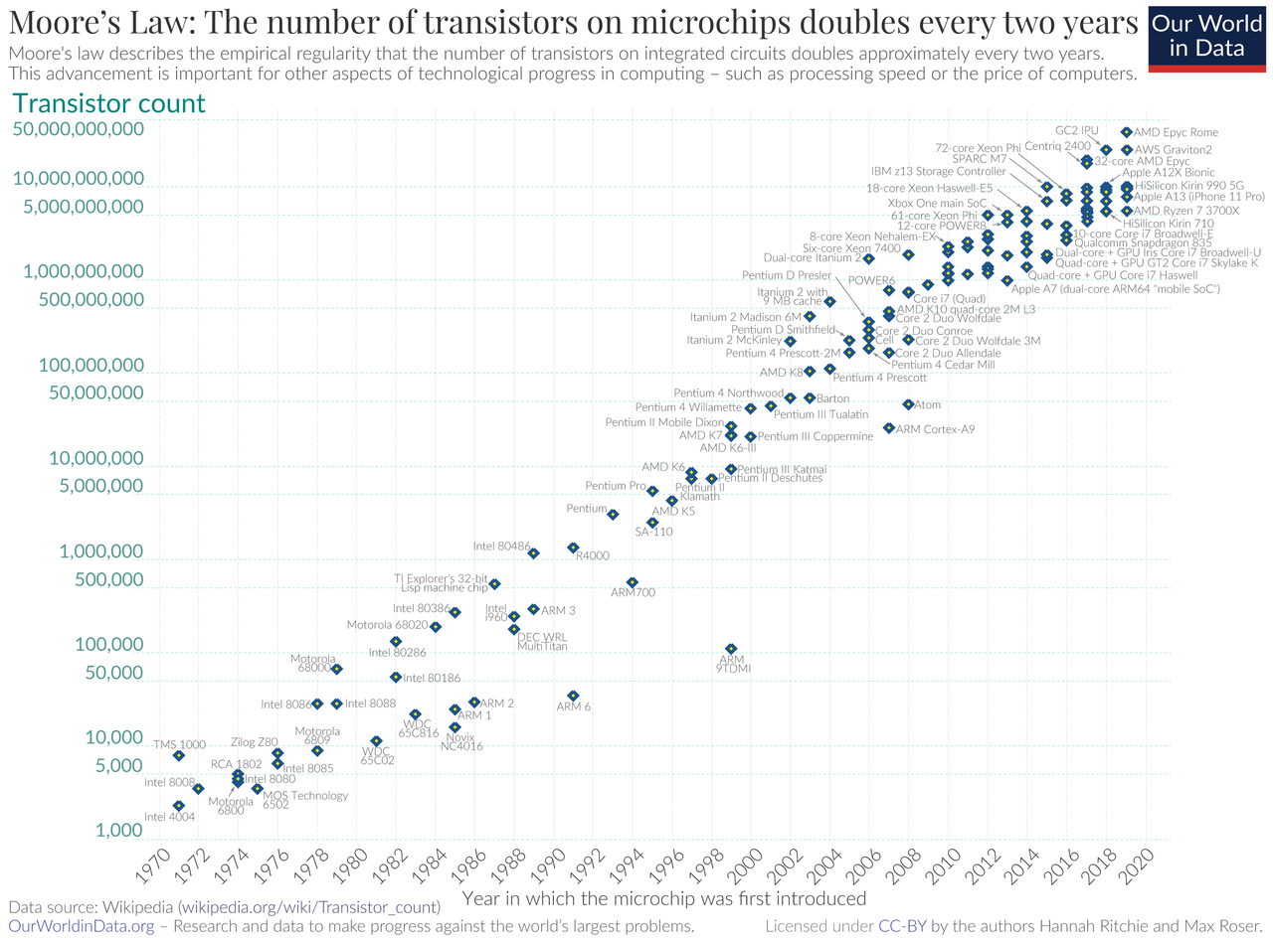
Device
Basic building block of a computer (i.e. transistors)
More transistors, more computing power
Notes:
https://en.wikipedia.org/wiki/Transistor_count#/media/File:Moore's_Law_Transistor_Count_1970-2020.png
https://www.101computing.net/from-transistors-to-micro-processors/

Slide 9
Circuits
An electronic circuit is composed of individual electronic components, such as resistors, transistors, capacitors, inductors and diodes, connected by conductive wires or traces through which electric current can flow. (Wikipedia)

Slide 10
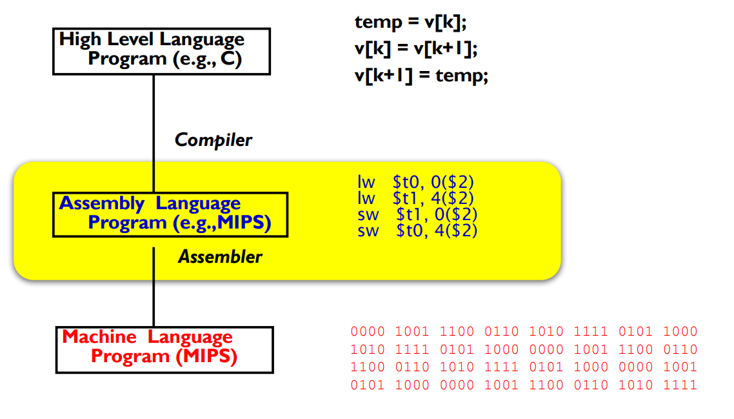
Levels of Computer Language
Low Level
Machine Language
0000 0101 1100 0010
Middle Level
Assembly Language
Add 2 3 Result
High Level
C, C++, Python etc.
https://www.freecodecamp.org/news/what-are-assembly-languages/

Slide 11
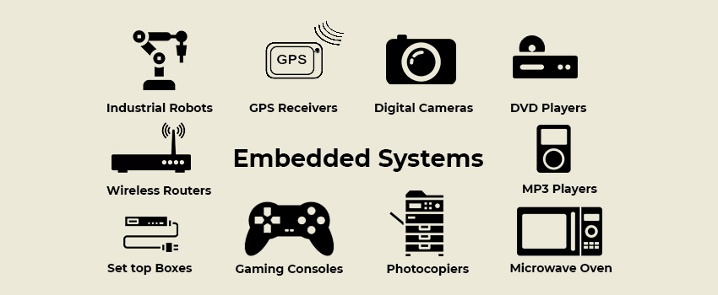
Popular Programming Languages
C, C++
Application: Embedded systems, Game development
Advantage: Faster speed, better hardware control
Disadvantage: Steep learning curve
https://www.brainvire.com/blog/everything-you-need-to-know-about-embedded-system-programming/

Slide 12
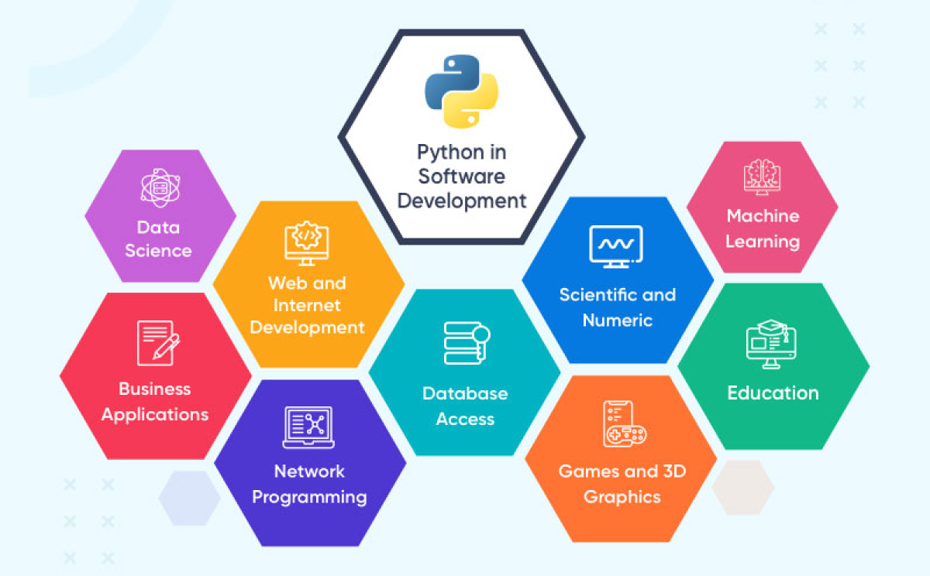
Popular Programming Languages
Python (My Favorite!)
Application: Machine learning, Data analysis & visualization
Advantage: Easy to learn, lots of ready-to-use libraries
Disadvantage: Less hardware control capability
https://www.springboard.com/blog/data-science/what-is-python-used-for/

Slide 13
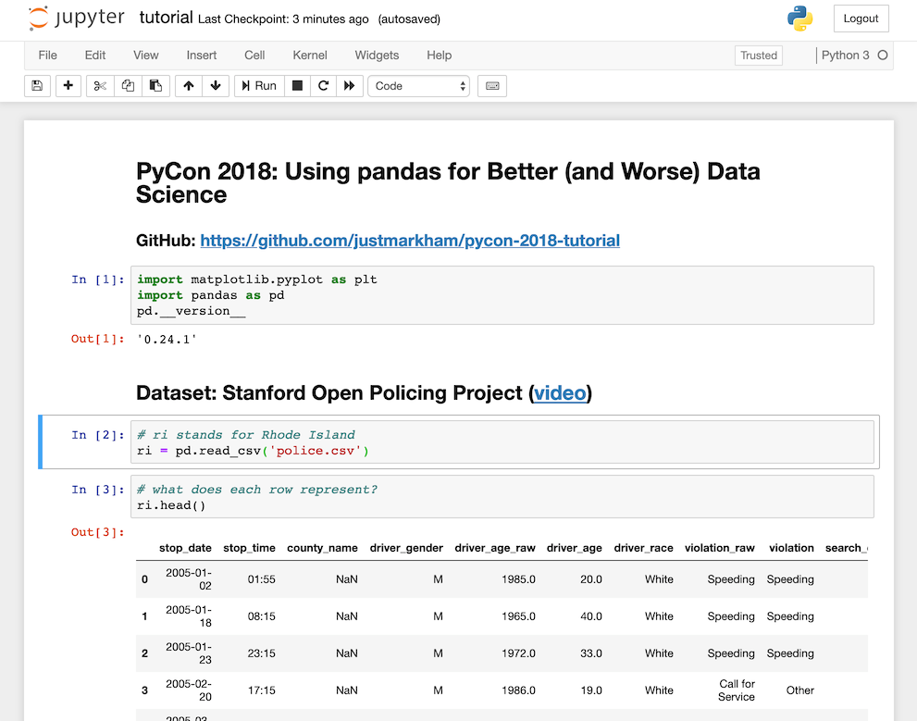
Integrated Development Environment (IDE)
An integrated development environment is a software application that provides comprehensive facilities to computer programmers for software development (Wikipedia)
In simple words, IDE is often what you use to write, compile and debug your codes. Each IDE has slightly different user interface, but they achieve the same thing.

Slide 14
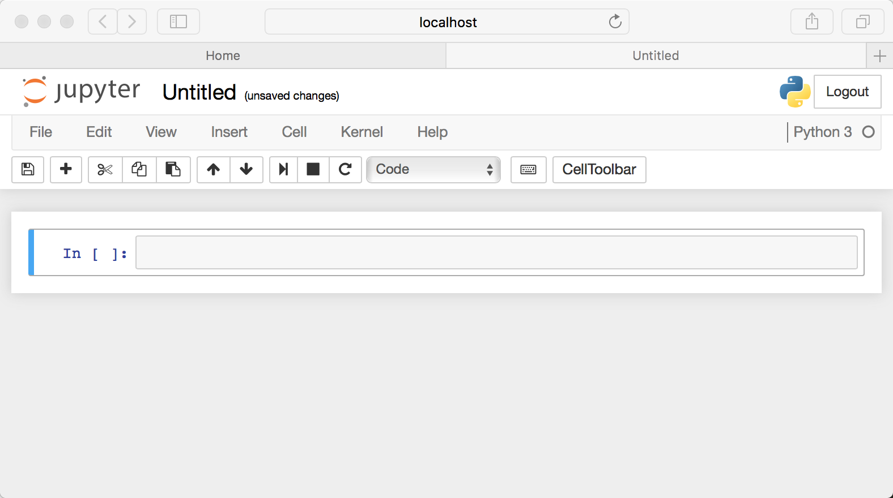
IDE – Jupyter Notebook
Free, friendly UI, Interactive, supports over 40 programming languages including Python and R
Data Science
Machine Learning
https://realpython.com/jupyter-notebook-introduction/

Slide 15
Jupyter Notebook Live Demonstration

Slide 16
Lab
https://www.learnpython.org/
https://www.w3schools.com/python/default.asp

