Slide 1


Slide 2
Lecture 2 Basic Neuroscience

Slide 3
Overview
Neurons
Definition
Structure
Properties
Brain Mapping and Functionality by region

Slide 4
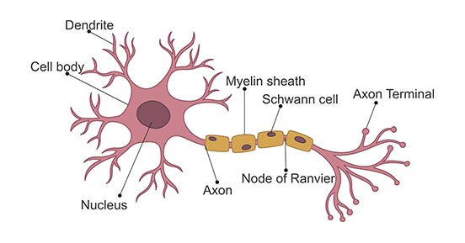
Definition
Neurons are the fundamental units of the brain and nervous system

Slide 5
Structure
Dendrite: Receives message from other neurons and allow the transmission of messages to the cell body.
Cell Body: Each neuron has a cell body with a nucleus, Golgi body, endoplasmic reticulum, mitochondria and other components.
Axon: Axon is a tube-like structure that carries electrical impulse from the cell body to the axon terminals that pass the impulse to another neuron
Notes:
https://byjus.com/biology/neurons/

Slide 6
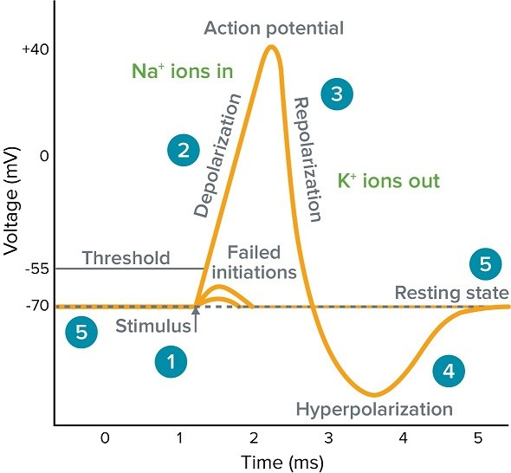
How does neurons decide when to fire?
5. Resting membrane potential: usually −60 mV to −70 mV
1. Once a stimulus is received and exceeds the threshold, voltage-gated ion channels open
2. Sodium (Na⁺) or Calcium Ions (Ca²⁺) rushes into the cell, causing depolarization. Neuron Fires!
3. After firing, sodium channels closes, stopping the inward rush of positive ions. Then potassium (K⁺) channels open, potassium ions flow out of the cell, causing repolarization
4. The potassium channels open for a little longer than needed, causing hyperpolarization

Slide 7
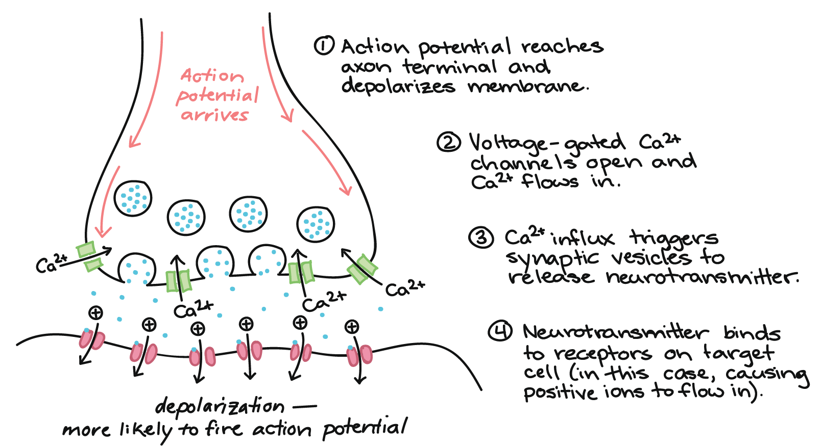
Synapse
The chemical junction between the terminal of one neuron and the dendrites of another neuron.

Slide 8
Cortexes and their functions
Prefrontal Cortex
Somatosensory cortex
Motor Cortex
Visual Cortex

Slide 9
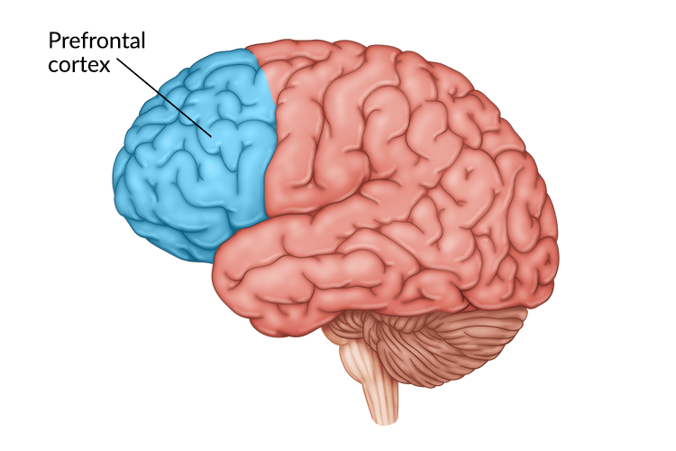
Prefrontal Cortex
Prefrontal Cortex regulates high level cognitive behaviors such as planning, memory, emotion, thoughts and language

Slide 10
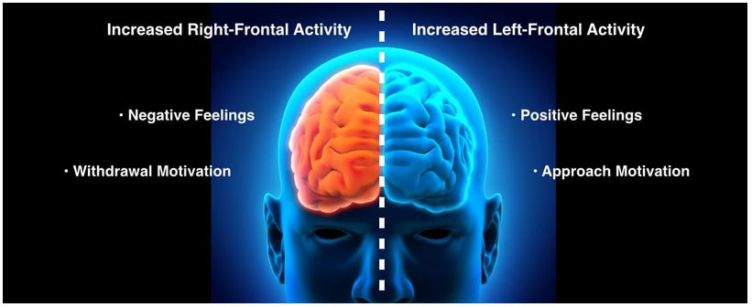
Biomarker Frontal Alpha Asymmetry

Slide 11
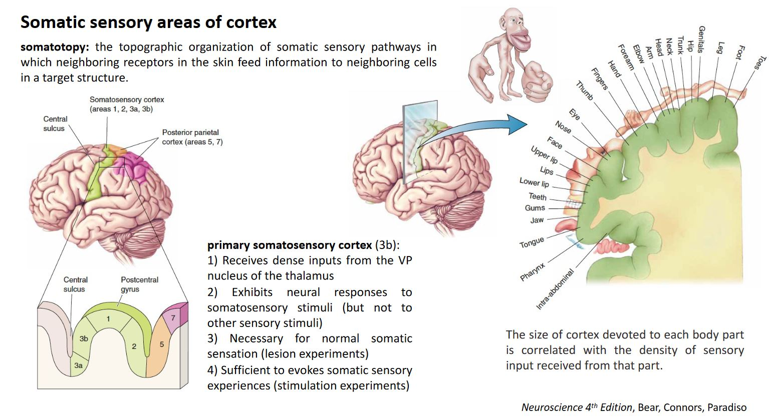

Slide 12
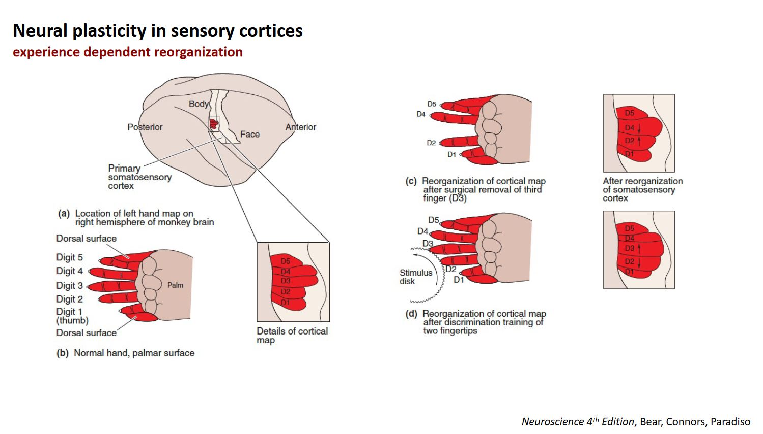

Slide 13
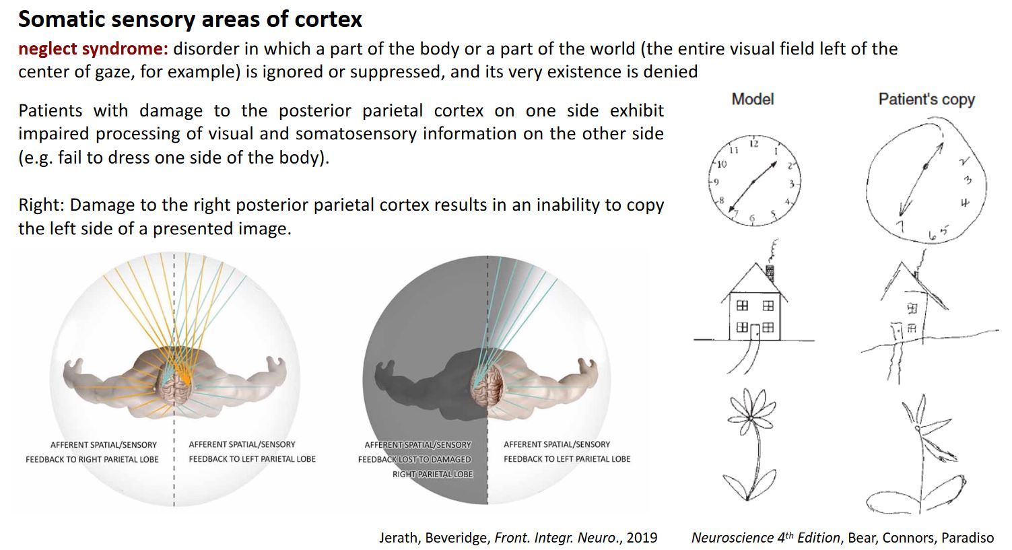

Slide 14
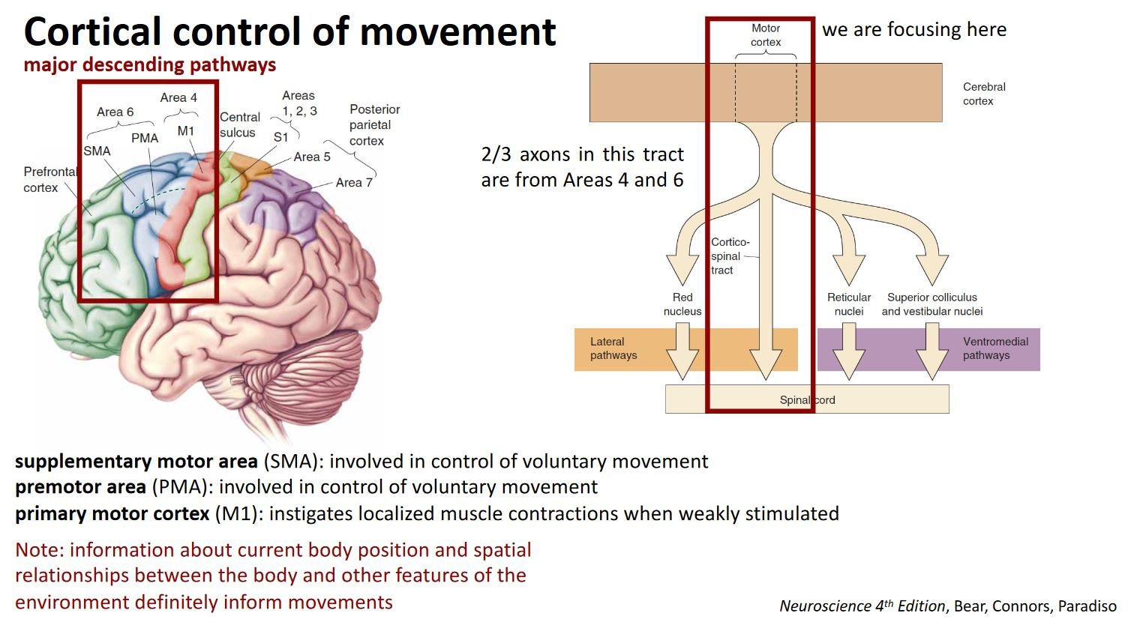

Slide 15
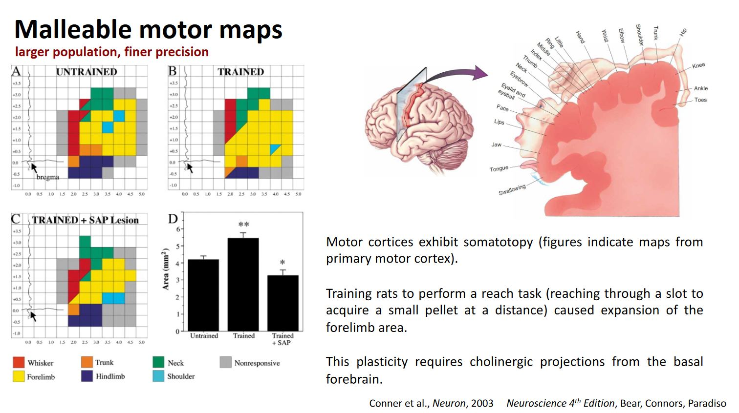

Slide 16
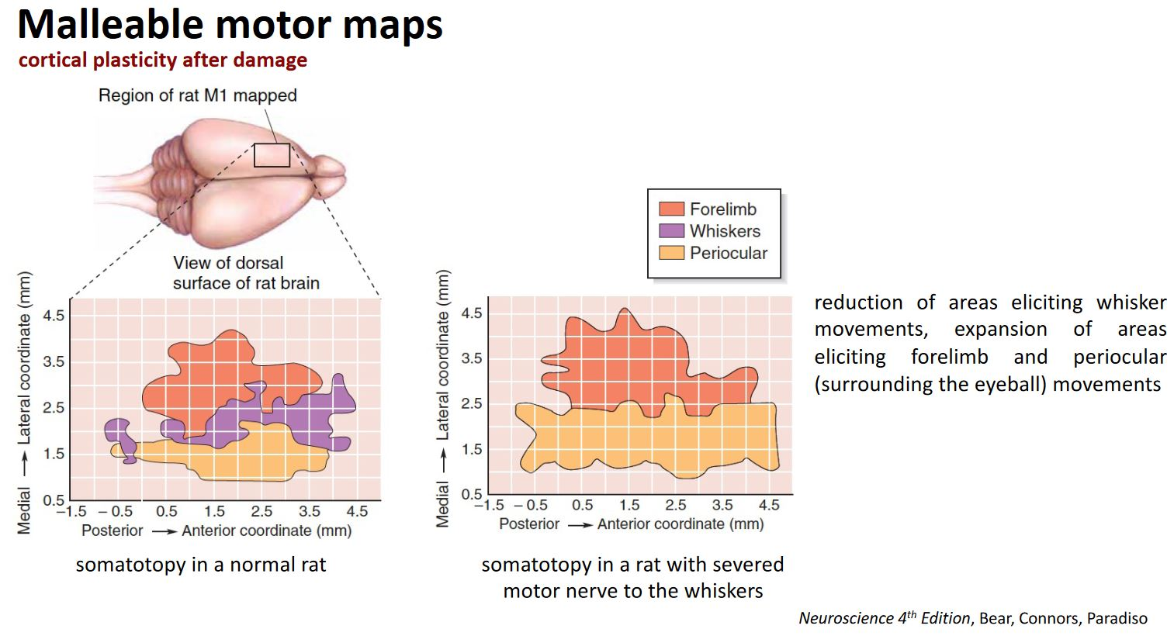

Slide 17
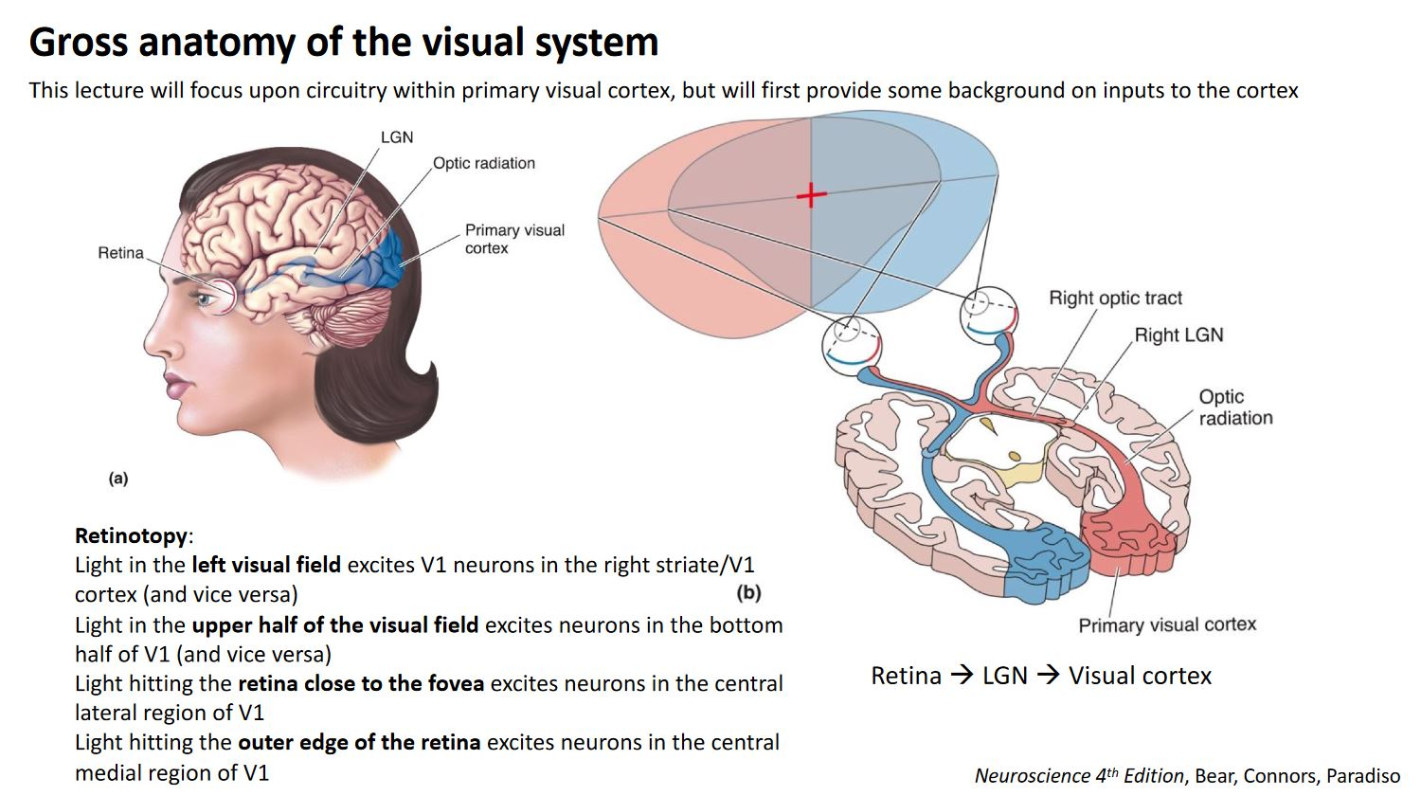

Slide 18
