Slide 1
Lecture 4 Signal Processing

Slide 2
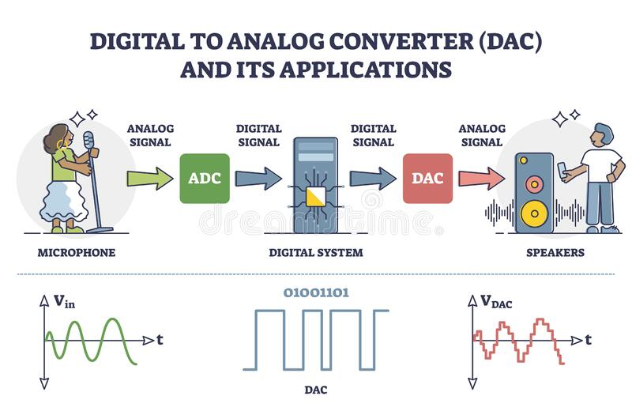
What is signal processing?
Signal processing is an electrical engineering subfield that focuses on analyzing, modifying and synthesizing signals, such as sound, images, potential fields, seismic signals, altimetry processing, and scientific measurements (Wikipedia)

Slide 3
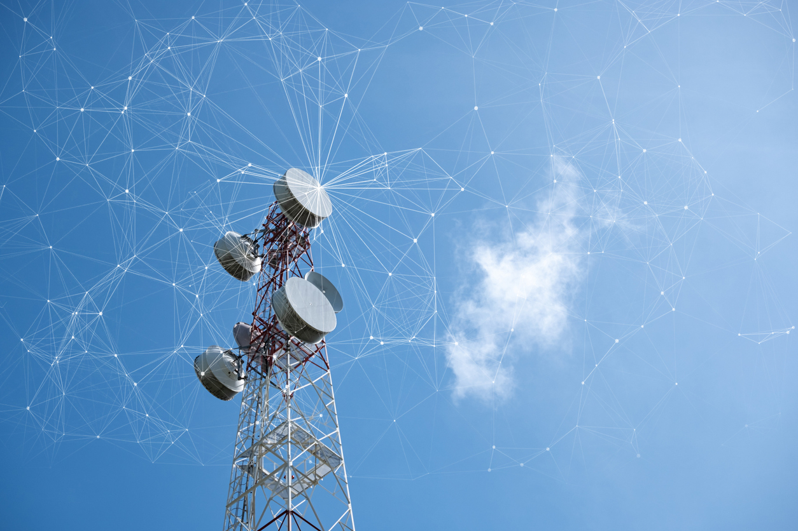
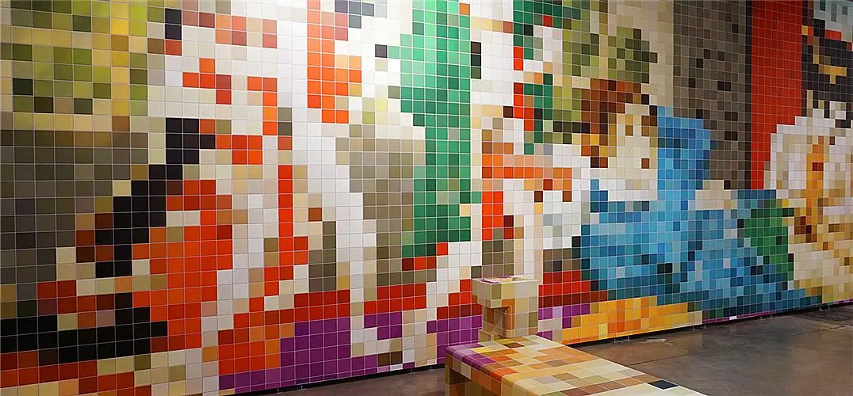

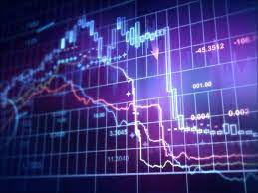
Applications that use signal processing
Telecommunication
Audio and video processing
Image processing
Speech Recognition
Biomedical Engineering
Financial Engineering
Notes:
https://www.electronicsforu.com/technology-trends/learn-electronics/signal-processing
https://www.einfochips.com/blog/speech-processing-model-in-embedded-media-processing/
https://engineering.nyu.edu/academics/programs/financial-engineering-ms

Slide 4
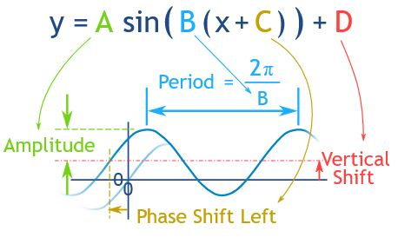

Waves (Amplitude, period, phase shift, frequency)
Notes:
https://www.mathsisfun.com/algebra/amplitude-period-frequency-phase-shift.html

Slide 5
Superposition of waves
https://www.desmos.com/calculator

Slide 6

Can we reverse engineer the set of sine waves are superposed with each other?
Notes:
https://www.freepik.com/free-photos-vectors/yes

Slide 7
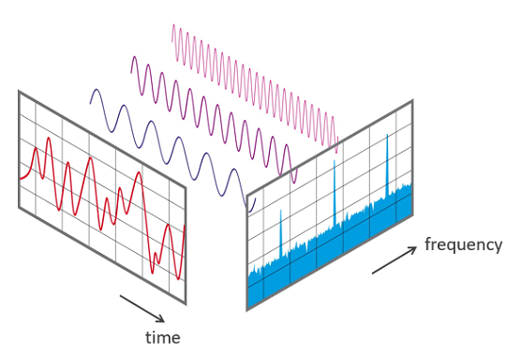
Signal Processing Techniques
Fourier Transform:
A mathematical method to transform any wave from its time domain representation to its frequency domain representation. It is a method to study signals from a different perspective. (Siwen, 2023)

Slide 8
Case study 1: Signal processing for audio data

Slide 9
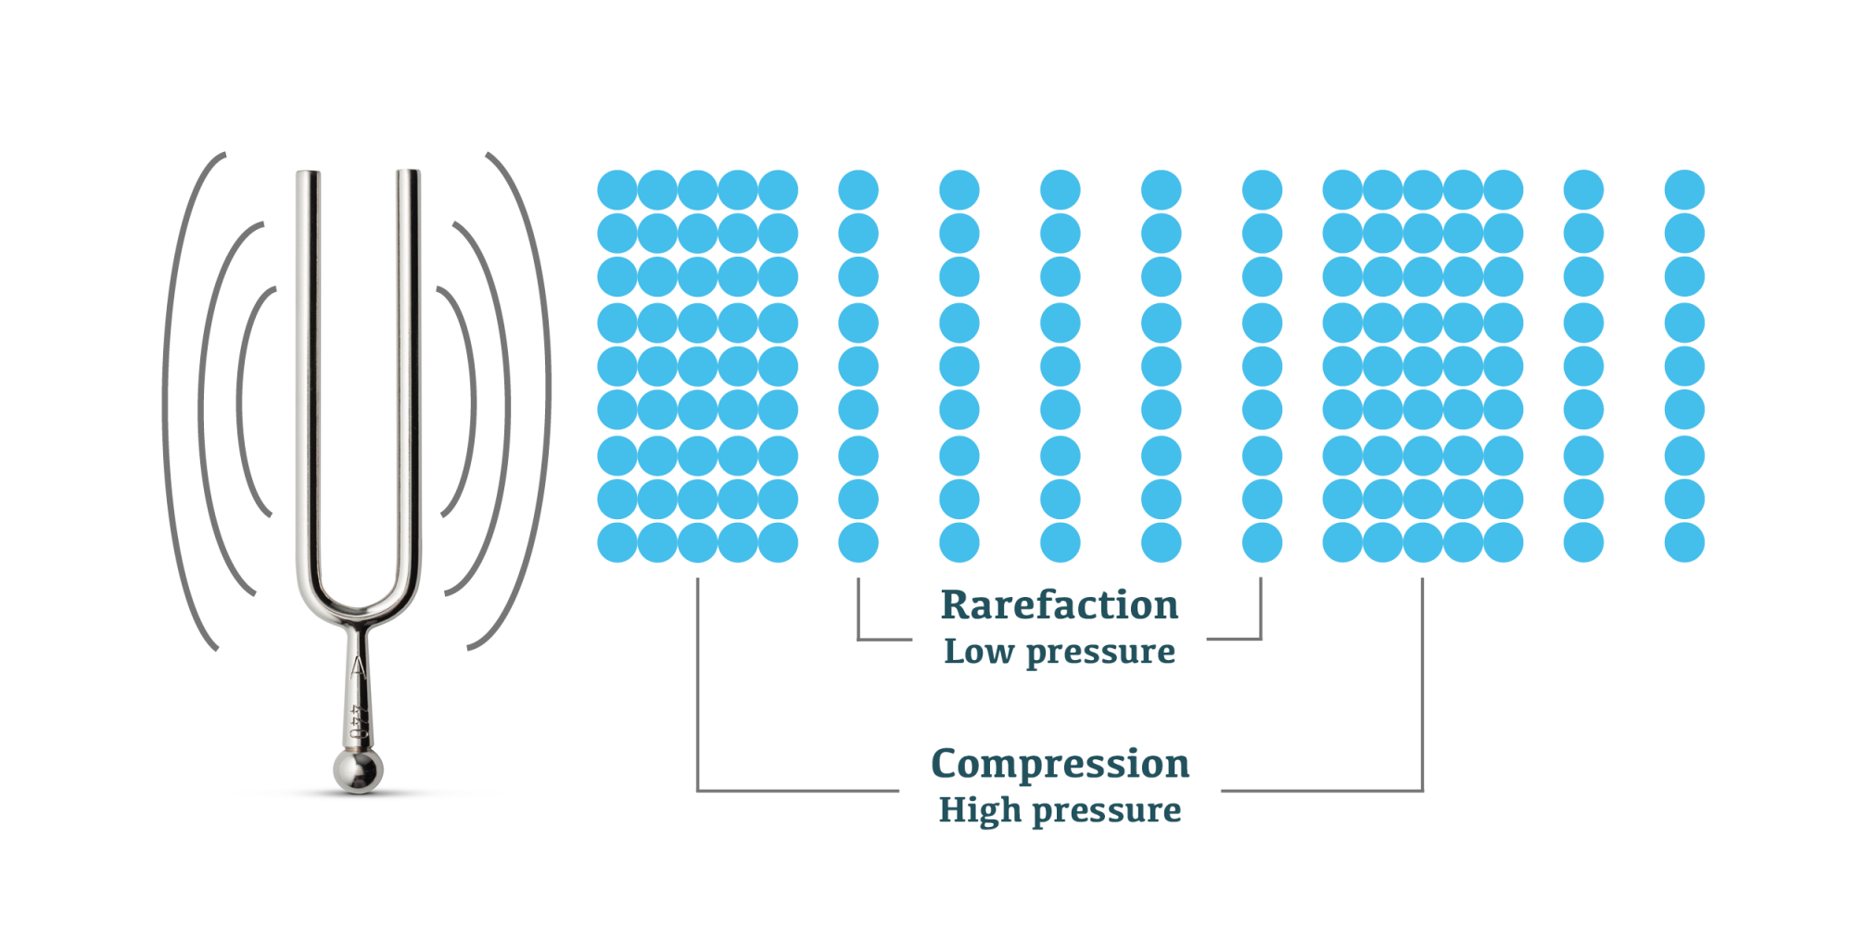
How is sound generated?
Sound is generated when an object vibrates, causing the molecules in the surrounding medium (usually air) to vibrate as well. These vibrations produce waves of pressure that travel through the medium, which our ears detect as sound (ChatGPT, 2023).
Notes:
https://www.pasco.com/products/guides/sound-waves

Slide 10
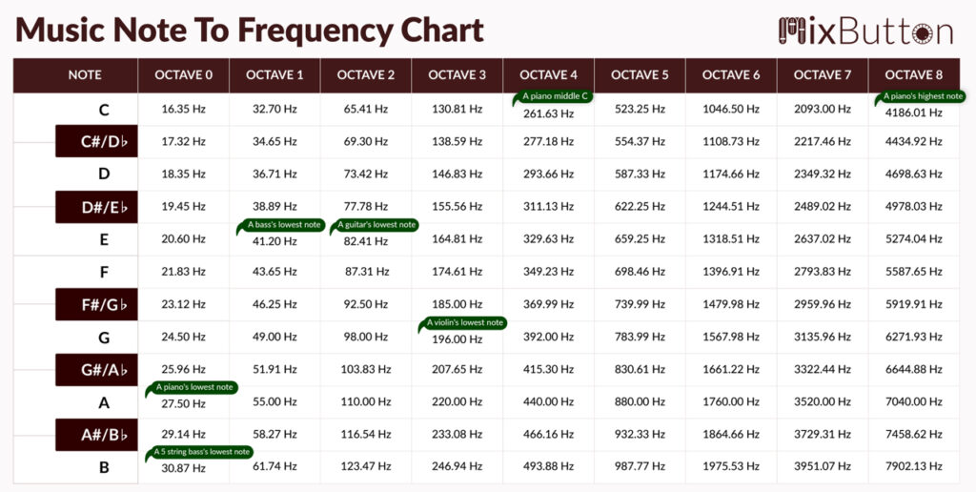
Notes:
https://mixbutton.com/wp-content/uploads/2021/08/Music-Note-To-Frequency-Chart-01-2-1024x516.jpg

Slide 11
Let’s make some music!
https://onlinetonegenerator.com/multiple-tone-generator.html

Slide 12
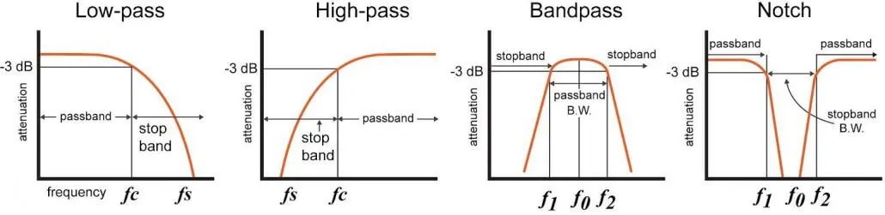
Filters
In signal processing, a filter is a device or process that removes some unwanted components or features from a signal.

Slide 13
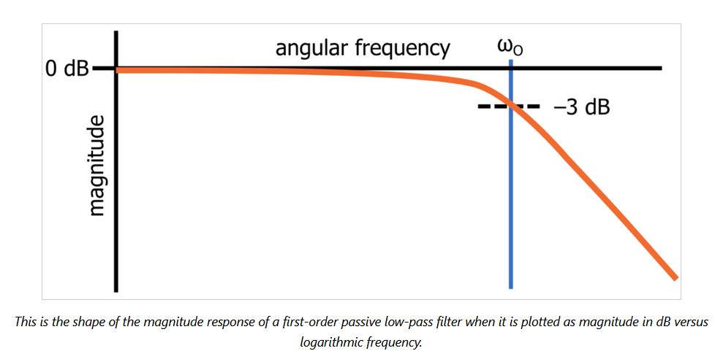
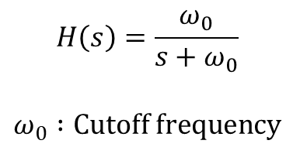
Low-pass Filters
A low-pass filter is a filter that passes signals with a frequency lower than a selected cutoff frequency and attenuates signals with frequencies higher than the cutoff frequency.
First-order low-pass filter
transfer function
$$H\left(s\right)=\frac{ω_{0}}{s+ω_{0}}$$
$$ω_{0} :Cutoff frequency$$
Notes:
https://www.allaboutcircuits.com/technical-articles/understanding-transfer-functions-for-low-pass-filters/

Slide 14
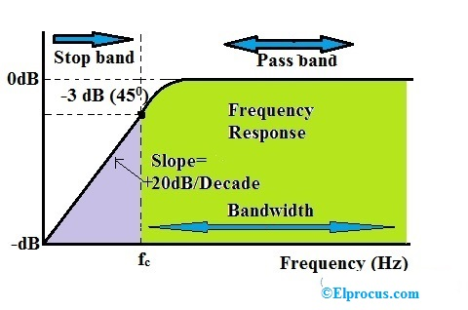
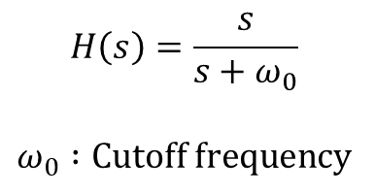
High-pass filters
A high-pass filter is an electronic filter that passes signals with a frequency higher than a certain cutoff frequency and attenuates signals with frequencies lower than the cutoff frequency.
First-order High-pass filter
transfer function
$$H\left(s\right)=\frac{s}{s+ω_{0}}$$
$$ω_{0} :Cutoff frequency$$
Notes:
https://www.elprocus.com/what-is-a-high-pass-filter-circuit-diagram-characteristics-and-applications/

Slide 15
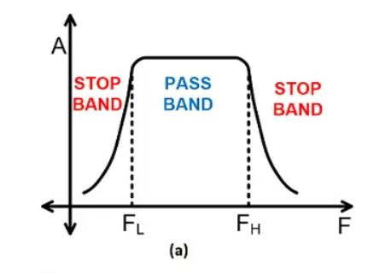
Band-pass filter
A band-pass filter or bandpass filter is a device that passes frequencies within a certain range and rejects frequencies outside that range (Wikipedia).
A bandpass filter can be implemented by putting a high-pass and low-pass filter in series

Slide 16
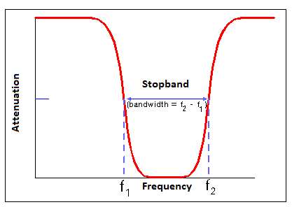
Notch/Band-stop filters
These filters reject/attenuate signals in a specific frequency band called the stop band frequency range and pass the signals above and below this band.

