Slide 1

移动平台GPU渲染

Slide 2
目 录
渲染的基本流程
01
CPU vs GPU
02
OpenglES 渲染流程
03
04
着色器Shader
渲染视频案例
05

Slide 3

早期的渲染流程
渲染本质上是决定屏幕上一个像素点的颜色
数据
业务
处理
图元
信息
光栅化
帧缓冲区
CPU
显示器以固定频率（60fps）从帧缓冲区中取出内容显示到屏幕上

Slide 4
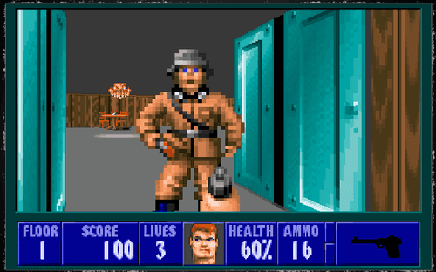
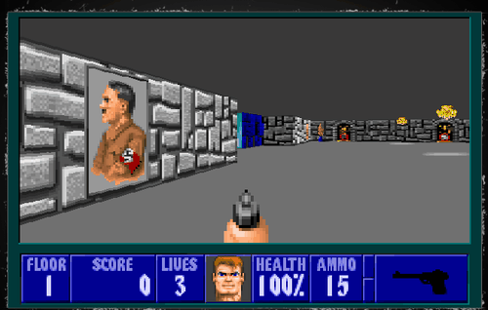
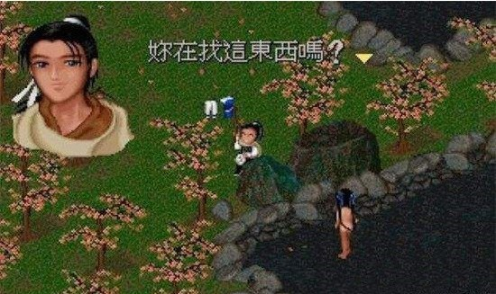
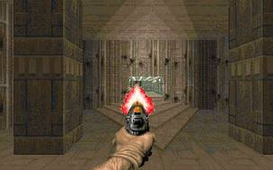
早期的渲染任务几乎都由CPU完成，所以出现了性能上的瓶颈
早期PC上的3A级大作

Slide 5
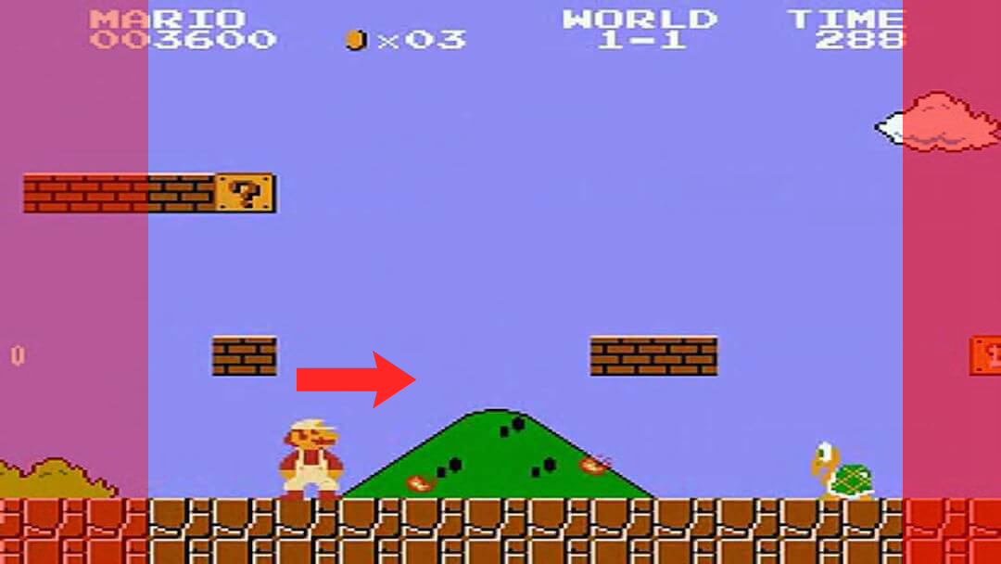
卡马克卷轴算法
早期的计算机是无法横板卷轴类的游戏，因为人物在屏幕上的移动会导致整个画面所有像素点的移动，屏幕上所有像素点均需要重新计算
为了在PC上流畅运行任天堂的《超级马里奥兄弟3》 约翰卡马克提出并实现了卷轴算法，以此减少运算上的消耗

Slide 6
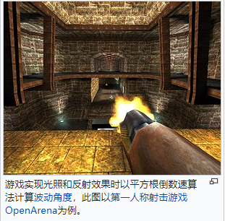
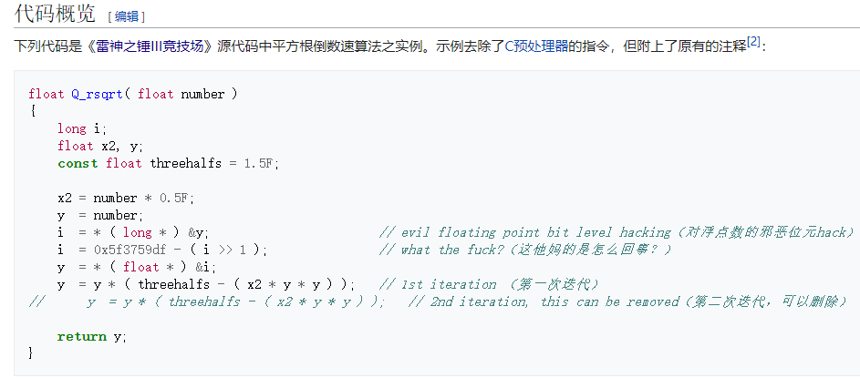
为了使画面更加流畅 使用了许多算法上的优化

Slide 7
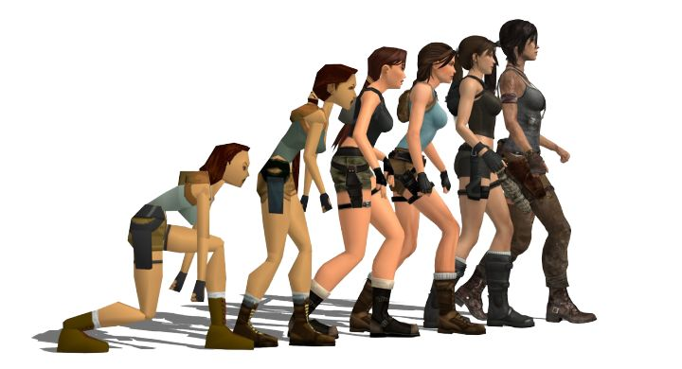
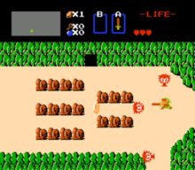

GPU的加入
CPU除了处理原有的程序逻辑，还需要完成图形 光栅化，帧缓冲区内存写入
后期显卡将这一部分任务承担下来，形成了CPU + GPU的工作模式
CPU ： 业务，数据加载，计算出需要被渲染的图形数据
GPU： 拿到图形数据后，送入图形渲染管线，最终结果写入FrameBuffer
The user can demonstrate on a projector or computer, or presentation and make it
可以处理更多的
渲染任务

Slide 8
CPU vs GPU
架构与工作模式上的差别
The user can demonstrate on a projector or computer, or presentation and make it
可以处理更多的
渲染任务

Slide 9
第一章节标题内容
The user can demonstrate on a projector or computer, or print the
标题文字添加
标题文字添加
标题文字添加
The user can demonstrate on a projector or computer
The user can demonstrate on a projector or computer
The user can demonstrate on a projector or computer
标题文字添加
标题文字添加
标题文字添加
The user can demonstrate on a projector or computer
The user can demonstrate on a projector or computer
The user can demonstrate on a projector or computer

Slide 10
第二章节
第二章节标题内容

Slide 11

第二章节标题内容
The user can demonstrate on a projector or computer, or print the
标题文字添加
The user can demonstrate on a projector or computer, or print the presentation and make it into a film to be used in a wider field. Using PowerPoint,
标题文字添加
The user can demonstrate on a projector or computer, or print the presentation and make it into a film to be used in a wider field. Using PowerPoint,

Slide 12
第二章节标题内容
The user can demonstrate on a projector or computer, or print the
20%
20%
20%
20%
20%
20%
20%
T-Shirt
Singlet
Jeans
Apparel
Shoes
Bags
Cawet
标题文字添加
标题文字添加
The user can demonstrate on a projector or computer, or print the presentation and make it into a film to be used in a wider field
The user can demonstrate on a projector or computer, or print the presentation and make it into a film to be used in a wider field

Slide 13
第二章节标题内容
The user can demonstrate on a projector or computer, or print the
标题文字添加
The user can demonstrate on a projector or computer, or print the presentation and make it into a film to be used in a wider field
标题文字添加
The user can demonstrate on a projector or computer, or presentation and make it film to be used in a wider fieldThe user can demonstrate on a projector or computer, or presentation and make it film to be used in a wider field
标题文字添加
The user can demonstrate on a projector or computer, or print the presentation and make it into a film to be used in a wider field

Slide 14

第二章节标题内容
The user can demonstrate on a projector or computer, or print the
标题文字添加
The user can demonstrate on a projector or computer, or presentation and make it film to be used in a wider fieldThe user can demonstrate on a projector or computer, or presentation and make it film to be used in a wider field

Slide 15
第三章节
第三章节标题内容

Slide 16
第三章节标题内容
The user can demonstrate on a projector or computer, or print the
标题文字添加
标题文字添加
The user can demonstrate on a projector or computer, or print the presentation and make it into a film to be used in a wider field
The user can demonstrate on a projector or computer, or print the presentation and make it into a film to be used in a wider field
标题文字添加
标题文字添加
The user can demonstrate on a projector or computer, or print the presentation and make it into a film to be used in a wider field
The user can demonstrate on a projector or computer, or print the presentation and make it into a film to be used in a wider field

Slide 17
第三章节标题内容
The user can demonstrate on a projector or computer, or print the
标题文字添加
The user can demonstrate on a projector or computer, or presentation and make it film to be used in a wider fieldThe user can demonstrate on a projector or computer, or presentation and make it film to be used in a wider field
标题文字添加
标题文字添加
标题文字添加
标题文字添加
The user can demonstrate on a projector or computer
The user can demonstrate on a projector or computer
The user can demonstrate on a projector or computer
The user can demonstrate on a projector or computer

Slide 18
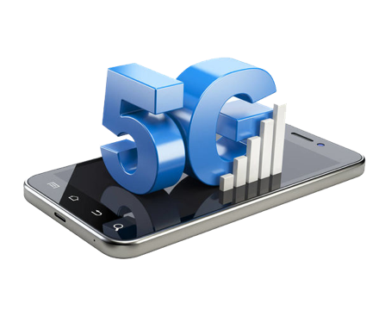
第三章节标题内容
The user can demonstrate on a projector or computer, or print the
标题文字添加
The user can demonstrate on a projector or computer, or presentation and make it film to be used in a wider field
标题文字添加
The user can demonstrate on a projector or computer, or presentation and make it film to be used in a wider field

Slide 19



第三章节标题内容
The user can demonstrate on a projector or computer, or print the
标题文字添加
The user can demonstrate on a projector or computer, or presentation and make it film to be used in a wider fieldThe user can demonstrate on a projector or computer, or presentation and make it film to be used in a wider field

Slide 20
第四章节
第四章节标题内容

Slide 21
第四章节标题内容
The user can demonstrate on a projector or computer, or print the
标题文字添加
标题文字添加
The user can demonstrate on a projector or computer, or presentation and make it film to be used in a wider field
The user can demonstrate on a projector or computer, or presentation and make it film to be used in a wider field
标题文字添加
标题文字添加
标题文字添加
The user can demonstrate on a projector or computer, or presentation and make it film to be used in a wider field
The user can demonstrate on a projector or computer, or presentation and make it film to be used in a wider field
The user can demonstrate on a projector or computer, or presentation and make it film to be used in a wider field

Slide 22

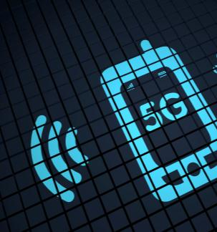
第四章节标题内容
The user can demonstrate on a projector or computer, or print the
标题文字添加
标题文字添加
The user can demonstrate on a projector or computer, or print the presentation and make it into a film to be used in a wider field.
The user can demonstrate on a projector or computer, or print the presentation and make it into a film to be used in a wider field.
标题文字添加
标题文字添加
The user can demonstrate on a projector or computer, or presentation and make it film to be used in a wider field
The user can demonstrate on a projector or computer, or presentation and make it film to be used in a wider field

Slide 23
第四章节标题内容
The user can demonstrate on a projector or computer, or print the
标题文字添加
The user can demonstrate on a projector or computer, or print the presentation and make it into a film to be used in a wider field
The user can demonstrate on a projector or computer, or print the presentation and make it into a film to be used in a wider field.
The user can demonstrate on a projector or computer, or print the presentation and make it into a film to be used in a wider field.
标题文字添加
The user can demonstrate on a projector or computer, or print the presentation and make it into a film to be used in a wider field
The user can demonstrate on a projector or computer, or print the presentation and make it into a film to be used in a wider field.
The user can demonstrate on a projector or computer, or print the presentation and make it into a film to be used in a wider field.

Slide 24
第四章节标题内容
The user can demonstrate on a projector or computer, or print the
标题文字添加
The user can demonstrate on a projector or computer, or presentation and make it film to be used in a wider fieldThe user can demonstrate on a projector or computer, or presentation and make it film to be used in a wider field
标题文字添加
The user can demonstrate on a projector or computer, or presentation and make it film to be used in a wider fieldThe user can demonstrate on a projector or computer, or presentation and make it film to be used in a wider field

Slide 25

第5代通信技术
THANK YOU
适用年度总结｜工作计划｜述职报告｜商务演示

