Slide 1

Ai agent
Syeda Irha Azhar Kazmi

Slide 2
Methodology overview
Framework: Built using LangChain + Ollama for local LLM execution
LLM: Default model – llama3.2 (runs locally with no cloud dependency)
Agent Type: ConversationalReactDescription for dynamic, multi-turn tasks
Tool Use:
🔍 Web Search via DuckDuckGo
Calculator via LLMMathChain
🐍 Python REPL (with security limits)
Memory:
Short-term: Conversation buffer (last 5 messages)
Long-term (optional): FAISS vector store

Slide 3
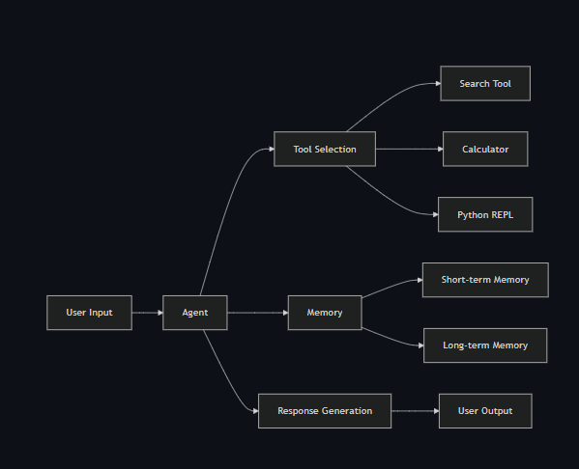
Agent Architecture

Slide 4
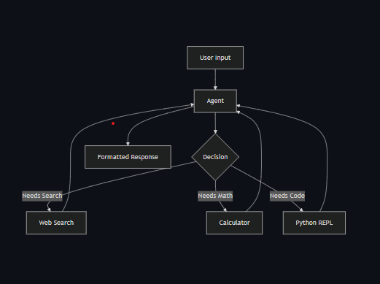
Key Components

Slide 5
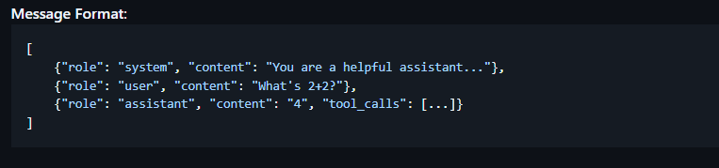
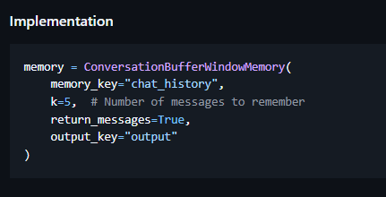
Implementation Details
UI: Streamlit-based chat interface with real-time response
Prompting Strategy:
Uses an implicit system prompt
Maintains conversation context (2048-token window)
Tool Safety:
Python REPL is sandboxed
REPL and search have execution timeouts & rate limits
LLM Settings:
Temperature: 0.2
Top-k, top-p sampling for balanced output

Slide 6
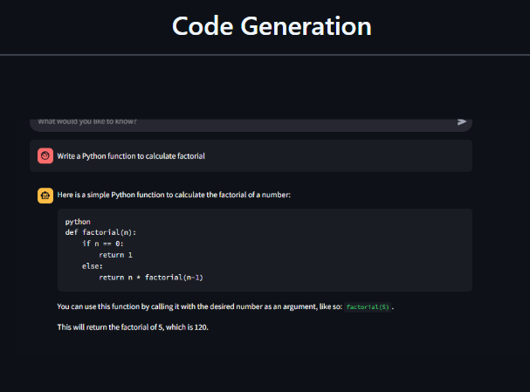
Results and evaluation
Use Case Tested
🧠 General Knowledge: “Tell me about quantum computing”
➗ Math: “45 * 89 + 32 / 8”
🧑‍💻 Code: “Python function to calculate factorial”

Slide 7
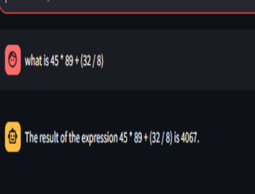
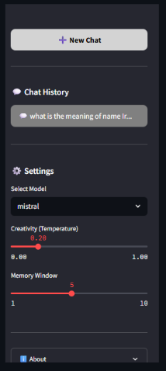
Results and evaluation
Strengths
Works offline with local models
Multi-turn reasoning with memory
Executes safe code and math tasks

Slide 8
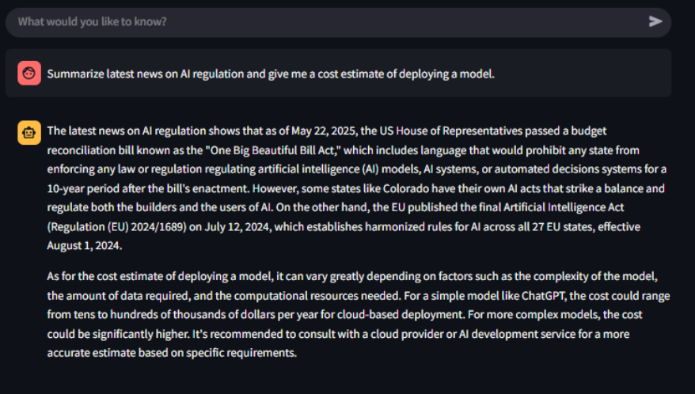
Results and evaluation
Limitations
First output may be slow (model warm-up)
Limited to system resources and context window size

