Slide 1
Container
Container
Container
App C
App C
App C
App C
App C
App C
라이브러리, 툴, dependencies
라이브러리, 툴, dependencies
라이브러리, 툴, dependencies
라이브러리, 툴, dependencies
라이브러리, 툴, dependencies
라이브러리, 툴, dependencies
가상 OS
가상 OS
가상 OS
Docker Engine
OS Built-in / Emulated Container Support
OS
OS
Container
Container Layer(Read/Write)
Image(Read Only)
호스트(내 컴퓨터)
Image Layer #3
컨테이너
Image Layer #2
/some_path
/app/user-data
Image Layer #1

Slide 2

Cluster
Worker Node
Master Node
kubelet
Control Plane
Proxy / Config
Cloud
Provider
API
API Sever
Pod
Scheduler
Worker Node
kubelet
Kube-Controller-Manager
Proxy / Config
Pod
Cloud-Controller-Manager
Worker Node
etcd
kubelet
Proxy / Config
Pod

Slide 3
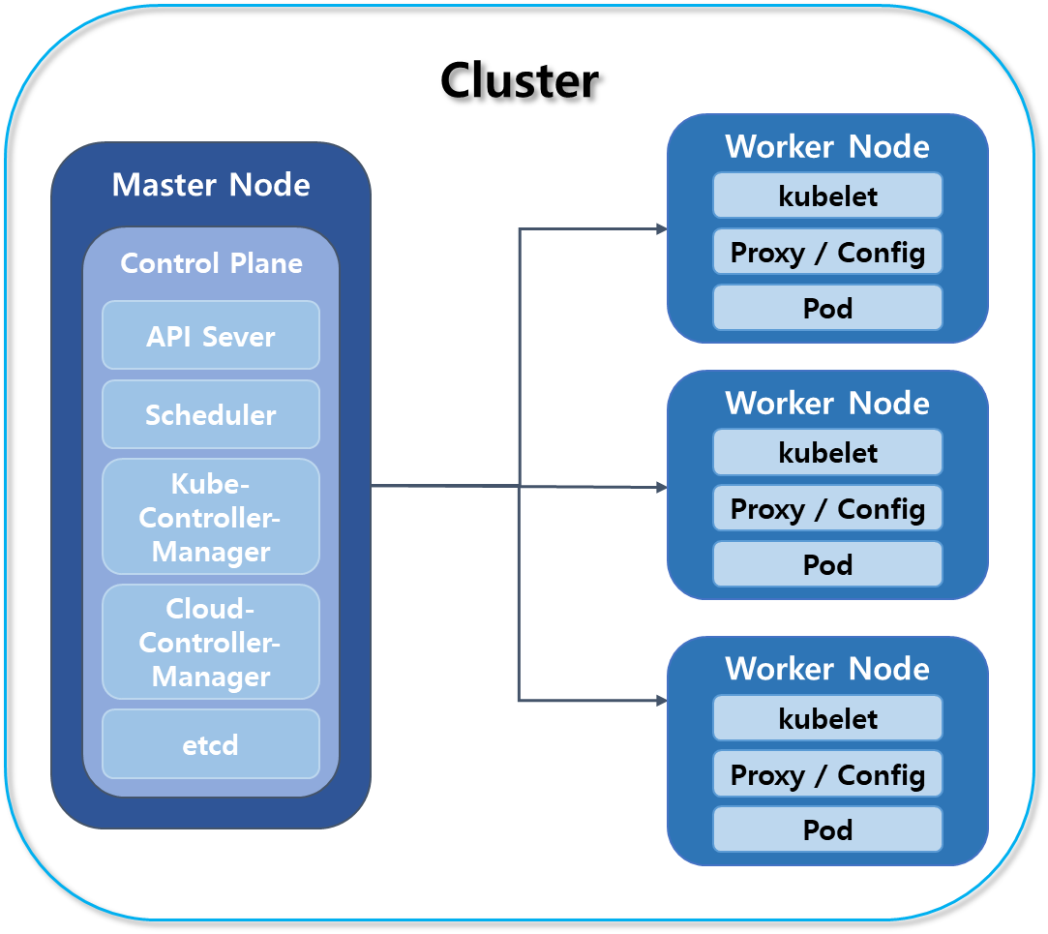

Kubectl
Worker Node
Kubelet
Docker
Kube-proxy
Pod
Pod
Pod
Volume
Volume
Volume
Container
Container
Container
Container
Container
Container

Slide 4
Container 4
create
Container 3
Host Container
Container 1
Container 2
Docker (Host Machine)
Agent Container
Container 3
Container 4
Container 1
Container 2
create
Docker (Host Machine)

Slide 5
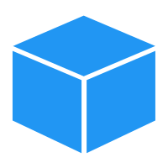


Host Machine
Container
Container
create
Jenkins Container
Docker Client /usr/bin/docker
Docker Socket /var/run/docker.sock
Docker Daemon /usr/bin/dockerd
Docker Client /usr/bin/docker
Docker Socket /var/run/docker.sock
Docker Daemon /usr/bin/dockerd

Slide 6
Host Machine
Jenkins Container
Volume Mounted
Volume Mounted
Docker Client /usr/bin/docker
Docker Socket /var/run/docker.sock
Docker Daemon /usr/bin/dockerd
create
Container
Container

Slide 7
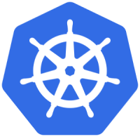
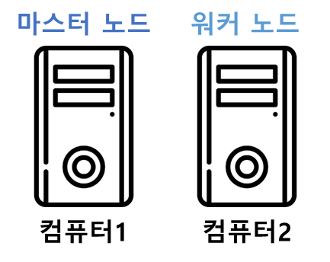

Pod
Replica Set
Deployment
Service
Volume
…
마스터 노드
워커 노드
워커 노드
컴퓨터1
컴퓨터2
컴퓨터3
컴퓨터1

Slide 8

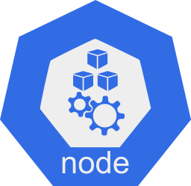
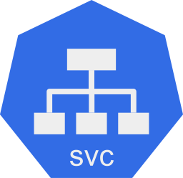

요청
Ingress / Load Balancer
분배
ClusterIP
ClusterIP
분배
분배

