Slide 1

Visualization and Analysis – Tutorial Presentation for Feedback Date: 26.11.2025
Group Id: Name of Student Presenting: Khant Zwe Naing

Slide 2
If you have not defined your Research Question (RQ) yet, please do not attempt to present Visualizations and/or analyses of your data. Go to Canvas, announcements on RQ presentations, and use the PowerPoint template provided for you to present your RQ. You can use the time slot to present your RQ instead of the Visualisation.
Part 1: VISUALISATION

Slide 3
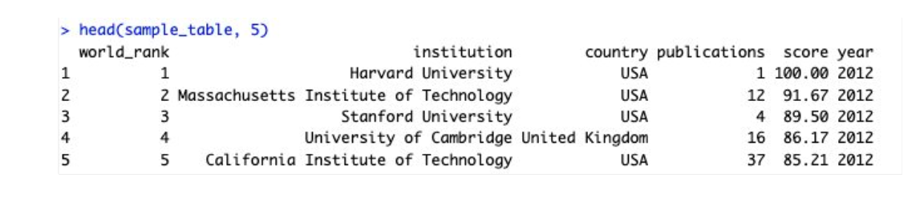
We are using the dataset ds276 to answer our Research Question “ (Is there a correlation between score and publications ”
Independent Variable
Dependent Variable
Include a sample of your .csv/xlxs dataset file to include column names (variables) in your RQ². Include number of rows: E.g. “the dataset has 655 rows and the variables we use are Valuation (dependent variable³) and Country (independent variable⁴).
¹ Be sure you follow one of the three prescribed RQ Templates – identifying the type of statistical analysis you will be using. If you do not have the correct RQ, we will stop your presentation here.
² The variable name in your RQ may be different from the column name in cases where the column names are abbreviations.
^{3.4.}Be sure to identify which variable is your dependent variable and which one is your independent variable on this slide

Slide 4
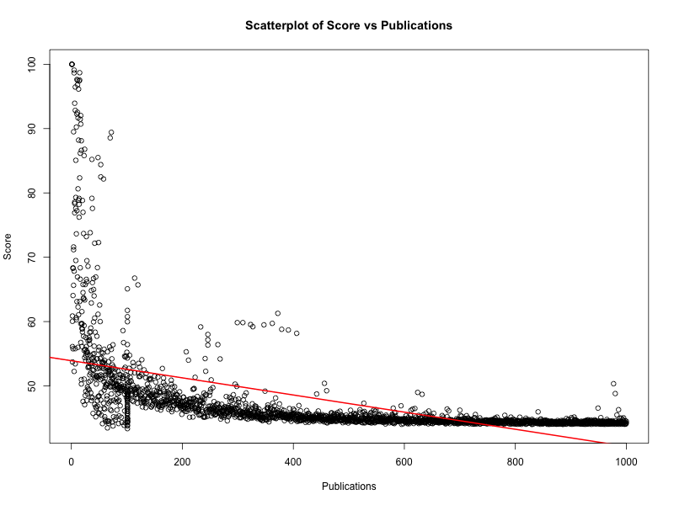
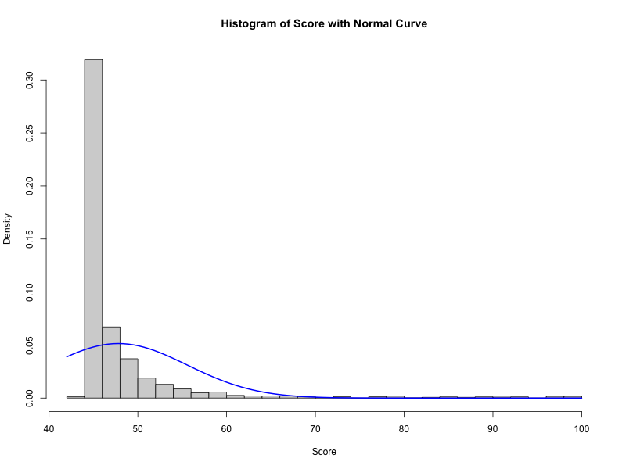
1. Where your research question asks about Correlation: Include two visualizations
Correlation analyses how an interval/ratio dependent var correlates to an ordinal/interval/ratio independent variable

Slide 5
Only attempt this Analysis part of the demo if you have completed your Visualization(s). Otherwise end your demo after the Visualization for feedback.
Part 2: Analysis (building on your Visualizations)

Slide 6
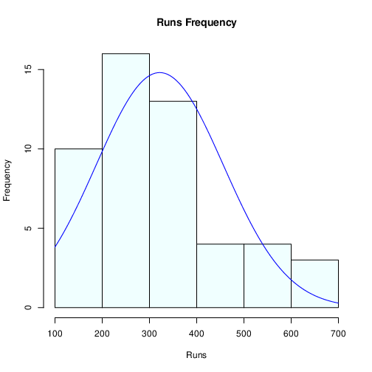
Here is a Histogram showing the frequencies of our dependent variable to include the normal curve overlay.
Our RQ asks about Correlation
For example:
The normal curve overlay does not follow the shape of the underlying data, so for our analysis we use the non-parametric test for correlation that does not assume normality: Spearman’s Rho or Kendal’s Tau
The example here is borderline, in terms of shape, so when in doubt choose the non-parametric equivalent.
6
Notes:
8

Slide 7
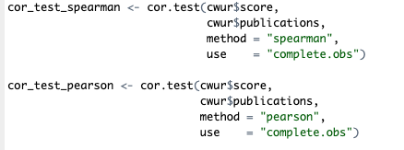
R Script and Results (For ALL types of test) – The Analysis
PRE 7COM1079-2022 Student Group No: ?????
7
Test statistic (Spearman’s ρ): ρ = –0.8686
p-value: p < 2.2 × 10⁻¹⁶ (reported as 0 in R due to rounding limits)
Is the result significant? Yes — p < 0.05, so the result is statistically significant.
Do we reject the null hypothesis? Yes — we reject H₀ (“there is no correlation”). We accept H₁: there is a correlation.
What does this mean for our Research Question? There is a strong, statistically significant negative correlation between score and publications. This means universities with stronger publication performance (better publication rank → lower publication number) tend to achieve higher CWUR scores. However, correlation does not prove causation, so we interpret this as an association, not a cause-and-effect relationship.
Notes:
9

