Slide 1
Tokens

Slide 2
Tokens
A smallest element of a C++ program that can be understood by the compiler.
In simple words, each word of a syntactically correct program is a token.
Example: int, new, float, main(), return,

Slide 3
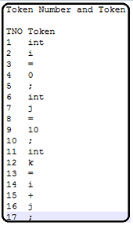
Example
Tokens in the statements
int I = 0;
int j = 10;
int k = I + j;

Slide 4
Types of Tokens
Keywords.
Identifiers.
Literals.
Punctuators.
Operators.

Slide 5
Keywords
Reserved words by the compiler for a specific purpose is called as Keywords.
Example: include, return.

Slide 6
Identifiers
The names given to the variables are known as Identifiers.
Rule to name a variables are
Can contain Alphabets, Numbers, Underscore.
Should not start with number.
Should not use Reserved Keyword (Keywords).

Slide 7
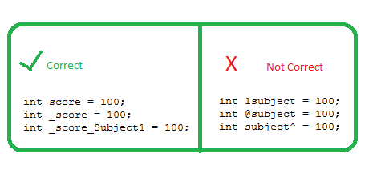

Slide 8
Literals
Any value we assign to a variable will fall under the category of literal.
int z=10;
char a = ‘h’
First ex: 10 is a literal.
Second ex: h is a literal.

Slide 9
Punctuators
Any the brackets we use in programming will be called as punctuators.
Ex: { } [ ] ( )

Slide 10
Operators
Operators used to perform mathematical or even technical calculations will be called as operators.
C = A + B
Here ‘=‘ and ‘+’ are operators.

