Slide 1
Expressions

Slide 2
Expressions
Expressions are related to operators.
One or more operators combined along with operands to give a specified computation.
C=a+b
C,a,b were operands.
=,+ are operators
Several expressions are there.

Slide 3
Examples
Assignment Operator =
C += a which actually same as c = c + a
C -= a which actually same as c = c – a
C *= a which actually same as c = c * a

Slide 4
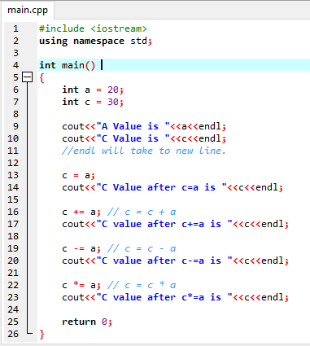
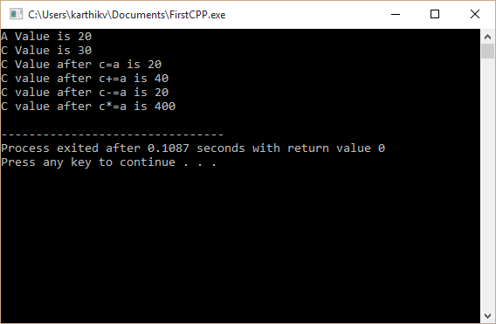
Output

Slide 5
Increment and Decrement Operators
Use and Increment a++ equal to a=a+1
Increment and Use ++a equal to a=a+1
Use and Decrement a-- equal to a=a-1
Decrement and Use --a equal to a=a-1
But the actual working of all the four will be discussed in next slide.

Slide 6
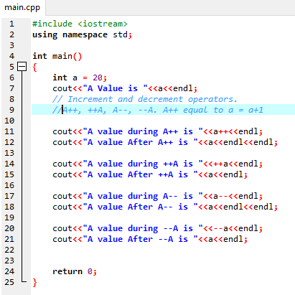
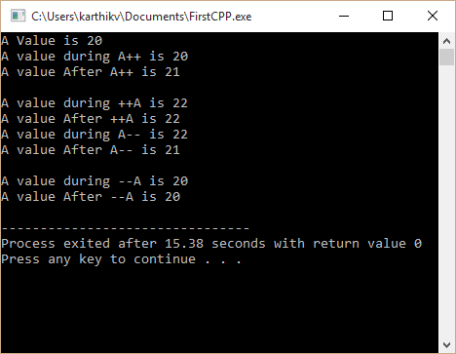
Increment and Decrement Operators

Slide 7
Other Operators
Arithmetic operators.
C = A + B
Logical Operators.
int i = 1;
int j = 0;
int k = i && j AND Operator. k = 1 && 0 which is equal to 0.
Similarly || OR operator.
Comparison Operators.
A >= B, A<=B, A==B
Conditional Operators.
C= (A>B ? A : B)
Check whether A>B if true then A will be assigned to C, else B will be assigned to C.

Slide 8
Special Operators
There are many special operators available in C++. Few are listed below.
SizeOf
int i = 10;
sizeof(i). This will display the memory size occupied by integer i.
New operator is used to allocate memory.
Delete operator is used to delete or free the memory.

