Slide 1
Functions

Slide 2
Functions
Four types of function
With return type with argument
Without return type with argument
With return type without argument
Without return type without argument

Slide 3
Function Syntax
return type function_name ( arguments )
{
// Code
}

Slide 4
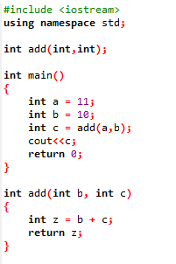
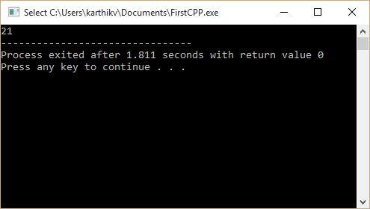
With return type and with arguments

Slide 5
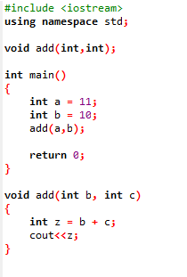
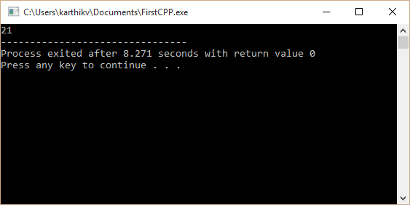
Without return type and with arguments

Slide 6
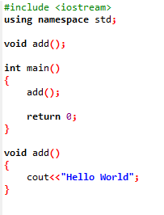
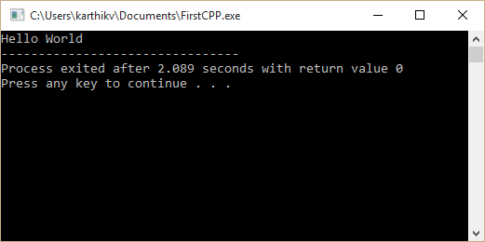
Without return type and without arguments

Slide 7
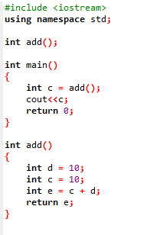

With return type and without arguments

