Slide 1
Classes and Objects

Slide 2
Class
Class in an entity that contains variables and member functions.

Slide 3
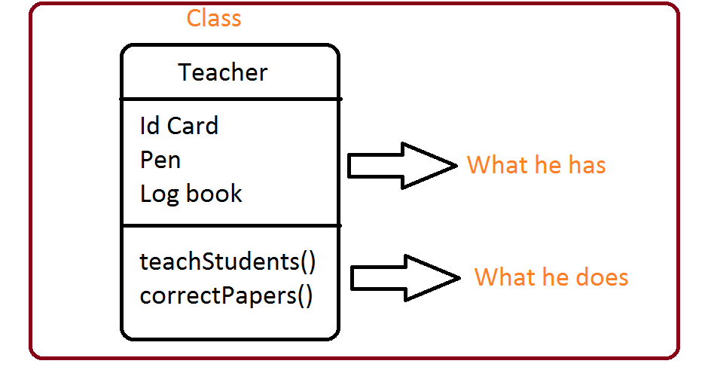

Slide 4
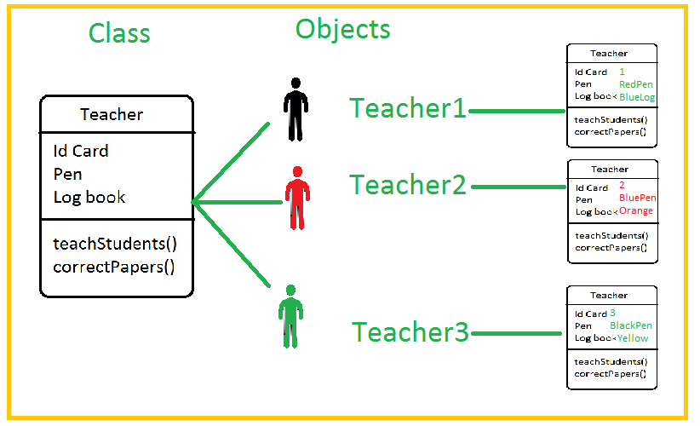

Slide 5
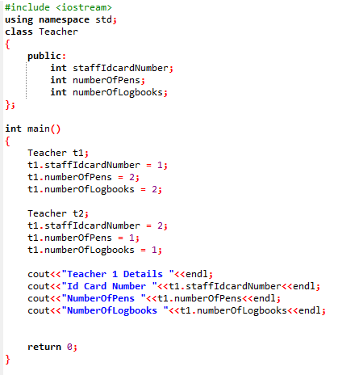
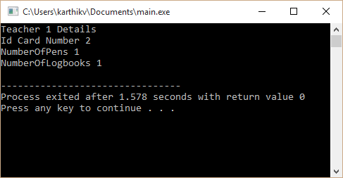
Code Example

