Slide 1
Constructor

Slide 2
Constructor
Constructor itself is a function.
Constructor is a Special kind of function.
Does not have return type.
Name of the constructor is same as class name followed by empty braces.
It will be automatically called when object is created.
Its used to initialize class variables.

Slide 3
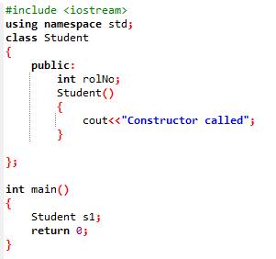
Code Sample
In the code… Class Student
Is a class. It has a constructor
Named Student.
Student()
{
cout<<“Constructor Called”;
}
It does not have a return type
It has the name as class name Student

Slide 4
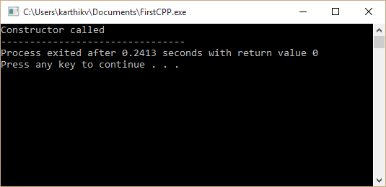
Code Sample
In the main function we have just created the object alone.
We have got the output as Constructor called which means that the constructor is called automatically after the object is created.

Slide 5
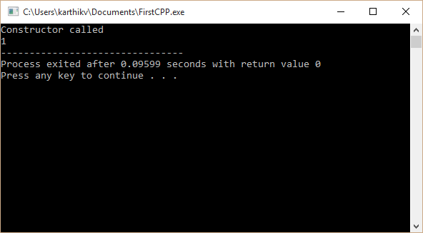
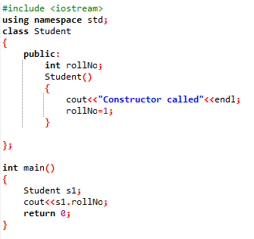
Code Sample
Lets use constructor for initializing class values.
We have created the object alone in line 1 inside the main function.
But next line rollNo is printed that shows how we have used constructor to initialize class variables.

