Slide 1
Destructor

Slide 2
Destructor
Destructor itself is a function.
Destructor is a Special kind of function.
Does not have return type.
Name of the Destructor is same as class name followed by empty braces.
It is almost same like constructor. But we add a single character ~ before destructor name.
It will be automatically called when object is Deleted.
Its used to free the memory used by the objects.

Slide 3
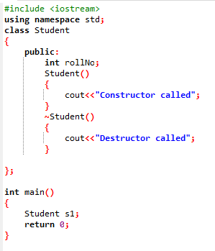
Code Sample
In the code… Class Student Is a class.
It has a constructor
Named Student().
And destructor named ~Student().
~Student()
{
cout<<“Destructor Called”;
}
Please note ~ symbol before destructor name.
It does not have a return type
It has the name as class name Student

Slide 4
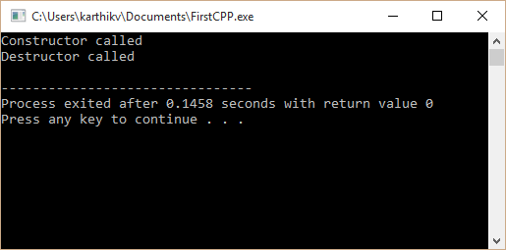
Code Sample
In the main function we have just created the object alone.
We have got the output as Constructor called which means that the constructor is called automatically after the object is created.
We have got the output as Destructor called which means that the destructor is called automatically once use of object is over and its deleted.

