Slide 1
Runtime Polymorphism
Virtual Functions

Slide 2
Virtual Functions
A base class can have functions of its own, which will be inherited by the derived class.
But when I need to redefine the base class function in the derived class then the conflict arises. Object of derived class will have a confusion whether which function to call … Base class function or derived class function.

Slide 3

Can you differentiate them ???
These both are twins as (Sangi Mangi - SM) and (Mangi Sangi - MS) ☺ ☺ ☺ ☺.
SM and MS are compared to derived classes. Their parent is obviously Base class.
We will always get confusion who is MS and who is SM
Sticking a red sticker on the shirt of SM by his mom (Parent class in c++) will clear our difficulty.

Slide 4
C++ Virtual Functions
To redefine the base class method in derived class few steps to be followed.
Declare base class function as virtual.
Then we can redefine the function in derived class.
While calling base class function we use pointer.
Derived class method can be called as usual.

Slide 5
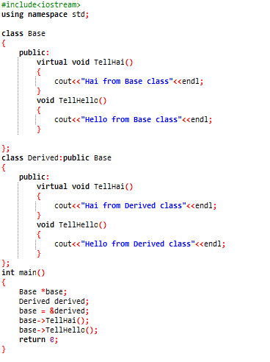
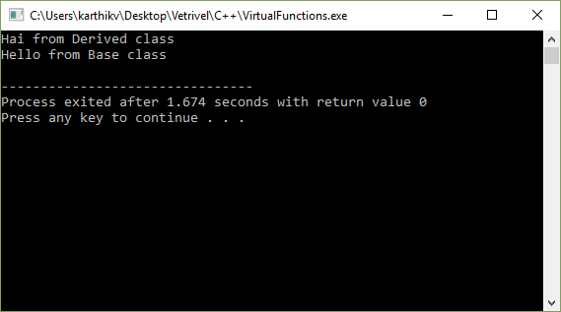
Code & Output

Slide 6
Explanation
We have declared a pointer for base class object that points to an object of derived class.
So now when we call tellhai() and tellhello() both should actually from derived class since pointer of base class object points to the object of derived class. But………………………………………………………….

Slide 7
Explanation
But what happened is different.
Hai came from Derived class. Which clearly denotes us that the keyword Virtual before the function in base class, allows the derived class to redefine the function from base class. So function of derived class is called. This is called late binding because it is binded during runtime.
Hello came from base class. Because Hello from the base class is not allowed to redefine in the derived class. Hence no virtual keyword is used before. So function of base class is called. This is called early binding because it is binded during compile time.

Slide 8
Explanation
If you still want to call hello from the derived class you can straight away create object for derived class without pointers and call it.

Slide 9
Few rules to be followed while using Virtual Function
Function must be declared in public scope.
Function Cannot be static.
Function Cannot be a friend function of another Class.
Should be accessed using pointers to achieve runtime polymorphism.
Class can have virtual destructor.
Class cannot have virtual constructor.

