Slide 1
Hackathon 2015
Data plausibility checks under time pressure
Team Tolerance
Keith Daigle
Patrick Knecht
Manuel Stächele
Jun Xu

Slide 2
Problem
Implement scalable automated machine learning algorithm to support user based publicaiton decision on real time financial market data.

Slide 3
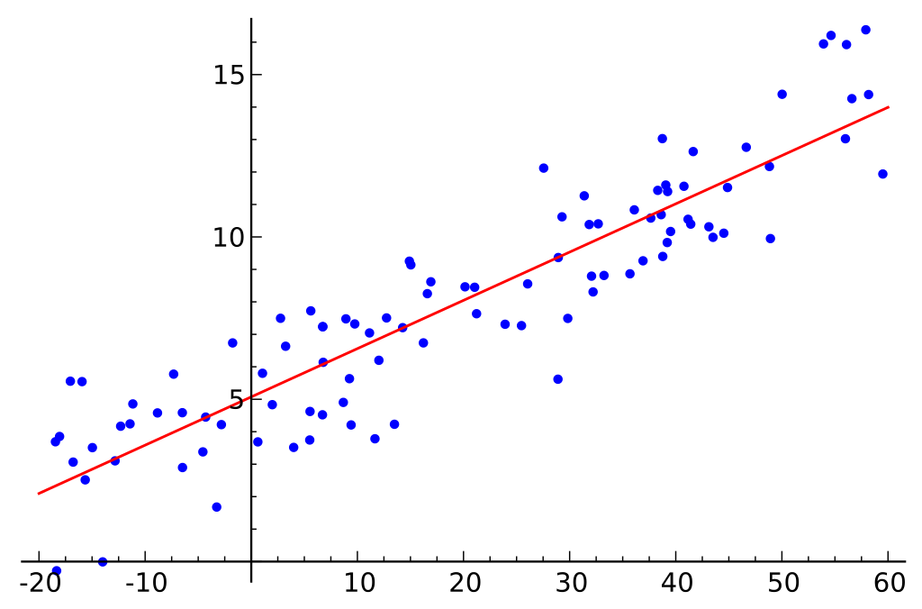
Approach

Slide 4
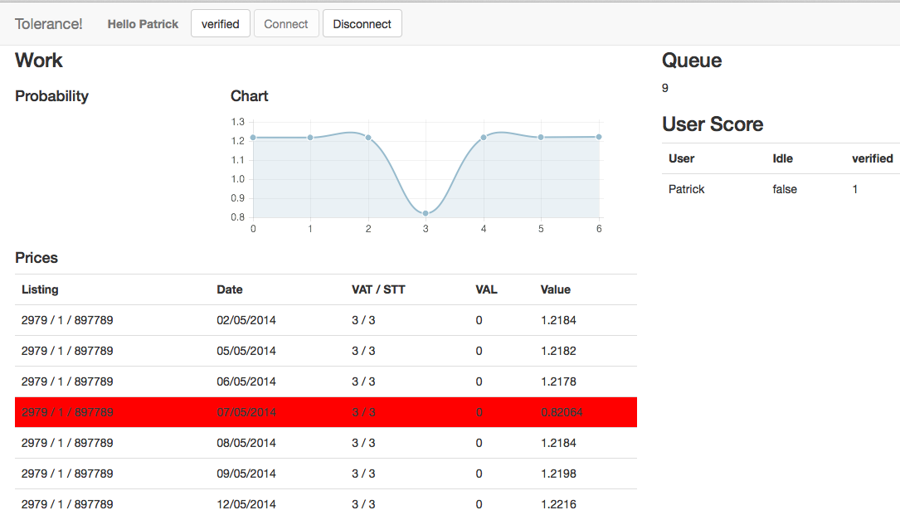
User Interface

Slide 5
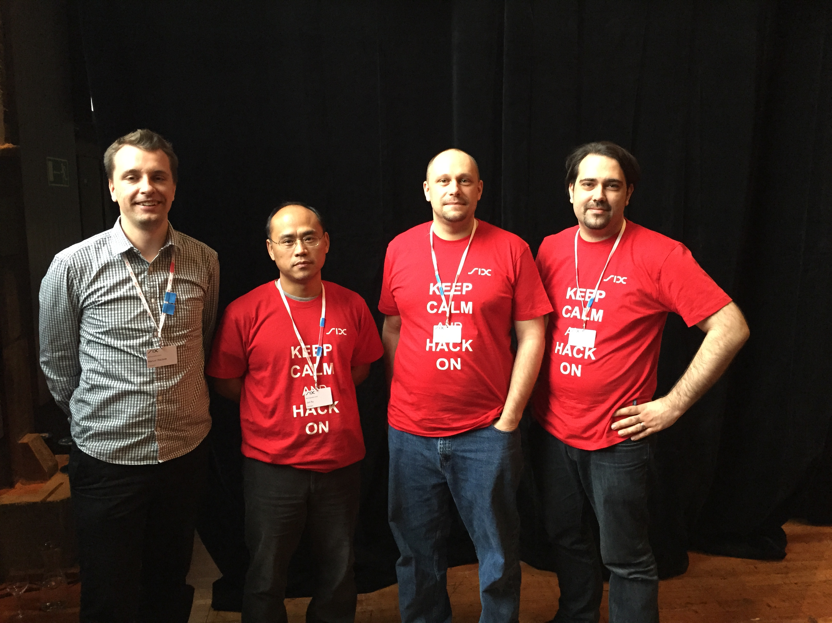
Team Tolerance

