Slide 1
Programming Applications
Spring 2021-2022
Asst. Prof. Dr. Pelin GÖRGEL (pelin.gorgel@iuc.edu.tr)
16.03.2022

Slide 2
Cookie Basics
Cookies are not programs, and they cannot run like programs do. Therefore, they cannot gather any information on their own. Nor can they collect any personal information about you from your machine.
A cookie is a piece of text that a Web server can store it on a user's hard disk. Cookies allow a Web site to store information on a user's machine and later retrieve it. The pieces of information are stored as name-value pairs.
For example, a Web site might generate a unique ID number for each visitor and store the ID number on each user's machine using a cookie file.
If you visit www.google.com, and the site may place a cookie on your machine as following:
UserID A9A3BECE0563982D www.google.com/

Slide 3
Cookie Basics
(continued)
The Web site stores the data, and later it receives it back. A Web site can only receive the data it has stored on your machine. It cannot look at any other cookie, nor anything else on your machine.
The data moves in the following manner:
If you type the URL of a Web site into your browser, your browser sends a request to the Web site for the page. For example, if you type the URL http://www.amazon.com into your browser, your browser will contact Amazon's server and request its home page.
When the browser does this, it will look on your machine for a cookie file that Amazon has set. If it finds an Amazon cookie file, your browser will send all of the name-value pairs in the file to Amazon's server along with the URL. If it finds no cookie file, it will send no cookie data.
Amazon's Web server receives the cookie data and the request for a page. If name-value pairs are received, Amazon can use them.
If no name-value pairs are received, Amazon knows that you have not visited before. The server creates a new ID for you in Amazon's database and then sends name-value pairs to your machine in the header for the Web page it sends. Your machine stores the name-value pairs on your hard disk.
The Web server can change name-value pairs or add new pairs whenever you visit the site and request a page.

Slide 4
How do Web sites use cookies?
Web sites use cookies in many different ways:
Sites can accurately determine how many people actually visit the site.
The only way for a site to accurately count visitors is to set a cookie with a unique ID for each visitor. Using cookies, sites can determine how many visitors arrive, how many are new versus repeat visitors and how often a visitor has visited.
Sites can store user preferences so that the site can look different for each visitor (often referred to as customization). For example, if you visit msn.com, it offers you the ability to "change content/layout/color."
It also allows you to enter your zip code and get customized weather information. When you enter your zip code, the following name-value pair gets added to MSN's cookie file:
WEAT CC=NC%5FRaleigh%2DDurham®ION=
www.msn.com/

Slide 5
How do Web sites use cookies?
(continued)
E-commerce sites can implement things like shopping carts and "quick checkout" options. The cookie contains an ID and lets the site keep track of you as you add different things to your cart. Each item you add to your shopping cart is stored in the site's database along with your ID value. When you check out, the site knows what is in your cart by retrieving all of your selections from the database. It would be impossible to implement a convenient shopping mechanism without cookies or something like them.

Slide 6
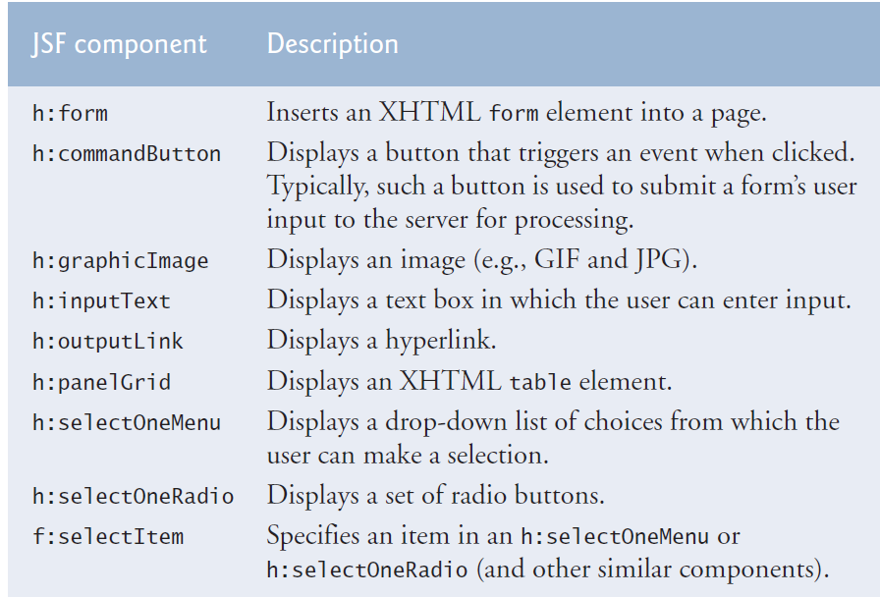
JSF Components

Slide 7
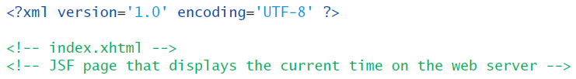
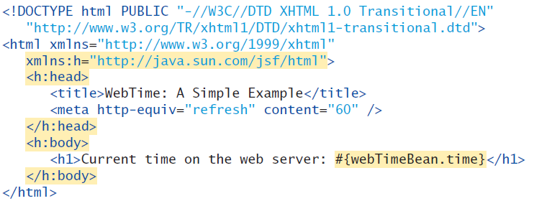
JSF App. 1
index.xhtml (JSF file)

Slide 8
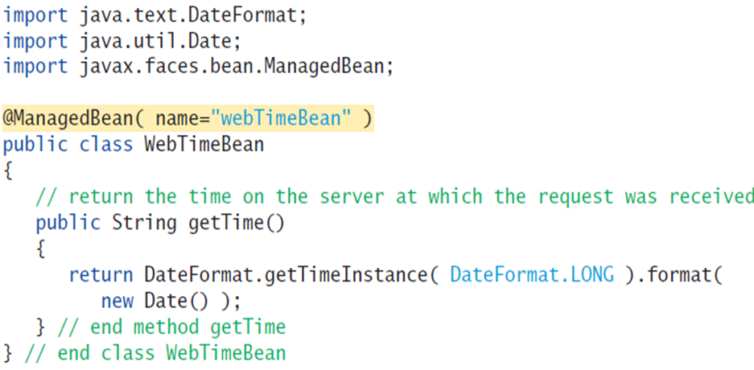
JSF App. 1
WebTimeBean.java (Bean file)

Slide 9
Notes
Web servers generally use 8080 port to receive the requests and send the responses.
Glassfish applicaton server sends the data to the server’s port.
The client browser gets tha data from that port.
Clients do not need to use application server.
Web programmers use application server to develop web pages. If the app. server and the client reside in the same machine, it is localhost

Slide 10
Proje31MartB Project index.xhtml :
<h:panelGrid columns="3"> // create a three column table
<h:outputText value="Name:"/> // 1. column
// 2. column: Define some restrictions for text box. If the user exceeds 30, the validatorMessage is displayed.
<h:inputText id="nameInputText" required="true"
requiredMessage="Please enter your name"
value="#{validationBean.name}"
validatorMessage="Name must be fewer than 30 characters">
<f:validateLength maximum="30" />
</h:inputText>
//3. column: The validatorMessage resides here, but you must say which component this message is for. You will write the components id here like «nameInputText»
<h:message for="nameInputText"/>

Slide 11
Proje31MartB Project index.xhtml :
//2. row, 1. column
<h:outputText value="E-mail:"/>
//2. row, 2. column
<h:inputText id="emailInputText" required="true"
requiredMessage="Please enter a valid e-mail address"
value="#{validationBean.email}"
validatorMessage="Invalid e-mail address format">
<f:validateRegex pattern=
"\w+([-+.']\w+)*@\w+([-.]\w+)*\.\w+([-.]\w+)*" />
</h:inputText>
//2. row, 3. column : If the user does not obey the regex pattern, he/she will see the validatorMessage in the page. You must specify the component id which is «emailInputText» here.
<h:message for="emailInputText" />

Slide 12
Proje31MartB Project index.xhtml :
Even if only one component is not valid, the form can not be submitted. And none of the fields can be assigned with form data. Or we can say, no setter methods will run if the form submission fails.
<h:commandButton value="Submit"/>
// If the form is submitted, setter methods run. escape="false" means you can get html code from java side. Here response method returns some html code in String format. And if you write escape: false, your String is interpreted as an html code.
<h:outputText value="#{validationBean.response()}" escape="false"/>
</h:form>

Slide 13
Proje31MartB Project
ValidationBean.java :
public String response()
{
// This method returns some String in html code format. So you can see online CSS here, a yellow format. Because the setters run accurately, the fields name, email and phone are not null now. So if you call getters they will return you the form data.
if ( name != null && email != null && phone != null ){
return "<p style=\"background-color:yellow;width:200px;" +
"padding:5px\">Name: " + getName() + "<br/>E-Mail: " +
getEmail() + "<br/>Phone: " + getPhone() + "</p>";}
else{
return "";} // request has not yet been made
} // end method getResult

