Slide 1
Members versus Casuals
What’s the difference between the two rider types?
Notes:
Hello everyone. I am here to present to you today the findings we were able to pull from our analysis of the bike log data. Using the logs from April 2021 to April 2020, we were able to find trends that both rider types tend to follow. These trends will help provide further insight into what it will take to convert casual riders into member riders.

Slide 2
Rider Type?
Casual rider – a user who uses our service through an ad hoc or daily basis
Member rider – a user who is subscribed to our service
Member riders generate more $$$
Notes:
Before we look into the data. Let us take the time to define the two rider types. The first rider type is a casual rider. They are those who use our service on a per ride or day pass basis. The second type is a member rider. They are users who are subscribed to our service and can ride the bikes as often as they wish. Why does it matter if a rider is one type or the other? It comes down to the bottom line. Our team has found that member riders generate more revenue and thus profit.

Slide 3
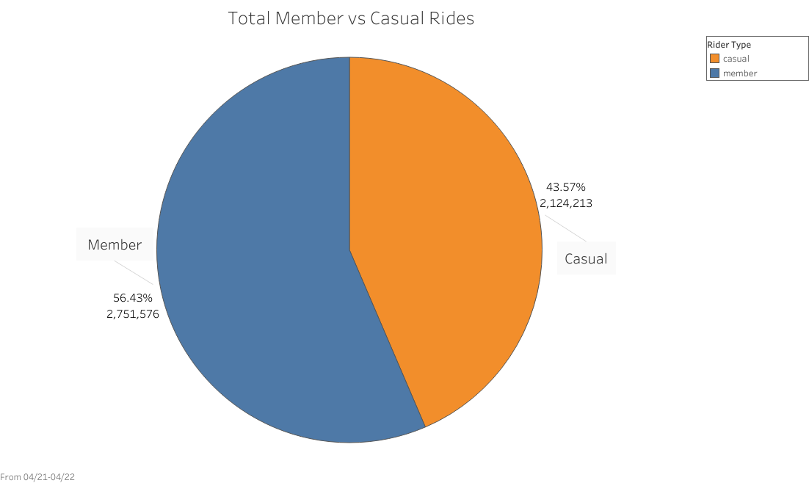
Total Ride Split
Notes:
As you may have been able to guess, member riders make up the larger share of the total number of rides between the two groups. This is likely due to the fact that subscribers face no additional cost to take another ride. Since they see the additional ride as free they will use the service more. Casual riders will have to pay each time they use the service so they are not as likely to take as many rides. This leads us to the next logical question, between the two riders who makes up the majority of time ridden on the bikes?

Slide 4
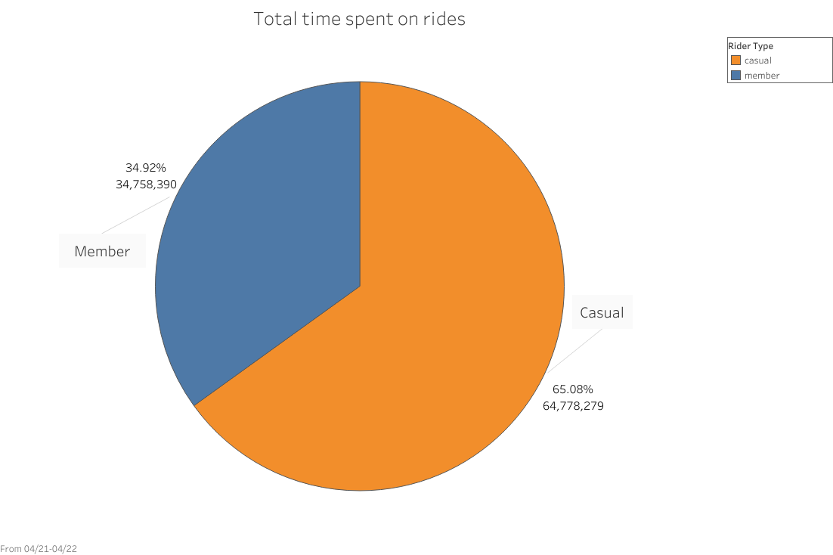
Total Minutes by Rider
Notes:
This is where the first interesting insight comes to surface. Even though total ride split was approximately 56 to 43 percent between members and casual riders, respectively, the total share of time ridden is inversely related and has a much larger split. Member riders take up 35 percent or about 34.7 million minutes rode between April 2021 and April 2022. Casual riders, within the same timeframe, took up about 65 percent of the time ridden or about 64.7 million minutes ridden. So it is safe to conclude that casual riders tend take longer rides than members.

Slide 5
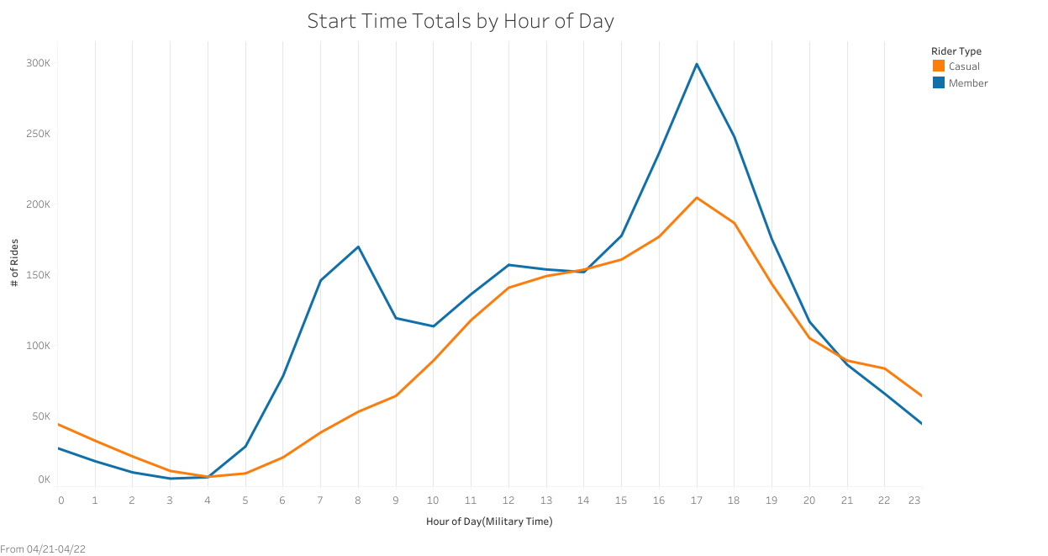
What time do they ride?
Notes:
Let’s take a look at the time of day and see what insights can be found. For member riders there are two notable peaks 8am and 5pm. These are peak traffic times for most major cities which also fits the usual 9 to 5 work schedule. Another small spike in usage comes at 12 which is most people’s lunch break. For casual riders their usage is less affected by the time of the day. This is demonstrated by the smoother line when compared to the member rider’s line which contains but the max and min of the chart. The most popular riding times for casual riders are between noon and 7pm. These tend to be the times when people are outside the house during the day. For both rider types 5pm is by far the most popular time.

Slide 6
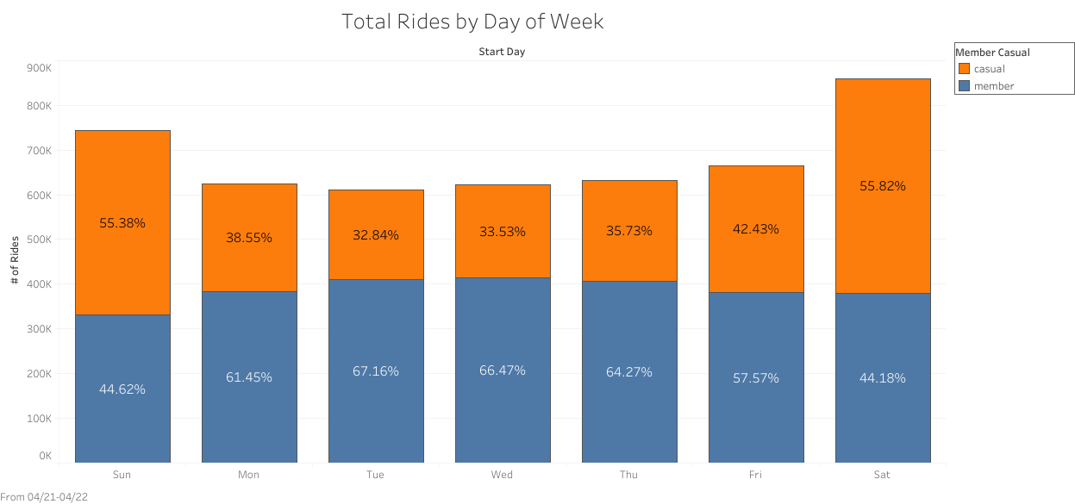
What days do they ride?
Notes:
Now that we’ve shown that what time of the day both rider types prefer to ride and that casual riders take longer rides, let’s see how they ride by day of the week. For this visualization, we complied the total number of rides for each day of the week and then calculated share by percentage between the two rider types. Also to note, the height of the bars represent the total # of rides. Member riders make up the majority of the rides taken during the normal work week that being Monday through Friday. Casual riders make up the majority of the weekend rides with the increased share of their ridership starting on Friday. It appears that casual riders prefer to use our service during their time off of work while members tend to use our service for everyday commuting. Before we make that assumption let’s look at some more data to see if that theory holds any weight.

Slide 7
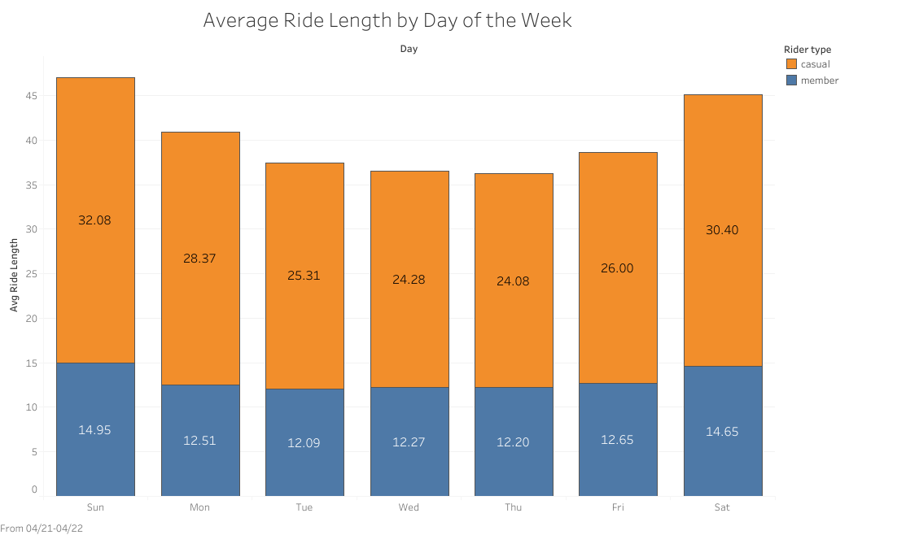
How long do they ride?
Notes:
Taking another look at rides by the day of the week, let see how the average ride length changes throughout the week. As demonstrated earlier by our pie charts, casual riders tend to take longer rides than member riders. When do they like to take their longest rides? Unsurprisingly they prefer to take their longest rides on the weekend with Sunday having the longest average ride length. Throughout the week member ride lengths stay relatively consistent. Thisfurther suggests that member riders tend to use the service for everyday commuting while casual riders prefer leisure rides on the weekend.

Slide 8
What influences someone to ride?
Need to commute
Free time
Fair weather
Notes:
Besides have free time or the need to be somewhere else, what else would influence someone to use our service? Since riding a bicycle is, generally speaking, an outdoor activity the next logical influence would be good weather. Most would assume that weather may have the biggest influence out of all three factors mentioned. If the weather is bad, no matter how badly you need to get somewhere or want to ride a bike an alternative would be strongly considered. Let’s take a look at the temperature patterns of the Chicago area and see if that has an influence on ridership.

Slide 9
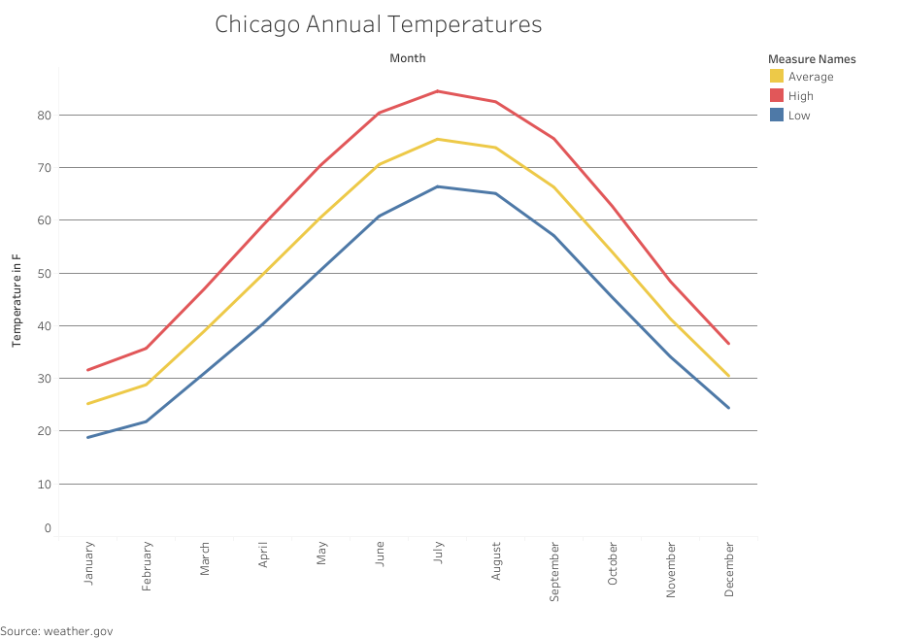
Annual Chicago Temperature Patterns
Notes:
We took a look at the high low and average temperature of Chicago from weather.gov to see if there would be any correlation between the weather and usage of our service. Generally speaking most people would prefer the weather to be warm to cool for a bike ride. This would be a range from about 60 to 70 degrees. This chart is organized by Month so let look at the ride data by month.

Slide 10
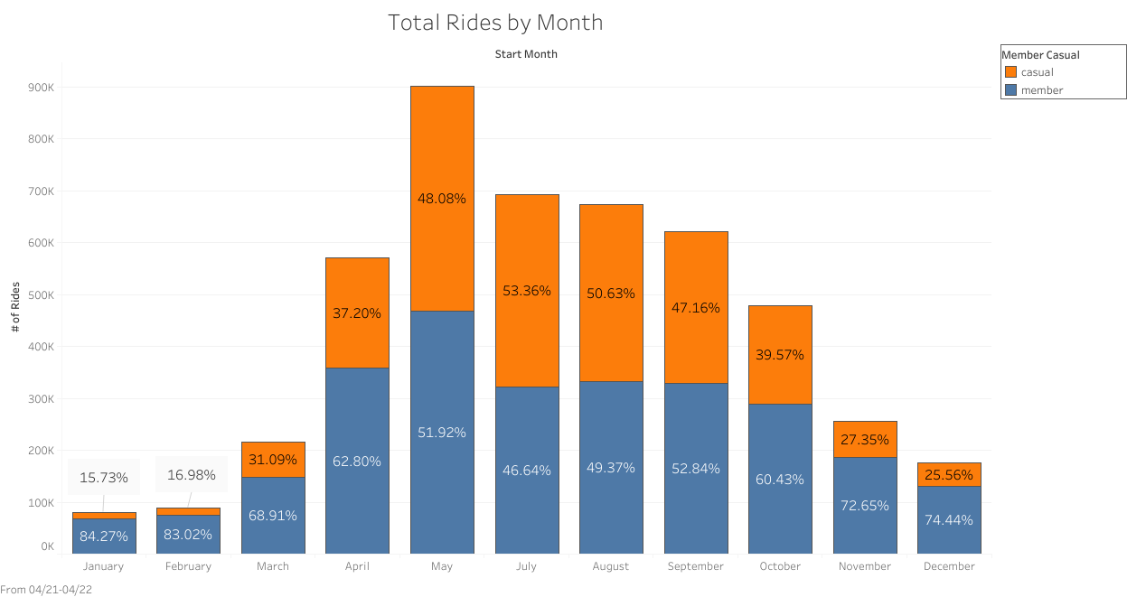
When do they ride by Month?
Notes:
We followed the same format here as we did for the total rides by day chart. We complied the total rides by rider type for each month then calculated the percentage difference. Generally speaking the ridership follows the same pattern as the temperature with May being the outlier. During the coldest months of December through February the lowest amount of rides are being taken. Conversely, during the fairest weathered months May through September the largest amount of rides are being taken. When looking at the data comparatively between the two rider types, casual riders show their highest presence during these fair weathered months as well. We have now seen how weather affects whether or not a person would like to use our service but how does that affect the length of ride?

Slide 11
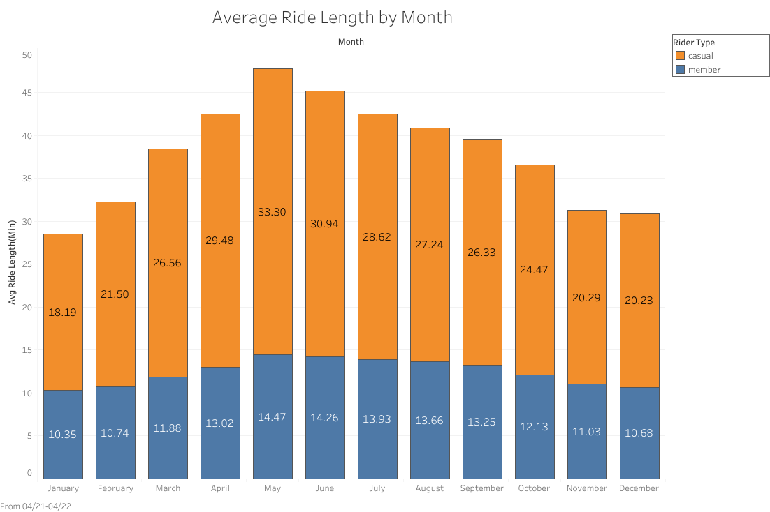
How long do they ride by Month?
Notes:
The correlation between outside temperature and rider behavior is even stronger when you look at average ride length. Following the footsteps of was mentioned earlier, both rider types prefer to take longer rides during fairer weather. This visualization as you can see more closely follows the Chicago temperature patterns of the year which suggests how long a person stays on a bike is more closely correlated to the temperature outside. Reflecting what was found on the previous chart, casual riders show a greater sensitivity to the temperature outside than member riders. For some users riding a bike is a necessity such as the case of a daily commute but for those going for a leisurely stroll, weather will have a larger impact. This is what we found to be the main difference between the two rider types. To further establish this, let’s take a look at where the two rider types prefer to ride.

Slide 12
Most Popular Casual Rider Stations
Start Station Name | # of Rides
Streeter Dr & Grand Ave | 70906
Millennium Park | 34290
Michigan Ave & Oak St | 29819
Shedd Aquarium | 23963
Theater on the Lake | 21284
Lake Shore Dr & Monroe St | 21099
Wells St & Concord Ln | 19598
Lake Shore Dr & North Blvd | 17851
Clark St & Lincoln Ave | 17212
Indiana Ave & Roosevelt Rd | 16582
End Station Name | # of Rides
Streeter Dr & Grand Ave | 74490
Millennium Park | 35946
Michigan Ave & Oak St | 31590
Theater on the Lake | 22879
Shedd Aquarium | 22583
Lake Shore Dr & North Blvd | 21442
Lake Shore Dr & Monroe St | 19897
Wells St & Concord Ln | 19324
Wabash Ave & Grand Ave | 17841
Clark St & Lincoln Ave | 17319
Notes:
The station locations that are most popular with casual riders are also those with destinations of leisure activities. Streeter Dr and Grand Ave dominate both the start and end stations for casual riders. This station is located on Lake Michigan’s shoreline and is home to parks, a beach area, and piers. Second comes Millennium Park which is home to Chicago’s famous Cloud Gate sculpture. Third is Michigan Ave & Oak St which is also on Lake Michigan’s shoreline and is home to a beach and a park. The fourth and fifth ranked stations are Shedd Aquarium and Theater on the Lake. It is worth noting that the top 5 start and stop stations are all along Lake Michigan.

Slide 13
Most Popular Member Rider Stations
Start Station Name | # of Rides
Kingsbury St & Kinzie St | 25938
Clark St & Elm St | 25731
Wells St & Concord Ln | 24489
Wells St & Elm St | 21813
Dearborn St & Erie St | 19648
Wells St & Huron St | 19265
St. Clair St & Erie St | 19174
Clinton St & Madison St | 19004
Wabash Ave & Grand Ave | 17878
Clinton St & Washington Blvd | 17733
End Station Name | # of Rides
Kingsbury St & Kinzie St | 25909
Clark St & Elm St | 25623
Wells St & Concord Ln | 25067
Wells St & Elm St | 22309
Dearborn St & Erie St | 20223
Clinton St & Madison St | 19632
Wells St & Huron St | 19153
St. Clair St & Erie St | 19143
Clinton St & Washington Blvd | 18317
Broadway & Barry Ave | 18296
Notes:
The stations most popular with casual riders are more centrally located within the Chicago area. The total rides for each station are also more evenly distributed. These stations are located more inland and closer to downtown. The most notable trend for the stations popular with members are that they are located close to metro stations. The most popular station, Kingsbury & Kinzie St is centrally located in the downtown area close by some of the city’s largest buildings. The second ranked station is in the neighborhood of the casual rider’s third most popular station but in close proximity of nine metro stations. The third most popular bike station is in between Sedgwick Metro station and Oak Park. What does this tell us? It suggests that member riders tend use the service more often for quick intercity trips and metro connections or in other words commuting purposes.

Slide 14
In Summary
Casual Riders
Prefer to ride in fair weather
Weekend Rides
Longer Rides
Leisure
Member Riders
Ride in less regard to weather
Everyday Rides
Shorter Rides
Commute
Notes:
As demonstrated by our data findings here are the main difference we found between the two rider types. Casual riders use our service for leisure rides. This was determined by their higher sensitivity to the outside temperature, their longer ride patterns, and their preference for the weekend. Although these variable were present in the member rider’s patterns they had a smaller effect. Member riders riding patterns are more consistent and are less effected by poorer weather and the weekend vs weekday rides. Their shorter rides suggest they are using the service as a transportation utility rather than source of leisure.

Slide 15
How to convert Casual riders to Members?
Emphasize the personal health benefits of using a bike for commutes.
Membership is cheaper and more convenient that other modes of transport.
Riding a bike is better for the environment vs cars, trains, buses etc.
Notes:
Here are our marketing suggestions for converting casual riders to members. We will need to convince casual riders to use our service for everyday commuting thus creating a need to becoming annual members. Our top 3 selling points are: riding bikes are better for your health, better than alternatives, and is better for the environment. Why use our service instead of just buying a bike? We will cover maintenance and storage of the bikes. You can just pick the bike of your liking and go!

