Slide 3
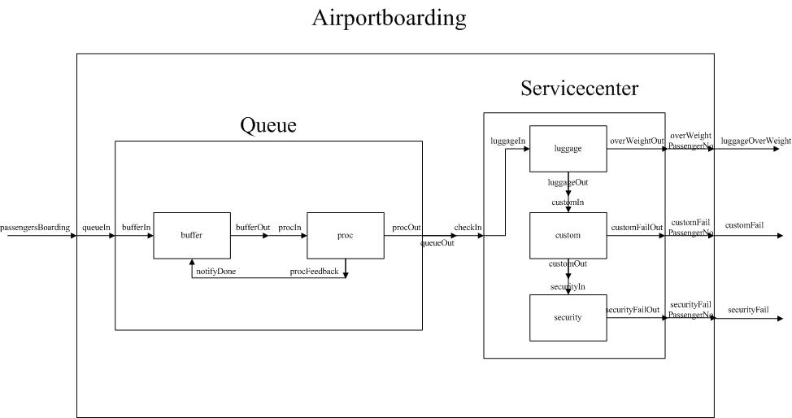

Slide 4
15
ABP Simulator
16
controlIn
sender
Network
19
receiver
dataOut
in1
subnet1
out1
in
ackReceived
18
17
packetSent
ackIn
out2
subnet2
in2
out

Slide 5
Ambulance Dispatch
CALL HANDLER
LOCATION
CALL INFO
Location
PRIORITY
CALL QUEUE
Priority
DISPATCH
CALL IN
CALL QUEUE
CALL OUT
Ambulance
CALL LENGTH
RESPONSE
Response
Figure 1 Ambulance Dispatch Flowchart

Slide 6
23
26
22
24
25

Slide 7
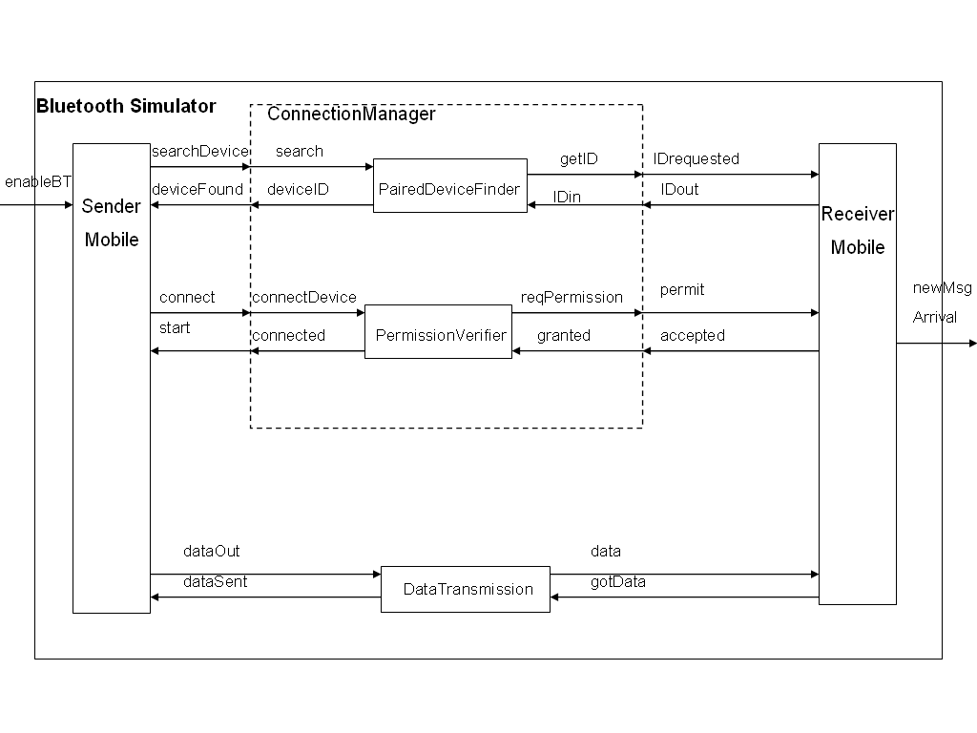
27
28
30
33
32
31
29

Slide 8
40
Robot
Event File
35
Generator
out
out
out
in:
{X, Y, D}
37
Path Generator
Chalk Engager
Queue
Planner
out
34
39
out
in
in
in
38
engaged
engaged
in
nextPosition
done
ready
done
Motor 1
Translator
in
36
out
in: next(ΔX, ΔY)
motorOut1
motorOut1
42
motorOut2
motorOut2
Motor 2
out
done
in
out
done

Slide 9
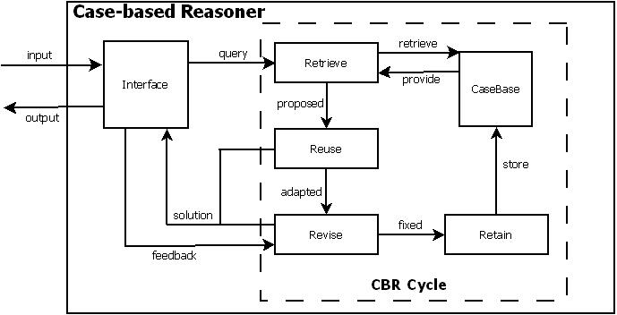
44
48
46
43
49
50
47
45

Slide 10
51
City Water Supply System
53
Pump Station
Water Supply - Wells
Pumps
Buffer Tank
55
52
54

Slide 11
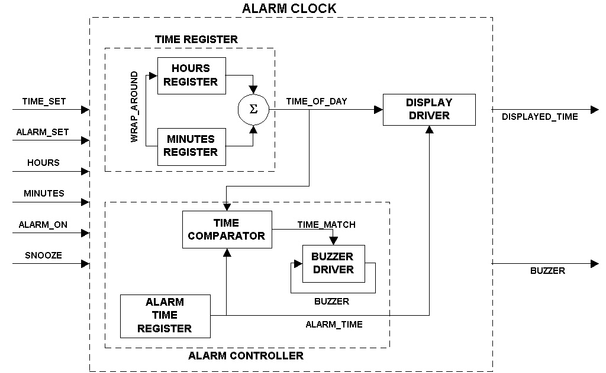
56
58
60
61
59
62
57

Slide 12
Top-garageDoor
68
input_code
66
DoorController
CodeCont
increm
Counter
DoorTimer
open_requeste
65
door_open
64
67
emerg_open
validCode
unauth_attempt
alarm_reset
emerg
AlarmGen
minor_alarm
63
major_alarm
LightIn
69
inlon
motion
LightOut
outlon
light
70

Slide 13
72
GSM Authentication Simulator
Mobile Network
73
SIM Card
Id
On
MaxValidId
AC
71
RAND
75
SRES_1
74
SRES_2
OK
MSC

Slide 14
Top-hospitalLaundry-76
All right = 77
79&80 = 78
79
80

Slide 15
83 & 84
Troom
Outdoor Temperature Generator
86
Thermostat
Transducer
Indoor Temperature Sensor
Report
Tout
Heat Losses
87
85
Troom
Troom
House Heating
Unit
Controller
82
Heat Gain
81
HeaterCntrSignal

Slide 16
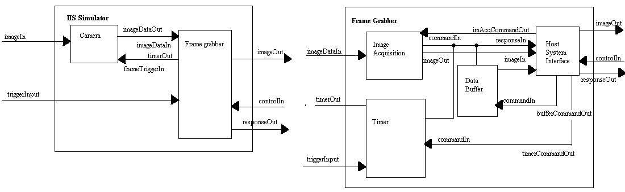
91
92
89
&90
91
93
88
94

Slide 17
100
98
95
96
99
97

Slide 18
105
107
102
106
111
110
101
109
108
103
104

Slide 19
News event
out
in
Editor
out in
Photo
Grapher
out in
Chef
Editor
out in
out
Text Journalist
Makeup
Printer
Top: 112
114
115

Slide 20
120
119
124 = 126+125
126
125
117
118
118
116
121
122
123
123

Slide 21
Create_Module
Capture
Created
Capture
Created
Create Commandd
Create_Capture
Create Command
Filter Go
Filter Done
Create_Filter
Filter Code
Filter Code
top129
no internal 127
128

Slide 22
135
136
Bayview Generator
Bayview Queue
134
O-Train Model
Carleton passengers
Carling Generator
Carling Queue
133
137
Bayview passengers
Station Arrival
Confederation passengers
Carling passengers
Carleton Generator
Carleton Queue
Greenboro passengers
Confederation Generator
Confederation Queue
Greenboro Generator
Greenboro Queue

Slide 23
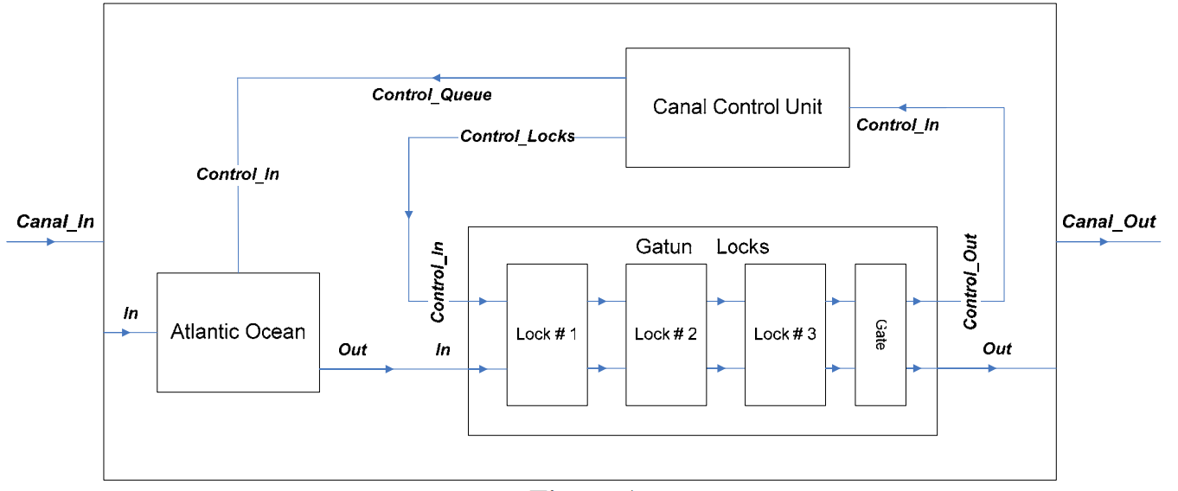
142
138
140&141
139
143

Slide 24
150
Raw material
In
Top
Production line model
Control model
Stank
149
Computer
Count
145&146
StoretankControl
in
done
StoreTank
151
StoretankEmpty
MixtankTemp
Start
MixTank
MixtankControl
147
MixtankEmpty
Start
MouldTank
MouldtankTemp
148
MouldtankEmpty
Out

Slide 25
155
SecureAreaAccessSystem
156
SystemAdmin
PinPrompt_In
Display
AlarmAdmin
1 – Arm
2 – Disarm
Admin_Out
Pin_Prompt
Arm_In
ArmReq_In
154
152
Alarm_Status1
AlarmStatus_Out
AlarmStatus_In
Disarm_In
DisarmReq_In
Arm
Error *
AlarmPin_Ok
Alarm_Status2
Alarm_Req
Msg_Out
Msg
Disarm
* Error_Out
Error _In
PIN
Authentication
- stores PINs
Error *
153
PIN_In
Pin_In
DoorPin_Ok
DoorOk_Out
DoorOk_In

Slide 26
Top 158
159
157
Soccer_Game_System
Ball_In_Play
Special_Cases
Kick_Off
ScoreHome
Corner_Kick
ScoreVisitor
Penalty_Kick
Play_Game
Period
Goal_Kick
Ball_Out_Of_Play
Referee (Player, Team events)

Slide 27
Switching Simulator
Source
163
Switch node
done swicthOut1
in
switchOut2
Sink1
Out1-sinkIn
packetsReceived1
161
Buffer
Switch
160
packetTotal
packetOut - In
out - switchIn
162
Sink2
gateWay
packetsReceived2
Out2-sinkIn
gateWay

Slide 28
TANK
172
LOADER
169
Sfin
164
Sin
Safety Loader
out
Ammu_in
Ain
Ain
Barrel
Amm_out
Ammu_out
171
Ammu_out
Safety_in
Sin
Fin
Fin
165
GUNNER
168
Elec_in
Ecin
in
Electric Fire
out
170
Ecin
167
Manu_in
Min
in
Manual Fire
out
Min
Fire
out
Emin
166
Emerg_in
Emin
in
Emergency Fire
out

Slide 29
Technical Support Financial Dept
177
Financial Q Control
174
176
Release Next
Financial Manager
Problem
Problem
Coverage Plan Manager
Plan OK
173
Done
Call in
Call in
Financial Queue
Result
175
Request
In
178
Validation

Slide 30
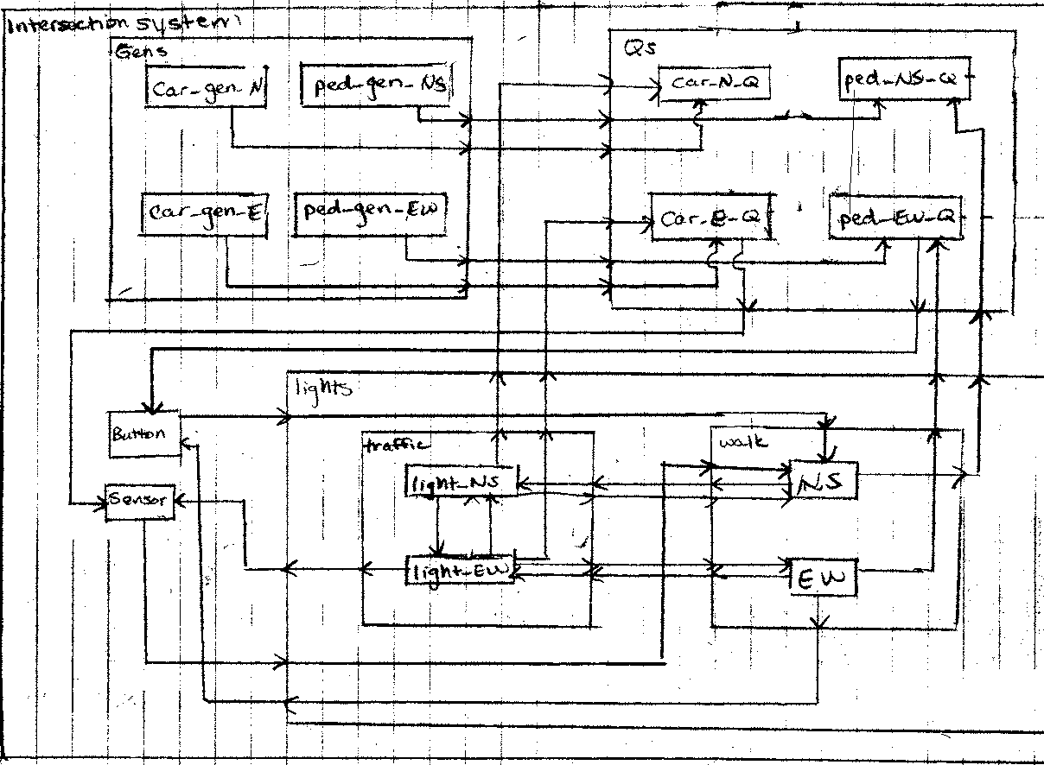
183
179
181
184
180
182
185

Slide 31
194
& 195
196
187
190
188
189
186
193

Slide 32
199
202
201
200
205
198
210
200
208
199
211
199
197

Slide 33
217
Gen
213
go
arriveload
214
loaddone
Q1
215
readygoload
readyaccept
S1
216
exitload
arriveunload
unloaddone
Q2
219
readygounload
218
readyreceive
S2
220
exitunload

Slide 34
Top:224
222
223
221
225
226

