Slide 1
Group One
Jerry 98765432

Slide 2
Suarez Home
1) Ignacio: I think there's a Knicks game on. Constance. Do we have an appointment today?
Constance: Oh, this isn't business. You were just so sweet the other night, getting my mind off Toussaint. By the way, here's his chocolates.
Ignacio: There's three left.
Constance: I don't like nuts. But I thought I'd make you a little gumbo as a thank you.

Slide 3
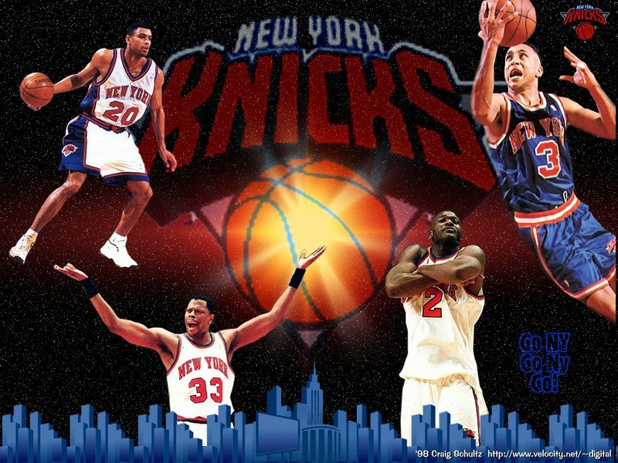
Basketball team
Knicks

Slide 4
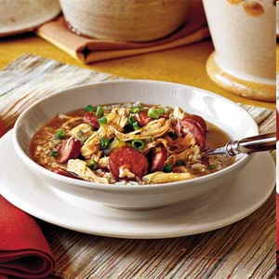
Gumbo
Soup

Slide 5
Q What does Constance make Ignacio as a thank you?
Ignacio: I think there's a Knicks game on. Constance. Do we have an appointment today?
Constance: Oh, this isn't business. You were just so sweet the other night, getting my mind off Toussaint. By the way, here's his chocolates.
Ignacio: There's three left.
Constance: I don't like nuts. But I thought I'd make you a little gumbo as a thank you.

Slide 6
Q: What does Constance make Ignacio as a thank you?
A: She makes him a little gumbo as a thank you.

