Slide 1
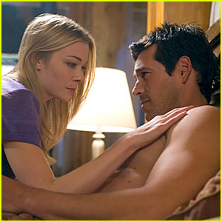
Affair

Slide 2
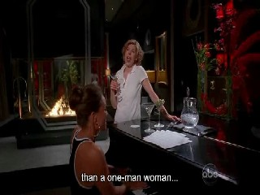
Wilhelmina's apartment

Slide 3
Q: How close were Cal and Claire?

Slide 4
Victoria: Unfortunately, Cal and Claire got a little too close.
Wilhelmina: Oh, you poor thing. There was an affair?
Victoria: Worse. There was a baby.

Slide 5
Q: How close were Cal and Claire?

Slide 6
A: There was a baby

