Slide 1
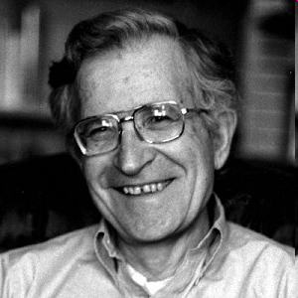
Noam Chomsky

Slide 2
Chomsky argues that the behaviorist theory fails to recognize what has come to be called
‘the logical problem of language acquisition’.

Slide 3
This logical problem refers to the fact that children come to know more about the structure of their language than they could reasonably be expected to learn on the basis of the samples of language which they hear.

Slide 4
Instead he claims that children are born with a special ability to discover for themselves the underlying rules of a language system.
Language Acquisition Device (LA D).

Slide 5
Chomsky and his followers no longer use the term LAD, but refer to the child’s innate endowment as Universal Grammar (UG ).
UG is considered to consist of a set of principles which are common to all languages.

Slide 6
Children seem to develop language in similar ways and on a similar schedule, in a way not very different from the way all children learn to walk.

Slide 7
Chomsky's innatist position:
1 Virtually all children successfully learn their native language at a time in life when they would not be expected to learn anything else so complicated.

Slide 8
2 Children successfully master the basic structure of their native language or dialect in a variety of conditions:
(caring, attentive parents who focus on the child's language) vs
(abusive or rejecting parents).

Slide 9
3 The language children are exposed to does not contain examples of all the information which they eventually know.

Slide 10
4 Animals—even primates receiving intensive training from humans. cannot learn to manipulate a symbol system as complicated as the natural language of a three- or four-year-old human child.

Slide 11
5 Children seem to accomplish the complex task of language acquisition without having someone consistently point out to them which of the sentences they hear and produce are ‘correct’ and which are ‘ungrammatical’.

