Slide 1
Natural experiments: deaf signers

Slide 2
Elissa Newport (1990) studied deaf users of American Sign Language
who acquired it as their first language at different ages.

Slide 3
Only ﬁve to ten per cent of the profoundly deaf are born to deaf parents
- exposed to ASL from birth.
The remainder of the profoundly deaf population
-begin learning ASL at different ages

Slide 4
Is there any difference between
Native signers - birth
Early learners - school (4-6)
Late learners - after 12
ability to produce and
comprehend grammatical structures?

Slide 5
ASL makes use of grammatical markers
(like -ed and –ing in English)
markers are indicated through speciﬁc hand movements.

Slide 6

Jonathan Coulton - The Future Soon
Stephen Torrence

Slide 7
Last week I left a note on Laura's desk
LAST WEEK, LAURA DESK NOTE (PLACE-THERE)
Song lyrics – Upper Lower case
ASL WORDS – UPPER CASE

Slide 8
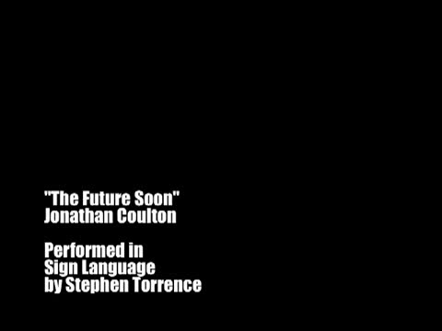

Slide 9
Is there any difference between
Native signers - birth
Early learners - school (4-6)
Late learners - after 12
ability to produce and
comprehend grammatical structures?

Slide 10
Results
Word order:
No difference between the groups.
Grammatical markers:
Native group > Early learner group > Late learner group

Slide 11
Native signers were highly consistent in their use of the grammatical forms.
Other two groups used many of the same forms as the Native group, they also used forms which were considered ungrammatical by the Native signers.

Slide 12
The researchers conclude that their study supports the hypothesis
that there is a critical period for ﬁrst language acquisition.

