Slide 1
FOXP2

Slide 2
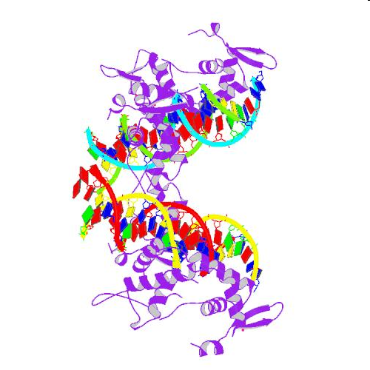
FOXP2 (“forkhead box P2″) gene

Slide 3
development of language skills

Slide 4
"this is a gene associated with language, not the gene,"

Slide 5
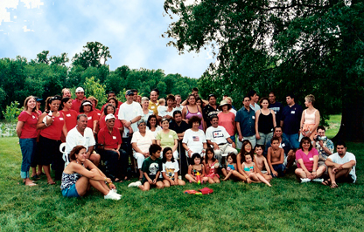
identified through studies of a large family
"KE."

Slide 6
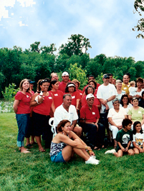
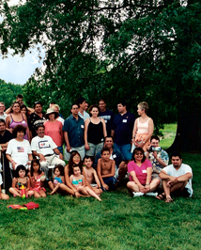
half the members

Slide 7

unable to select and produce the fine movements with the tongue and lips that are necessary to speak clearly.

Slide 8
unintelligible to others without disorder

Slide 9

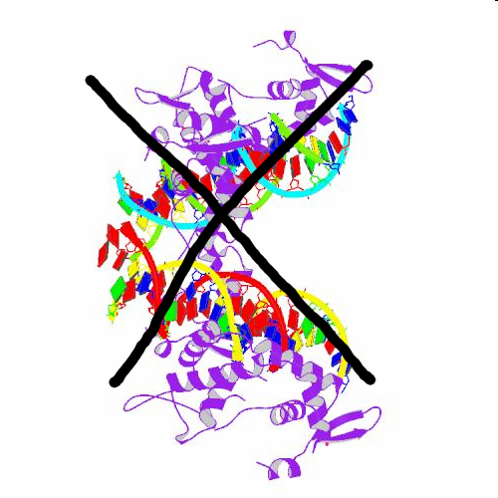
2 functional copies

Slide 10
Those members of the family also have
difficulty in reading
poor spelling and grammar

Slide 11
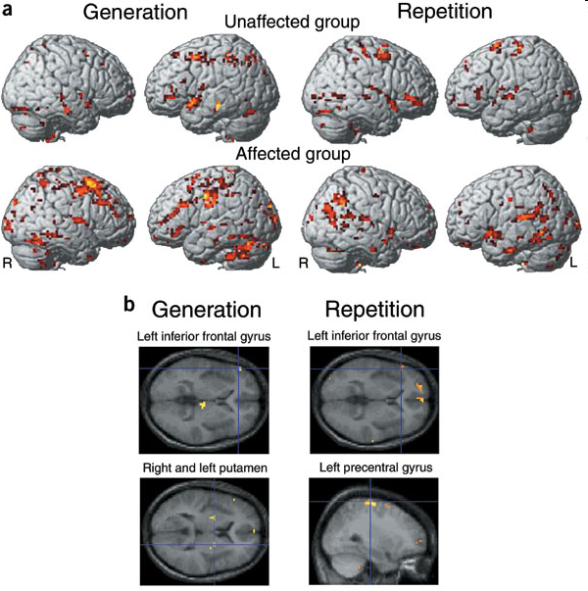
Brain imaging of the KE family

Slide 12
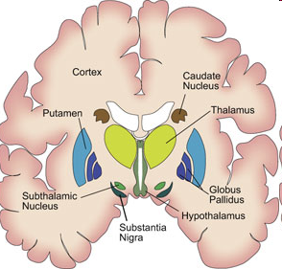
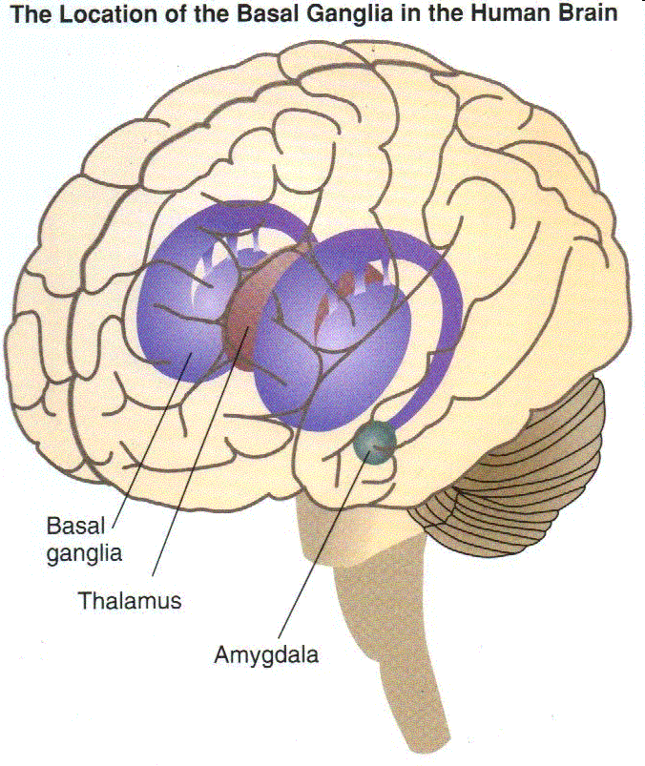
abnormal basal ganglia—a region in the brain involved with movement—which could explain difficulty in moving the lips and tongue.

Slide 13
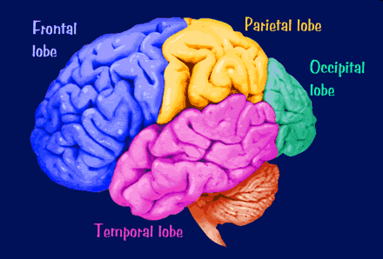
Regions of the cortex involved in speech and language also appear abnormal.

Slide 14
human FOXP2 differs from chimp FOXP2 by only 2 amino acids, mouse FOXP2 by only 3 amino acids, and zebra finch FOXP2 by only 7 amino acids

Slide 15
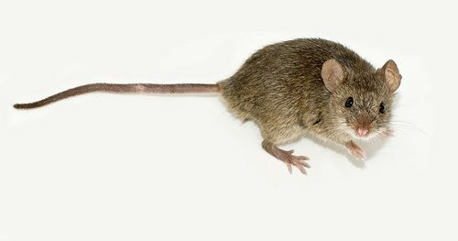
Humanizing mice FOXP2

Slide 16
Enard tweaked the mouse Foxp2 so that it produced a protein with the two human-specific amino acids.

Slide 17


Slide 18
Humanized Impaired (1 copy)

Slide 19
“Humanized mice”
Healthy mice, with the only apparent effects showing up in the brain.
more nerve cells with more complex dendrites in their basal ganglia, an area known to be important for human language.
The vocalizations of baby mice were slightly lower in pitch among mice with the human gene.
showed decreased exploratory behavior and lower concentrations of dopamine in the brain.

Slide 20
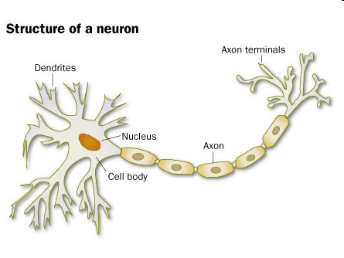
Dendrites are the sensing, or listening part of the neuron

Slide 21
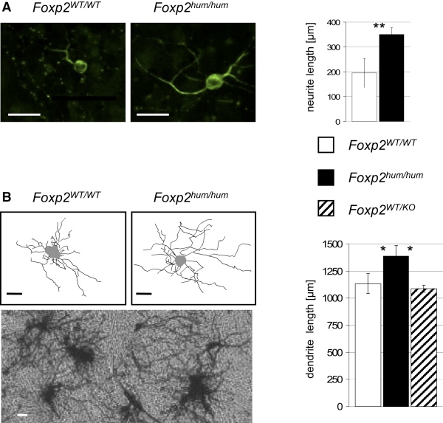

Slide 22
vital for learning and long-term memory

