Slide 1
Ophelia
Pregnant?

Slide 2
After telling Polonius that he is a fishmonger, Hamlet asks him if he has a daughter- then tells him ...
“Let her not walk i' th' sun. Conception is a blessing, but, as your daughter may conceive—Friend, look to ’t. “
Never let her walk in public. Procreation is a good thing, but if your daughter gets pregnant … look out, friend.

Slide 3
What is the sin?
How does Hamlet know?
“Nymph, in thy orisons Be all my sins remembered!”
“Get thee to a nunnery.
Why, wouldst thou be a breeder of sinners?“
Pretty lady, please remember my sins when you pray.
Get yourself to a convent, at once.
Why would you want to give birth to more sinners?

Slide 4
Flowers
Sorrow, repentance
Rosemary
Pansies
Fennel
Columbine
Rue
Daisies
Violets

Slide 5
Rue is a mild poison
Wasn’t used for suicide (unpleasant),
Could be used to reject the embryo (abortion)
"...there's rue for you, and here's some for me; we may call it herb of grace o'Sundays; O, you must wear your rue with a difference."
We can call it the merciful Sunday flower.
You should wear it for a different reason.

Slide 6
Branagh’s Hamlet depicts Ophelia as not an “innocent child”
"'Tis told me, he hath very oft of late
Given private time to you, and you yourself
Have of your audience been most free and bounteous."
I’ve heard Hamlet’s been spending a lot of time alone with you recently, and you’ve made yourself quite available to him.

Slide 7
Ophelia sings not just about her dead father
“Tomorrow is St. Valentine's day All in the morning betime
And I a maid at your window
To be your Valentine.
Then up he rose and donn'd his clothes and dupp'd the chamber door;
Let in the maid, that out a maid
Never departed more. “
Tomorrow is St. Valentine’s Day and
early in the morning
I’m a girl below your window waiting to be your Valentine.
Then he got up and put on his clothes And opened the door to his room.
He let in the girl, and when she left She
wasn’t a girl anymore.

Slide 8
More singing
Quoth she, "Before you tumbled me,
You promis'd me to wed."
He answers:
"So would I ha'done, by yonder sun,
An thou hadst not come to my bed."
She said, “Before you got me into bed,
You promised to marry me.”
He answers:
“I would have married you, I swear, If you hadn’t gone to bed with me.”

Slide 9
What can a girl do?
Her lover rejects her
Her lover goes mad
Her father is murdered
She is pregnant
She goes mad
Her life is ruined and she has no future

Slide 10
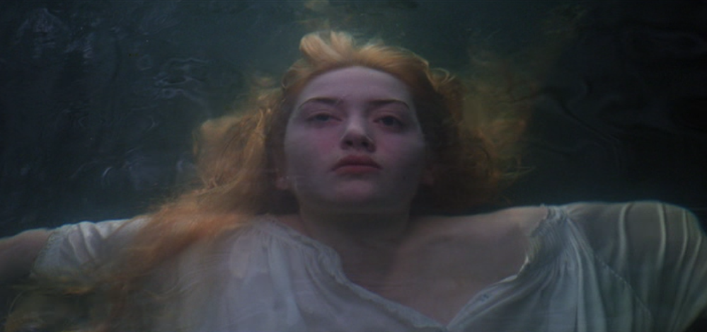
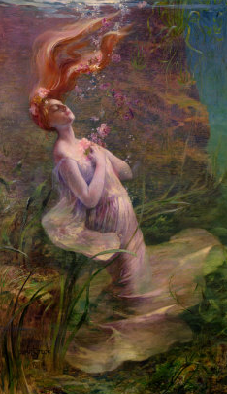
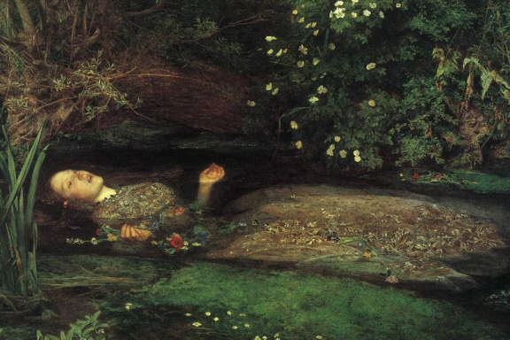

Slide 11
Although Shakespeare doesn’t say it clearly
He hints that Ophelia may have been pregnant

