Slide 1
Word order

Slide 2
I ate the sandwich..

Slide 3
I the sandwich ate.

Slide 4
Ate the sandwich I.

Slide 5
Ate I the sandwich.

Slide 6
The sandwich I ate.

Slide 7
The sandwich ate I.

Slide 8
I ate the sandwich.
I the sandwich ate.
Ate the sandwich I.
Ate I the sandwich.
The sandwich I ate.
The sandwich ate I.

Slide 9
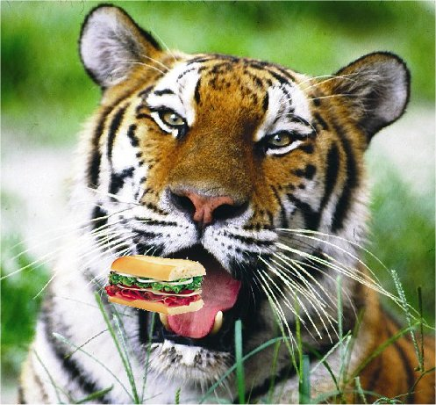
The sandwich ate I.

Slide 10
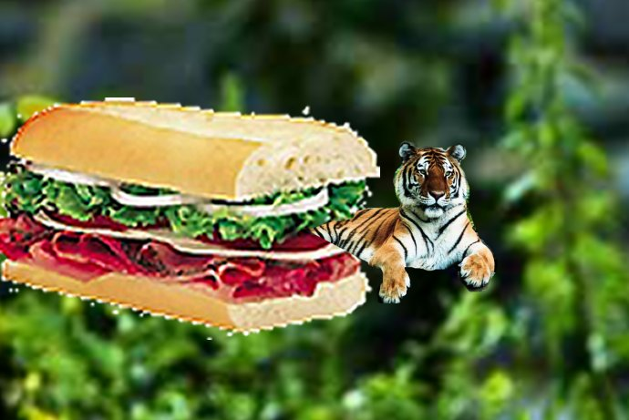
The sandwich ate me.

