Slide 1

Project Title -Seasonal Agriculture Performance Analysis
NAME- Sakshi Sinha
COLLEGE NAME- University Institute of Technology , RGPV
AICTE ID - STU67dcd471933c21742525553

Slide 2

PROBLEM STATEMENT
Agricultural activities are influenced by seasonal variations in environmental conditions, farming practices, resource availability and market conditions. As a result, agricultural performance may differ from one season to another. However, raw agricultural data does not clearly explain how agricultural performance changes across seasons or what patterns can be observed in different seasonal conditions. The problem is to analyze the given agricultural dataset and investigate seasonal differences in agricultural performance by identifying meaningful patterns, trends, relationships and variations within the available data.

Slide 3
Project Description Seasonal Agriculture Performance Analysis is a data analysis project designed to evaluate and understand agricultural performance across different seasons, crops, regions, and years. The project uses historical agricultural data such as crop production, cultivated area, yield, rainfall, temperature, and other relevant factors to identify patterns and trends in agricultural productivity. The analysis focuses on comparing crop performance across Kharif, Rabi, and other agricultural seasons, identifying high- and low-performing crops, and examining how climatic and regional factors influence production and yield. Data visualization techniques such as bar charts, line graphs, heatmaps, and interactive dashboards can be used to present the findings clearly.

Slide 4

WHO ARE THE END USERS?
The main end users of this project can be:
Farmers – To understand which crops perform better in different seasons and regions and make informed crop-selection decisions.
Agricultural Officers – To monitor crop performance and identify areas that require support or intervention.
Government & Policymakers – To use agricultural trends for planning subsidies, irrigation programs, crop insurance, and agricultural policies.
Agricultural Researchers – To study seasonal patterns, crop productivity, and factors affecting agricultural performance.
Agribusiness Companies – To analyze production trends and support decisions related to procurement, supply chains, and market planning.
Agricultural Consultants – To provide data-driven recommendations on crop selection and seasonal farming strategies.
Students & Data Analysts – To study agricultural datasets, trends, correlations, and data visualization techniques.
NGOs & Rural Development Organizations – To identify regions or farming communities that may need agricultural assistance.

Slide 5

Technology Used
The project can be developed using the following technologies:
Python – For data cleaning, processing, statistical analysis, and predictive analysis.
Pandas – For handling and analyzing agricultural datasets.
NumPy – For numerical calculations and data manipulation.
Matplotlib & Seaborn – For creating graphs, charts, and visualizations....
Jupyter Notebook – For data exploration, analysis, and documentation.
Excel / CSV – For collecting, importing, and initially organizing agricultural datasets

Slide 6
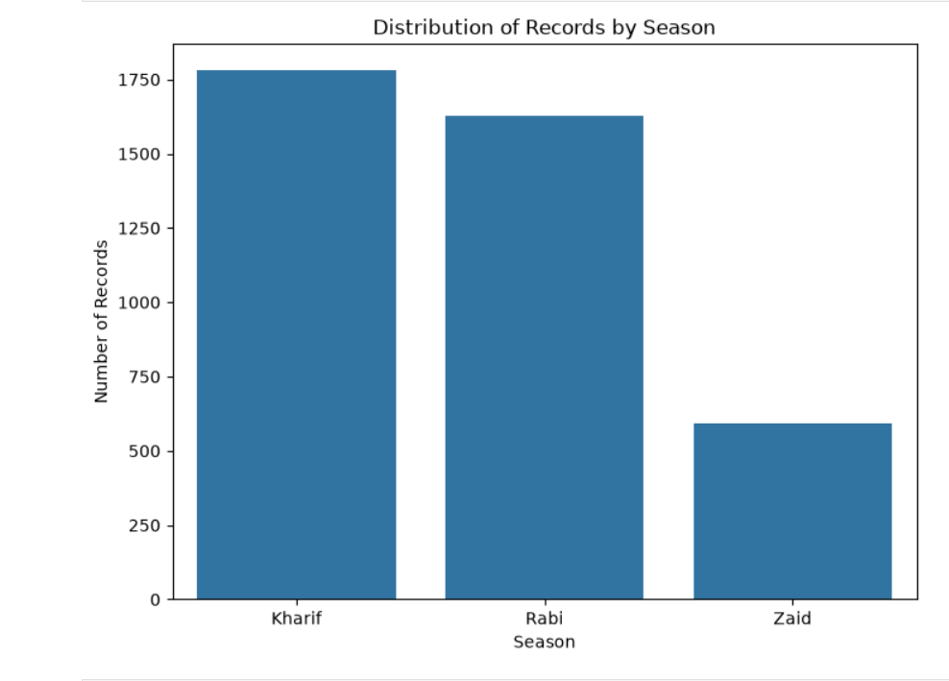
RESULTS

Slide 7
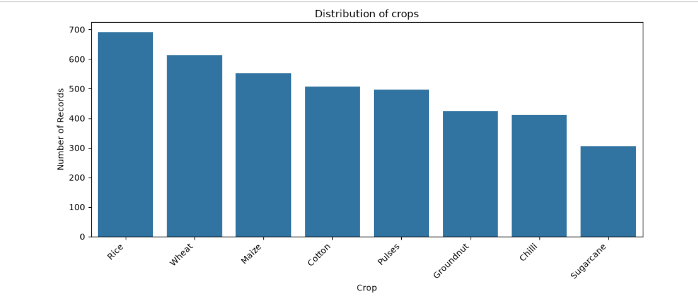
RESULTS

Slide 8
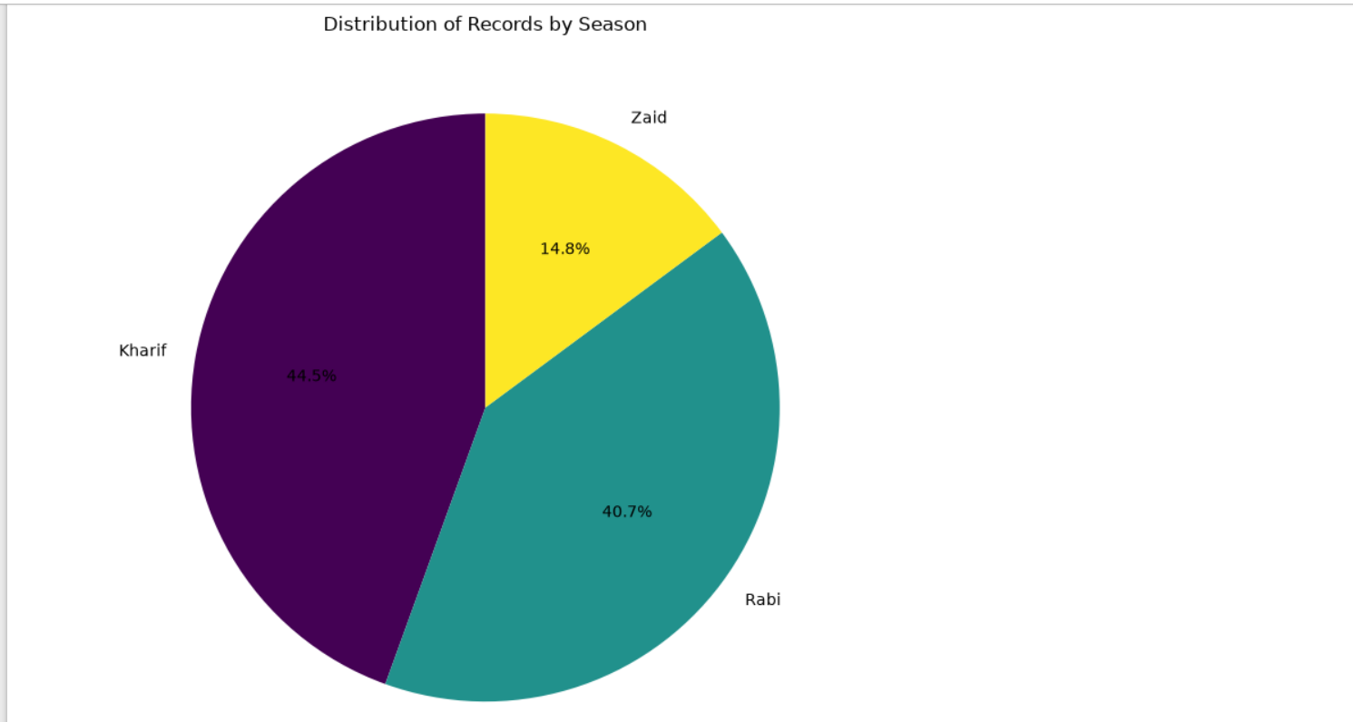
RESULTS

Slide 9
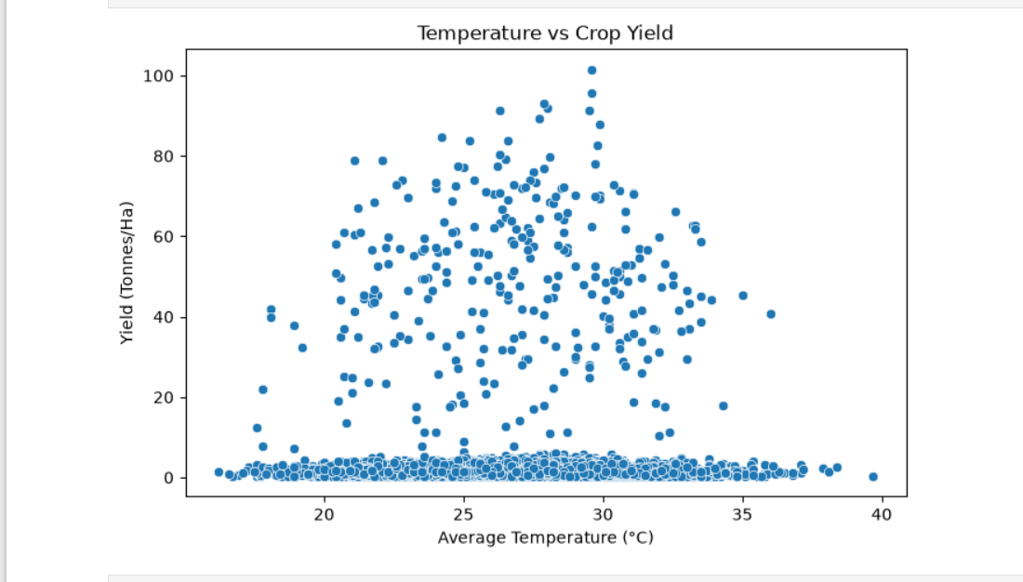
RESULTS

Slide 10
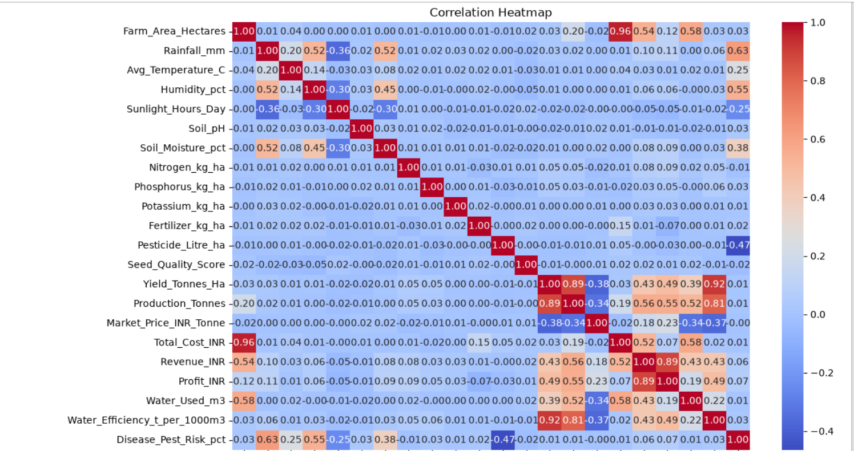
RESULTS

Slide 11
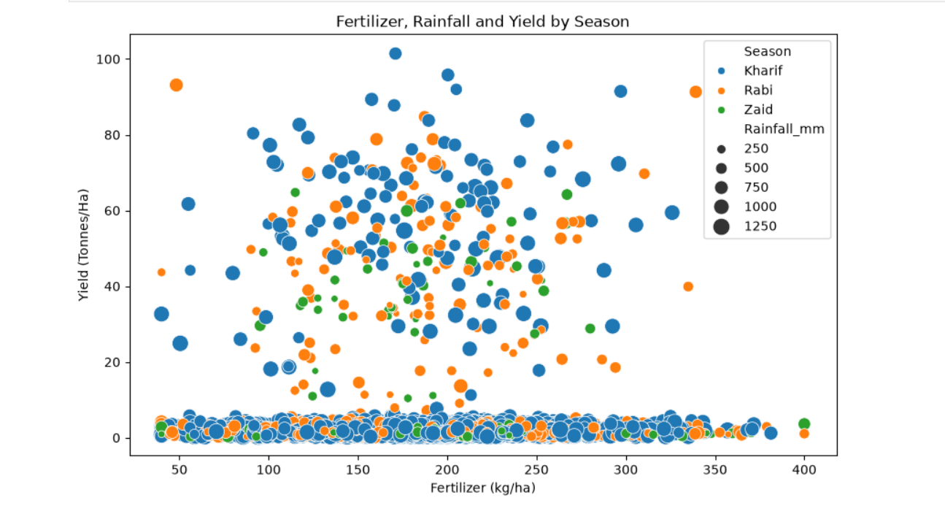
RESULTS

Slide 12
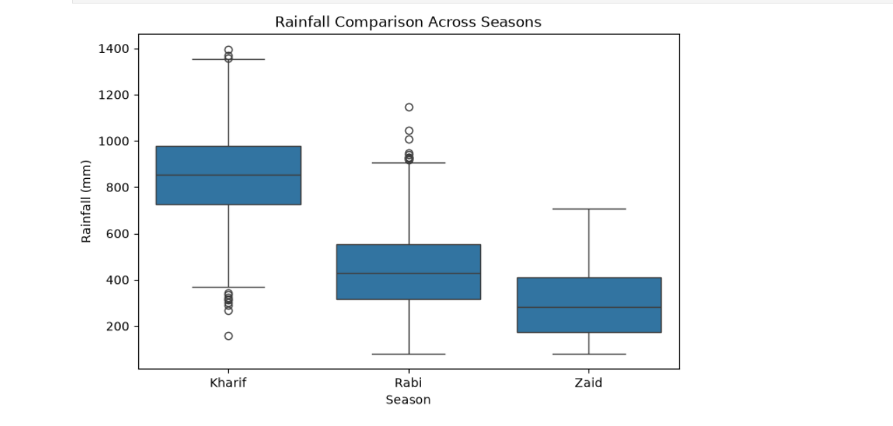
RESULTS

Slide 13
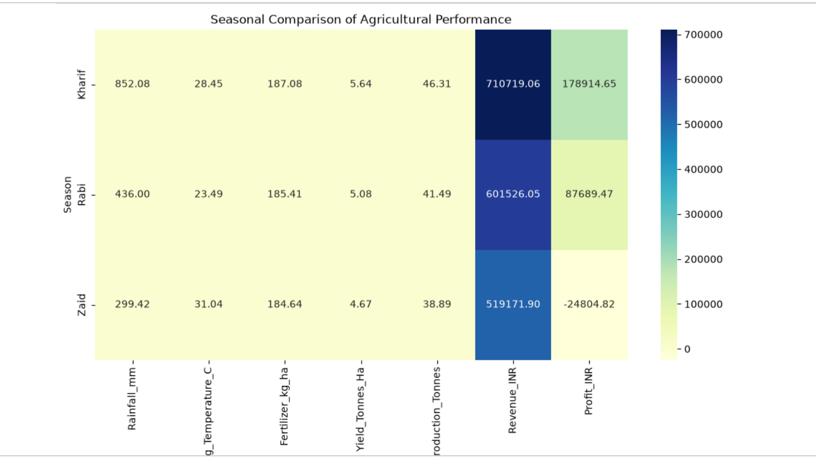
RESULTS

Slide 14
FUTURE SCOPE Crop Yield Prediction – Develop machine learning models to predict crop yield based on historical production, weather, soil, and seasonal data. Weather Integration – Include real-time weather information such as rainfall, temperature, humidity, and drought conditions to improve analysis. Soil Analysis – Incorporate soil properties such as pH, moisture, nutrients, and soil type to recommend suitable crops. Crop Recommendation System – Build a system that recommends the most suitable crop for a particular region and season Climate Change Analysis – Study how changing rainfall and temperature patterns affect seasonal crop productivity. Mobile Application – Develop a mobile app that provides farmers with crop recommendations, seasonal insights, and performance predictions. Early Warning System – Predict potential crop failures caused by drought, excessive rainfall, pests, or unfavorable weather conditions.

Slide 15
GitHub Link
https://github.com/siya0510/MAJOR-PROJECT-.git

Slide 16
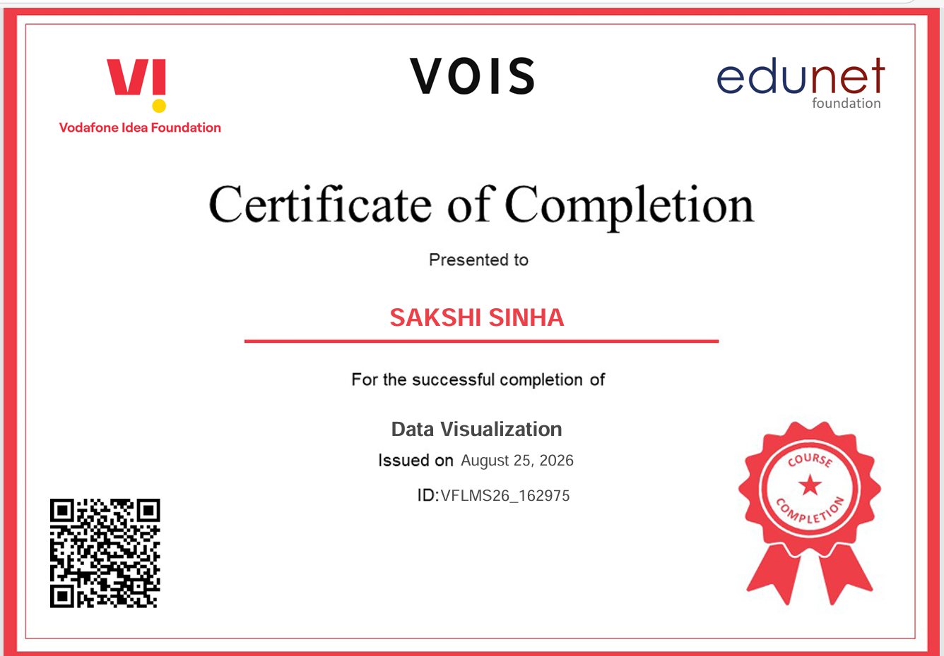
VOIS Course completion certificate - Course name- Data Visualization

Slide 17
Thank you
.
.

