Slide 1



Team Name: The Marauders Team members
GLITCH OVER
Track Name: PLAYPULSE
Title: AI-Powered Highlight Extraction and Player Tracking By Glitchover
Prit shah (22BCE284)
Shiv Patel (22BCE333)
Khushi Makwana (22BCE171)
Aarchi Dholakia (22BCE002)
Het Kalaria (22BCE111)

Slide 2

PROBLEM STATEMENT
Analyzing player performance in FPS games like Valorant is time-consuming and inefficient. Existing tools lack automation and require manual review. An AI-powered solution is needed to extract key metrics, detect highlights, and generate insights for players and analysts.

Slide 3
INTRODUCTION
PlayPulse leverages AI, computer vision, and machine learning to analyze gameplay videos, extracting insightful statistics such as kills, deaths, weapon performance, and event highlights. By automating the extraction of player statistics and key match events, PlayPulse aims to enhance post-game analysis, helping players refine their strategies and engage with their gameplay more effectively.

Slide 4
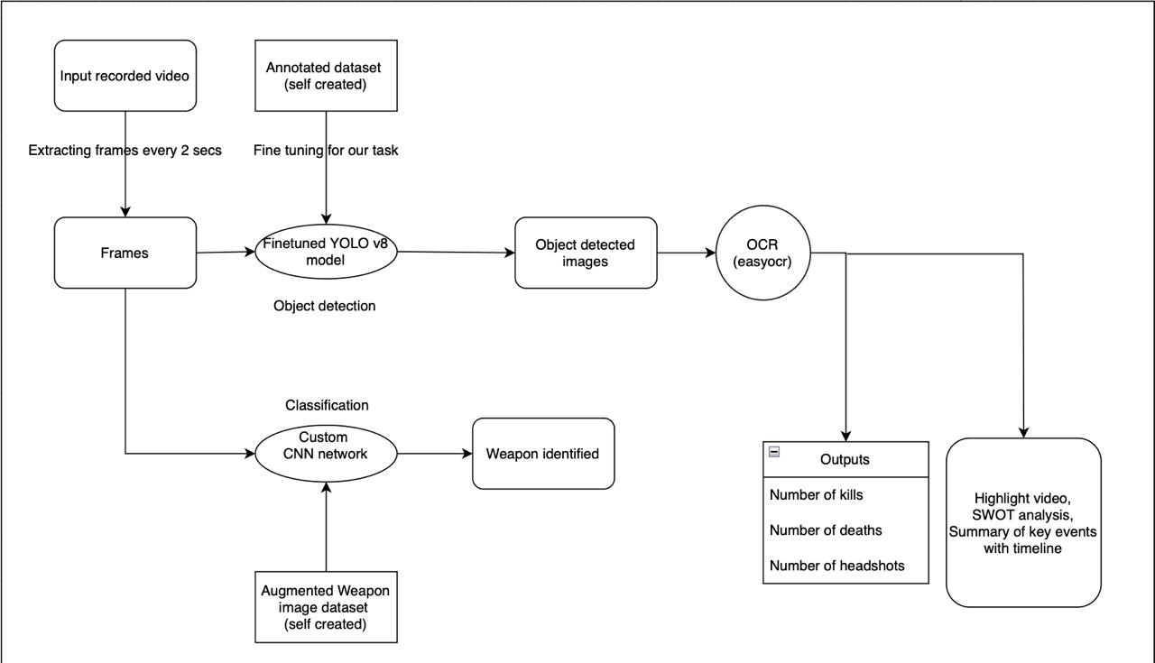
PROJECT WORKFLOW

Slide 5

PROPOSED APPROACH
AI-Driven Analytics
Automated Gameplay Insights
1. Dataset Creation & Annotation
Extracted frames from Valorant gameplay videos at specific intervals.
Annotated kills using Make Sense AI Tool to create a custom dataset for object detection.
2. Kill & Headshot Detection
Fine-tuned YOLOv8 to detect kills in frames.
Used OCR to extract in-game text for kills, headshots and clutches.
Computed total kills, headshot percentage, and kill-death ratio.
3. Match Timeline Mapping & Summarization
Extracted and plotted key match events like kills vs timesteps.
Used Gemini AI to generate a structured and readable match summary from the data extracted by OCR.
4. SWOT Analysis for Gameplay Insights
Leveraged Gemini AI to conduct a SWOT analysis of the player (Strengths, Weaknesses, Opportunities, Threats).
5. Weapon Detection & Analysis
Trained custom CNN to recognize weapons used in gameplay.

Slide 6
Why should one choose your solution?
Automated Analytics
AI-Powered Insights
Automated & Accurate – Detection of kills, headshots, clutches and weapons using custom trained YOLOv8 & OCR. Comprehensive Insights – Extracts key stats, match timeline, and match highlight video.
AI-Driven Summarization – Gemini AI generates match summaries & SWOT analysis for strategy improvement Efficient & Scalable – Works for players, analysts, and content creators, with potential for expansion to other FPS games.

Slide 7
FUTURE SCOPE
More Accurate Analysis
Enhanced Weapon Analysis – Improve accuracy in detecting weapon usage and their performance metrics.
Round-wise Analysis – Provide round-by-round breakdowns of player performance and team strategies. Multi-Game Compatibility – Extend support to other FPS titles like CS2, Apex Legends, and Rainbow Six Siege

Slide 8
Demonstration

