Slide 1
Front End Engineering-I Project
Team Details: G27
Siya Bansal – 2210992386(Team Lead)
Sneha Jindal – 2210992390
Sudhanshi – 2210992413
Shruti Sharma – 2210992358
:
Chitkara University Institute of Engineering and Technology,
Chitkara University, Punjab

Slide 2
Table of Contents
Introduction
Problem Statement
Technical Details
Key Features
Project Highlights
Conclusion
References/Links used

Slide 3
Introduction
Task Management App
A task management app is a software tool designed to help individuals and teams organize, prioritize, and manage their tasks and projects more effectively. This app usually feature a user-friendly interface that allows users to easily create and track tasks, set deadlines, mark important and monitor progress in real-time by putting them in different categories.

Slide 4
Problem Statement
Design and build a task management app that allows users to organize, track, and manage their tasks according to different categories effectively. The app should provide a user-friendly interface for adding, completing, and deleting tasks.

Slide 5
Technical Details
There are several ways to create a task management app using HTML technologies. We can create a task management app using some HTML features, CSS, and Java script. Use of popular application programs
like vs code is also brought in use.

Slide 6
Key Features
1.Adding tasks with deadline dates.
2.Expanding tasks and subtasks.
3.Showing completed and uncompleted tasks .
4.Listing task according to important marked.
5.Calculating number of important and completed tasks.
6.Adding tasks into different categories
7.Store all notes and important information digitally.
8.Displaying tasks according to selected categories.

Slide 7
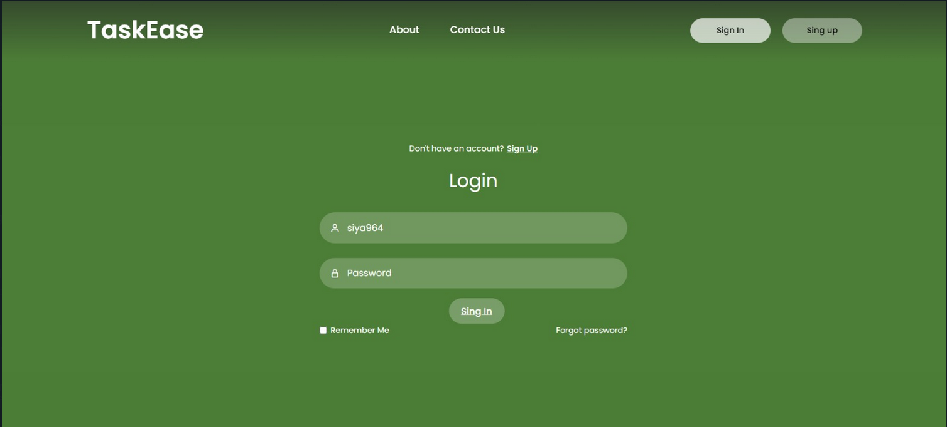

Slide 8
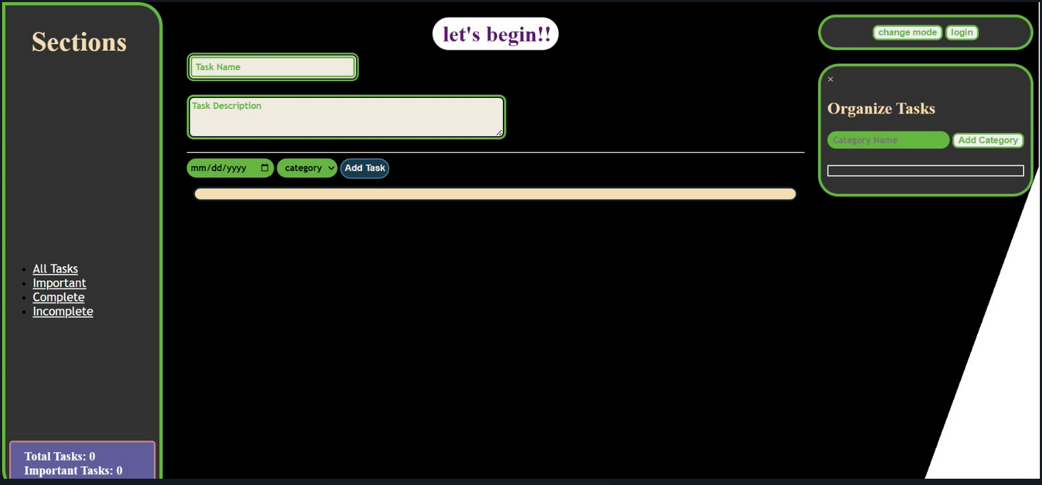

Slide 9
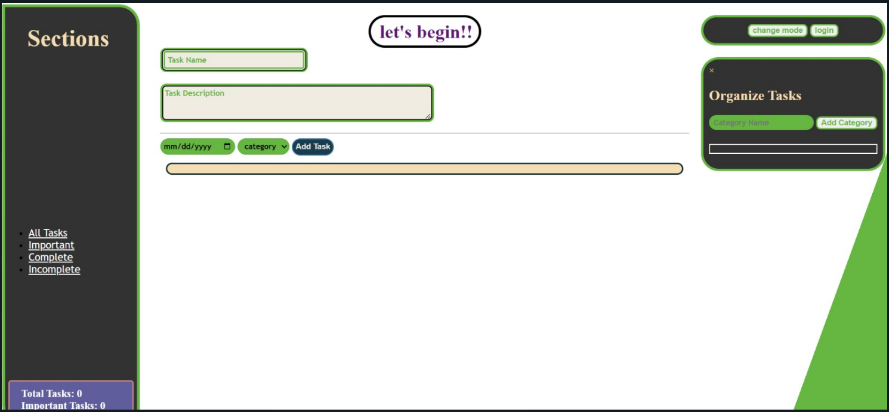
Project Highlights
This slide followed by many slides includes the relevant screenshots of the running project and their corresponding code snippets.

Slide 10
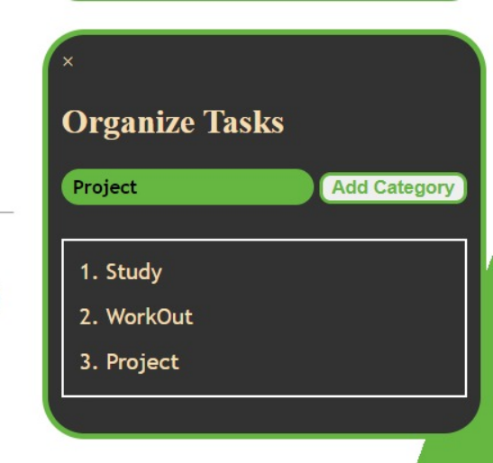

Slide 11
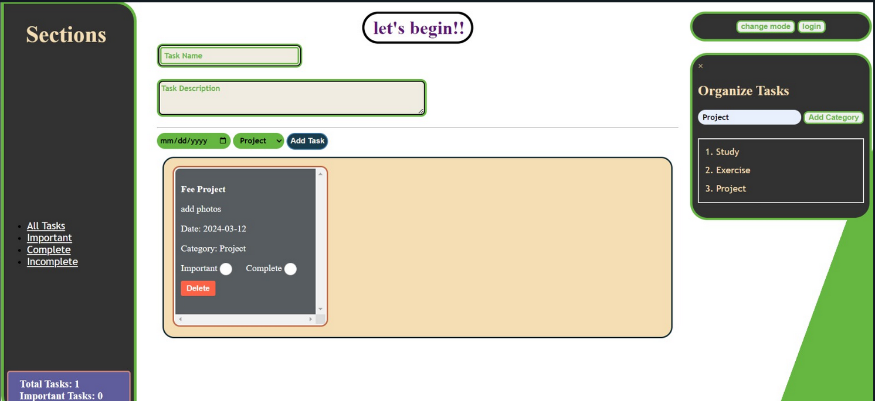

Slide 12
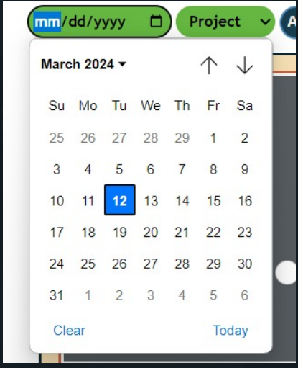

Slide 13
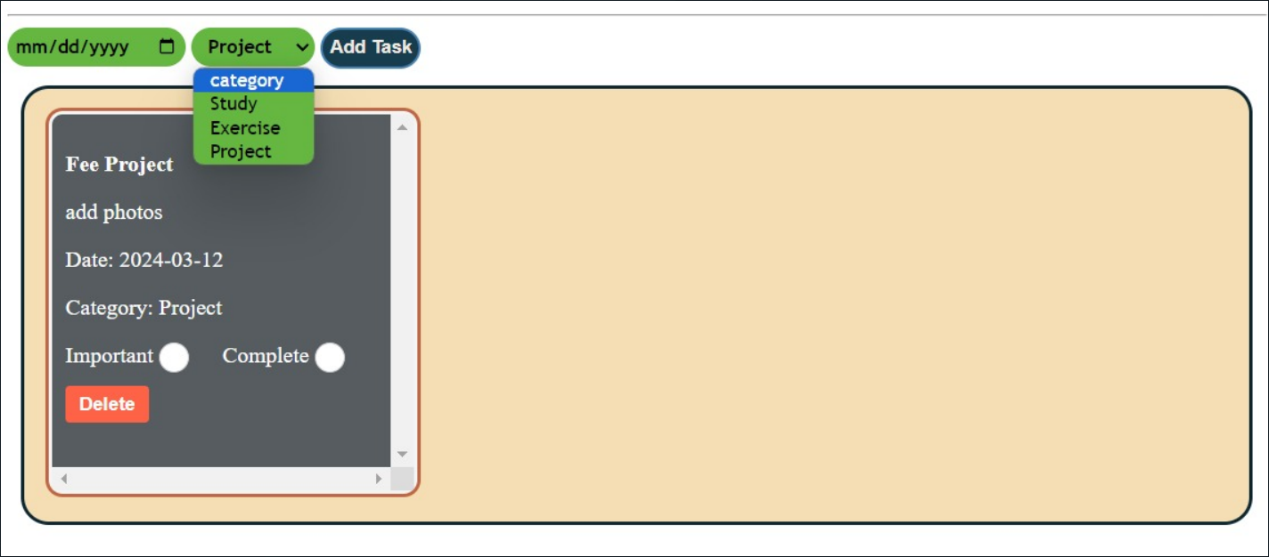

Slide 14
Conclusion
The task management app is generally used to maintain our day to day tasks or list of everything that we have to do. It is helpful in planning our daily schedules. There is a space for further developments with regards of keeping app small and quick and improving overall performance and adding more features.

Slide 15
References/Links used
*Geeks for Geeks
JavaScript Project on Todo List – GeeksforGeeks
* Web design play ground: HTML+ CSS the interactive
*JavaScript Full Course - Beginner to Pro

Slide 16


