Slide 1
Stroke Price Prediction

Slide 2
TEAM MEMBERS :
Shubham Thakur (2210992371)
Shubham Verma (2210992372)
Siya Bhagat (2210992387)
Sukriti (2210992417)

Slide 3
CONTENT :
Problem Statement
Objective
Tools Used
Data Summary
Exploratory Data Analysis

Slide 4
PROBLEM STATEMENT :
Develop a machine learning model to predict the likelihood of an individual having a stroke based on various demographic, lifestyle, and health-related factors. The model should analyze a dataset containing features such as age, gender, hypertension, heart disease, smoking status, body mass index (BMI), and average glucose level.
The goal is to create a predictive model that can assist healthcare professionals in identifying individuals at higher risk of stroke, allowing for early intervention and preventive measures.

Slide 5
OBJECTIVE :
The objective of the project is to perform an exploratory data analysis, data pre-processing, data cleaning and at the end, apply different Data Visualization techniques to get the meaningful insight from the given data. This project aims applying some amazing Python Libraries like as Plotty which will give a boost to our visual understanding of the data.

Slide 6
TOOLS USED:-
Jupyter Notebook is used as IDE.
Pandas and NumPy are used for Data Manipulation & Pre-processing and Mathematical functions respectively.
Exploratory data analysis is automated by
data prep.
For visualization of the plots, Matplotlib, Seaborn, Plotty are used.
GitHub is used as version control system

Slide 7
DATA SUMMARY :
Numerical data
Age Distribution
Health Metrics
Prevalence of Conditions
Stroke Incidence
Correlation Analysis
Missing Values
Outliers
Summary Statistics
Categorical Data
Gender Distribution
Smoking Status
Hypertension Diagnosis
Heart Disease Diagnosis
Residence Type (Urban/Rural)
Marriage Status
Work Type
Average Glucose Level Categories

Slide 8
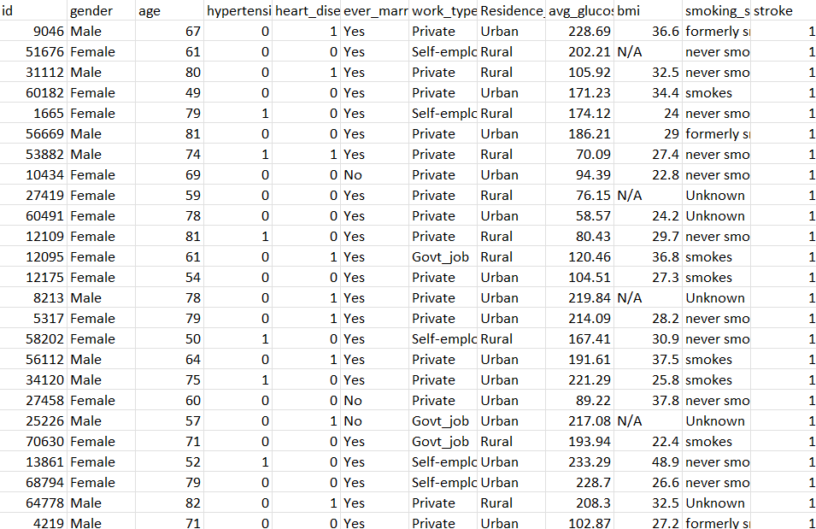
DATA :

Slide 9
FEATURE DESCRIPTION :
ID: Unique identifier for each individual.
Gender: Categorical variable indicating the gender of the individual.
Age: Numerical variable representing the age of the individual.
Hypertension: Categorical variable indicating whether the individual has hypertension (1 if yes, 0 if no).
Heart Disease: Categorical variable indicating whether the individual has heart disease (1 if yes, 0 if no).
Ever Married: Categorical variable indicating whether the individual is ever married (Yes/No).

Slide 10
FEATURE DESRICPTION :
7.Work Type: Categorical variable indicating the type of work the individual does.
8.Residence Type: Categorical variable indicating the type of residence of the individual (Urban/Rural).
9.Average Glucose Level: Numerical variable representing the average glucose level of the individual.
10.BMI: Numerical variable representing the Body Mass Index (BMI) of the individual.
11.Smoking Status: Categorical variable indicating the smoking status of the individual (Smokes, formerly smoked, never smoked).
12.Stroke: Binary variable indicating whether the individual has had a stroke (1 if yes, 0 if no).

Slide 11
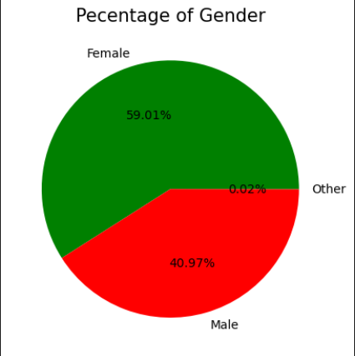
Percentage Of Genders :

Slide 12
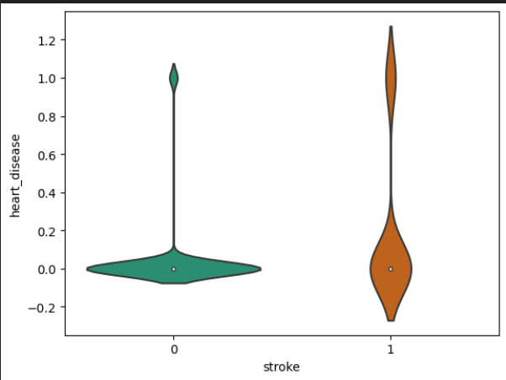
STROKE VS HEART DISEASE :
The following chart illustrates the relationship between stroke and heart disease among individuals in the dataset, highlighting how these conditions might be dependent on each other.

Slide 13
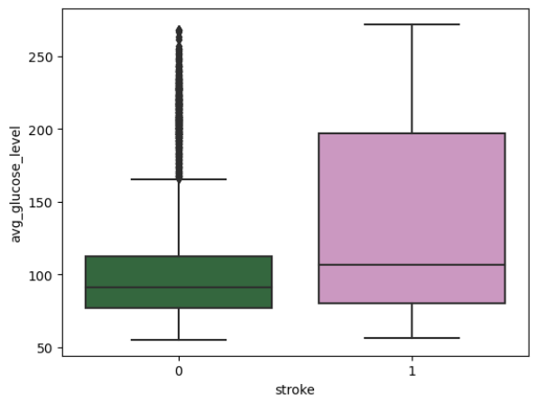
SRTOKE VS AVG GLUCOSE LEVEL :
High glucose levels can lead to vascular damage, inflammation, and increased blood clotting, all of which contribute to a higher risk of stroke.
Managing and controlling glucose levels through lifestyle changes and medication is crucial in reducing the risk of stroke, especially for diabetic individuals.

Slide 14
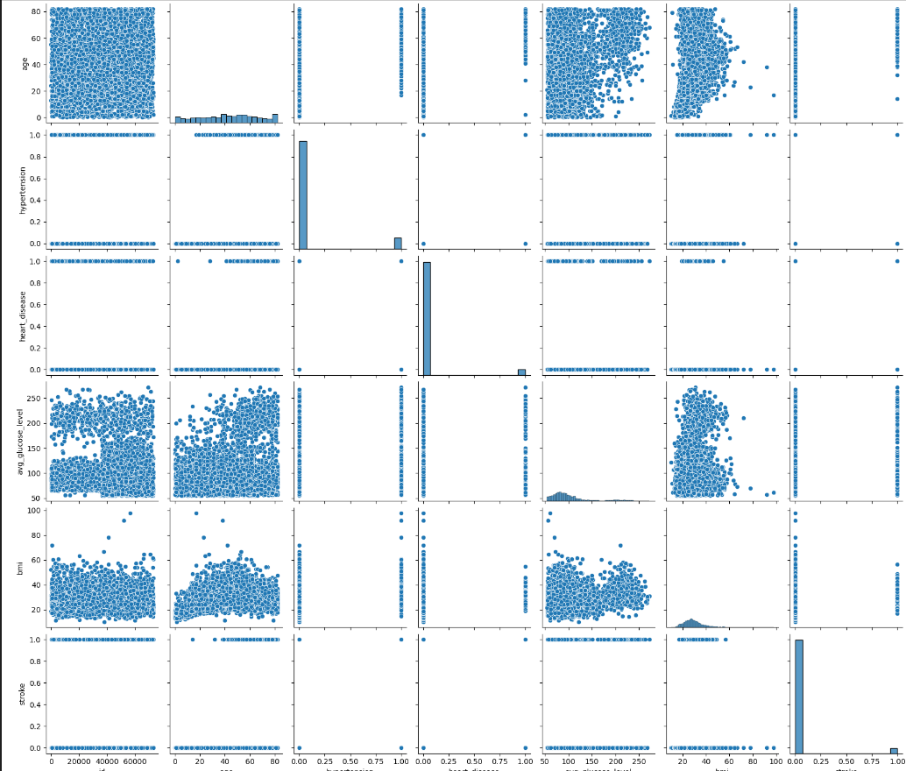
PAIRPLOT OF GIVEN DATA :

Slide 15
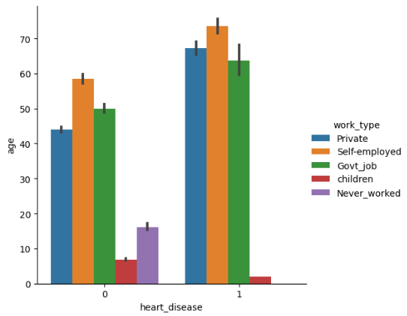
COUNT OF HEART DISEASE W.R.T AGE :
Heart disease prevalence increases significantly with age, highlighting the importance of age as a key risk factor.

Slide 16
CHALLENGES :
Data quality and quantity: Obtaining a sufficiently large and high-quality dataset with relevant features for accurate prediction can be challenging.
Feature selection: Identifying the most relevant features that contribute to stroke price prediction while avoiding overfitting.
Model complexity: Balancing the complexity of the machine learning model to achieve accurate predictions without making it overly complex and difficult to interpret.
Interpretability vs. accuracy: Trade-off between the interpretability of the model and its accuracy, as more complex models may provide better predictions but be harder to interpret.
Imbalanced data: Addressing imbalances in the dataset, such as a disproportionately small number of stroke cases, to ensure the model does not favor the majority class.
Generalization: Ensuring the model can generalize well to unseen data and different populations to be useful in real-world applications.
Ethical considerations: Addressing potential biases in the data or model predictions and ensuring fairness, transparency, and accountability in the use of AI/ML for stroke price prediction.

Slide 17
RECOMMENDATIONS :
Improve data collection: Gather more diverse and comprehensive data on car features, manufacturers, and market prices to enhance the model's predictive power.
Feature engineering: Explore additional features or transformations of existing features that could improve the model's performance, such as interaction terms or derived variables.
Advanced modeling techniques: Consider using more sophisticated machine learning algorithms or ensemble methods to improve prediction accuracy.
Cross-validation: Use cross-validation techniques to assess the model's performance and ensure its generalizability to unseen data.
Interpretability: Balance model complexity with interpretability, favoring models that can provide insights into the factors driving price predictions.
Regularization: Apply regularization techniques to prevent overfitting and improve the model's ability to generalize to new data.
Validation and testing: Validate the model using independent datasets or conduct A/B testing to evaluate its performance in real-world scenarios.
Continuous monitoring and updating: Regularly monitor the model's performance and update it as necessary to account for changing market conditions or data trends

Slide 18
CONCLUSION :
The project faces challenges such as data quality, feature selection, model complexity, and interpretability vs. accuracy trade-offs.
Recommendations include improving data collection, exploring additional features, considering advanced modeling techniques, and using cross-validation.
Balancing model complexity with interpretability and applying regularization are crucial for improving the model's performance.
Validation and testing, along with continuous monitoring and updating of the model, are essential for ensuring its effectiveness in real-world scenarios.
Implementing these recommendations can enhance the accuracy and effectiveness of the stroke price prediction model.

Slide 19
Thank you

