Slide 1
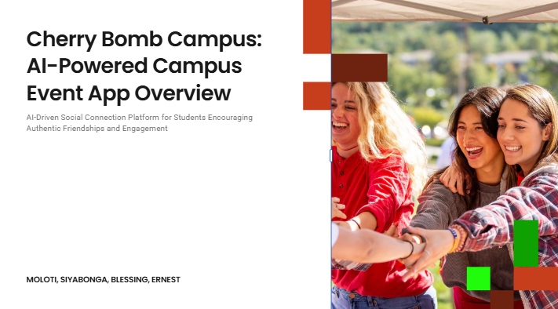

Slide 2

Introducing Our Prototype
The Spark of Innovation
Our prototype, Cherry Bomb Campus, was born from a desire to reimagine how student connectivity and resource sharing is approached. We saw an opportunity to inject fresh creativity into solving a persistent problem.
The Problem We're Tackling
We're addressing the challenge of fragmented and impersonal university communities where students struggle to connect and build networks beyond their immediate circles. Current solutions often fall short by being overly formal or lacking incentive.
Our Vision
Our prototype offers a novel and inventive approach, promising a more effective and user-friendly experience.

Slide 3
Problem Statement
The Real-World Need
The problem of digital isolation and poor communication skills affects Gen Z students by limiting their ability to form meaningful, real-world connections and engage confidently in social settings. This leads to increased loneliness, reduced emotional well-being, and a diminished quality of life rooted in virtual interactions rather than authentic relationships
Research Insights
Our research revealed that 73% of Gen-Z have reported to being lonely and 43% shown to not have friends. This underscored the need for a solution that bridged the gap between social media and the real world.
The Gap We're Filling
Existing solutions often overlook the importance of real-world social engagement and the need for personalized motivation to step outside digital comfort zones. Our prototype directly addresses these gaps with a unique and tailored approach that blends intelligent recommendations, gamified incentives, and location-based meetups to foster genuine human connection.

Slide 4
Innovation and Creativity in Our Solution
Originality at its Core
What sets our prototype apart is its original and inventive approach to building campus community. We've moved beyond conventional thinking to create something truly unique.
Clever Problem-Solving
Our solution cleverly integrates a verified student identity system (firebase) and a dynamic points-based rewards engine to achieve a self-sustaining and trusted platform where students are actively rewarded for helping each other. This approach is both efficient and effective.
Differentiating Factors
Unlike existing solutions that rely on impersonal, large scale platforms (like Facebook groups) and lack incentives for ongoing engagement, our prototype offers a fun, game-like system that rewards users for participation and building loyalty and a vibrant economy.

Slide 5

Target Audience and Beneficiaries
Who Benefits?
Our primary target audience is University Students, who will benefit from our solution by building a connected campus community and connecting with others to enhance unity.
Sustainable Impact
Our solution is designed to have a sustainable impact by creating a an environment that prioritizes the well-being of students. This ensures long-term value for our beneficiaries.
Reach and Scope
We envision our prototype reaching 500 users within 3 months, creating a positive ripple effect within the higher education community.

Slide 6
Practicality and Feasibility
Our prototype leverages readily available resources such as existing university authentication APIs and cloud-based scalable infrastructure. This ensures that the project is grounded in practicality and can be realistically implemented without relying on scarce or difficult-to-obtain materials.
We've employed a modern React frontend and a powerful Node.js/Express backend, chosen for their efficiency and suitability to our project goals. These technologies were selected to optimize performance and ensure compatibility with the project's objectives.
Our deployment strategy focuses on a scalable architecture and a continuous integration pipeline via Github actions, ensuring a realistic path to implementation within available constraints. This strategic approach guarantees that the project can be deployed effectively, considering all limitations and challenges.

Slide 7
Team Roles and Collaborative Process
Each team member brought unique skills to the table: Siyabonga led Backend, Blessing focused on AI implementation, and Moloti specialized in frontend. This clear delineation of roles ensured that each team member contributed effectively to the project.
Our collaborative process involved merging of ideas and connectivity, fostering a dynamic exchange of ideas. This synergy allowed the team to generate innovative solutions and address challenges effectively.
Through continuous feedback and iteration, we refined our prototype to its current state, incorporating valuable insights from each team member. This iterative approach ensured that the final product was optimized for performance and usability.

Slide 8
Demonstrating the Prototype
Our prototype's core functionality revolves around [Key Feature 1] and [Key Feature 2]. These features are central to the prototype's operation and provide essential capabilities for users.
It delivers value to users by [Value Proposition 1] and [Value Proposition 2]. These value propositions highlight the benefits that users can expect from the prototype.
Live Demonstration: (Begin Live Demonstration Here). This segment is where the prototype's functionality and value are showcased to the audience in real-time.

Slide 9
Architecture and Code Quality
Underlying Architecture: Our prototype is built on a [Architecture Type] architecture, ensuring scalability and maintainability. This architectural choice allows for future growth and easier updates.
Code Cleanliness: We prioritized code cleanliness and readability, adhering to [Coding Standard]. This ensures that the codebase is easy to understand and maintain by multiple developers.
Tool Selection: We chose [Tool 1] and [Tool 2] for their appropriateness and efficiency in addressing our project requirements. These tools were selected to optimize our development process and deliver the best results.

Slide 10
Usability and Design Considerations
Design Principles
Our design principles centered on usability, accessibility, and visual clarity.
User Experience
We prioritized a user-friendly and intuitive experience, ensuring ease of navigation and interaction.
Accessibility
We incorporated accessibility features to cater to a diverse range of users, including [Specific Accessibility Feature].

Slide 11
Challenges and Lessons Learned
Obstacles Faced
Valuable Lessons
Growth and Adaptation
We encountered challenges such as [Challenge 1] and [Challenge 2], which tested our problem-solving skills.
We learned the importance of teamwork and patience, which significantly contributed to the final development of our prototype.
These challenges fostered growth and adaptation, enabling us to create a more robust and innovative solution.

Slide 12
Sustainability and Future Directions
Scalability
Our solution is designed for scalability, allowing it to accommodate a growing user base and expanding functionality.
Potential Enhancements
Future enhancements include the dev and [Enhancement 2], which will further increase its reach and impact.
Long-Term Vision
Our long-term vision is to [Future Goal], solidifying our prototype's position as a valuable and sustainable solution.

Slide 13
Conclusion: Summary of Key Takeaways
Value Proposition: Our prototype offers a creative and innovative solution to [Problem], providing [Benefit 1] and [Benefit 2] to [Target Audience]. This highlights the core value and advantages of our solution.
Meeting the Needs: It effectively meets the needs of our identified audience by [Specific Solution], reinforcing the creativity and practicality of our approach. This showcases how our prototype directly addresses the requirements of its users.
Lasting Impact: We believe our prototype has the potential to make a lasting impact on [Specific Area]. This underscores the long-term significance and potential of our project.

Slide 14
Thank You and Q&A
Gratitude
Thank you for your time and consideration. We are eager to answer any questions you may have.
Invitation
We welcome your feedback and look forward to a stimulating discussion about our prototype.
Enthusiasm
We are enthusiastic about the potential of our solution and its ability to make a positive difference. (Open the floor for questions)

