Slide 1















Multi-Lingual
AI Assistance
Capstone Project First Review

Slide 2

Introduction
The project emerges from the growing need for inclusive AI technology in our multilingual world. As digital assistants become increasingly prevalent, there remains a significant gap in serving diverse linguistic communities. This multilingual voice bot project aims to revolutionize human-computer interaction by enabling natural conversations in regional languages while incorporating visual and contextual understanding for more meaningful interactions.

Slide 3
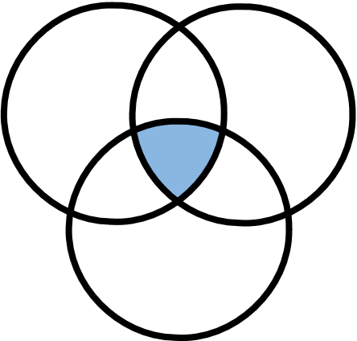
Conversational
AI
Multilingual NPL
Domain
Our project lies at the intersection of Artificial Intelligence, Natural Language Processing and Speech Processing. We aim to work on bringing the gap in interfacing these subdomains together to accomplish the goal of the project.
Speech to Text
and
Text to Speech

Slide 4

Keeping up with the Trend
With the rise of models like ChatGPT, conversational AI has become a cornerstone for building intelligent systems capable of understanding and generating human-like text responses. While text-based chatbots are widely used, incorporating speech as a primary medium of communication makes such systems more accessible and user-friendly.
Linguistic Barrier
The lack of seamless integration of audio input/output for multiple languages limits the practical application of these models in diverse settings. Bridging linguistic and cultural barriers is essential for businesses, education, and personal communication in a globalized world.
BACKGROUND
Improvement in STT and TTS Tech
Services like Google Speech-to-Text, AWS Polly, and Whisper by OpenAI have made speech processing highly reliable for various languages. But combining them with advanced conversational AI for real-time interaction is still an emerging area.
Existing Gap
Most voice systems are designed for predefined tasks, not dynamic conversational responses in multiple languages. Many users with disabilities or non-technical backgrounds struggle with text-based interfaces, highlighting the need for voice-based solutions.

Slide 5
Literature Survey
Findings
Gaps
Increasing importance of transfer learning and large language models (LLMs) for improving multilingual NLP systems, particularly for low-resource languages like Tamil.
Traditional voice assistants limited to major languages.
Existing multilingual systems lack visual context integration.
Gap between regional language processing and AI assistance.
Existing models struggle with error correction and contextual accuracy for low-resource languages.
Focus on accessibility and inclusivity.
Need for more advanced systems that integrate real-time visual processing with text and speech, ensuring context-aware interaction.
Growing demand for localized AI solutions. Lack of robust privacy-preserving mechanisms for handling sensitive user data.

Slide 6

Problem Statement
“Building a Multilingual AI VoiceBot to enable real-time voice-to-voice communication across languages, addressing gaps in accessibility, education, and cross-cultural communication.”

Slide 7
Research Objectives
The project seeks to create a breakthrough in multilingual AI interaction by developing a voice interface that understands and responds in regional languages. Through the integration of visual context and clipboard data, the system aims to provide more natural responses. The focus extends to ensuring ethical data handling while maintaining high accuracy in language processing.
To Do :
To develop a multilingual voice interface.
Implement context-aware responses.
Create seamless integration between services
Set up a interface to understand the preferences of user.
Allow personalization to an extent.

Slide 8
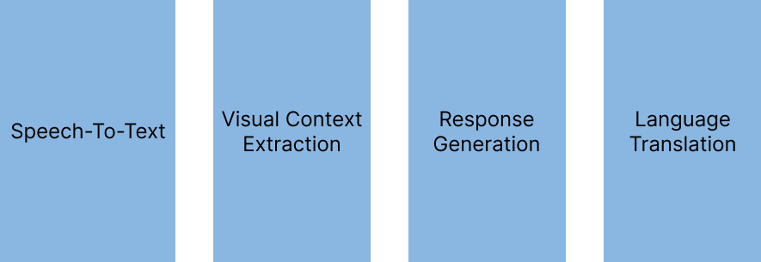


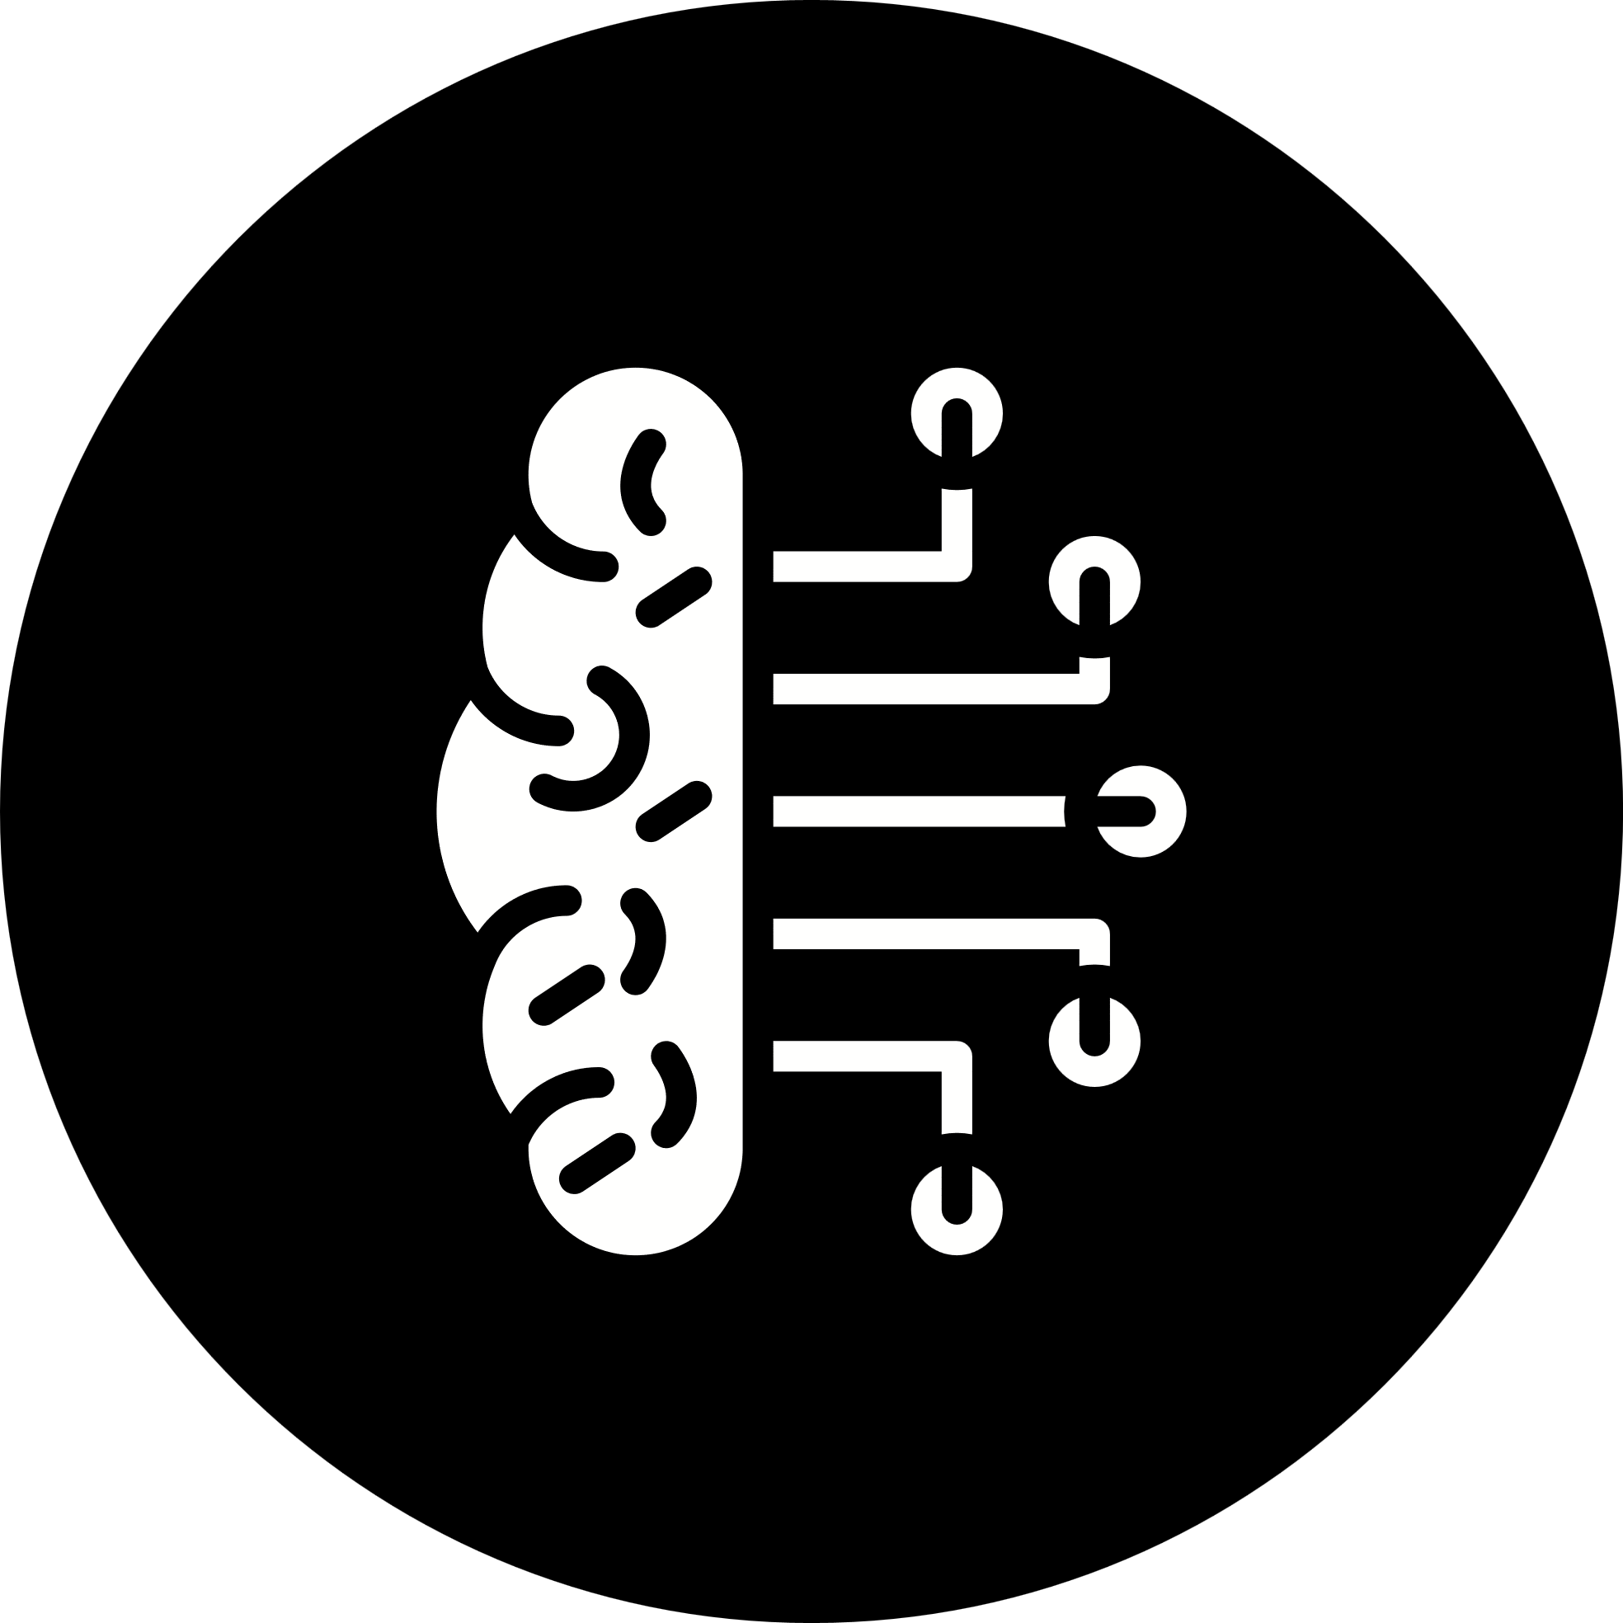

Methodology -
Model

Slide 9
Data Collection & Analysis
Pre Trained Generative models use real-time Queries from user to form their responses.
These include:
Screenshot capture for visual context
Webcam integration
Clipboard content extraction
Voice input processing
Text Queries input
Data analysis employs NLP techniques, while the LLM model ensures seamless API integration with robust safety filters and error handling mechanisms.
Models Used in Implementation
Whisper Model - Multilingual Voice Input
Google GenAI - Visual Data interpretation
Llama3 - Query Result Generation
Groq AI - Function Call prompt

Slide 10
Progress so far
The current implementation has successfully established the core voice processing pipeline and integrated essential APIs for basic functionality. Visual context extraction capabilities are operational, demonstrating promising results in understanding and incorporating visual information into responses. The basic language translation framework has been implemented, laying the groundwork for expanded language support.
Core query processing pipeline
Visual context extraction
Basic language translation
Initial API integrations

Slide 11
Work to be done
Voice Input Processing
The user audio input needs to be converted into text without contextual changes.
Expand Language Support
Currently we are working only on Tamil Language. Based on the performance of the application, we are hoping to included as many regional languages as possible.
User Interface Implementation
Provide the users with proper UI/UX that is clear and simple as the focus group consists of users from non-technical background.
Latency Improvement
Security Implementation
Pre-process data to remove personal information from the user inputs.

Slide 12
Project Proposed by
Siyamala V (21BRS1710)
Thank You 🙏

