Slide 1

ASSIGNMENT GUIDELINES
Make the changes in the PPT as you solve the parts
This file contains the template for the EDA part of the project.
Check the instructions added in the note section of every slide for clarity.
Don’t move around any image or text box
If you require more/lesser elements, be careful when you copy/delete the existing ones.

Slide 2
ASSIGNMENT Name: Siya Mulge
Problem Statement
Bank of Corporate conducted a telemarketing campaign for one of its financial products ‘Term deposits’ to build a long-term relationship with the existing customers. These campaigns need to be cost efficient such that the bank not only increases their overall revenues but also the total profit.
Assignment Objective
To identify the target customers and the driving factors behind the successful conversion of a customer and optimize future marketing campaigns.
Notes:
Problem Statement

Slide 3
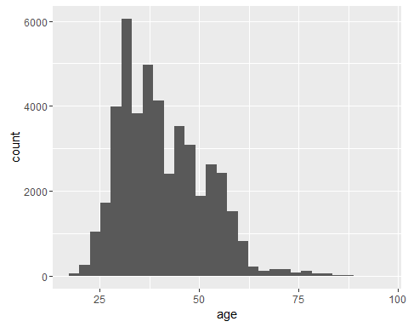
PART I : Univariate Analysis Marketing Campaign Optimization
Variable under consideration:
In univariate analysis, we analyze one variable at a time.
The following plot shows the distribution of peoples' ages in the data.
Since age is a numeric variable, we plot a histogram.
Notes:
Mention the results of the excel analysis and add the corresponding visualisations to the space provided above. Use copies of the above slide if necessary.

Slide 4
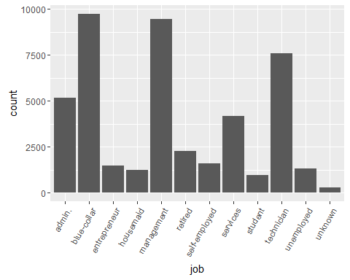
PART I : Univariate Analysis Marketing Campaign Optimisation
Variable under consideration:
Mosst people are between 25-50 years old. Very few people older than 60 years have been targeted.
Next, let's look at the types of jobs people have. Now job is not a numeric variable, it is a categorical variable and so we plot a bar chart for it.
Notes:
Mention the results of the excel analysis and add the corresponding visualisations to the space provided above. Use copies of the above slide if necessary.

Slide 5
PART I : Univariate Analysis Marketing Campaign Optimisation
Variable under consideration:
We have a large number of people with blue-collar jobs and in management, which are about 9000 each. The third highest category is technicians which are about 7500 people. Note that among 45,000 people, about 25,000 or 55% are either blue-collar workers, management employees technicians.
The average salary is about INR 57000 per month. Note that the maximum is only about INR 1.2 lacs per month
Notes:
Mention the results of the excel analysis and add the corresponding visualisations to the space provided above. Use copies of the above slide if necessary.

Slide 6
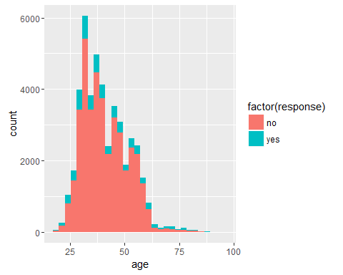
PART II : Bivariate Analysis Marketing Campaign Optimisation
Variables under consideration:
Now, Taking two variables at a time, one of which should obviously be the target variable 'response’.
So now the plot shows information of two variables - the age on x-axis and response as a colour. This chart does not show any obvious trend of response rate with age.
The analysis will be easier if we could divide the age into buckets, e.g. 0-10 years, 10-20 years etc. This is called bucketing and is often done to divide numeric variables into smaller buckets.
Notes:
Mention the results of the excel analysis and add the corresponding visualisations to the space provided above. Use copies of the above slide if necessary.

Slide 7
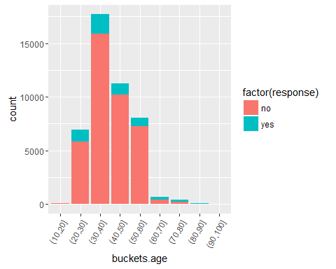
PART II : Bivariate Analysis Marketing Campaign Optimisation
Variables under consideration:
Notes:
Mention the results of the excel analysis and add the corresponding visualisations to the space provided above. Use copies of the above slide if necessary.

Slide 8
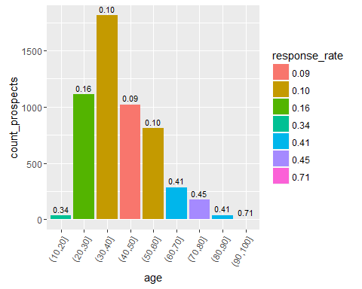
PART II : Bivariate Analysis Marketing Campaign Optimisation
Variables under consideration:
Notes:
Mention the results of the excel analysis and add the corresponding visualisations to the space provided above. Use copies of the above slide if necessary.

Slide 9
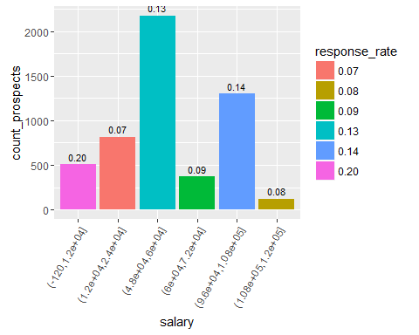
PART II : Bivariate Analysis Marketing Campaign Optimisation
Variables under consideration:
Notes:
Mention the results of the excel analysis and add the corresponding visualisations to the space provided above. Use copies of the above slide if necessary.

Slide 10
PART III: Optimisation Results Marketing Campaign Optimisation
Firstly, note that the accuracy is approx. 90% which means that the model has made about 90% predictions correct (whether yes or no).
There are two other important metrics - sensitivity and specificity.
Sensitivity is the fraction of correctly identified responses, i.e. out of those who will actually respond, how many has the model identified.
Specificity is the fraction of incorrectly identified responses, i.e. out of those who will actually NOT respond, how many has the model identified.

Slide 11
PART IV: Major insights Marketing Campaign Optimisation
The usual response rate is 11%, which means that if we telemarket to 10,000 people, 1100 will buy the product.
We can rather telemarket to only those whose probability of purchase is high. Let's look at the probabilities of purchase. Note that we will use only test data for this analysis.
Thus, we can acquire about 86% of the customers for only about 22% of the marketing cost.

