Slide 1
Analyze the Effect of Class Type on First Grade Math Scores Using Two-way ANOVA
Team 13

Slide 2
Introduction
Data
Student-Teacher Achievement Ratio (STAR)
Variables: teacher ID, class type, school ID and math scores
Drop the missing values
Question of interest
To analyze whether there is an association between class types and teachers’ teaching quality
Make causal inference between class types and teachers’ teaching quality

Slide 3
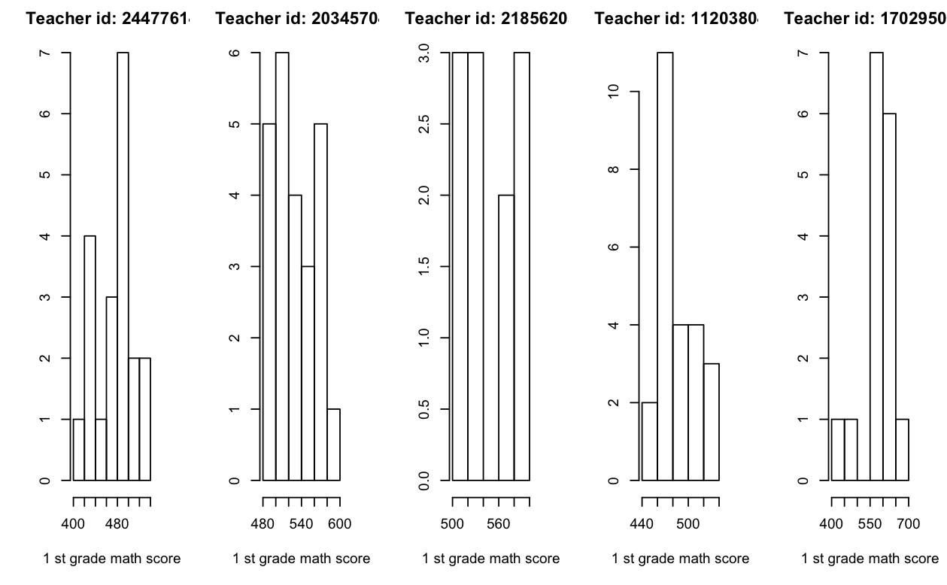
Choose the response variable

Slide 4

Model
Two-way ANOVA model
$Y_{i,j,k}=μ+α_{i}+β_{j}+ε_{i,j,k}$
$α_{i}$ denotes an effect for level i of class types
$β_{j}$ denotes an effect for level j of schools
$Y_{i,j,k}$ denotes the median math scores of students in first grade taught by each teacher
Model assumption
Normality - Q-Q plot
Equal variance - Residual versus Fitted Value
Independence

Slide 5
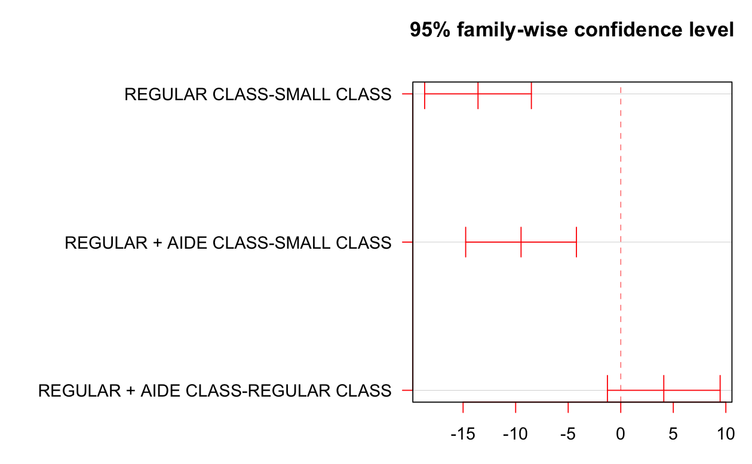

Tukey’s Pairwise Comparison
Null hypothesis $H_{ii′,0}:D_{ii′}=μ_{i}−μ_{i′}=0$
Confidence intervals:
Result: There is relationship between class types and the performance of teachers

Slide 6
Potential Outcomes Framework
Assumptions
Conclusion
Class size does have an effect on first-grade teachers’ performance

Slide 7

Fisher’s Exact P-Values(FEP)
Framework
The potential outcomes are considered fixed
Randomness comes from assignment mechanism
Sharp Null Hypothesis
$$H_{0}:Y_{K}(0)=Y_{K}(1), \text{for} \text{all} K$$

Slide 8

Test Statistic of FEP
$$T^{obs}=\left|\sum_{m=1}^{M}{\frac{N(m)}{N}}\left({\overline{Y}}_{1}^{obs}(m)−{\overline{Y}}_{0}^{obs}(m)\right)\right|$$
Regular class denotes as control(0) and small class denotes as treatment(1)
$K$ denotes teachers
$M$ denotes the number of schools which is 76
$N(m)$ denotes the number of classes in school $m$, $m=1,2,…M$; $N=\sum_{m=1}^{M}{N}(m)$
${\overline{Y}}_{1}^{obs}(m)$ and ${\overline{Y}}_{0}^{obs}(m)$ denote the average of observed median math score for small and regular classes in school $m$ respectively

Slide 9
Method of FEP
all possible assignment
all possible T value
exact distribution of T
exact p-value

Slide 10
Example
There are 2 schools
School A has 1 small class and 1 regular class
School B has 2 small class and 1 regular class

Slide 11
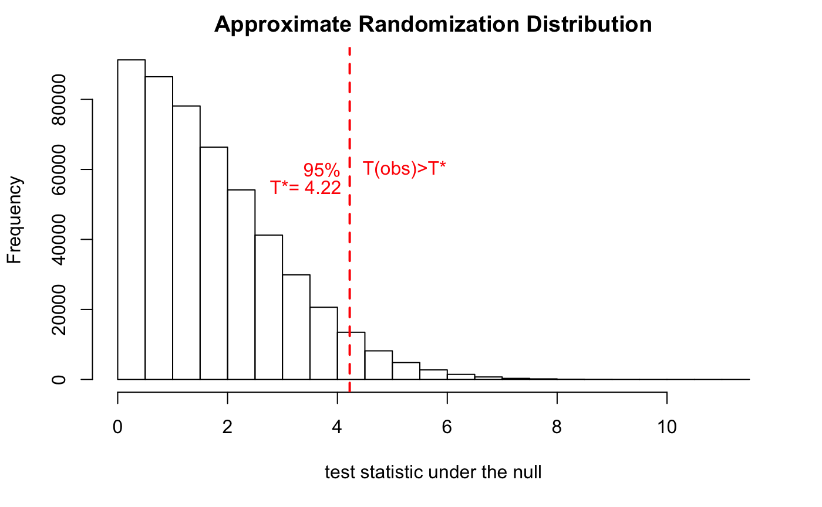
Result of STAR
Conclusion
Teachers with small classes had different performance than teachers with other type of classes

Slide 12
Comparison between Two Methods
Comparison
Fisher’s Exact P-value | Potential Outcomes Framework
H0 : no individual treatment effect | H0 : no average treatment effect
SUTVA-no interference automatically holds under H0 | Check first
Reference
Causal Inference for Statistics Social and Biomedical Sciences An Introduction, Chapter 5 and Chapter 9

Slide 13
Q&A

