Slide 1
jQuery Mobile
Funniest jQuery Mobile Bloopers

Slide 2
JQuery Mobile
A unified, HTML5-based user interface system for all popular mobile device platforms
Built on the rock-solid jQuery and jQuery UI foundation
Lightweight code is built with progressive enhancement, and has a flexible, easily themeable design
Seriously cross-platform & cross-device

Slide 3
Mobile browser support
Apple iOS 3.2-5.0 beta
Android 2.1-2.3
Windows Phone 7
Blackberry 6.0-7
Palm WebOS
Firebox Mobile
Meego, Kindle

Slide 4
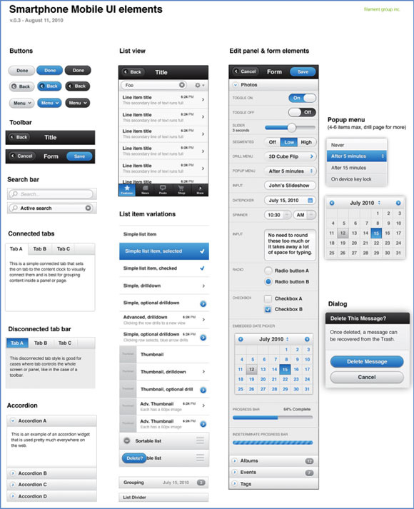
UI Components

Slide 5
HTML5 data-* attributes
Header, Footer toolbars | <div data-role="header"> <div data-role="footer">
Content body | <div data-role="content">
Buttons | <a href="index.html" data-role="button" data-icon="info">Button</a>
Grouped buttons | <div data-role="controlgroup"> <a href="index.html" data-role="button">Yes</a> <a href="index.html" data-role="button">No</a> <a href="index.html" data-role="button">Hell Yeah</a> </div>
Transitions | <a href="index.html" data-transition="pop" data-back="true">

Slide 6
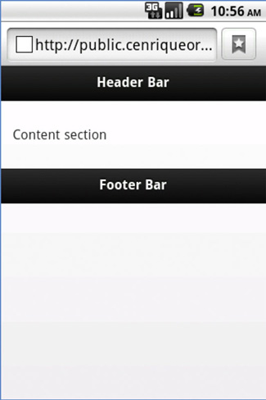
Structure of a jQuery Mobile page

