Slide 1
From technology vision
to shipped outcomes
Independent IT advisory and delivery leadership
for organizations that need strategy connected
to execution.

Slide 2
02
POSITIONING
THE BRIDGE
One partner across the gaps others leave behind
Strategy only matters when it survives contact with architecture, engineering, delivery, and the customer.
Translate
Bridge
Bring breadth and depth
Business vision into architecture, roadmap, backlog, and delivery steps.
Executive intent, product decisions, engineering reality, and customer value.
Technical leadership, architecture, delivery, pre-sales, and product thinking.
Breadth without handoffs: one accountable partner from strategy to customer value.

Slide 3
03
EXPERIENCE
FULL LIFECYCLE
20+ years of experience, earned across the full lifecycle
01
03
RANGE THAT TRAVELS
Software engineer
Product manager
Industries
Financial services, manufacturing, HR, telecom, life sciences, and government programs.
Markets
Primarily US, with Europe, Southeast Asia, and India.
Methods
Waterfall, iterative delivery, Agile Scrum, and Extreme Programming.
Builds technical depth close to the work.
Connects customer value to the roadmap.
1
2
3
4
02
04
Technical leader
Program manager
Turns systems into decisions teams can act on.
Keeps complex delivery moving to outcomes.

Slide 4
04
PROOF POINTS
OUTCOMES
Delivery discipline backed by measurable product outcomes
Metrics are decision tools: they expose where momentum is real, where risk is building, and what needs to change next.
3–15
90%+
60+
3.5:1
member teams led
CSAT
NPS
CLTV:CAC
$1M–$15M engagements · 5,000–30,000 man-hours
Across product and delivery work
A signal of customer confidence
Alongside 2–3% churn and 9–10 month payback
The operating habit: turn evidence into the next decision, not another report.

Slide 5
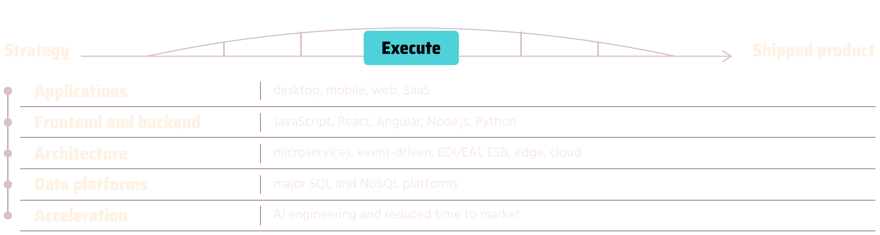
05
TECHNICAL RANGE
EXECUTABLE STRATEGY
Technical range that makes the strategy executable
Choose the right level of abstraction, then stay close enough to the implementation to make the choice real.
BREADTH
LEVERAGE
Applications across frontend and backend ecosystems, from desktop and mobile to web and SaaS.
Use AI to accelerate engineering and reduce time to market.

Slide 6
06
WAYS TO ENGAGE
MOMENTUM
Services for leaders who need momentum, not more handoffs
01
02
Strategy to roadmap
Architecture and modernization
Technology vision, product strategy, prioritization, and execution plans that teams can use.
Solution architecture, platform choices, integration, cloud, and AI acceleration.
03
04
Delivery leadership
Product and commercial readiness
Program recovery, Agile transformation, operating cadence, and stakeholder alignment.
Discovery, pre-sales support, metrics, and customer-value focus.
Engage for an advisory sprint, a defined transformation, or hands-on fractional leadership.

