Slide 1
Time-LLM: Time Series Forecasting by Reprogramming Large Language Models
Presented by
FALGUNI GHOSH
As part of BioMedIA Reading Group Session, July 10, 2025

Slide 2
PAPER DETAILS
Presented in ICLR 2024
Authors: Ming Jin, Shiyu Wang et al
Project page: https://github.com/KimMeen/Time-LLM
Affiliated Institutions: Monash University Ant Group IBM Research Griffith University Alibaba Group The Hong Kong University of Science and Technology (Guangzhou)

Slide 3
BACKGROUND
Task-specific learning
Transfer learning
Foundation Model
Model Reprogramming
Notes:
Training a specific model from scratch by minimizing the task-specific loss
A common practice for in-domain knowledge transfer. One notable limitation is that: in some target domains, there may be lack of adequate pretrained models from similar domains for effective finetuning.
Foundation model features task agnostic pre-training (often on large scale datasets) and efficient finetuning to downstream tasks.
Model Reprogramming: Only requires training the inserted input transformation and output mapping layers while keeping the source pre-trained model intact for target tasks.

Slide 4
BACKGROUND (contd.)
Sorted by Number of trainable parameters (from high to low)
Foundation Model
Task-specific learning
Transfer Learning
Model Reprogramming

Slide 5
MOTIVATION FOR LLM IN FORECASTING
Generalizability
Data efficiency
Reasoning
Multimodal knowledge
Easy optimization
Notes:
Demonstarted zero-shot and few-shot transfer learning capability
Leaverage pretrained knowledge, perform new tasks with only few examples even when histricial data is limited.
Reasoning and pattern recognition capabilities
Can also add other modalities like vision, speech, text
Already trained on massive computing. No need for learning from scratch, so architecture search and hyperparam tuning less significant.

Slide 6
RELATED WORK
Traditional Models: ARIMA, LSTM
LLM in Time Series: 1. GPT4TS freezes the self-attention layers of the LLM while fine-tuning as they contain a majority of the pretrained LLM's learned knowledge. 2. LLM4TS uses a two-stage process: first, an autoregressive approach to align pretrained LLM with patched time series and then Parameter-Efficient Fine-Tuning (PEFT) methods to selectively adjust a limited portion of the LLM parameters.

Slide 7
GOAL
Forecast future time series values
No fine-tuning of LLM backbone
Align time series modality with natural language

Slide 8

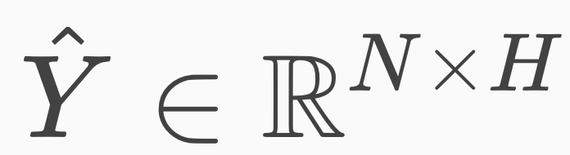
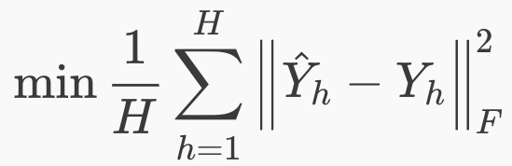
PROBLEM FORMULATION
Input:
Output:
Objective:
Notes:
Input is a sequence of historical observations: of N different 1 dimensional variables across T timesteps

Slide 9
METHODOLOGY OVERVIEW
Time-LLM reprograms time series into LLM-compatible format.
Components: 1. Input transformation 2. A pre-trained and frozen LLM 3. Output projection

Slide 10
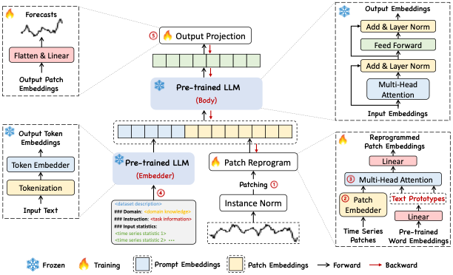
ARCHITECTURE

Slide 11
ARCHITECTURE

Slide 12
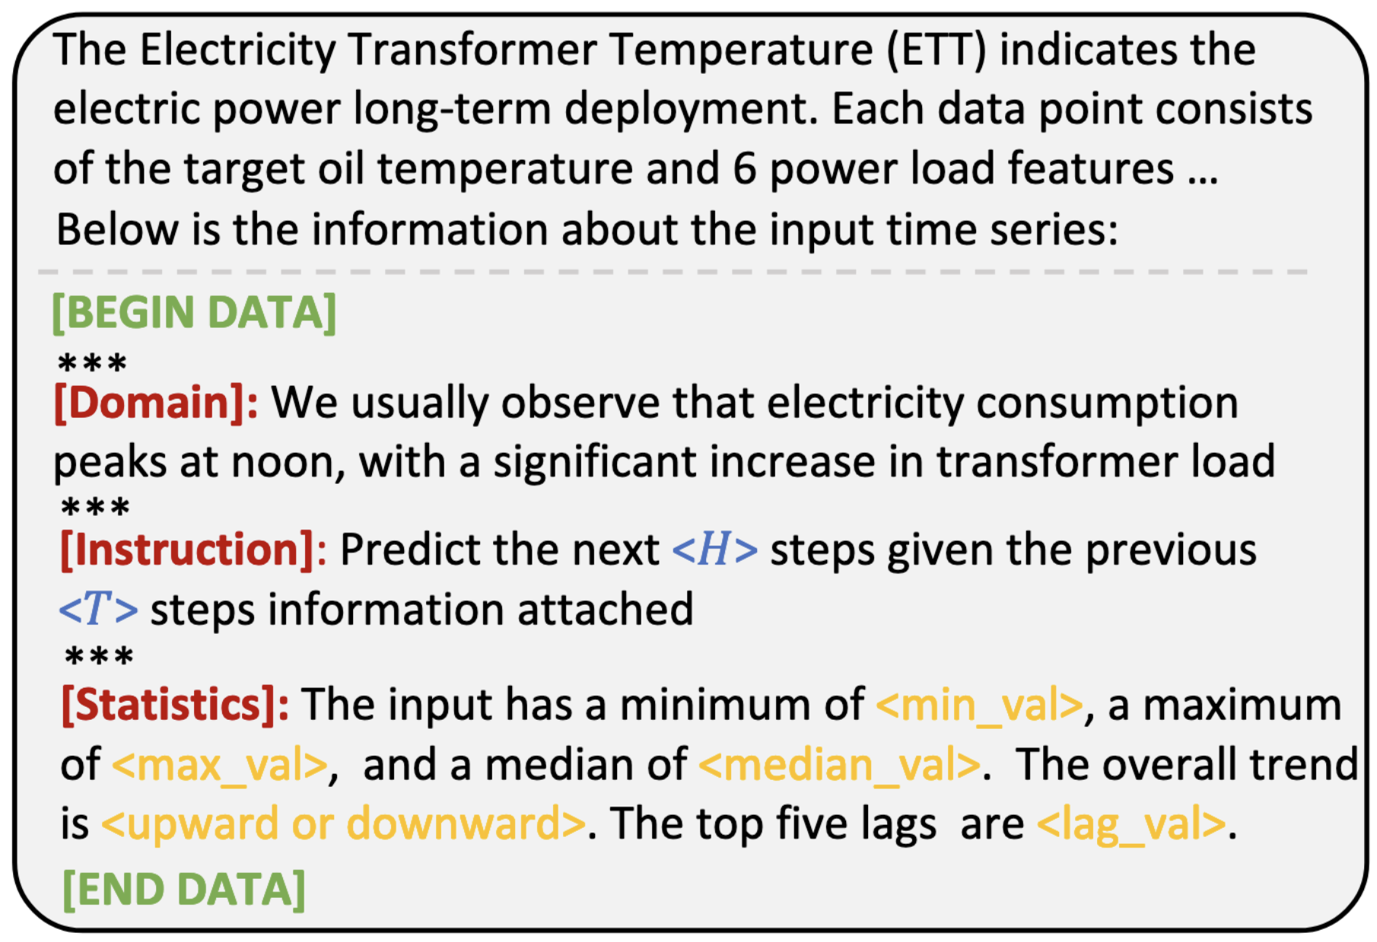
PROMPT EMBEDDING

Slide 13
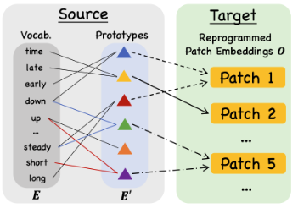
PATCH REPROGRAMMING

Slide 14
OUTPUT

Slide 15
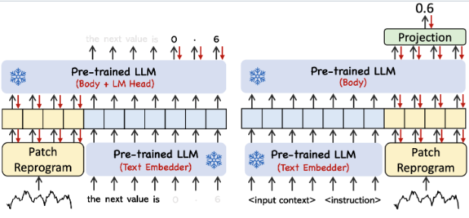
PROMPT-AS-PREFIX
Notes:
In Patch-as-Prefix, a language model is prompted to predict subsequent values in a time series, articulated in natural language. This approach encounters certain constraints: (1) language models typically exhibit reduced sensitivity in processing high-precision numerals without the aid of external tools, thereby presenting substantial challenges in accurately addressing practical forecasting tasks over long horizons; (2) intricate, customized post-processing is required for different language models, given that they are pre-trained on diverse corpora and may employ different tokenization types in generating high-precision numerals with precision and efficiency. This results in forecasts being represented in disparate natural language formats, such as [‘0’, ‘.’, ‘6’, ‘1’] and [‘0’, ‘.’, ‘61’], to denote the decimal 0.61. Prompt-as-Prefix, on the other hand, tactfully avoids these constraints.

Slide 16
ARCHITECTURE RECAP

Slide 17
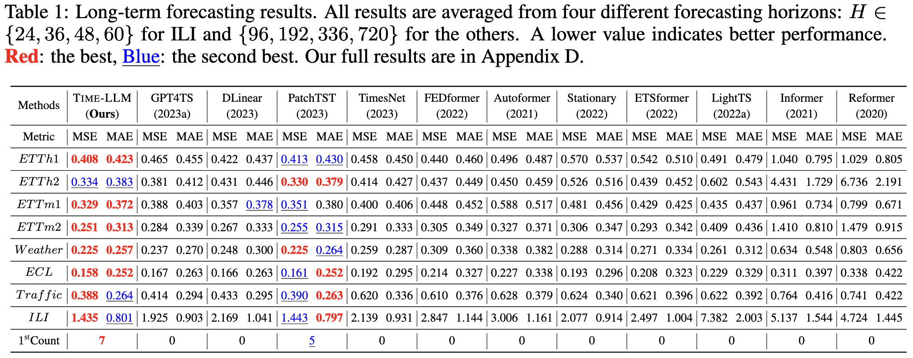
LONG TERM FORECASTING

Slide 18
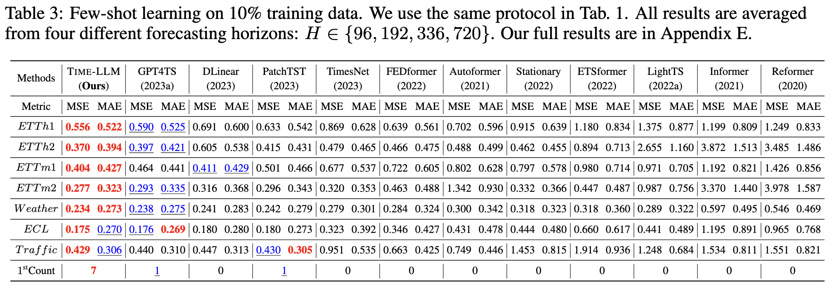
FEW-SHOT LEARNING

Slide 19
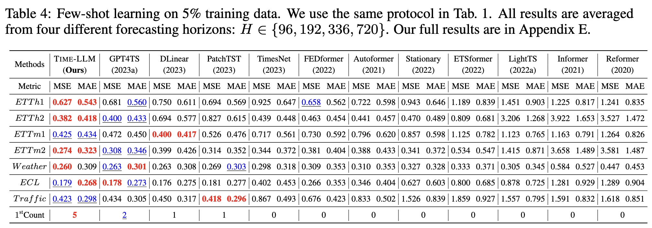
FEW-SHOT LEARNING (Contd.)

Slide 20
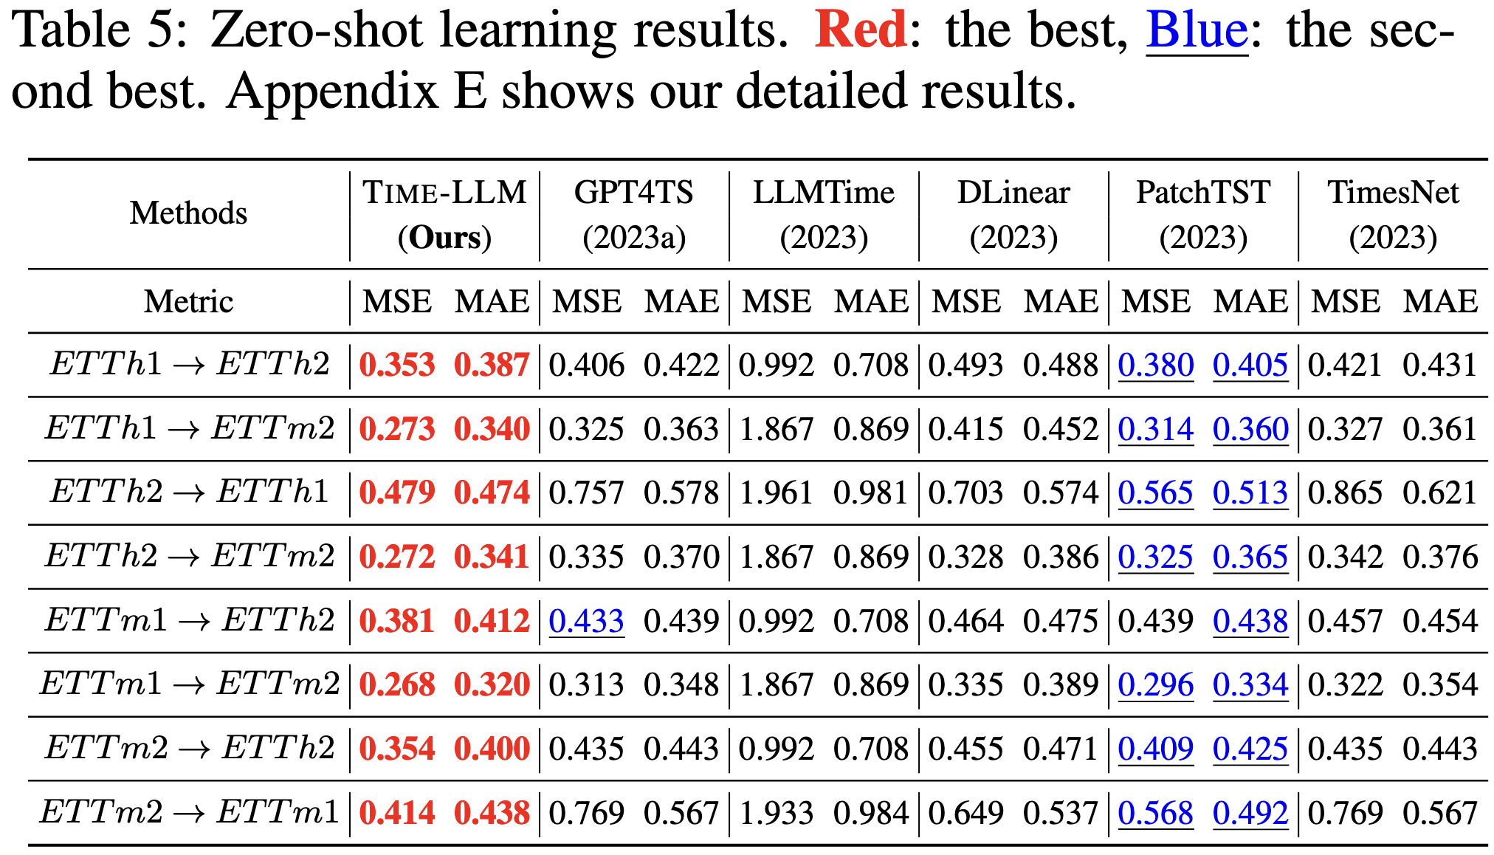
ZERO-SHOT LEARNING

Slide 21
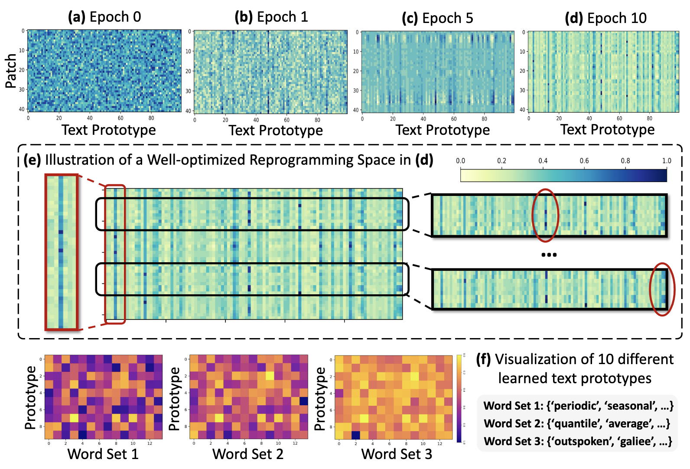
REPROGRAMMING INTERPRETATION

Slide 22
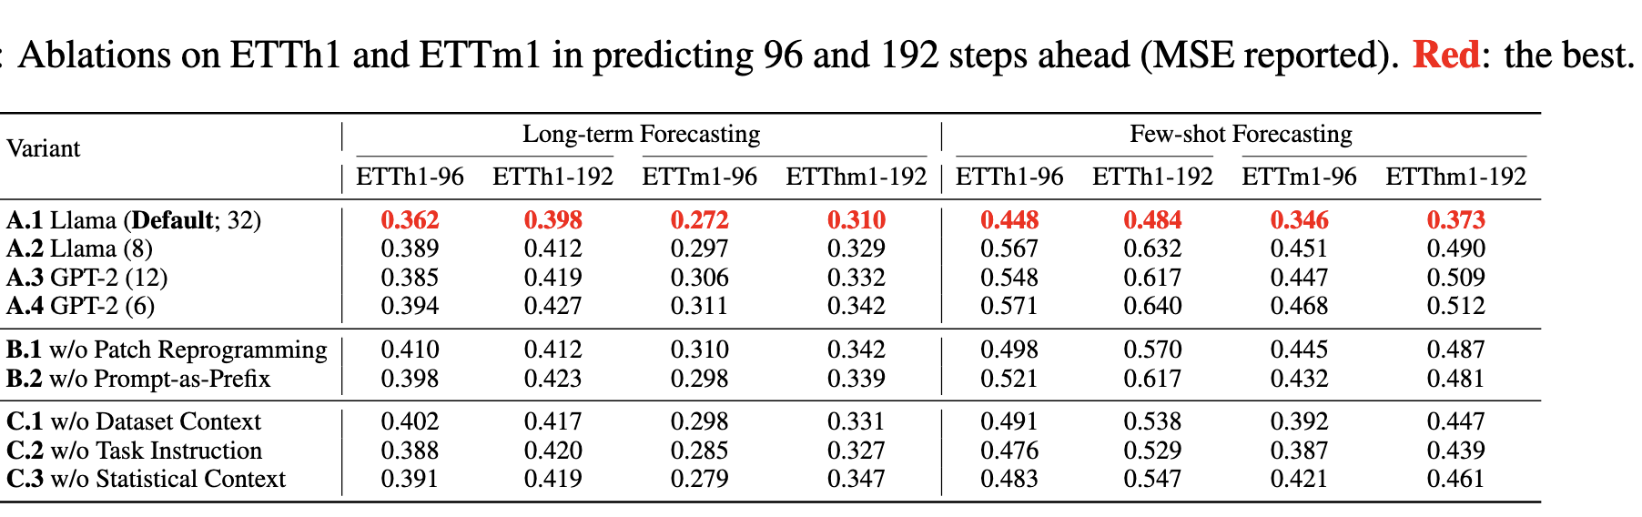
ABLATIONS

Slide 23
INSIGHTS
Reprogramming is efficient (fewer than 6.6 M trainable params, only around 0.2% of the total trainable params of Llama).
Text prototypes learn meaningful representations.
Reprogramming activates LLM reasoning.
Effective in low-data regimes.
Time Series forecasting can be cast as language task.

Slide 24
FUTURE WORKS
Explore optimal reprogramming representations
Equip LLM with broader time series analytical tasks
Build multimodal models with joint reasoning across time series, natural language and other modalities.

Slide 25
THANK YOU

