Slide 1
Learning to Augment Distributions for Out-of-Distribution Detection
Presented by
FALGUNI GHOSH
As part of BioMedIA Reading Group Session, Nov. 28, 2024

Slide 2
PAPER DETAILS
Presented in Neurips 2023
Authors: Qizhou Wang, Zhen Fang, Yonggang Zhang, Feng Liu, Yixuan Li, Bo Han
Affiliated Departments: Department of Computer Science, Hong Kong Baptist University Australian Artificial Intelligence Institute, University of Technology Sydney School of Computing and Information Systems, The University of Melbourne Department of Computer Sciences, University of Wisconsin-Madison

Slide 3
BACKGROUND: OUTLIER EXPOSURE INTRO
ID joint distribution D_{XIYI} , where X_{I}∈𝒳, Y_{I}∈𝒴
OOD joint distribution D_{XOYO}, where X_{O}∈𝒳, Y_{O}∉𝒴
Set of Auxiliary OOD data employed as surrogate of real OOD data. S = {(x¹_{I} , y¹_{I} ), ..., (x^{n}_{I} , y^{n}_{I} )} ∼ D^{n} _{XIYI} , i.i.d., T = {x¹_{A}, ..., x^{m}_{A} } ∼ D^{m}_{XA} , i.i.d.
Notes:
Iid – independent and identically distributed. Real OOD data cannot be accessed at training time.

Slide 4
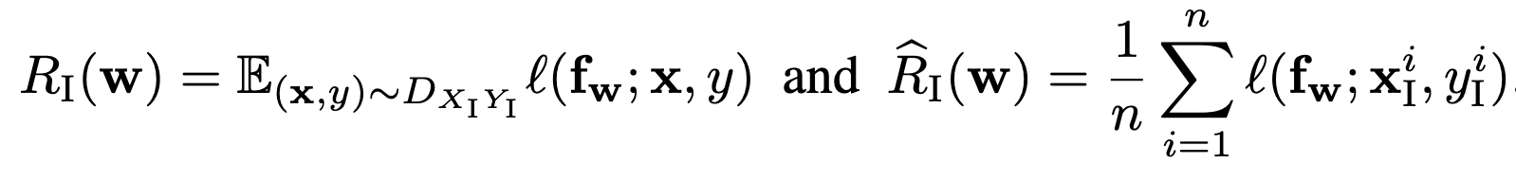
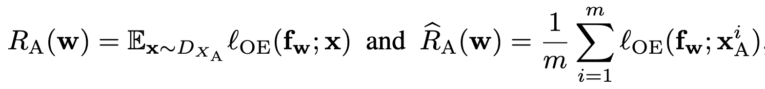
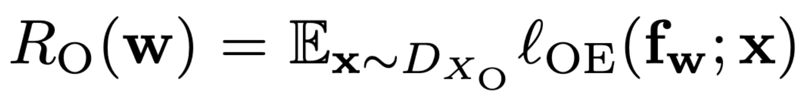
BACKGROUND: RISK ESTIMATION
Expected and empirical risks:
Expected real OOD risk:
Notes:
Mention scoring strategy, softmax and ood detector maybe

Slide 5
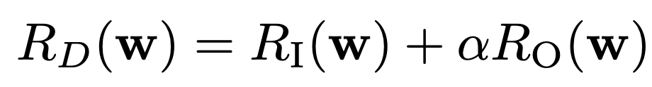
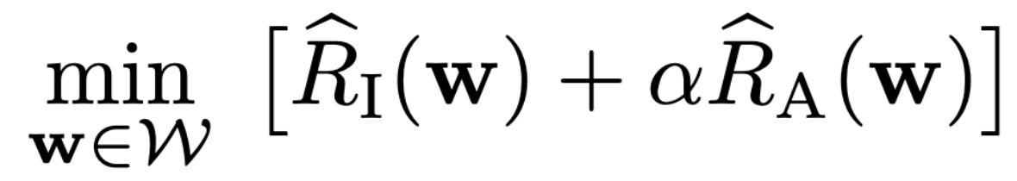
BACKGROUND: LEARNING STRATEGY
Expected detection risk w.r.t. real OOD data:
Common learning strategy is to optimize the empirical ID and auxiliary OOD risk jointly.
Learning strategy in Outlier Exposure:
Generally expected that predictor trained over auxiliary OOD data can perform well even on unseen OOD data.

Slide 6
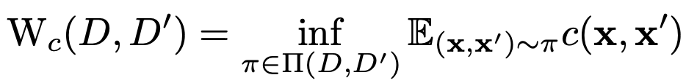
MOTIVATION
Optimal transport cost between two distributions:
Under certain conditions, with high probability, the following generalization bound holds:
Due to the upper bound, a larger distribution discrepancy between the auxiliary and real-world OOD data fails to ensure reliable detection of unseen OOD data.

Slide 7
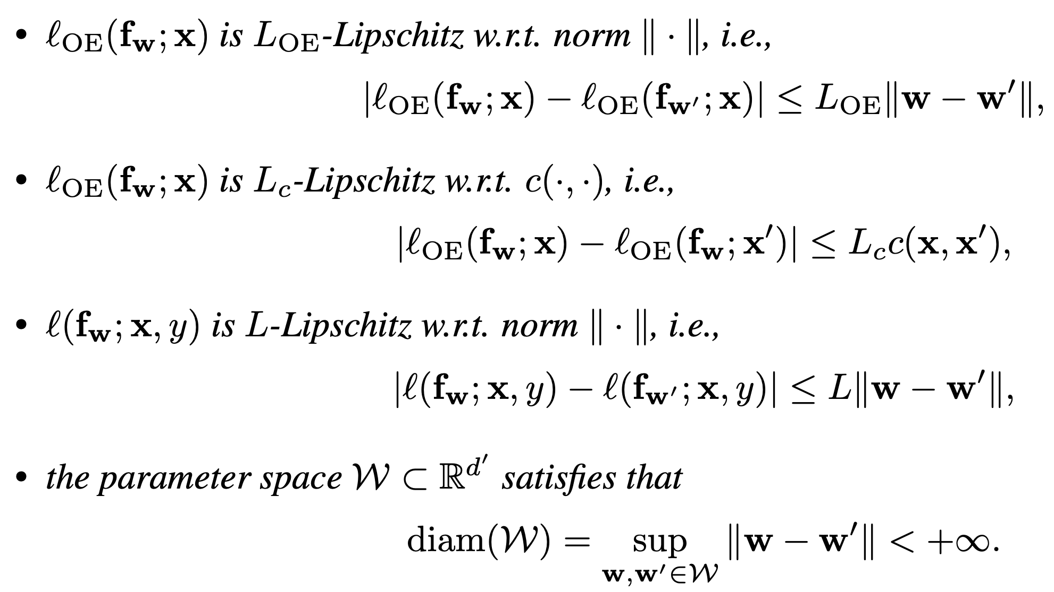
CONDITIONS

Slide 8
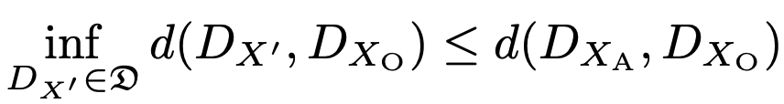
MITIGATING THE OOD DISTRIBUTION DISCREPANCY
Given a space 𝔇 consisting of some OOD distributions, including D_{XA} :
If 𝔇 is a Wasserstein-1 ball with a radius 𝜌 > 0:
A specific set of distributions , augmented around the auxiliary OOD distribution makes it possible to mitigate the distribution discrepancy

Slide 9
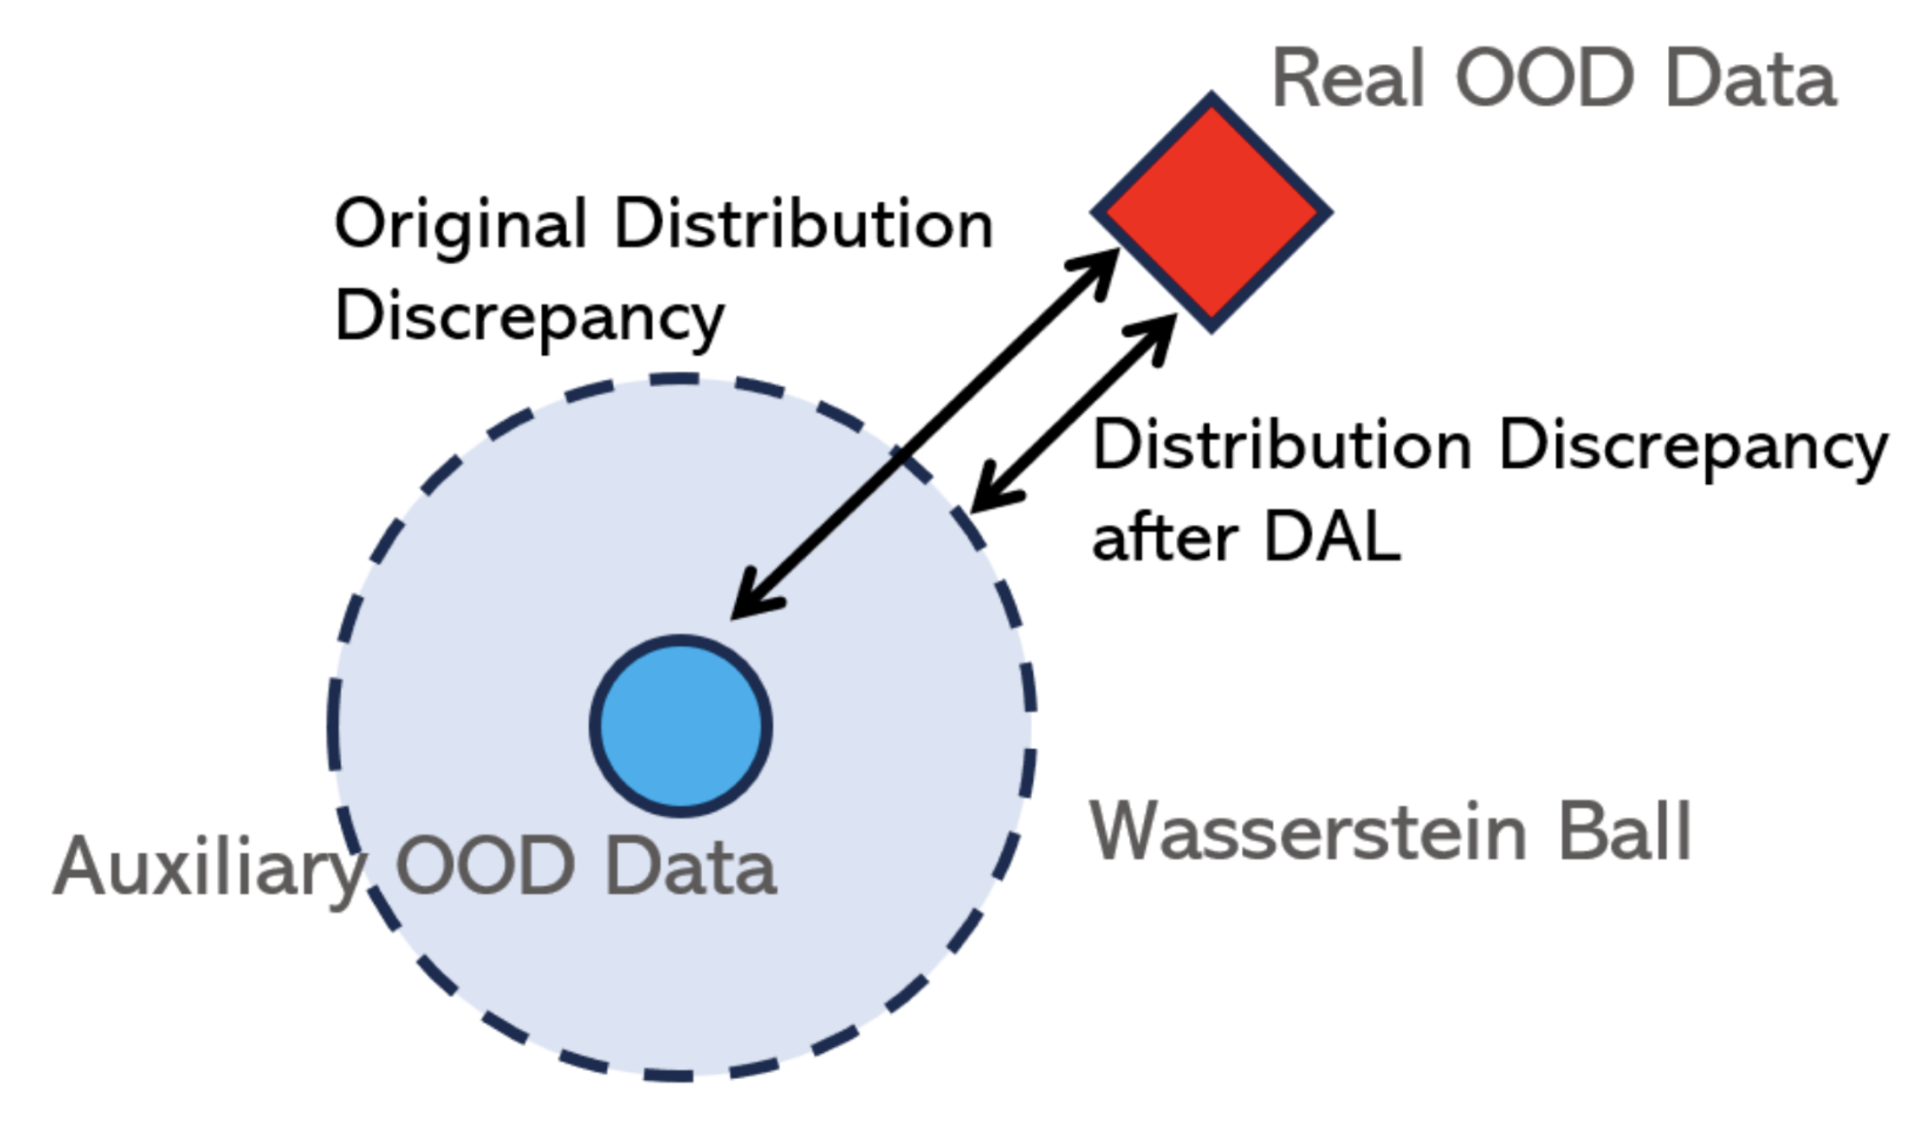
DISTRIBUTION-AUGMENTED OOD LEARNING (DAL) ILLUSTRATION

Slide 10
CHOICE OF DISTANCE METRIC
Any f-divergence-based space 𝔇 includes only distributions that share the same support set as D_{XA}.
Effective solutions within the MMD-based space have not yet been provided.
Notes:
The support set of a probability distribution refers to the subset of the space where the distribution is non-zero (i.e., where it has positive probability or density). In simpler terms, it is the region of the space where the data points or events described by the distribution can potentially exist. f-divergence measures are defined between two distributions PPP and QQQ only if Supp(P)⊆Supp(Q)\text{Supp}(P) \subseteq \text{Supp}(Q)Supp(P)⊆Supp(Q), or vice versa. This is because fff-divergence is undefined in regions where P>0 but Q=0, or vice versa. Formal Definition:
For a probability distribution PPP over a space X\mathcal{X}X:
The support set, denoted as Supp(P)\text{Supp}(P)Supp(P), is: Supp(P)={x∈X∣P(x)>0}\text{Supp}(P) = \{ x \in \mathcal{X} \mid P(x) > 0 \}Supp(P)={x∈X∣P(x)>0} This means the support set includes all points in the space X\mathcal{X}X where the probability or density assigned by PPP is greater than zero.
Examples:
Discrete Distribution:
Suppose PPP is defined over X={1,2,3,4}\mathcal{X} = \{1, 2, 3, 4\}X={1,2,3,4} with: P(1)=0.3, P(2)=0.5, P(3)=0.2, P(4)=0.P(1) = 0.3, \, P(2) = 0.5, \, P(3) = 0.2, \, P(4) = 0.P(1)=0.3,P(2)=0.5,P(3)=0.2,P(4)=0. Here, the support set is: Supp(P)={1,2,3}.\text{Supp}(P) = \{1, 2, 3\}.Supp(P)={1,2,3}.
Continuous Distribution:
For a normal distribution P(x)P(x)P(x) with mean μ\muμ and standard deviation σ\sigmaσ, defined over X=R\mathcal{X} = \mathbb{R}X=R, the support is theoretically: Supp(P)=R.\text{Supp}(P) = \mathbb{R}.Supp(P)=R. However, practically, it is concentrated around μ\muμ and diminishes quickly as xxx moves away.
Mixture Distribution:
A Gaussian mixture model with components in distinct regions will have a support set combining those regions.

Slide 11
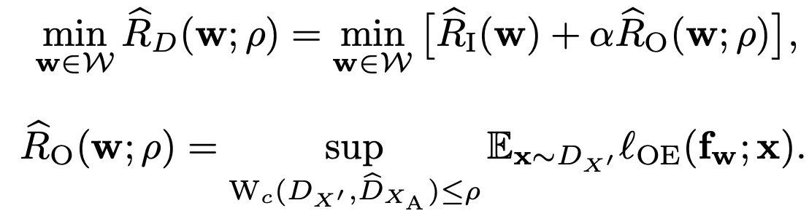
OBJECTIVE
Since the augmentation of the auxiliary OOD data within the distribution space mitigates distribution discrepancy, that objective is chosen instead of minimizing empirical risk directly.
The optimization problem:
Notes:
Instead of directly minimizing empirical auxiliary risk, we augment …
Problem with this objective

Slide 12
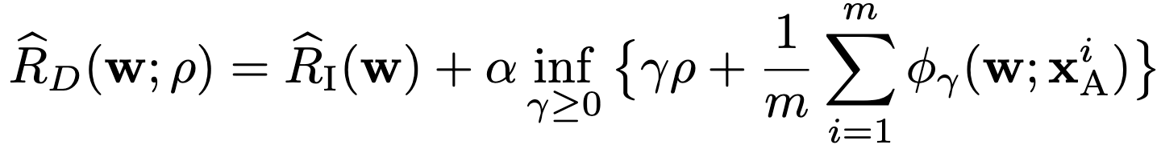
CONVERTING TO TRACTABLE OBJECTIVE
Let c(.,.) be a continuous metric and ϕ_{𝛾}​(w;x)=sup_{x′∈X​}{𝓁(fw​;x′) − 𝛾c(x′,x)} be the robust surrogate function. This transforms the infinite-dimensional objective to its finite counterpart:
For practical purposes, the surrogate is the worst OOD case.
where h is the classifier, e is feature extractor and p is perturbation for the embedding features

Slide 13
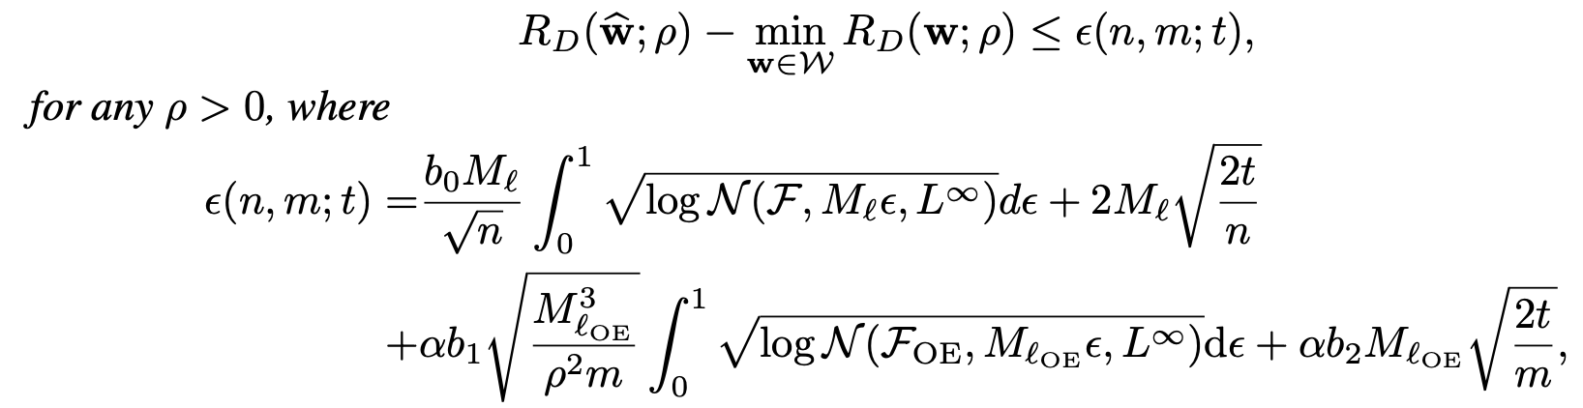
EXCESS GENERALIZATION BOUND
This theorem shows that the empirical model can achieve consistent learning performance. With the probability of atleast 1-4e^{-t}>0,
Notes:
our results rely on the covering number (cf., Appendix C.1) for the model classes F = {l(fw; ·) : w ∈ W} and FOE = {lOE(fw; ·) : w ∈ W} to represent their complexity. Intuitively, the covering numbers N (F , ε, L∞) and N (FOE, ε, L∞) are the minimal numbers of L∞ balls of radius ε > 0 needed to cover the model classes F and FOE, respectively. Now, we demonstrate that DAL can achieve consistent performance under mild assumptions.

Slide 14
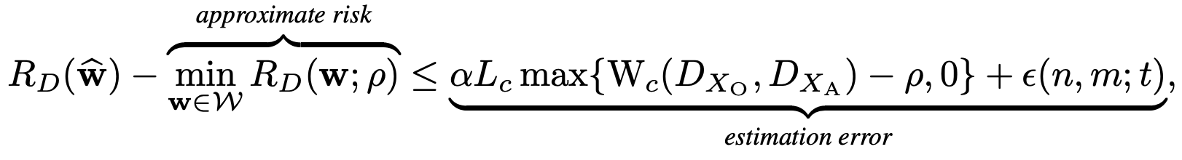
RISK ESTIMATION
This theorem shows the risk estimation of the empirical model. With the probability of atleast 1 - 4e^{-t} > 0, the optimum risk can be within the bounds of an approximate risk.
The bias term becomes smaller with bigger 𝞺 but Approximate risk increases . So, trade-off between approximate risk and bias by choosing proper 𝞺 is needed for practical effectiveness.

Slide 15
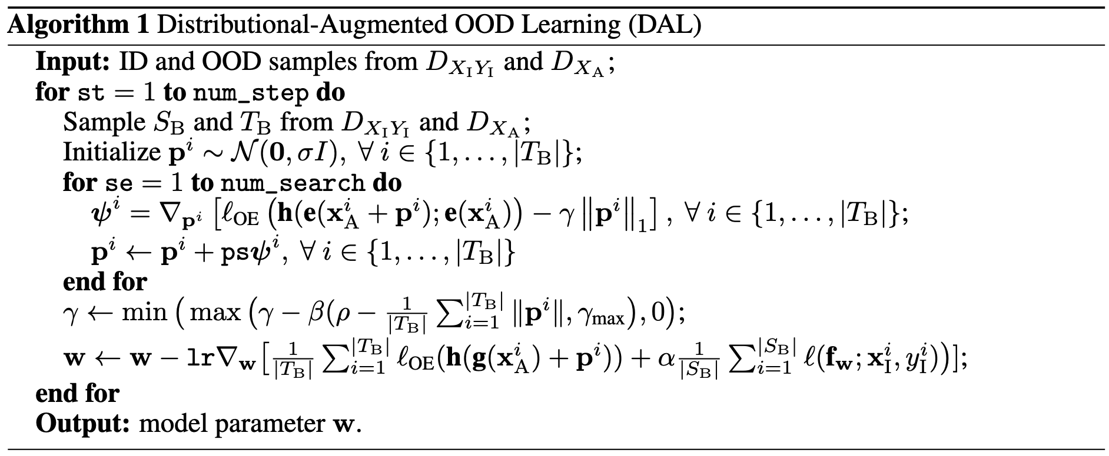
ALGORITHM
Notes:
γ: Regularization weight that controls the strength of the L1 norm penalty on pip_ipi​.β\betaβ: A scaling factor for the regularization adjustment.ρ\rhoρ: A target magnitude for the perturbation.γ\gammaγ is updated dynamically based on the deviation of ∥pi∥\|p_i\|∥pi​∥ (average perturbation magnitude) from ρ\rhoρ. It is constrained between 0 and γmax\gamma_{\text{max}}γmax​.

Slide 16
ALGORITHM
Notes:
γ: Regularization weight that controls the strength of the L1 norm penalty on pip_ipi​.β\betaβ: A scaling factor for the regularization adjustment.ρ\rhoρ: A target magnitude for the perturbation.γ\gammaγ is updated dynamically based on the deviation of ∥pi∥\|p_i\|∥pi​∥ (average perturbation magnitude) from ρ\rhoρ. It is constrained between 0 and γmax\gamma_{\text{max}}γmax​.

Slide 17
ALGORITHM
Notes:
γ: Regularization weight that controls the strength of the L1 norm penalty on pip_ipi​.β\betaβ: A scaling factor for the regularization adjustment.ρ\rhoρ: A target magnitude for the perturbation.γ\gammaγ is updated dynamically based on the deviation of ∥pi∥\|p_i\|∥pi​∥ (average perturbation magnitude) from ρ\rhoρ. It is constrained between 0 and γmax\gamma_{\text{max}}γmax​.

Slide 18
EXPERIMENTS
ID Dataset: CIFAR
Auxiliary OOD Dataset: 80 million Tiny Images
Real OOD Dataset: Textures, SVHN, Places365, LSUN, iSUN
Pre-training setups: Wide ResNet-40-2 trained for 200 epochs via empirical risk minimization, with a batch size 64, momentum 0.9, and initial learning rate 0.1. The learning rate is divided by 10 after 100 and 150 epochs.
Hyperparams: σ = 0.001, num_search = 10. Grid search to choose γ_{max} from {0.1, 0.5, 1, 5, 10, 50}; β from {1e −3 , 5e −3 , 1e −2 , 5e −2 , 1e −1 , 5e −1 , 1, 5}; ρ from {1e −2 , 1e −1 , 1, 10, 100}; ps from {1e −3 , 1e −2 , 1e −1 , 1, 10, 100}; α from {0.1, 0.5, 1.0, 1.5, 2.0} For CIFAR-10, DAL is run for 50 epochs with the ID batch size 128, the OOD batch size 256, the initial learning rate 0.07, γ_{max} = 10, β = 0.01, ρ = 10, ps = 1, and α = 1.

Slide 19
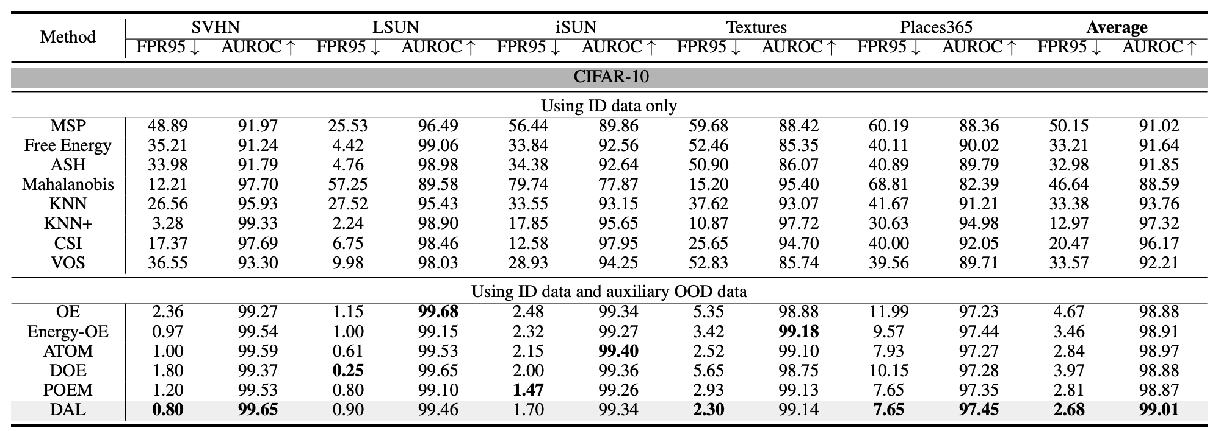
RESULTS

Slide 20
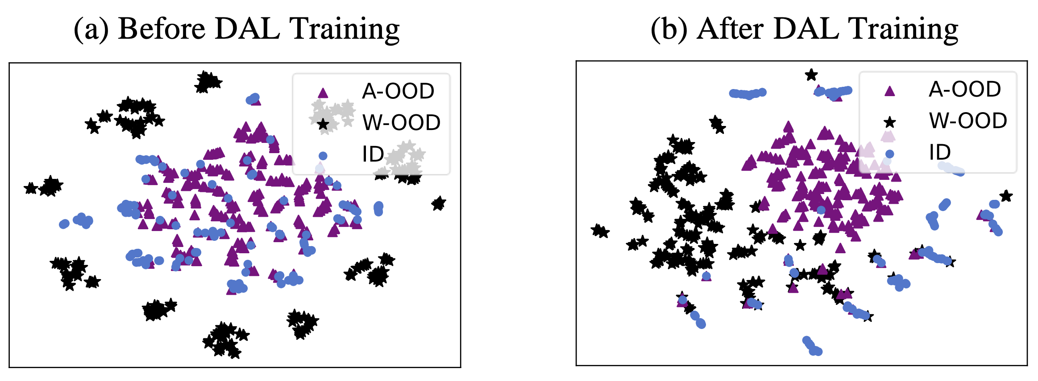
VISUALIZATION
t-SNE visualization on the embedding features from the ID, Auxiliary OOD and
worst OOD data

Slide 21
FUTURE WORK
Apply on timeseries data for time series anomaly detection problems
Feasible dimension-wise as even multimodal or multivariate time series data expected to have lower dimension than image data (used by the authors)
Synthetic anomalous timeseries data creation possible
Challenges: - Creating setup for real and auxiliary OOD data. Timeseries subsequence with an anomalous timestep taken as auxiliary OOD? - How to preserve the temporal context? Applying feature aggregator on the subsequence patches and then perturbing?

Slide 22
THANK YOU

