Slide 1
Geometry of Long-Tailed Representation Learning: Rebalancing Features for Skewed Distributions (Yi et al., ICLR 2025)
Presenter:
Felix Nützel

Slide 2

Preliminaries
Supervised Contrastive Learning (SCL)
For every class K, calculate the loss for each member of K in the batch B
Make the contribution independent of the class size N_{k}
Sum over all positive examples
Temperature-scaled negative log likelihood of the positives
z_{j}
z_{i}
z_{l}
Cosine distance of embeddings
Notes:
C

Slide 3
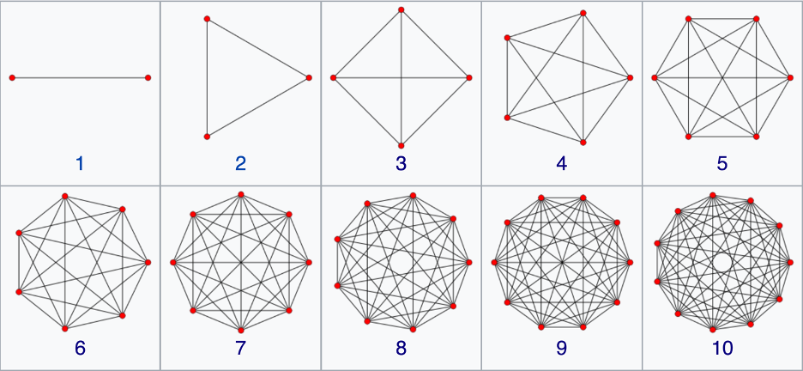
Preliminaries
Regular Simplex
A K-point configuration forms the vertices of a regular simplex inscribed in the unit hypersphere, if:
All vertices lie on the unit hypersphere
The inner product between all distinct pairs is identical (Equidistance)
The average of the vertices is the origin (Balance)
Projections of Simplices of varying dimensions

Slide 4
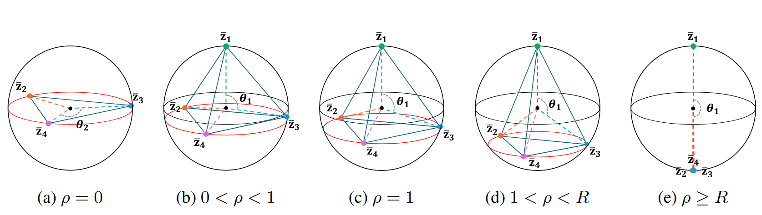
Optimal Representation Configuration (ORC)
Geometries for different imbalance factors ρ
Demonstration Example:
Four classes of size N_{i} and centers $$\overline{z}$$_{i}
N₂ = N₃ = N₄
N₁ = ρN₂
θ₁: Angle between head class centers and tail class centers
θ₂: Angle between tail class centers
Collapse at critical constant R (approximated by 12.16 (K - 1)

Slide 5
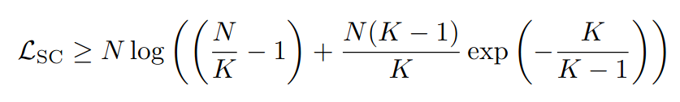
Relationship between ORC and SCL
Balanced Case
N unit vectors z_{i} $$∈$$ S^{h-1}
Balanced: N_{k} = N/K, 3 $$≤$$ K $$≤$$ h + 1
Equal to lower bound iff
There exists K-point configuration $$\overline{Z}$$ on S^{h-1} s.t. i ∈ B_{k}, z_{i} = $$\overline{z}$$_{k} (A1)
$$Z$$ form a regular simplex inscribed in the unit hypersphere (A2)
Takeaways:
The contrastive loss is minimal if the class clusters converge to a single point (A1) and are maximally separated (A2)
Lower bound depends on the dataset size N and the number of classes K

Slide 6

Relationship between OCR and SCL
Unbalanced Case (1)
Function dependent on
Head class size a₁ and center angle θ₁
Tail class size a₂ and center angle θ₂
Number of classes K
Imbalance factor ρ
Equal to lower bound iff
All class features converge to a single point
The tail classes form regular simplex with angle θ₂
The inner product between head and tail classes equals cos(θ₁) and cos(θ₂) = (K-1)cos²(θ₁) - 1 / (K-2)
C
Takeaways:
When optimality is reached, θ₂ depends on θ₁
When fixing cos(θ₂) in f to the optimal value, we get a convex function g, which as ρ increases, θ₁ increases and θ₂ decreases

Slide 7
Relationship between OCR and SCL
Unbalanced Case (2)
Numerical Relationship between ρ and θ₁ :
ρ | θ₁ | Interpretation
ρ $$<$$ 1 | (arccos(-1/(K-1)), 0) | Head vertex lies inside the K-simplex
ρ = 1 | arccos(-1/(K-1)) | Head vertex is a vertex of the K-simplex
1 < ρ < R | (-π, arccos(-1/(K-1))) | Head vertex lies outside the K-simplex
ρ ≥ R | -π | Collapse (180° reached)

Slide 8
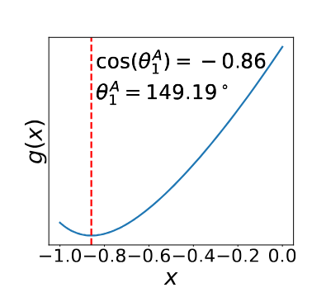
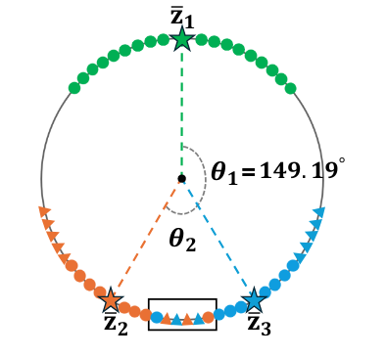
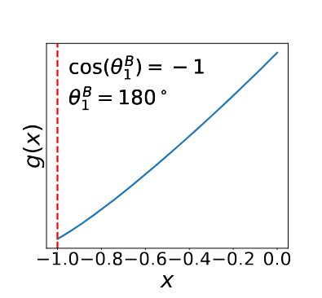
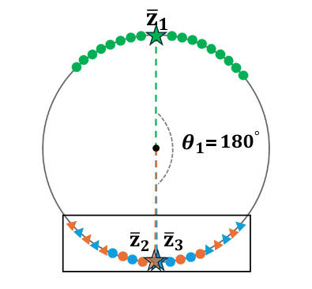
Relationship between OCR and SCL
Numerical Example
ρ = 10, K = 3, N₂ = N₃ = 50:
ρ < R(2)
θ₁ = 149.49°
θ₂ = 61.63°
ρ = 100, K = 3, N₂ = N₃ = 50:
ρ $$>$$ R(2)
θ₁ = 180°
θ₂ = 0°

Slide 9
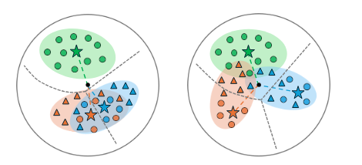
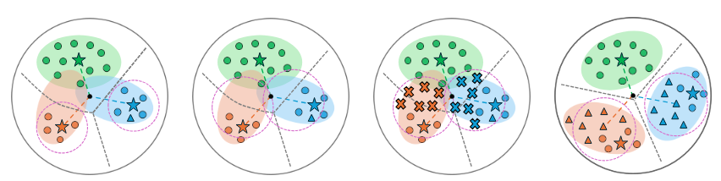
FeatRecon
Overview
Before Correction
After Correction
Skewed center configurations cannot be easily fixed, since overlaps might occur during test time due to distribution gaps
Estimation
Regularization
Generation
Optimization
FeatRecon solves this problem using a 4-step algorithm

Slide 10

FeatRecon
Confidence Support Estimation
Confidence Support Estimation:
Characterize hyperspherical cap for each class by estimating its center and central angle
Estimated mean of class features
α-Quantile
Deviation of class features from estimated mean

Slide 11

FeatRecon
Head Class Regularization
Head Class Regularization:
Improve our estimated statistics of the tail classes by choosing the top q head classes with the most similar estimated means:
Construct the weights preferring more samples and more similar est. means :
Interpolate the statistics using parameter $$γ$$:

Slide 12
FeatRecon
Feature Generation
Feature Generation:
The estimated statistics are used to generate features in the specified caps, disallowing caps that are more than half the distance between two class centers, to avoid overlaps
half the angular distance to the next vertex in a regular simplex
area inside the cap of class k
$$θ$$
µ
cap boundary

Slide 13


FeatRecon
Optimization
Temperature Adjustment:
For better separation between head and tail classes, the temperature scale is adjusted based on the class size
Training Framework:
Model consists of base encoder, prediction head and projection head
The prediction head is optimized via cross entropy loss and logit compensation, shifting the logits by the log of the class priors $$δ$$_{y}:
Final Loss:

Slide 14
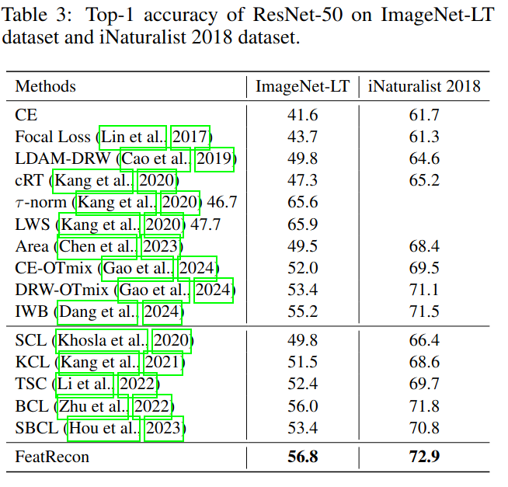
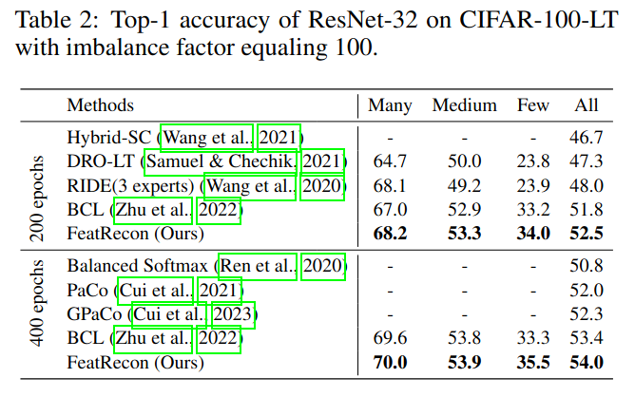
Results (1)

Slide 15
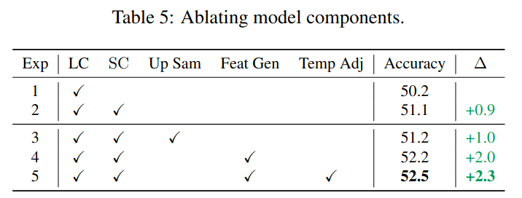
Results (2)

Slide 16

Questions

