Slide 1
The Evolution of LLM Alignment Tuning: From PPO to DPO to GRPO
BioMedIA Reading Group
Presenter: Siyi Du
2025-10-30

Slide 2



Why Alignment
Don’t follow the instruction
Unsafe
Violent
Society bias
Instruction
LLM after next-token pre-training
Follow the instruction
Safe
LLM after being aligned with human preference
[1] Bender, Emily M., et al. "On the dangers of stochastic parrots: Can language models be too big?🦜." Proceedings of the 2021 ACM conference on fairness, accountability, and transparency.
Notes:
follow the user’s instructions helpfully and safelly

Slide 3
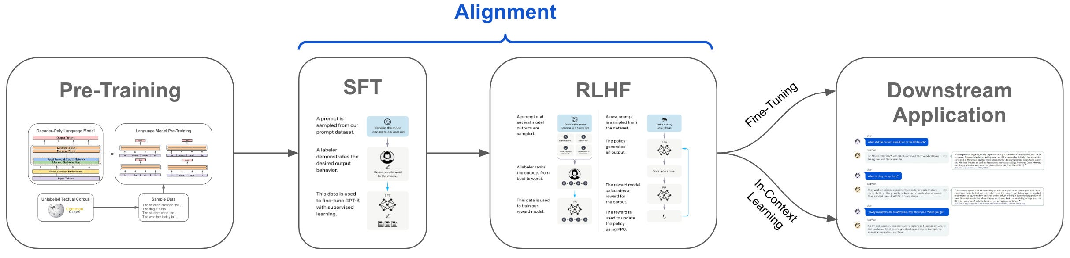
Why Alignment
Don’t follow the instruction
Unsafe
Violent
Society bias
Instruction
LLM after next-token pre-training
Follow the instruction
Safe
LLM after being aligned with human preference
Notes:
follow the user’s instructions helpfully and safelly

Slide 4
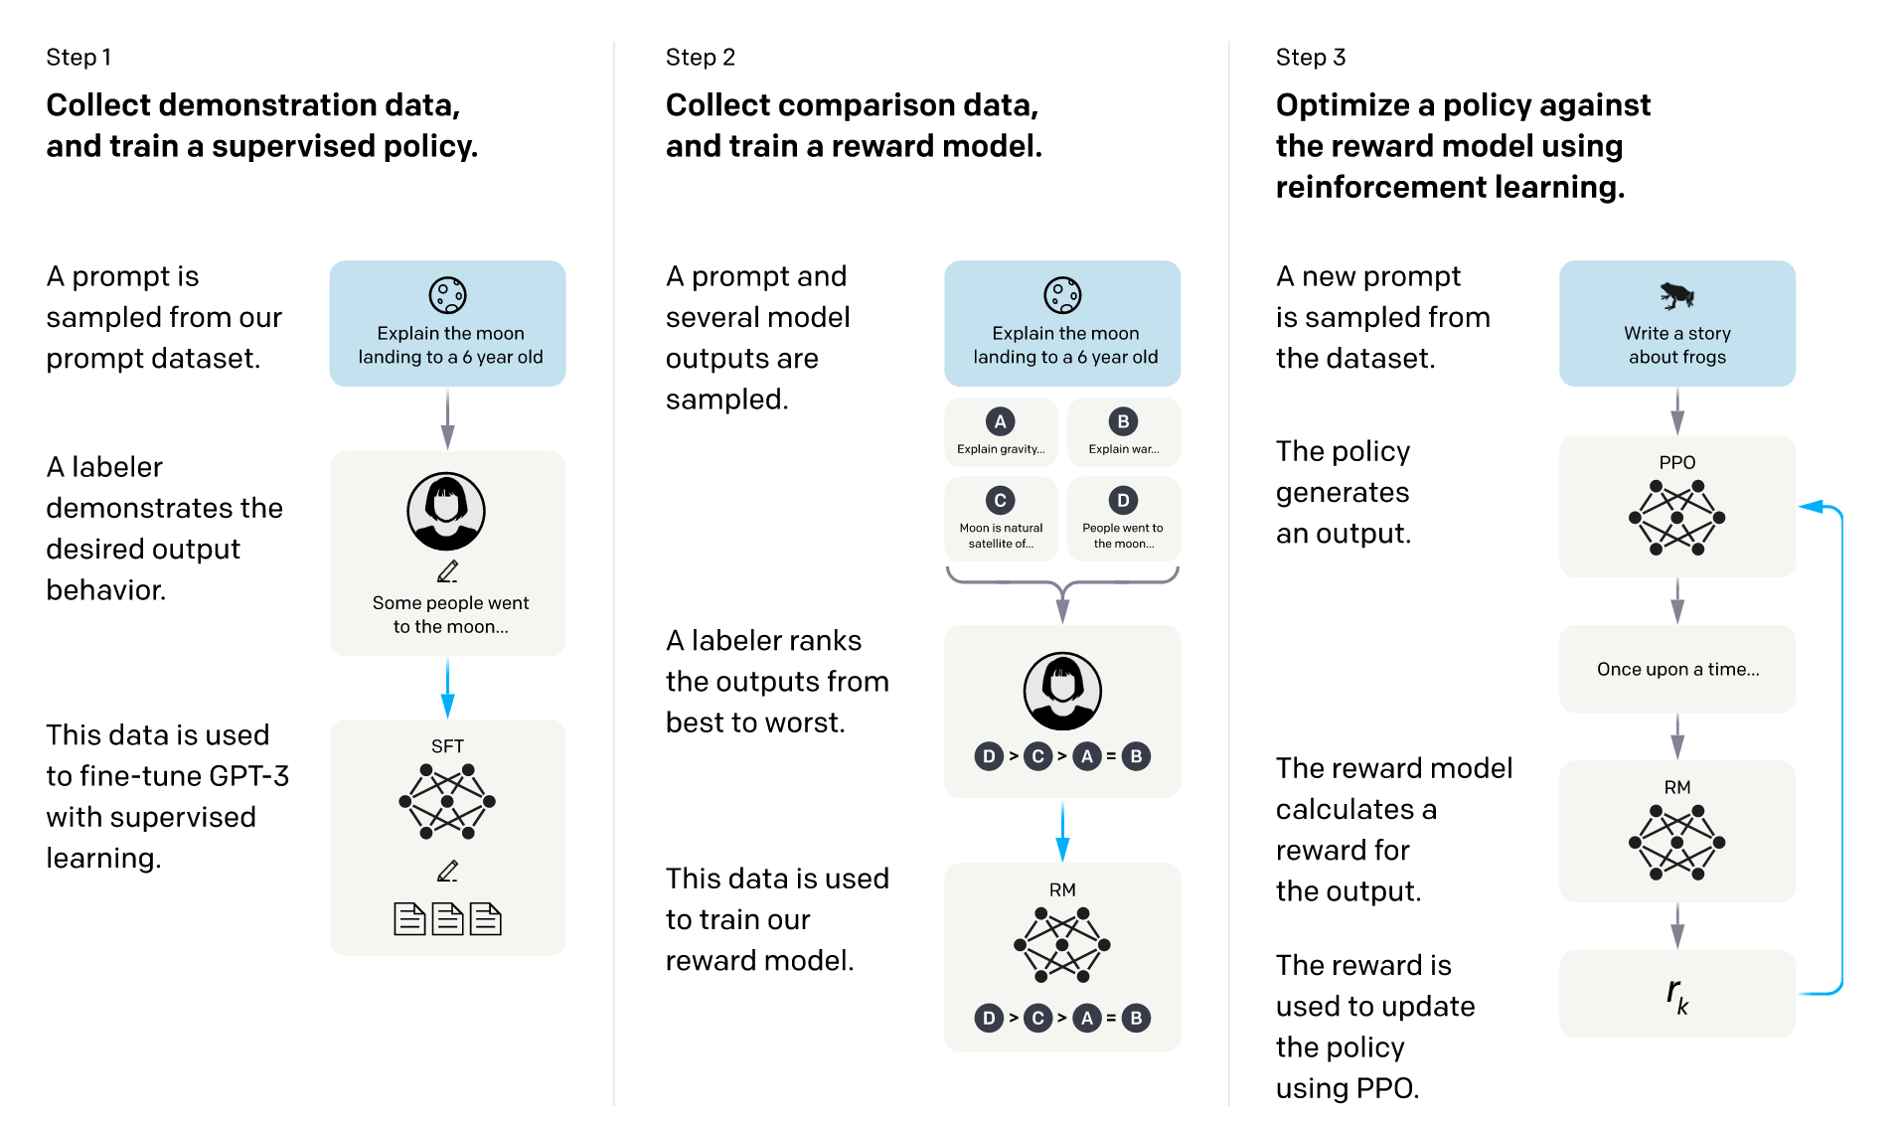
Alignment Overview
Supervised fine-tuning (SFT)
Train a reward model
PPO optimization
[1] Ouyang, Long, et al. "Training language models to follow instructions with human feedback." NIPS 2022
Notes:
InstructGPT

Slide 5
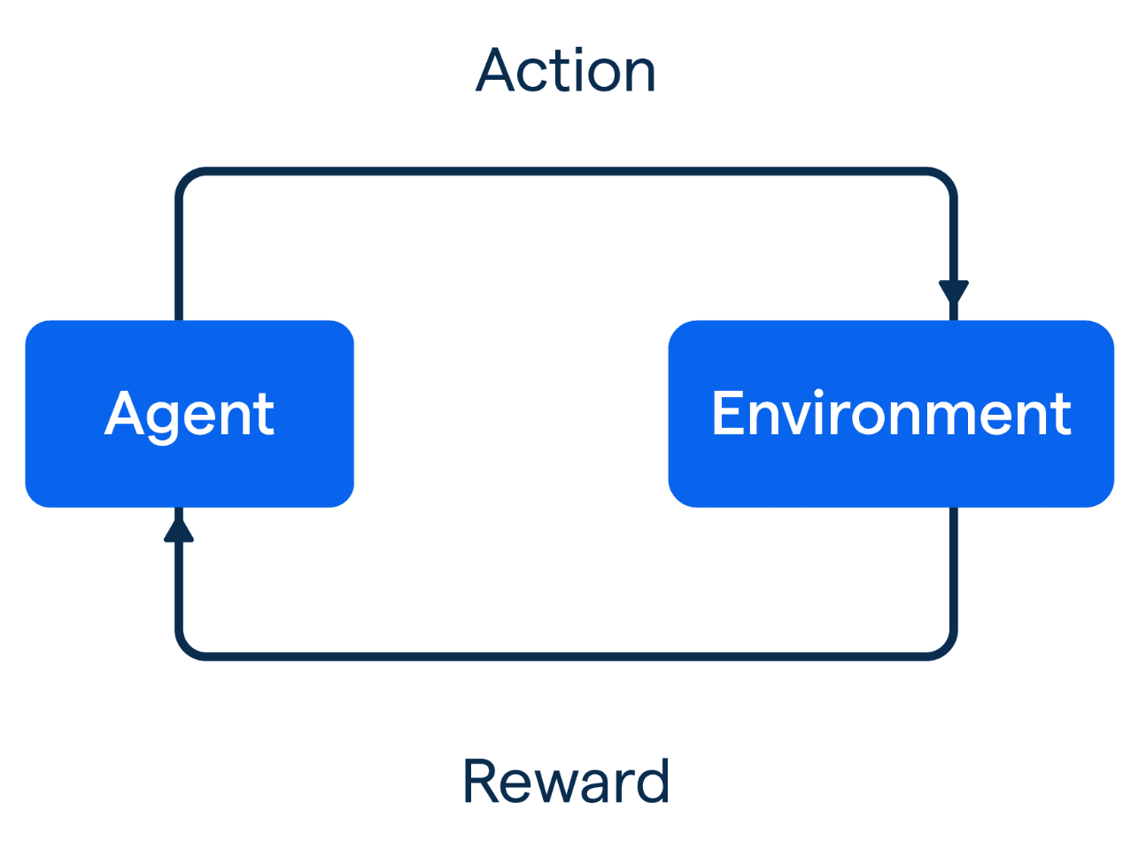

RL Fundamentals
(Next token/response)
(Context)
(Human preference)
Update policy to maximize the expected reward

Slide 6


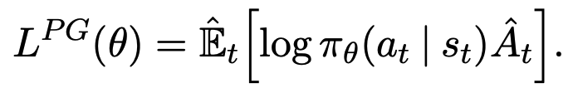
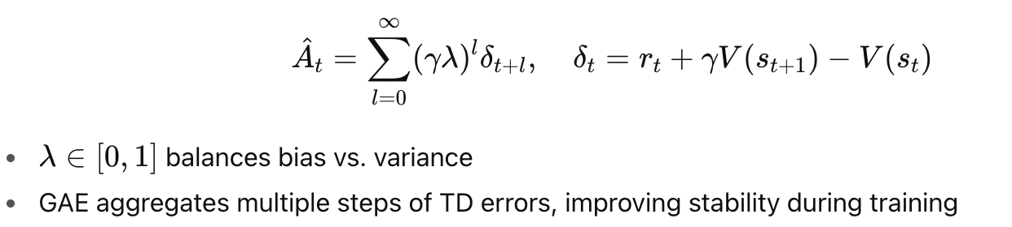

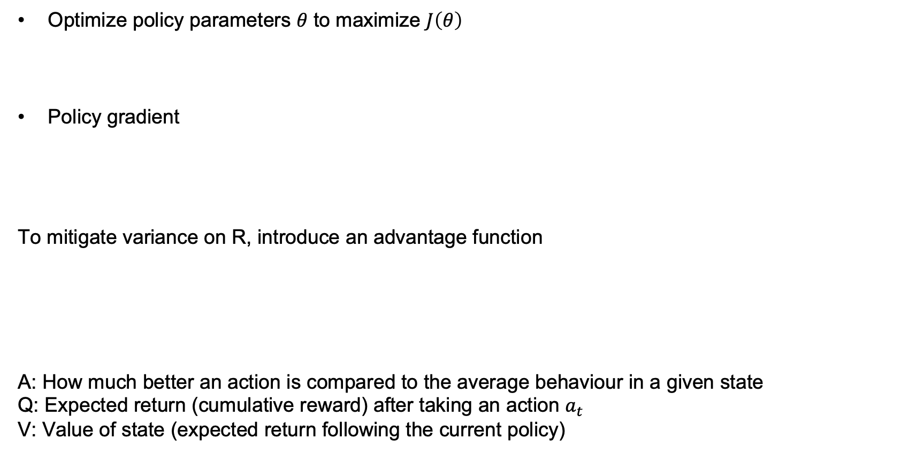
Policy Gradient & Optimization
Optimize policy parameters 𝜃 to maximize $J\left(θ\right)$
Policy gradient
To mitigate variance on R, introduce an advantage function
A: How much better an action is compared to the average behaviour in a given state
Q: Expected return (cumulative reward) after taking an action $a_{t}$
V: Value of state (expected return following the current policy)
Generalized advantage estimation
[1] Schulman, John, et al. "Proximal policy optimization algorithms." arXiv preprint arXiv:1707.06347 (2017).
Notes:
log trick
empirical expectation

Slide 7
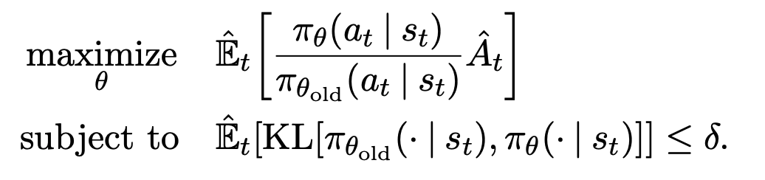
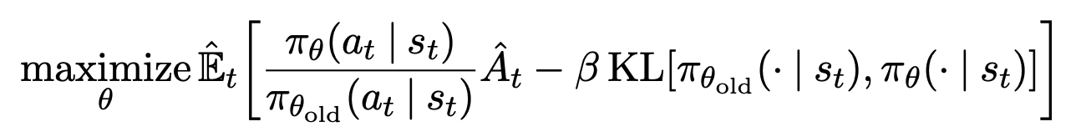
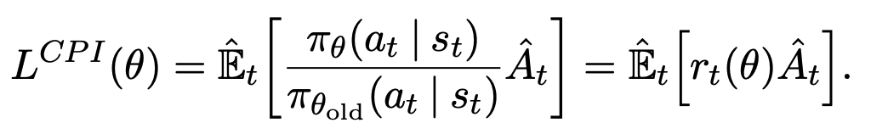
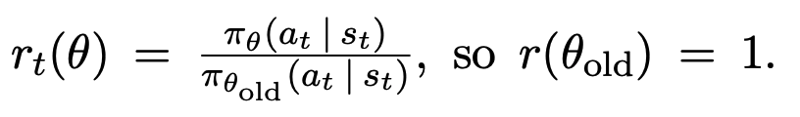
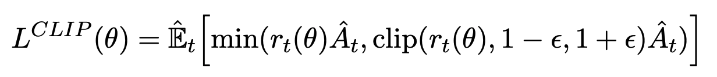
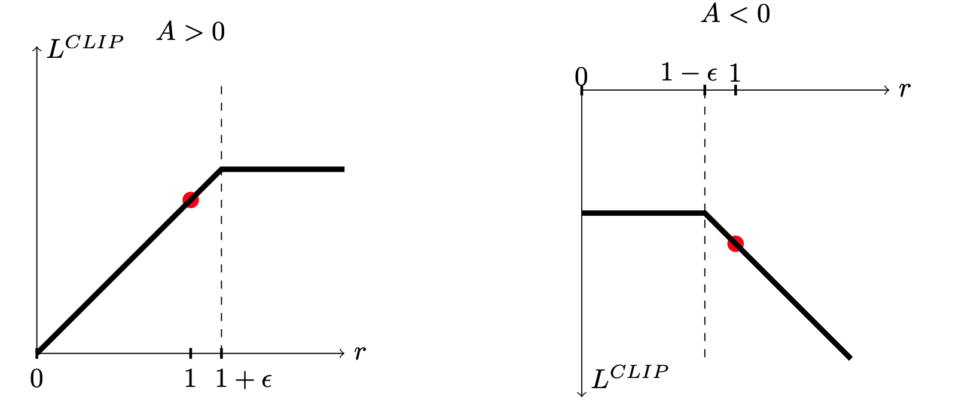
Proximal Policy Optimization (PPO)
Trust region policy optimization (TRPO)
Use a constraint to guarantee that the policy change is smaller than a trust region
To reduce the computational cost of TRPO, PPO introduces clipping to resemble TRPO
TRPO
PPO
[1] Schulman, John, et al. "Proximal policy optimization algorithms." arXiv preprint arXiv:1707.06347 (2017).

Slide 8

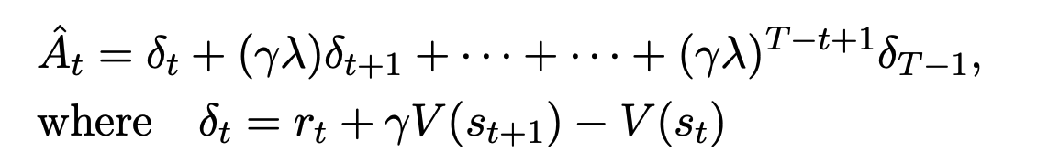
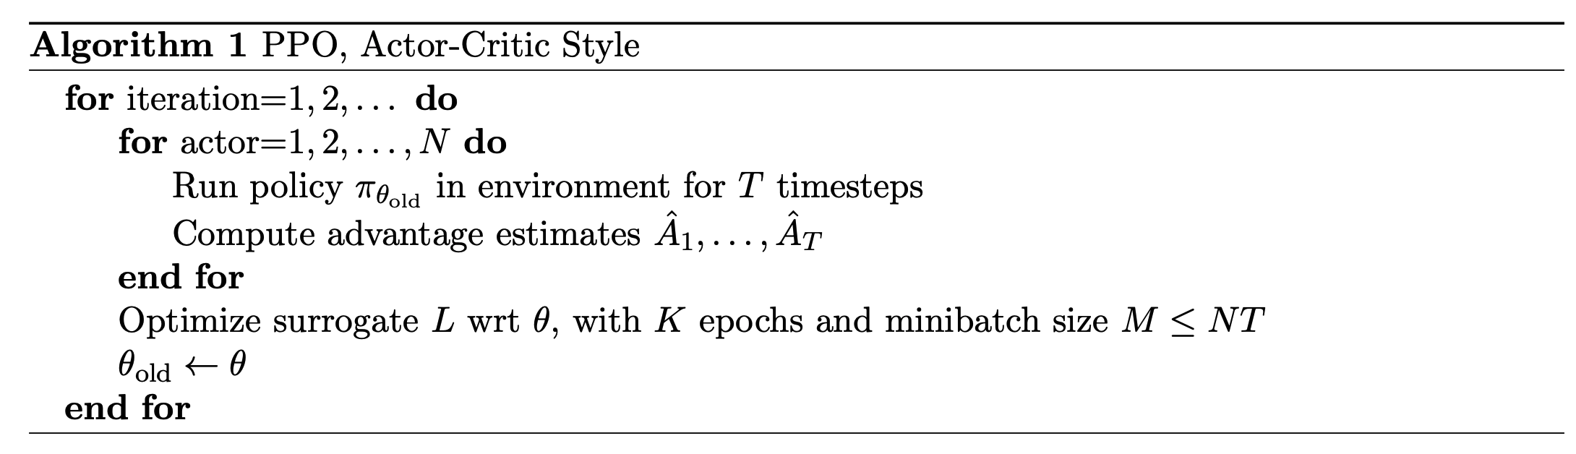
PPO Algorithm
Value function error term
Entropy bonus to ensure sufficient exploration

Slide 9
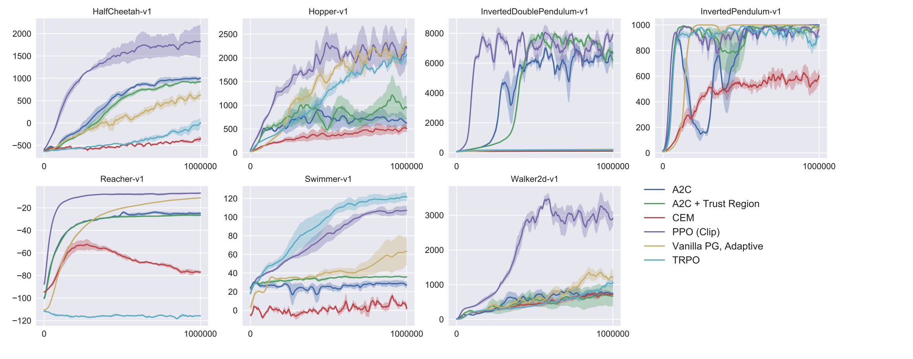
Experiment
Reward
Notes:
converge fast
stable
final reward is higher

Slide 10
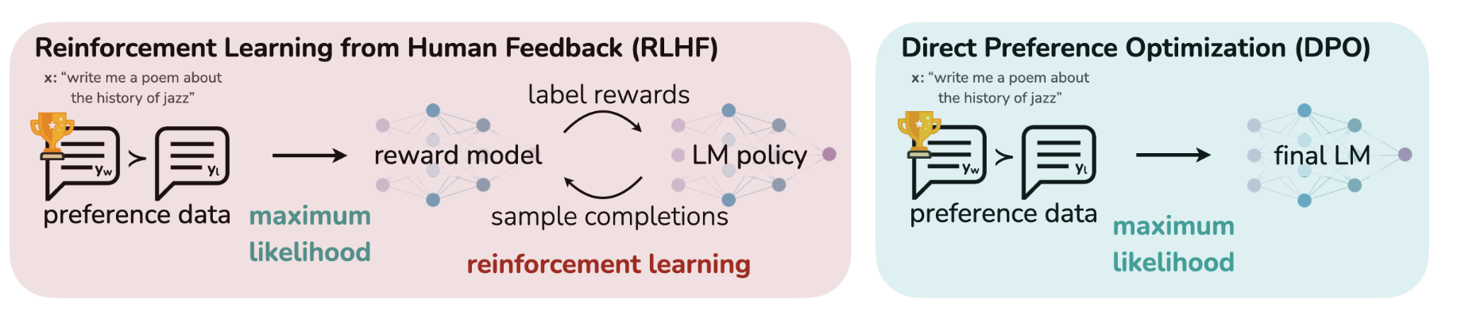
Direct Policy Optimization (DPO)
Direct Preference Optimization: Your Language Model is Secretly a Reward Model (NIPS 2023)
RLHF is a complex and often unstable procedure
DPO transfers the problem to be a classification task to avoid RL
[1] Rafailov, Rafael, et al. "Direct preference optimization: Your language model is secretly a reward model." NIPS 2023.

Slide 11

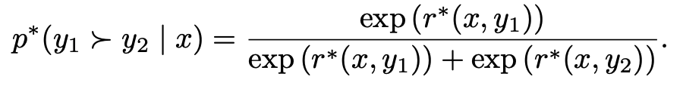

Reward Modelling in RLHF
SFT model is prompted to produce pairs of answers, which are then presented to human labelers
Human preference distribution p* can be written as
Classification loss for the reward model
LLM RL fine-tuning using the GP loss

Slide 12
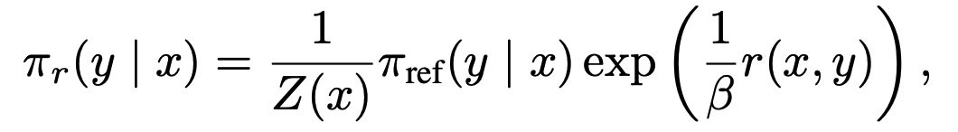
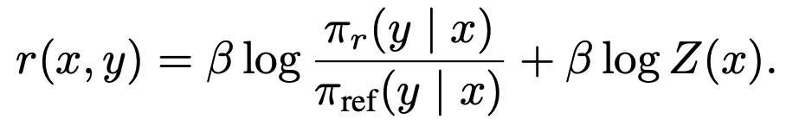
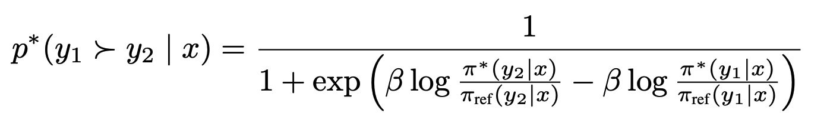

DPO
The optimal solution for the the GP loss takes this form
DPO proposes to avoid computing Z. First, take the logarithm on both sides
Then, rewrite p* using only the optimal policy $π^{∗}$
Similar to the reward modelling in RLHF, DPO’s policy objective becomes

Slide 13
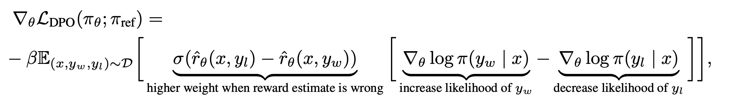
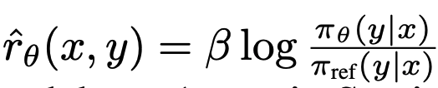
What does the DPO update do
is the reward implicitly defined by the language model and reference model

Slide 14
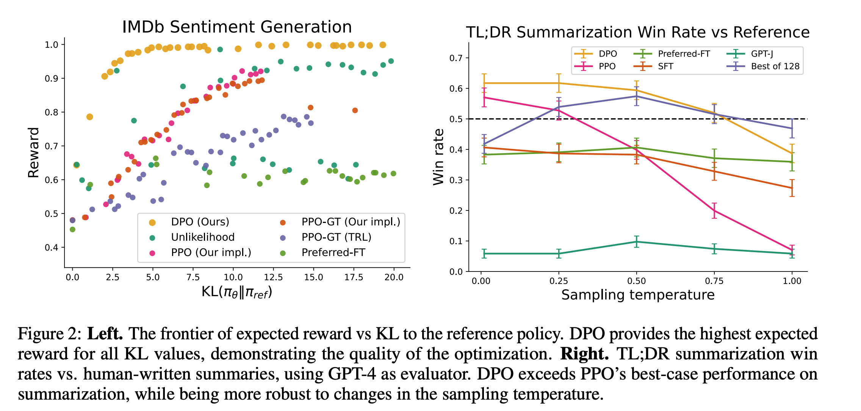
Experiment

Slide 15
DPO vs PPO
Characteristics | PPO | DPO
Reward Model | ✔︎ | ✘
RL Loop | ✔︎ | ✘
Optimization | Maximize reward | Maximize preference
Complexity | High | Low
Data resource | Online | Offline

Slide 16
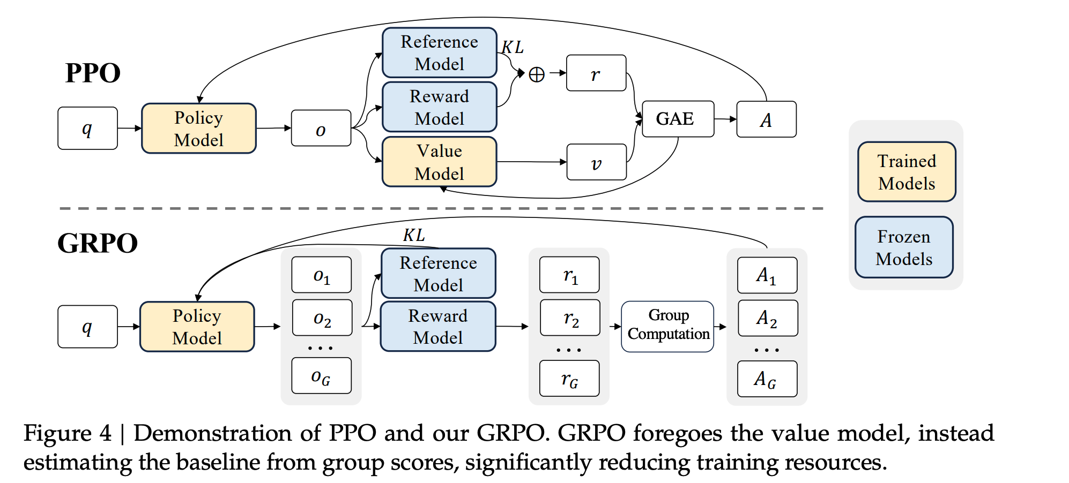
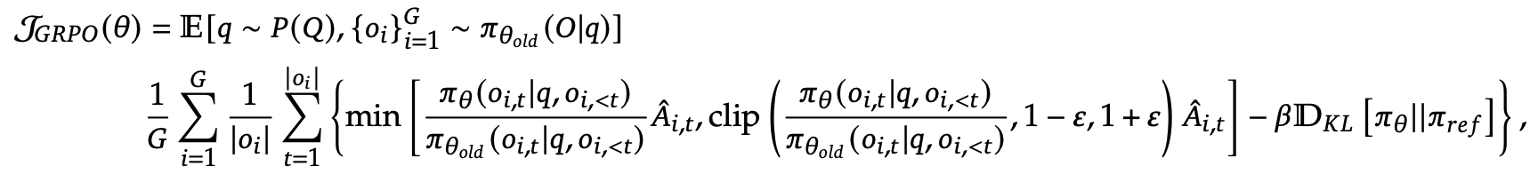

Group Relative Policy Gradient (GRPO)
DeepSeekMath: Pushing the Limits of Mathematical Reasoning in Open Language Models
PPO requires a reward model and a value model to estimate the advantage A
GRPO proposes using the average reward of a group outputs to estimate A
[1] Shao, Zhihong, et al. "Deepseekmath: Pushing the limits of mathematical reasoning in open language models." arXiv preprint arXiv:2402.03300 (2024).

Slide 17
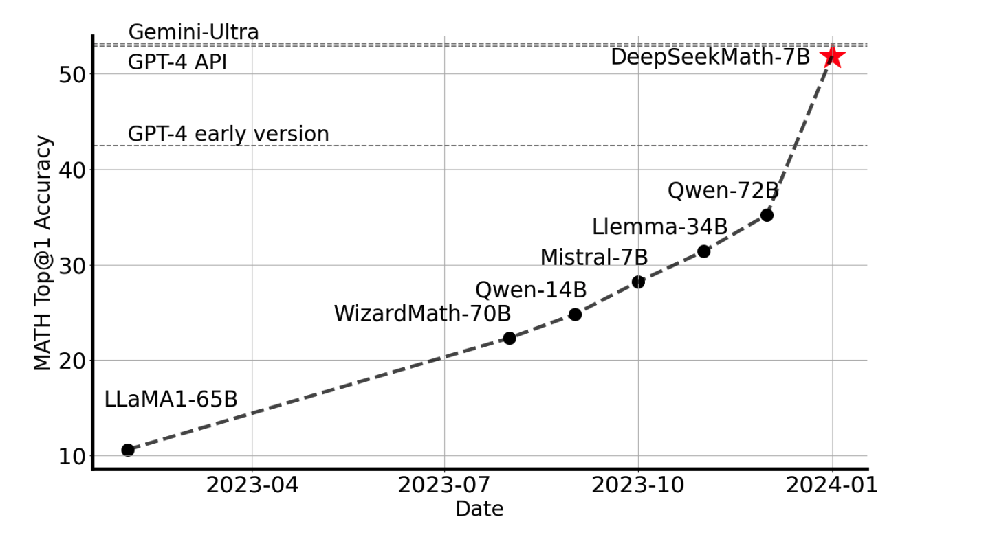
Experiment

Slide 18
Conclusion
Gradient Policy Optimization
Proximal Policy Optimization (PPO) improves simplicity and performance 2017
Direct Preference Optimization (DPO) avoids the RL loop 2022
Group Relative Policy Optimization (GRPO) removes the value model 2024

