Slide 1
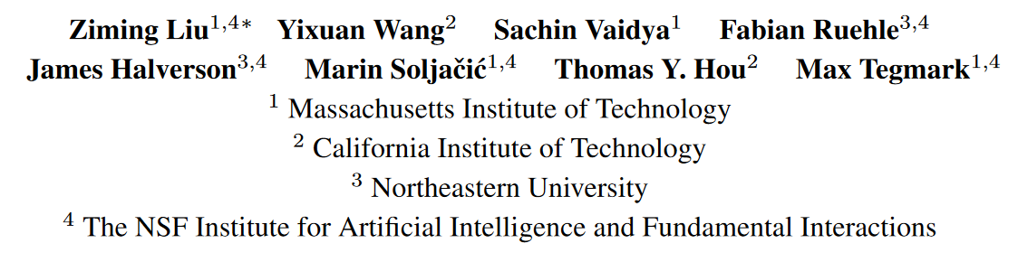
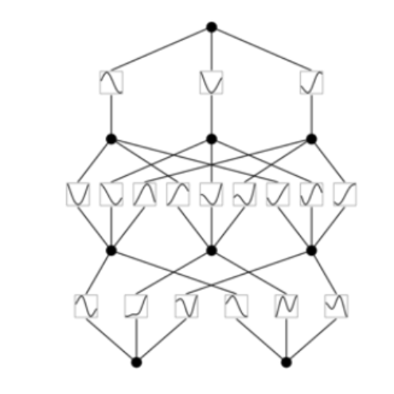
KAN: Kolmogorov–Arnold Networks
presented by Erick Franciskus (FAU)
and Ines Rieger (xAI Lab @ University of Bamberg)

Slide 2
Introduction, Problem settings
MLPs approximate non-linear functions with Universal Approximation Theorem
UAT : “given a function and error tolerance ϵ > 0, a two-layer network with k > N(ϵ) neurons can approximate the function within error ϵ.”
Can we however build something more interpretable than MLP?
Notes:
Essentially, a why not approach

Slide 3

Kolmogorov-Arnold Representation Theorem
If f is a multivariate continuous function, then f can be written as a finite composition of continuous functions of a single variable and the binary operation of addition
where and
Source : https://en.wikipedia.org/wiki/Kolmogorov%E2%80%93Arnold_representation_theorem
Notes:
every multivariate continuous function
𝑓:[0,1]𝑛→𝑅
can be represented as a superposition of the two-argument addition of continuous functions of one variable.

Slide 4
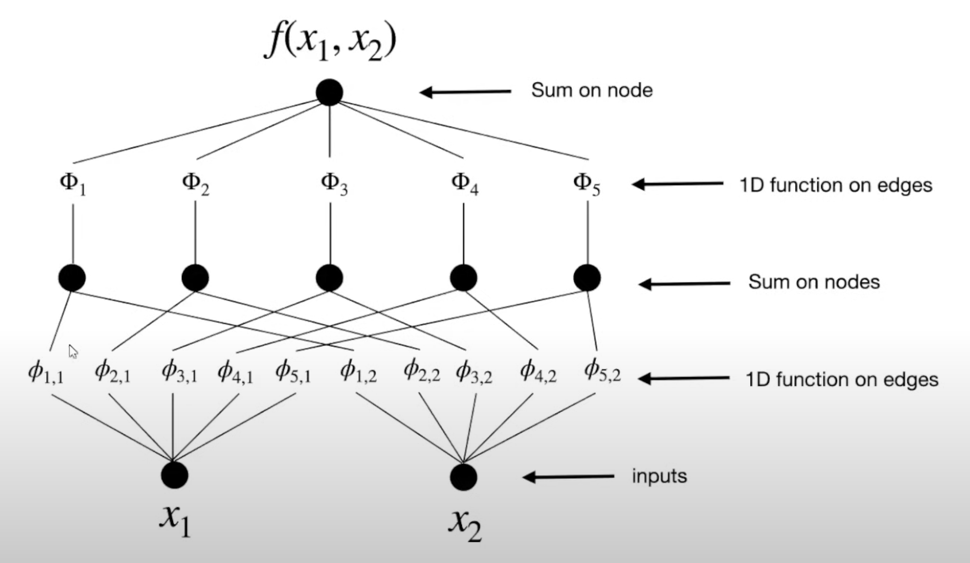
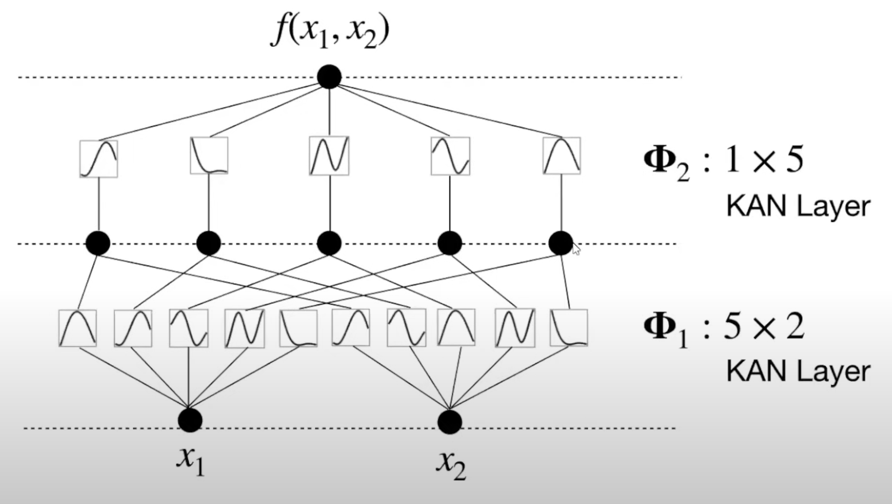
From KART to KAN
Past works on KART based NN were limited to 2-layers networks → superposition of 1D functions which might be non-smooth or fractal
What if: 1) Deeper networks 2) Assume that functions are mostly smooth
KAN leverages the structures of MLP while incorporating splines!
Source : https://www.youtube.com/watch?v=AUDHb-tnlB0

Slide 5
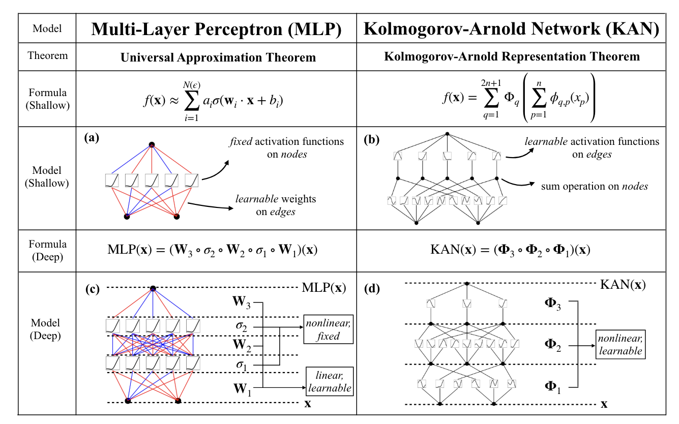
KAN Architecture

Slide 6
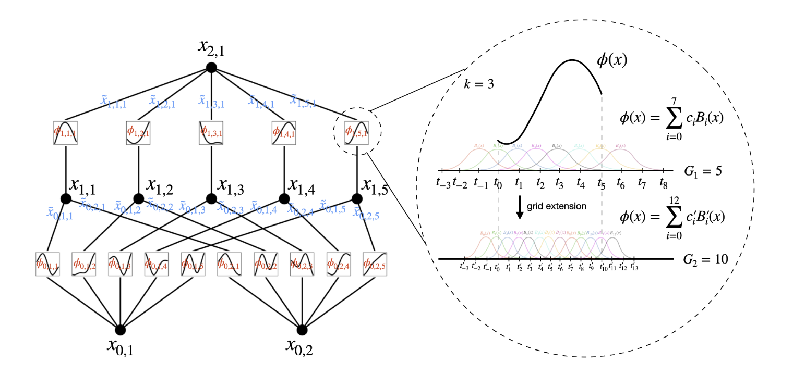
Algorithmic Details : B-splines
A B-spline of order 𝑝 + 1 is a collection of piecewise polynomial functions of degree 𝑝 in a variable 𝑡.
The values of 𝑡 where the pieces of polynomial meet are known as knots, denoted and sorted into nondecreasing order.

Slide 7
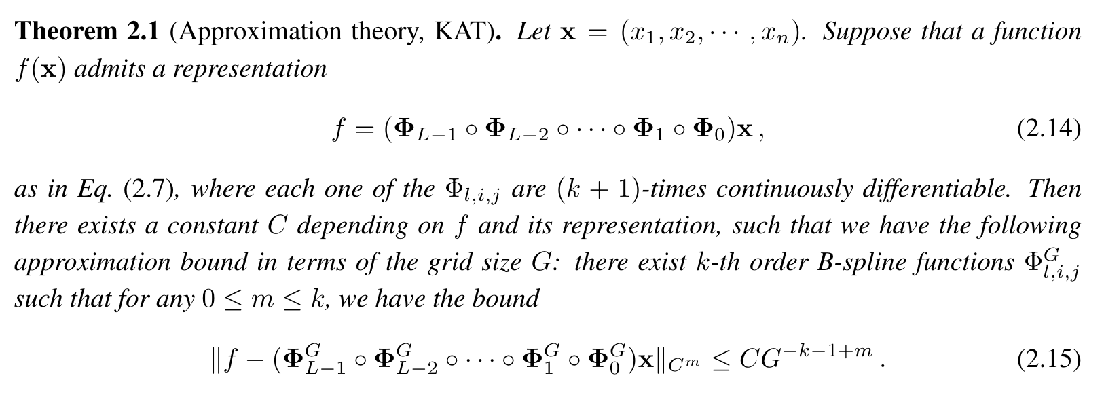
Approximation ability, scaling laws
Issue : Splines → Curse of Dimensionality!
KAT :
KAT vs UAT :
KATs independent of dimension, UAT dependent of dimension . KAT is proven to be only dependent of the grid size of splines G.
KATs take advantage of the intrinsically low-dimensional representation, while UAT does not!

Slide 8




Scaling laws and parameter count
For a function ( d dimensions ), with order k-splines
For functions approximated by KAN, d = 1
Parameter count
MLP KAN
L = Depth, G = grid size. More expensive, but KAN arguably use less parameters
Approximation error Number of parameters Scaling exponent
Notes:
enable very fine scaling exponent with more grids! For cubic spline we can use 3

Slide 9
B-splines and Grid extension
Active fine-tuning of activation function through grid extension
One can first train a KAN with fewer parameters and then extend it to a KAN with more parameters by simply making its spline grids finer, without the need to retraining the larger model from scratch

Slide 10
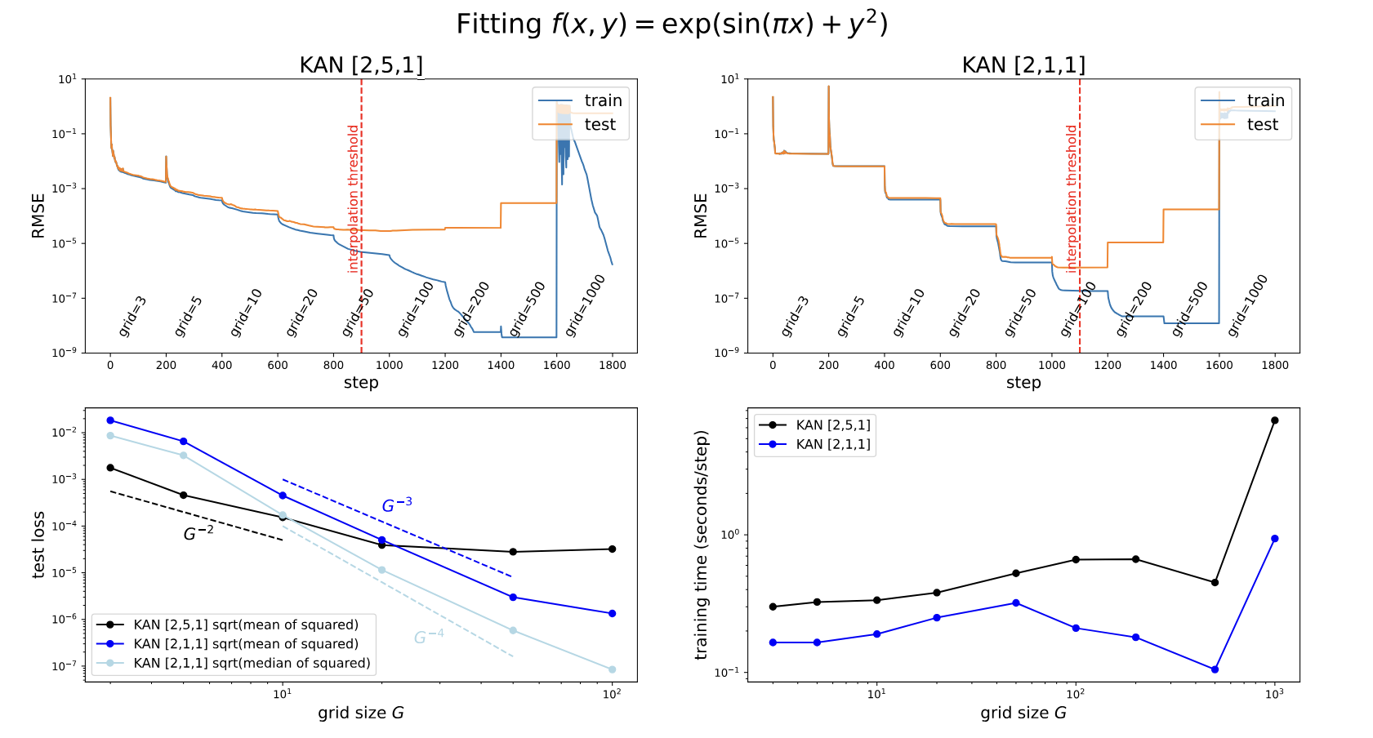
Grid extension
Every time fine graining happens, the training loss drops faster than before
However, test loss correlates only weakly to the theoretically scaling law

Slide 11
Simplifications and usability
How do we choose a specific KAN shape for a given problem? → Start from large KANs and train with the following simplifications:
Sparsification
L1 and entropy regularization to penalize unimportant nodes and edges
Pruning
Pruning unimportant nodes
Symbolification
User may input potential candidate symbolic formulas ( such as cos, log, sigmoid ) for a specific activation function node

Slide 12
Example of KAN Training
Source : https://github.com/KindXiaoming/pykan

Slide 13
Are KANs accurate?
KANs’ accuracy compared to MLPs: KANs outperform MLPs in terms of accuracy. They achieve better performance with fewer parameters. However, only on toy datasets.
Neural scaling laws: KANs possess faster neural scaling laws than MLPs, ensuring better generalization with increased parameters.
Continual learning: KANs less susceptible to catastrophic forgetting.

Slide 14
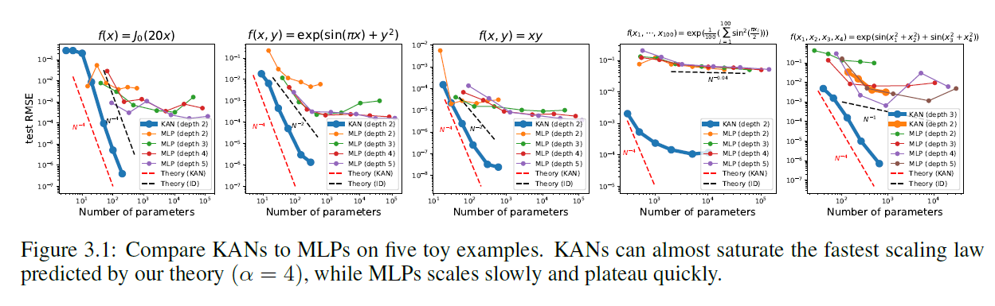
Accuracy: Fitting symbolic functions
KANs have better scaling laws than MLPs for data fitting, especially for high-dimensional examples 4 and 5
All toy examples have smooth KA representations

Slide 15
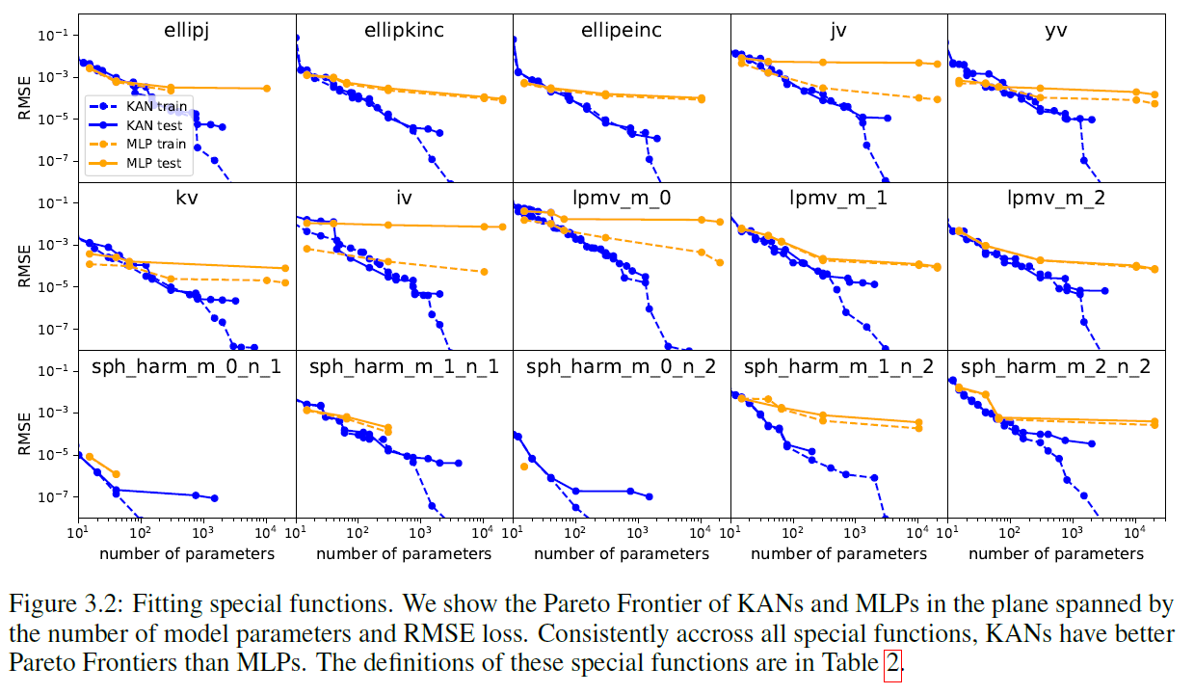
Accuracy: Fitting special functions
Finding (approximate) compact KA representations of special functions is possible
Reveals novel mathematical properties of special functions from the perspective of Kolmogorov-Arnold representations.

Slide 16
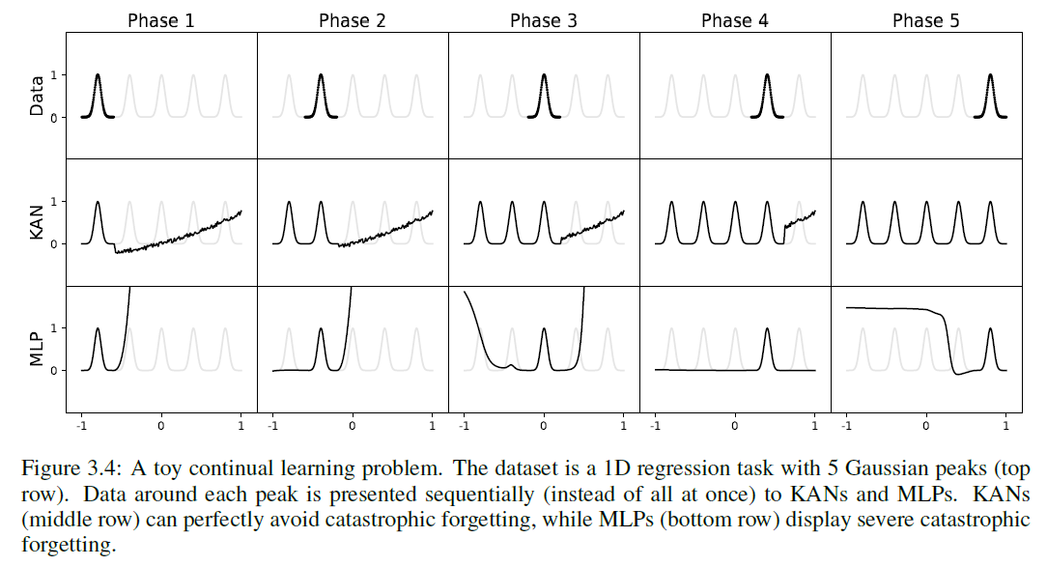
KANs can avoid catastrophic forgetting
KAN has great potential for continual learning by leveraging the locality of splines
Notes:
The idea is simple: since spline bases are local, a sample will only affect a
few nearby spline coefficients, leaving far-away coefficients intact (which is desirable since faraway
regions may have already stored information that we want to preserve). By contrast, since
MLPs usually use global activations, e.g., ReLU/Tanh/SiLU etc., any local change may propagate
uncontrollably to regions far away, destroying the information being stored there.

Slide 17
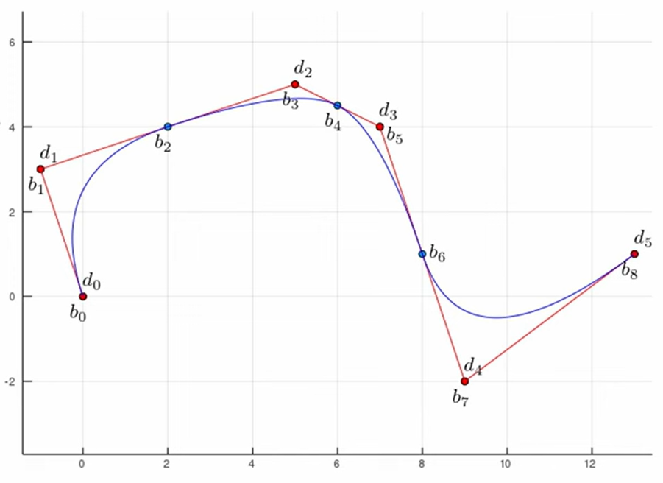
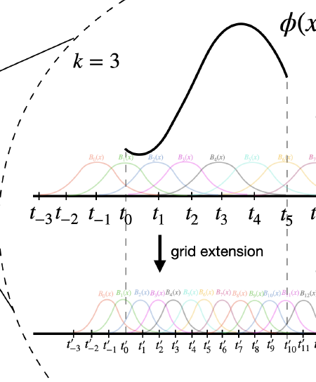
Neural scaling laws
B-Splines have multiple control points, are KANs not hopelessly expensive?
Usually, KANs allow much smaller computation graphs than MLPs
Grid Extension: After pre-training with fewer parameters, finetune KAN with more parameters by making its spline grids finer for higher accuracy - MLPs of different size must be trained independently

Slide 18
Are KANs interpretable?
KANs provide intuitive visualizations: Transparency and node importance
Simplification techniques: Various techniques such as sparsification, pruning, and symbolification enhance interpretability.
KANs as collaborative tools: KANs help in (re)discovering mathematical and physical laws.
User interaction for improved interpretability

Slide 19
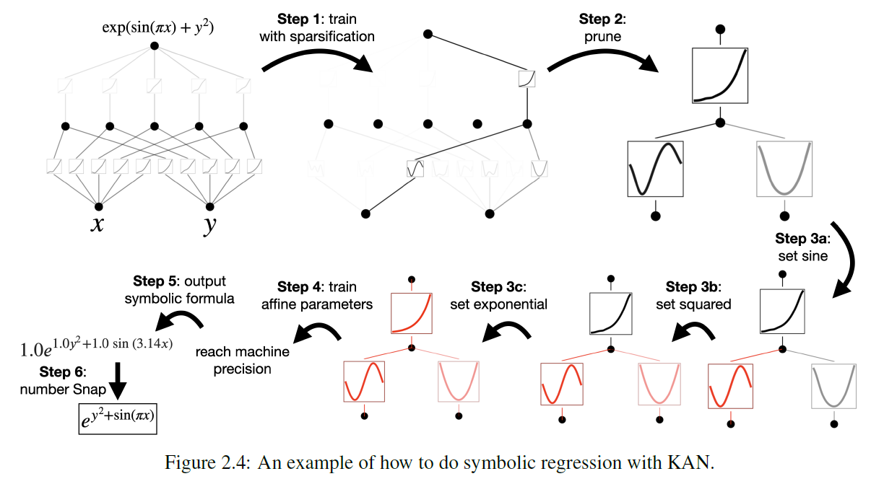
Recap Interpretability

Slide 20

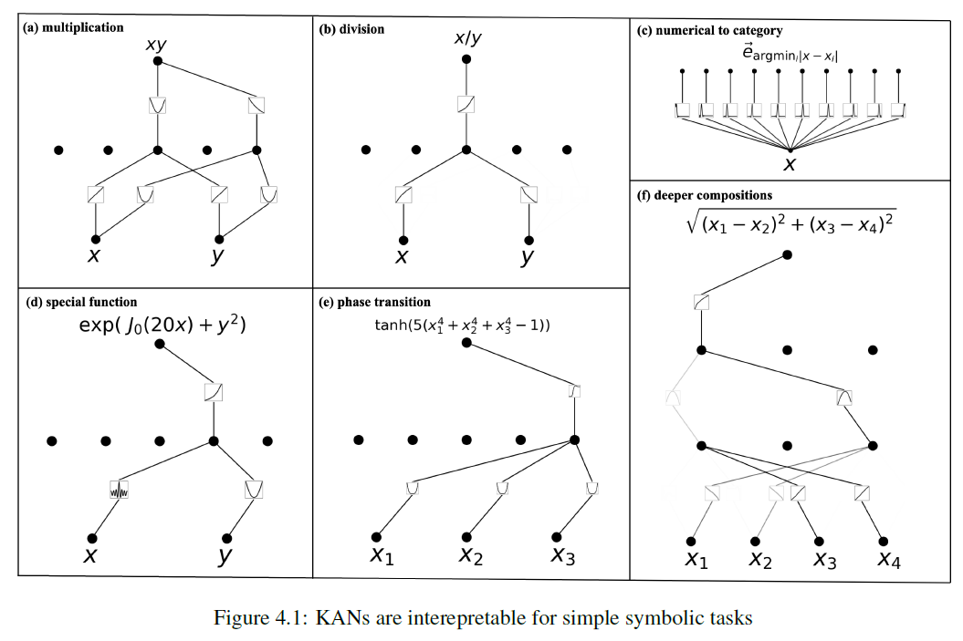
Interpretability: Discover symbolic formulas
KANs can reveal compositional structures in symbolic formulas and learn the correct univariate functions

Slide 21
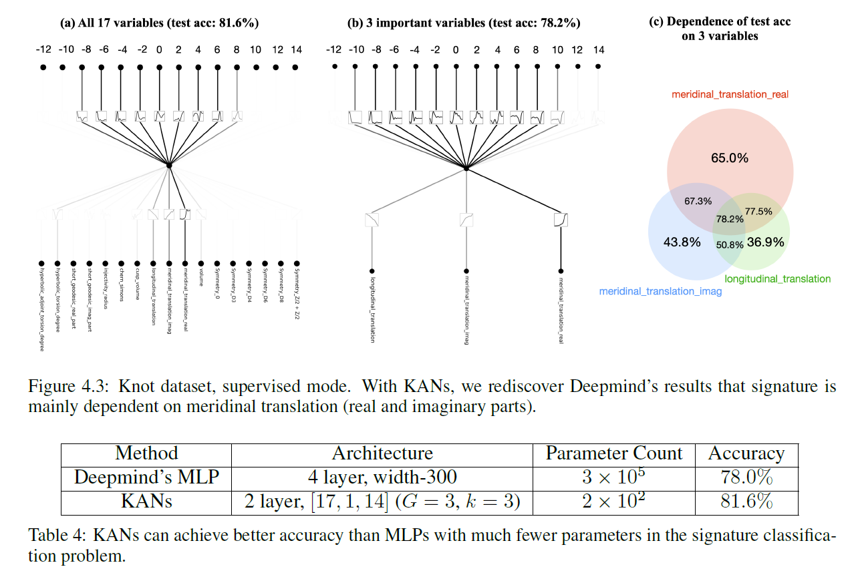
Interpretability: Discover mathematical laws of knots
Knot theory sheds light on topological aspects of three- and four-manifolds
Can KAN predict signature of a knot?

Slide 22
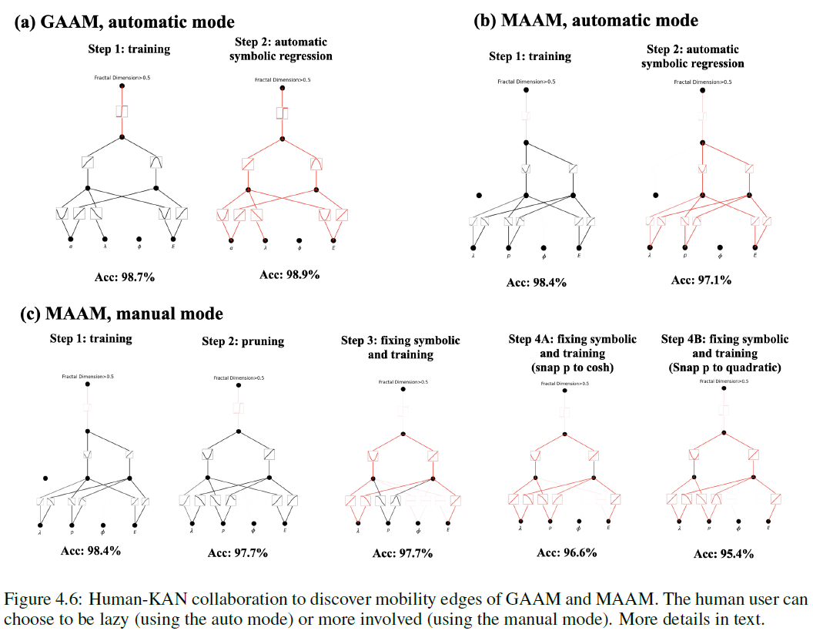
Interpretability: Human-KAN collaboration for Anderson localization
Anderson localization: disorder in a quantum system leads to the localization of electronic wave functions, causing all transport to be ceased
Manual mode:
Size (start smaller or use pruning)
Set output activation to sigmoid
Turn on automatic symbolic snapping to constrain library to specific functions (e.g. linear, quadratic)
likely simpler symbolic formula
Automatic symbolic regression:
gets automatically complicated formula

Slide 23
Summary of Advantages
Accuracy: KANs outperform MLPs in various tasks.
Catastrophic Forgetting: Less susceptible due to locality of splines in contrast to MLPs that use global activation functions.
Interpretability: Intuitive visualizations and simplification techniques. User interaction possible.
Scalability: Efficient scaling with neural scaling laws.
Robustness: Noisy data and adversarial attacks by learning robust representations of data through adaptive activation functions.
Applications: Wide range of scientific and mathematical applications.

Slide 24
Summary of Limitations
Complexity of learning: Long training periods and challenge to ensure stability and convergence during optimization. Need of regularization methods.
Toy datasets: Only small scale math and physics examples are considered
Continual Learning: Generalization to more realistic setups?
Interpretability for deeper architectures: Trade-off between complexity and interpretability.
“Instead of using feature attribution methods (which are great methods), one can instead simply stare at visualizations of KANs.”
Computational overhead: Adaptive activation functions and spline parameters require additional computational resources.

Slide 25
Future Directions
Enhanced Training Methods: Improving training algorithms for KANs.
Hybrid Models: Combining KANs with other neural network architectures.
Real-World Applications: Expanding the use of KANs in industry and research.
Community and Collaboration: Encouraging open-source contributions and interdisciplinary research.

