Slide 1
Cornelius
Melissa Leal, Matthew Rose, Kiori Tanaka, Siyi Xu

Slide 2

Problem
Have you ever been to a Doctor’s appointment where you receive very troubling information and you just find yourself confused.
What did they say? What does all this jargon mean? What should I do?
After the meeting, do you feel overwhelmed and disorganized?
Cornelius will solve these problems for our users. The app can help users to record their clinical visit and summarize the important appointment information.

Slide 3
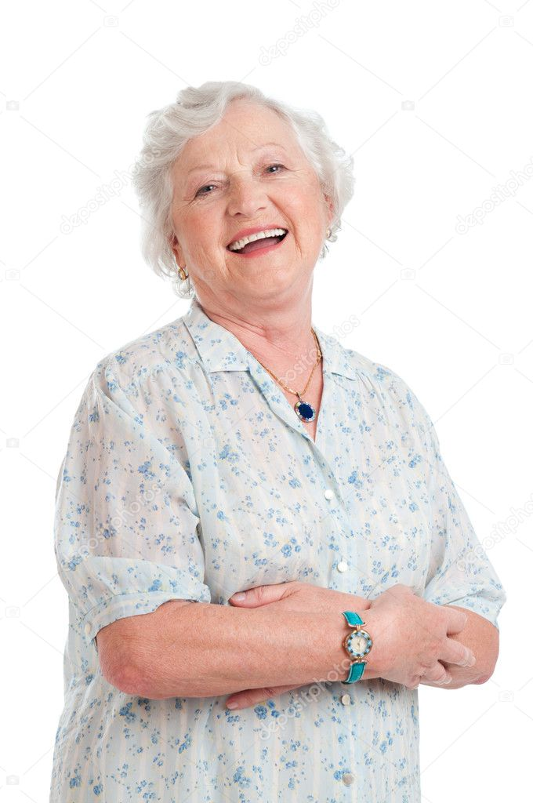
Persona
Marjorie
Older cancer patient
Has relatively poor hearing and memory
Family is constantly asking about her condition
Has a busy life
Plays piano in her local church
Watches her grandchildren

Slide 4
User Stories
As a busy cancer patient, Marjorie would like to:
Double check her medications and treatment recommendations from visit to visit
Track how her symptoms and diagnoses change over time
Access her doctor’s contact information easily to ask clarifying questions

Slide 5
Demo
https://balsamiq.cloud/s8ucy6c/pudqrgg/r2278?f=N4IgUiBcCMA0IDkpxAYWfAMhkAhHAsjgFo4DSUA2gLoC%2BQA%3D

Slide 6
Learned
Client: What to prioritize in our MVP
Login screen, accurate voice recording, visit journal
User: Wants a more holistic overview of their clinical visits
Timeline of their past visits
Information about treatment and diagnosis
More information about their physicians
Notes:
After meeting with our client, we realized what we need to prioritize in order to fulfill expectations on both our side and their side. This discussion helped us come up with our MVP
We will have a simple login feature so that users can easily access their past information taking into account older user base
accurate voice recording → which is why we settled on Google Speech which costs money but is more extensive than react native library
An aesthetically pleasing visit journal to easily visualize past clinical visits
After talking to our users, we realized that all of them felt overwhelmed by the amount of information they got on their treatments, diagnosis, medications
They wanted a more holistic view of their clinical experience
This pushed us to create a timeline view for past visits
Section to have information about physicians in user profile

Slide 7

Possible Impacts
Positive impact: Enhance clinical visit experience and increase productivity for both the physician and the patient
Negative impact: For the older population, it could be confusing or even stressful to use this app

Slide 8
Concerns
Privacy and Security
Clinical Visit recording are private and sensitive information for users.
Accidentally leaking personal medical information or the transcriptions of the physician would violate HIPAA and therefore put patient and physician privacy at risk.

