Slide 1







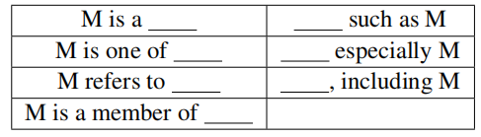
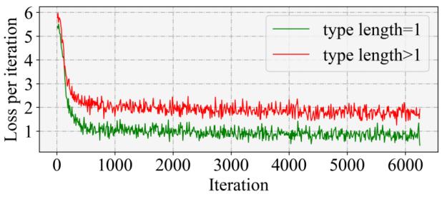
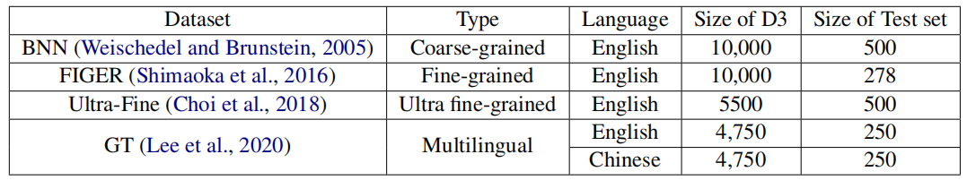
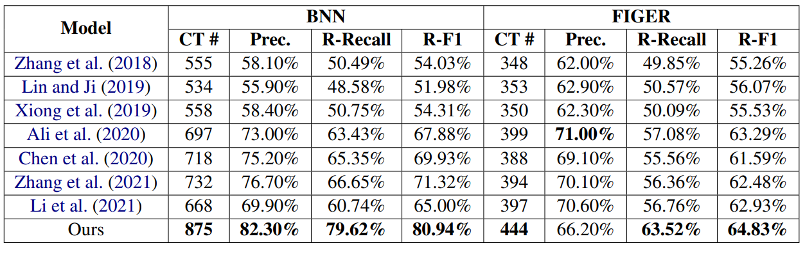
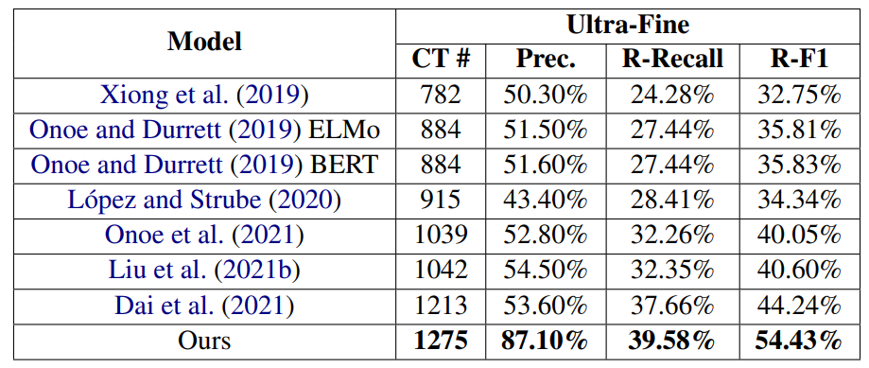
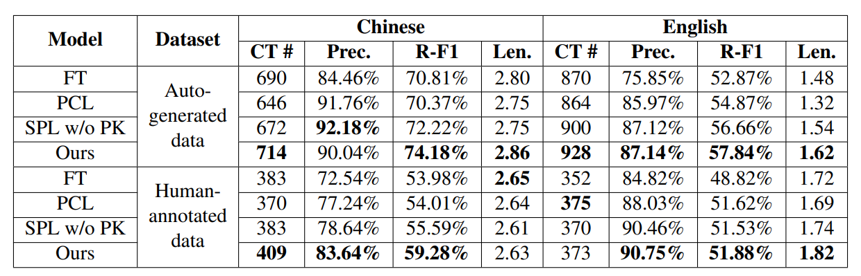
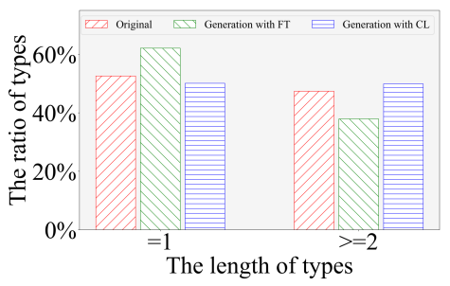
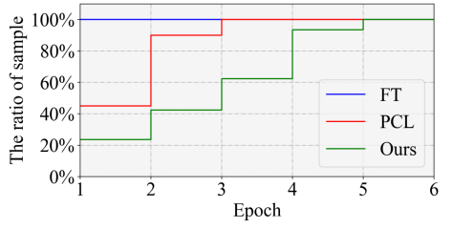
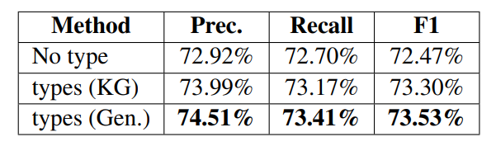
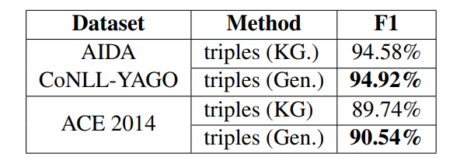


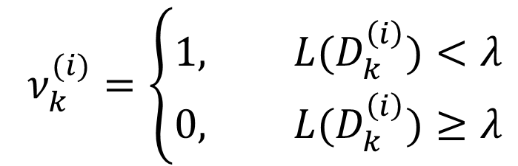

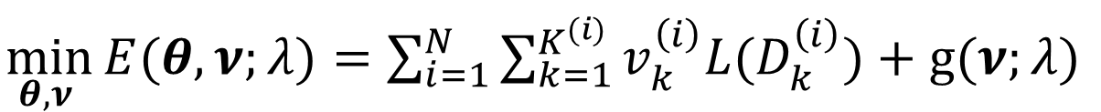







Generative Entity Typing with Curriculum Learning
Siyu Yuan, Deqing Yang*, Jiaqing Liang, Zhixu Li, Jinxi Liu, Jingyue Huang, Yanghua Xiao*
Fudan University
Introduction
Challenges & Contribution
Task: Entity typing
Aims to assign types to the entity mentions in given texts.
The drawbacks of pervious work
Closed Type Set: Cannot assign the entity to the types out of the predefined set.
Few-shot Dilemma for Long-tail Types: Hardly handle few-shot and zero-shot issues.
Solution: Generative Entity Typing
Generate types with a pre-trained language model from given a text with an entity mention.
Two advantages:
Open Type Set: more open types for entity mentions
Conceptual Reasoning Capability: handle the few-shot and zero-shot dilemma well
Challenge 1: Fine-grained Types Generation
How to guide the PLMs to generate high-quality and fine-grained types for entities is crucial.
Challenge 2: Heterogeneous data
How to train the PLMs to generate desirable types on these low-quality heterogeneous.
Solution: Curriculum Learning
Better learn heterogeneous data by ordering the training samples based on their quality and difficulty.
CL can control the order of using training subsets from coarse-grained and lower-quality ones to fine-grained and higher-quality ones.
Input Text
Predefined type set
In the early 1980s , P & G tried to launch here a concentrated detergent under the Ariel brand name that it markets in Europe.
1.Prompts Construction
2.Curriculum Instruction
3.CL-based Learning
company
Entity: P & G
Input text
Easy
Prior knowledge
substance
Generation
Classification
Coarse-grained
auto-generated data
Order of subsets
Length of types
product
detergent company*
company
$$D_{A}$$
continent
detergent manufacturer*
(*) means the generated types are out of predefined type set
Hearst
patterns
$$D_{B}$$
…
company
Fine-grained
auto-generated data
Predetermined
curriculum
T5
Human-annotated data
Input data
Difficult
$$D_{C}$$
SPL
CL-based GET
Input Text
Prompts Construction
Construct the prompts in cloze format from the Hearst patterns
Curriculum Instruction
It is more difficult for PLMs to fit the samples of fine-grained types.
Coarse-grained auto-generated data => 𝑡𝑦𝑝𝑒 𝑙𝑒𝑛𝑔𝑡ℎ=1
Fine-grained auto-generated data => 𝑡𝑦𝑝𝑒 𝑙𝑒𝑛𝑔𝑡ℎ≥2
Human-annotated data => 𝑢𝑙𝑡𝑟𝑎 𝑓𝑖𝑛𝑒−𝑔𝑟𝑎𝑖𝑛𝑒𝑑 𝑡𝑦𝑝𝑒𝑠
CL-based Learning (T5 backbone)
A fixed curriculum ignores the feedback from the training process => adopt Self-paced Learning (SPL)
Loss function of one sample ${D_{k}^{\left(i\right)}=<X}^{\left(i\right)} ,{M^{\left(i\right)},T}_{k}^{\left(i\right)}>$=> $L(D_{k}^{\left(i\right)})=L_{CE}(T_{k}^{\left(i\right)},f(X^{\left(i\right)},θ,M^{\left(i\right)}))$
The training objective:
The binary variable $ν_{k}^{(i)}∈[0,1]$
Expect the model to be trained according to the predetermined curriculum => adopt prior knowledge
Whole training data
$D=D_{A}⋃$ $D_{B}⋃D_{C}$
Input Text + <Entity> is a ____
$\min_{θ,ν }{E(θ,ν;λ})=\sum_{i=1}^{N}{\sum_{k=1}^{K^{(i)}}{v_{k}^{\left(i\right)}L(D_{k}^{\left(i\right)})}}+g(ν;λ)$
$$ν_{k}^{(i)}=\left\{\begin{aligned}1, L(D_{k}^{\left(i\right)})<λ \\ &0, L(D_{k}^{\left(i\right)})≥λ\end{aligned}\right.$$
$$λ=μλ, μ>1$$
$$g\left(ν;λ\right)=−\sum_{i=1}^{N}{\sum_{k=1}^{K^{(i)}}{v_{k}^{\left(i\right)}}}$$
More samples with larger losses are gradually incorporated
$$γ\left(D_{k}^{\left(i\right)}\right)=\left\{\begin{aligned}1, ifD_{k}^{\left(i\right)}∈D_{A} \\ 2, ifD_{k}^{\left(i\right)}∈D_{B} \\ 3, ifD_{k}^{\left(i\right)}∈D_{C}\end{aligned}\right.$$
$$length(T_{k}^{\left(i\right)})$$
$$w(D_{k}^{\left(i\right)})=length(T_{k}^{\left(i\right)})×γ(D_{k}^{\left(i\right)})$$
A sample with a large weight would be incorporated later
Order of subsets
Length of types
$$L(D_{k}^{\left(i\right)})=L_{CE}(T_{k}^{\left(i\right)},f(X^{\left(i\right)},θ,M^{\left(i\right)}))×w(D_{k}^{\left(i\right)})$$
Experiment
Datasets: 4 dataset
Metrics:
CT # The number of correct types
Len. The average length of types
Precision, Relative Recall, Relative F1
RQ1: Can GET improve the task performance? A1: Yes
RQ2: How do CL improve GET performance?
Let the model pay more attention to fine-grained types.
the former subsets can be regarded as a pre-training process that helps model optimization and regularizes the training on the later subsets.
RQ3: How do we adopt the typing generated from our GET model?
Short Text Classification and Entity linking
If you have any questions, please email: syyuan21@m.fudan.edu.cn

