Slide 1
Hybrid Embedding
Bridging LLM and Differential Trees for Explainable, Efficient AI
White Paper Presentation
Sizhe Tan
With assistance from GPT-5 (AI research assistant)
2025-09-23
Repository: https://github.com/sizhet/hybrid-embedding-project
DOI 10.5281/zenodo.17205861

Slide 2
1. Introduction
LLM embeddings: powerful but black-box and costly
Differential Trees: structured, interpretable, anchor-based
Hybrid Embedding unifies the two paradigms

Slide 3
2. Core Design
Hybrid Embedding: H(x) = [C(x) || R(x)]
C(x): routing code (~128d) → interpretable path & margins
R(x): residual (~1024d) → preserves semantic fidelity
Together: interpretable and precise embeddings

Slide 4
3. Training Paradigm
Tree-then-Distill approach
Freeze base embeddings
Teacher-Tree generates labels
Student heads predict C and R
Losses: Path-CE, Margin-L1, Residual-L2, InfoNCE, HubnessReg

Slide 5
4. Deployment Architecture
Two-tier system: Teacher & Service Models
Teacher: costly, updated rarely
Service Models: lightweight, domain-optimized
Supports multiple domains, lowers cost

Slide 6
5. Online Serving Workflow
Router selects domain head
Phase-1: C(x) for coarse bucket search
Phase-2: R(x) for fine ranking
Explainer outputs path, prototypes, differences
Fallback to Teacher if confidence is low

Slide 7
6. Benefits
Efficiency: fewer candidates, faster serving
Fidelity: R ensures accuracy
Explainability: paths, prototypes, differences
Metrics: Recall@k, path stability, audit pass rates, latency

Slide 8
7. Applications
Search & Recommendation
Conversational AI with intrinsic explanations
Finance & Healthcare: transparency critical
Multi-domain platforms with one backbone

Slide 9
8. Industry Impact
Reduce LLM deployment costs
Provide transparency for compliance
New market for interpretable AI services

Slide 10
9. Research Impact
Breaks black-box paradigm of embeddings
Unifies continuous and discrete methods
Opens new hybrid symbolic-neural AI pathways

Slide 11
10. Conclusion
Hybrid Embedding = interpretable + efficient foundation
Unifies LLM and DBM
Foundational design for next-generation AI

Slide 12
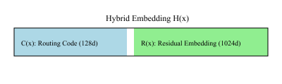
Diagram: Hybrid Embedding Structure

Slide 13
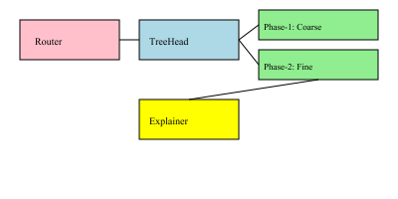
Diagram: Serving Workflow

