Slide 1

COMP 301
Welcome
Swuber

Slide 2
Contents
Navigating the insandouts of Q&A
ins and outs the Project
INTRODUCTION
PROJECT DETAILS
UML

Slide 3
COMP301 Project
Introduction

Slide 4
Our Team
Ahmed Khaled
Nada Magdy
Noureen Ahmed
Sherif Lotfy

Slide 5
COMP301 Project
What is Swuber?
Swuber is a ridesharing application, similar to uber for car rides / shuttle but integrating but also mashed up with some features of SWVL, hence the name being a mashup of the two
Key Features:
Ride Planning: Users can easily plan their rides by selecting pick-up and drop-off locations, with real-time updates on available options and estimated arrival times.
Shuttle Services: Swuber offers reliable shuttle services, allowing users to book shared rides along predetermined routes, making transportation convenient and cost-effective.
Ride History: Users have access to a detailed history of their rides, enabling them to track past journeys, view receipts, and manage their transportation preferences.
Offers and Discounts: Swuber provides various promotional offers and discounts, rewarding users and making rides more affordable.

Slide 6
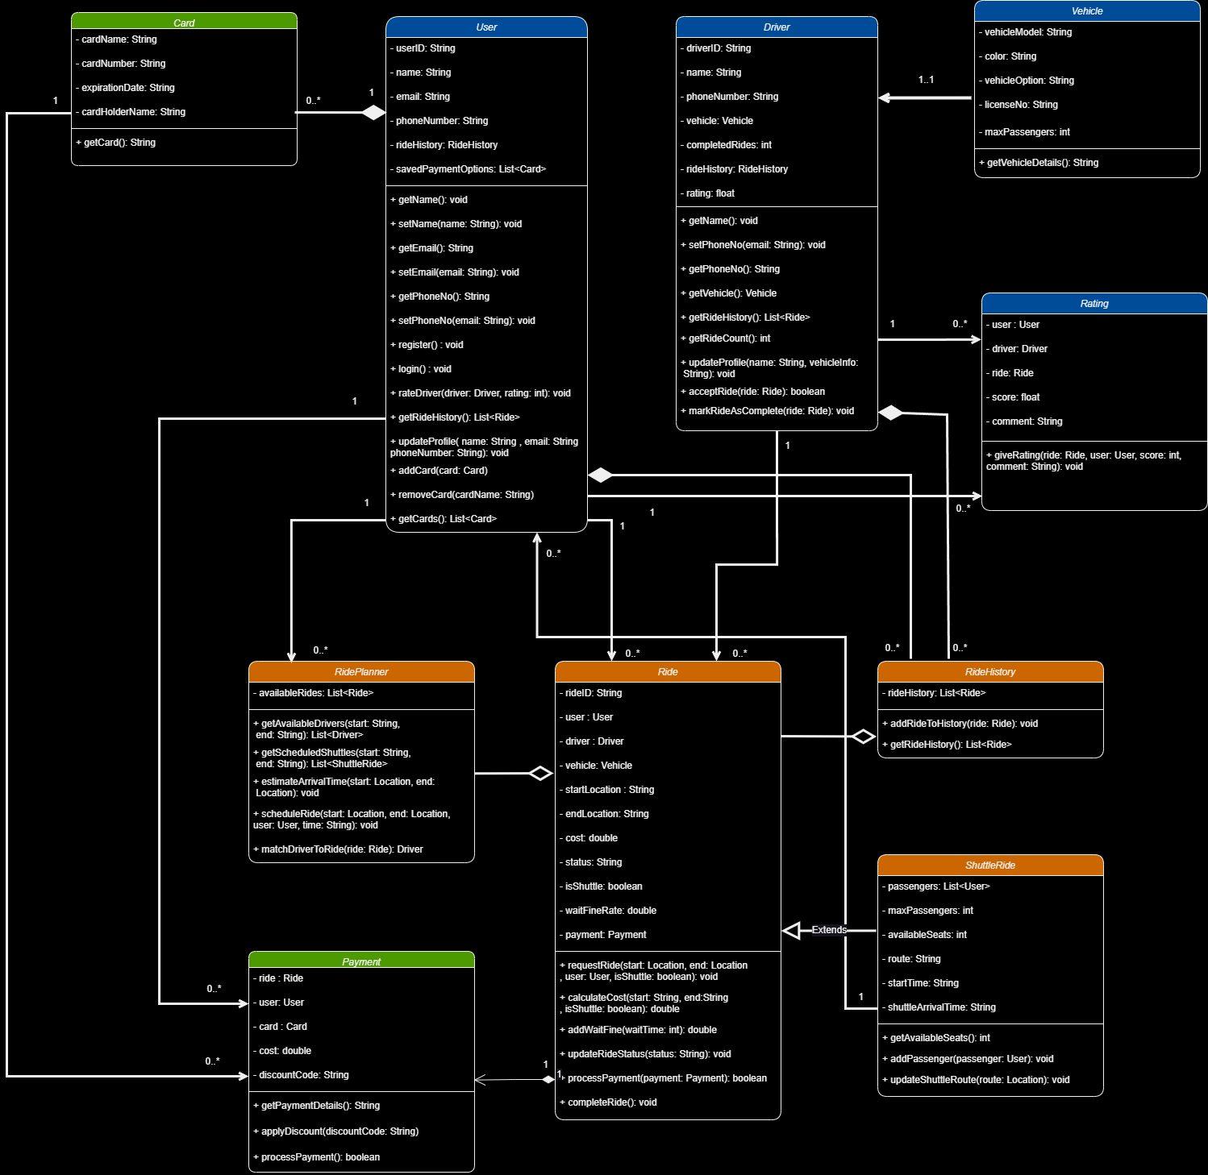
COMP301 Project
UML

Slide 7
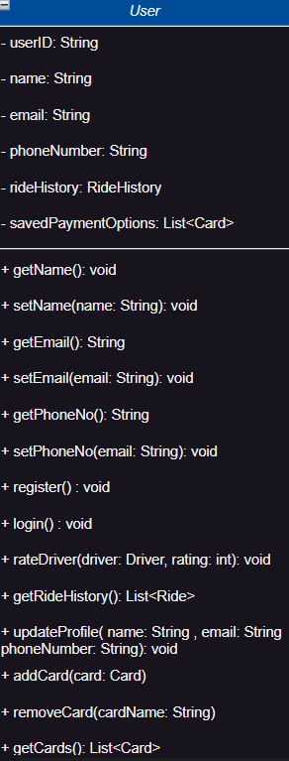
COMP301 Project
Classes & Relations
1. User Class
Variables & types
Methods
Setters & Getters:
- getName, setName
getEmail, setEmail
getPhoneNo, setPhoneNo
getRideHistory: fetches ride history of the user
register: registers a new user
Login: logs in a registered user
rateDriver: allows user to give a driver rating for a ride
updateProfile: updates user info
Add/RemoveCard: adds or removes payment card
getCards: fetches all cards stored for the user
- userID : String
- Name : String
Email : String
phoneNumber : String
rideHistory : RideHistory (Assoc. Class)
savedPaymentOptions: List of Cards
Relations
- Associated with ride
Associated with payment
Associated with ride planner
Has Ride History
Can book shuttleRides for self + multiple others
Composition with cards class (Payment Cards linked to the user)
Associated with rating, user rates the drivers for a given ride

Slide 8
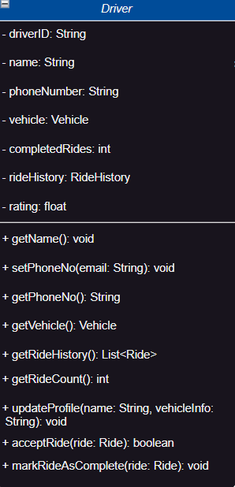
COMP301 Project
Classes & Relations
2. Driver Class
Variables & types
Methods
- driverID : String
- name : String
phoneNumber : String
rideHistory : RideHistory (Assoc. Class)
rating: float
vehicle: Vehicle (Assoc Class
completedRides: int
Setters & Getters:
- getName
getPhoneNo, setPhoneNo
getRideHistory: fetches ride history of the user
getVehicle: fetches driver’s vehicle
getRideCount: fetches driver’s ride count
updateProfile: updates driver info
acceptRide: accepts a ride request from a user looking for a ride
markRideAsComplete: ends the ride and brings user to payment, when done, adds ride to both user and driver ride history
Relations
- Associated with ride
Associated with rating
Has an associated vehicle
Has Ride History

Slide 9
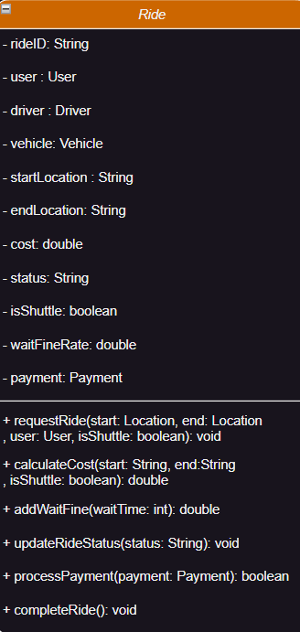
COMP301 Project
Classes & Relations
3. Ride Class
Variables & types
Methods
Relations
requestRide: Allows user to request rides from one location to another
calculateCost: calculates ride cost, static for each shuttle route
addWaitFine: Adds a fine to the cost if the user holds up the ride/shuttle for a given time
updateRideStatus: a function that updates current ride status
processPayment: starts the payment process
completeRide: a function called by the drivers’s markRideAsComplete method which ends the ride, but only after payment is verified and then adds to history
Has user, driver, vehicle associated with it
Has a child class shuttleRide
Ride History Aggregate of Ride
Payment cannot exist/composite of ride
- rideID : String
- user: User
- driver : Driver
Vehicle: Vehicle
Start,end Location: String
Cost: double
Status: String
isShuttle: Boolean
waitFineRate: double
Payment: Payment

Slide 10
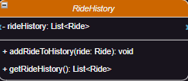
COMP301 Project
Classes & Relations
4. Ride History
Variables & types
rideHistory: List or rides
Methods
addRideToHistory: adds completed rides to history
getRideHistory: fetches the ride history list
Relations
Users, Drivers have ride histories
Ride History is an aggregate of rides

Slide 11
COMP301 Project
Thank you!
We hope you liked our work on this project!

