Slide 1
Milled part
E = Electricity
Heat
PART HANDLING
(Turning table)
A = Compressed air
Raw part
EXTRACTION SYSTEM
H = Hydraulic Power
14
E
Clamped
raw part
H (11)
Clamped
milled part
E
10
M
Heat exchange Machine environmental
TOOL
CHANGER (Revolver I)
AXES
Compressed air for part cooling
A (26)
8
M
SPINDLE
E (3-7)
MILLING PROCESS
A (26)
E , H (11)
Contaminated fluid
TOOL
CHANGER (Revolver II)
E (2)
H (11)
A (26)
Fluid for part cooling
Chips
CHIP CONVEYOR
9
M
Fluid for inner
tool cooling
A (26)
22
P
21
M
E , H (11)
E
E
Cooled cooling fluid
Hot cooling fluid
25
P
24
P
E
FLUID FILTERING
M
SPINDLE COOLING
E
23
P
E
Filtered fluid
New filter
E
13
12
P
FLUID RESERVOIR
E
17
New fluid
E
Kühlmittelreinigungsanlage
18
E
E
26
P
CNC & CABINET
11
P
Drossel
Fan E/R module (19)
Control module (20)
Main supply
24 V supply (15)
230 V supply (16)
Simodrive (1)
E
E
E (0)

Slide 2
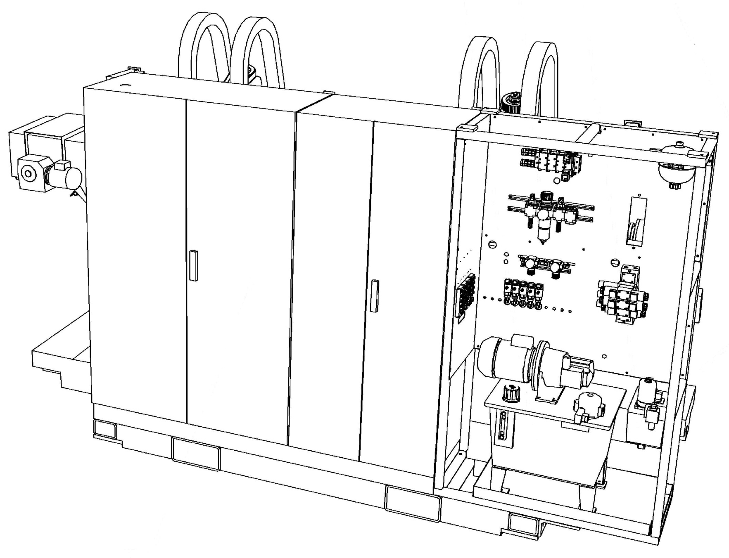
0.85 m

Slide 3
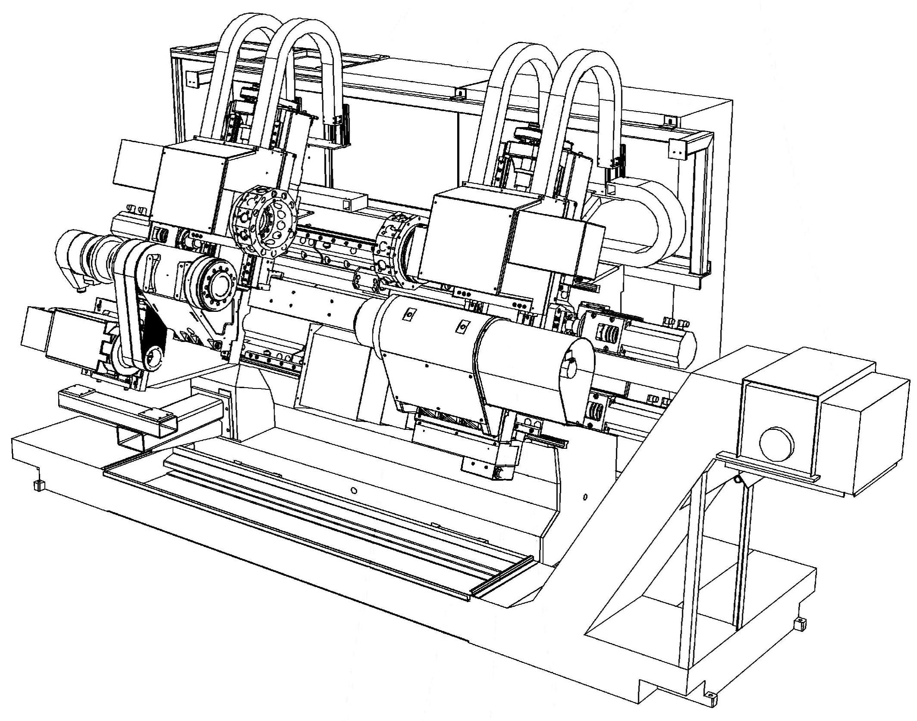
Feed drive (X-axes)
Feed drive (Z-axes)
Revolver I and II
Main spindle
Tailstock (W-axes)
Feed drive

